Slide 1
Moisture and the Ageostrophic Wind in a Cool-season Coastal Cyclone
Matt Vaughan
ATM 619

Slide 2
Motivation
Moisture is an important factor in cyclogenesis
Moisture is a necessary ingredient in extreme precipitation events
Neiman and Shapiro (1993)

Slide 3
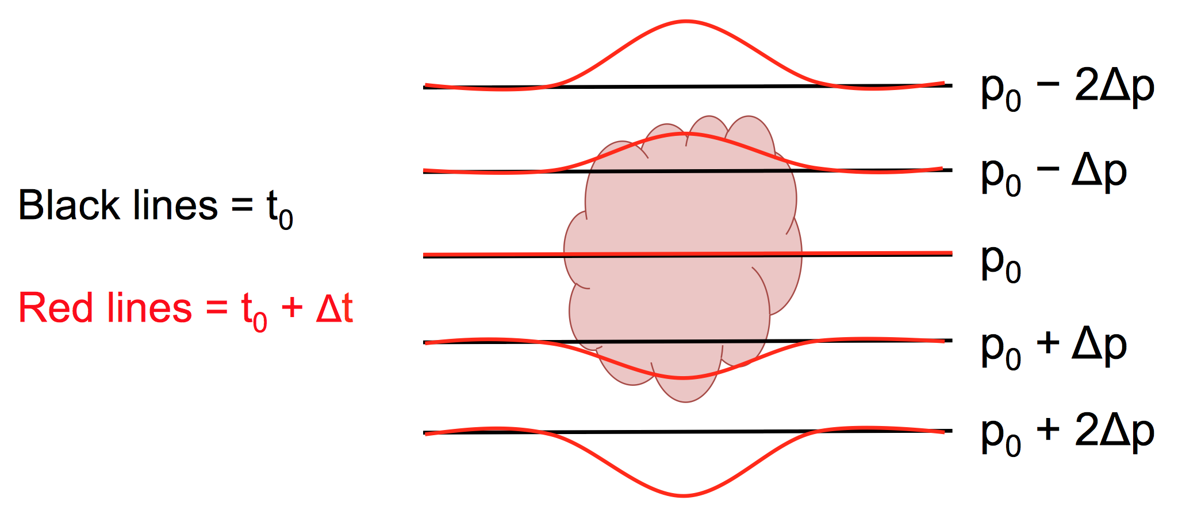
Motivation
Latent heating modifies the pressure field around cyclones, affecting the track and intensity of the surface cyclone
A. Bentley

Slide 4
Motivation
Sanders and Gyakum (1980)
Hypothesized PBL and CU parameterizations critical to model (under)representation of explosive cyclogenesis.

Slide 5
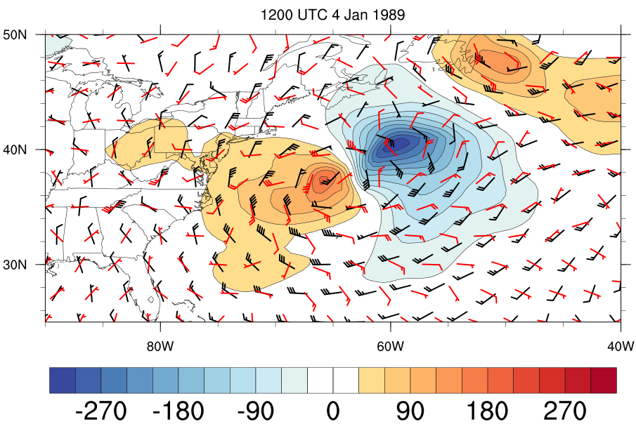
Motivation
Explosive cyclogenesis can challenge geostrophic approximation
Ageostrophic wind becomes large in highly curved flow and rapidly changing pressure fields
1000-hPa geopotential height tendency [m (6h)^{–1}, shading], geostrophic wind (black), and ageostrophic wind (red)

Slide 6
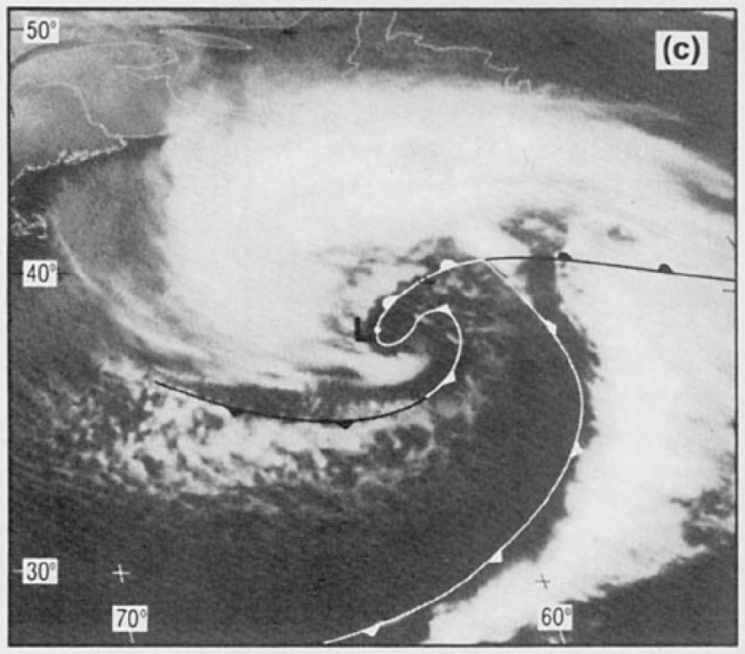
Methods
Representative case for explosive cyclogenesis and extreme precipitation:
4–5 January 1989 ERICA cyclone
Neiman and Shapiro (1993)

Slide 7
Methods
Analyze moisture transport around cyclone
Banacos and Schultz (2005)

Slide 8
Methods
Focus on terms directly proportional to wind
Moisture flux convergence can be broken down by components of the observed wind
Banacos and Schultz (2005)

Slide 9
Methods
Wind Decomposition
(a) (b) (c) (d)
a: Isoallobaric component
b and c: Inertial-Advective component
d: Friction component
Banacos and Schultz (2005)

Slide 10
Methods
Wind Decomposition
(a) (b) (c) (d)
a: Isoallobaric component
b and c: Inertial-Advective component
d: Friction component
Banacos and Schultz (2005)

Slide 11
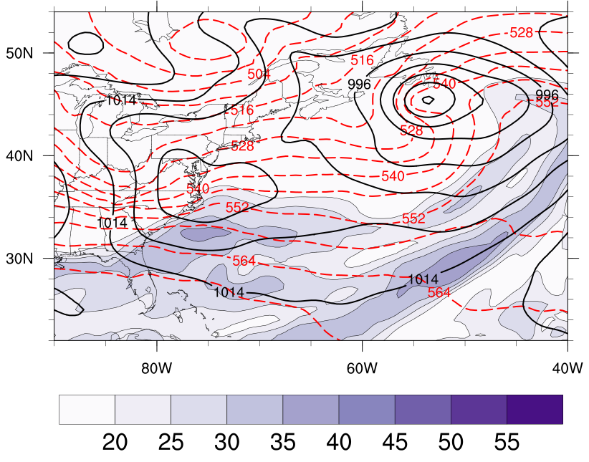
Evolution of ERICA cyclone
0000 UTC 4 January 1989
1000–500-hPa thickness (dashed, every 6 dam), mean sea level pressure (contoured, every 6 hPa), and precipitable water (shaded, mm)

Slide 12
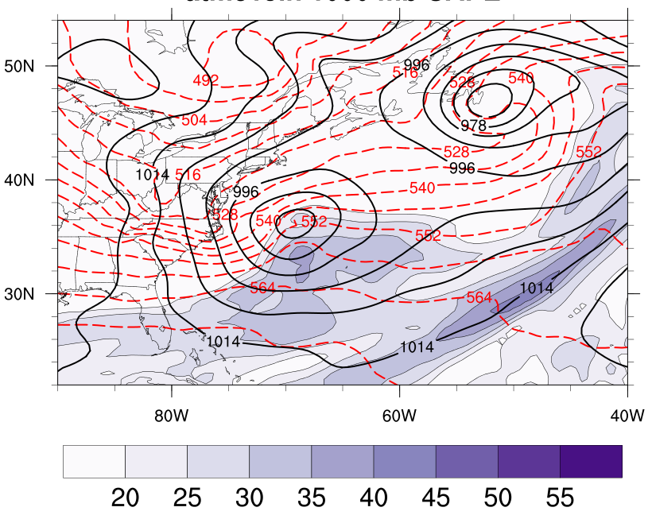
Evolution of ERICA cyclone
0600 UTC 4 January 1989
1000–500-hPa thickness (dashed, every 6 dam), mean sea level pressure (contoured, every 6 hPa), and precipitable water (shaded, mm)

Slide 13
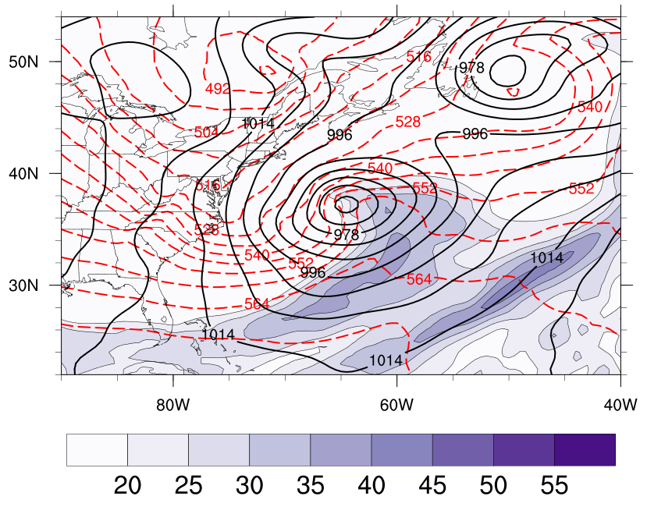
Evolution of ERICA cyclone
1200 UTC 4 January 1989
1000–500-hPa thickness (dashed, every 6 dam), mean sea level pressure (contoured, every 6 hPa), and precipitable water (shaded, mm)

Slide 14
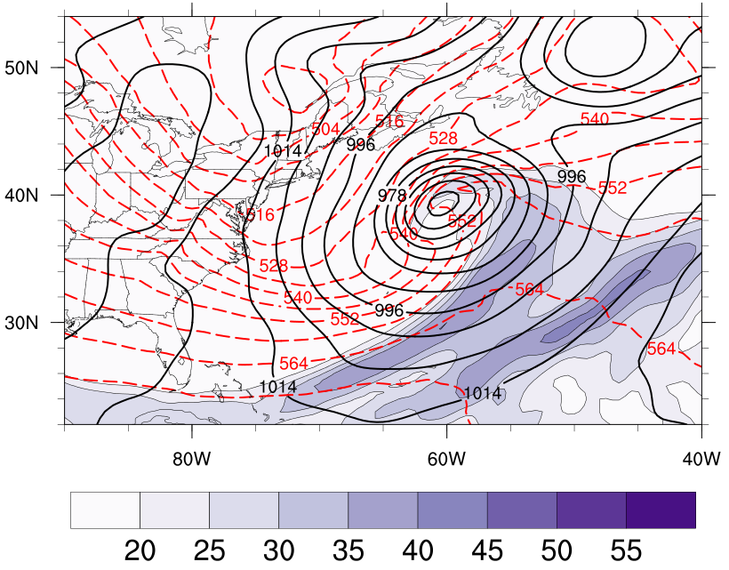
Evolution of ERICA cyclone
1800 UTC 4 January 1989
1000–500-hPa thickness (dashed, every 6 dam), mean sea level pressure (contoured, every 6 hPa), and precipitable water (shaded, mm)

Slide 15
Precipitable Water Tendency
0600 UTC 4 January 1989
Precipitable water tendency [every 3 mm (6 h) ^{–1}, red contours (dashed is negative)], mean sea level pressure (every 6 hPa, black contours), and precipitable water (shaded, mm)

Slide 16
Precipitable Water Tendency
1200 UTC 4 January 1989
Precipitable water tendency [every 3 mm (6 h) ^{–1}, red contours (dashed is negative)], mean sea level pressure (every 6 hPa, black contours), and precipitable water (shaded, mm)

Slide 17
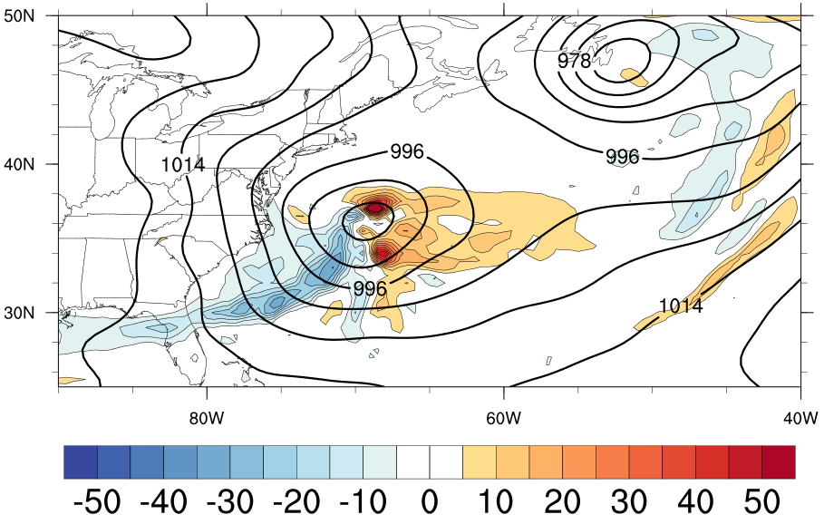
0600 UTC Total MFC
Vertically-integrated moisture flux convergence from the total wind (10^{–6} kg m^{–2} s^{–1}, shaded) and mean sea level pressure (every 6 hPa, black contours)

Slide 18
0600 UTC Total MFC
Geostrophic
AGeostrophic
Isallobaric
Residual
Vertically-integrated moisture flux convergence from the total wind (10^{–6} kg m^{–2} s^{–1}, shaded) and mean sea level pressure (every 6 hPa, black contours)

Slide 19
1800 UTC Total MFC
Vertically-integrated moisture flux convergence from the total wind (10^{–6} kg m^{–2} s^{–1}, shaded) and mean sea level pressure (every 6 hPa, black contours)

Slide 20
Geostrophic
AGeostrophic
Isallobaric
Residual
Vertically-integrated moisture flux convergence from the total wind (10^{–6} kg m^{–2} s^{–1}, shaded) and mean sea level pressure (every 6 hPa, black contours) at 1800 UTC 4 January 1989

Slide 21
Conclusions
The geostrophic wind is the dominant MFC wind around the warm front
The MFC by the ageostrophic wind can be comparable to the geostrophic wind
MFC ahead of the cold front is due to both geostrophic and ageostrophic (isallobaric) effects

Slide 22
References
Banacos, P., and D. Schultz, 2005: The use of moisture flux convergence in forecasting convection initiation: Historical and operational perspectives. Wea. Forecasting, 20, 351–366.
Neiman, P.J., and M. A. Shapiro, 1993: The life cycle of an extratropical marine cyclone. Part I: Frontal-cyclone evolution and thermodynamic air–sea interaction. Mon. Wea. Rev., 121, 2153–2176.
Sanders, F., and J. R. Gyakum, 1980: Synoptic-Dynamic Climatology of the “Bomb”. Mon. Wea. Rev., 108, 1589–1606.
Notes:
Pg. 41 in Life cycles of Extratropical Cyclones
Rossby and Weightman (1926) paper for earlier discussion.

