Slide 1
Planetary boundary layer parameterizations and their effects in the model world
Matt Vaughan
ATM 621

Slide 2
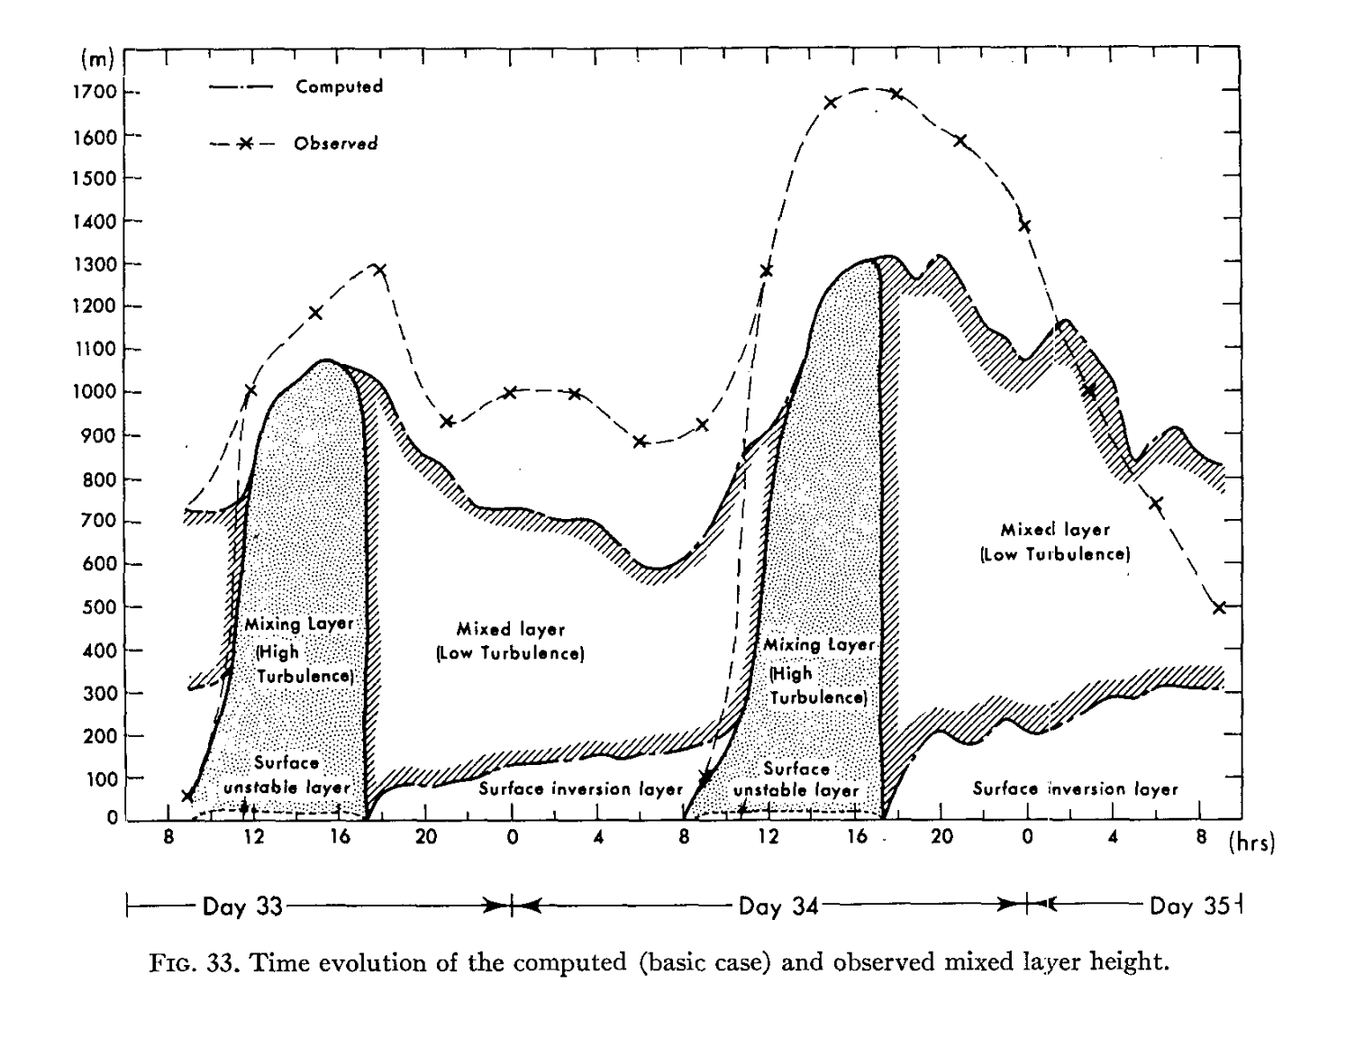
What is the Planetary Boundary Layer (PBL)?
The bottom layer of the troposphere
  Often turbulent and capped by statically stable air
  Height varies from tens of m to several km
  Typically has a strong diurnal cycle
  Interacts with the surface layer

Slide 3
PBL height
Daytime:
Deep vigorous mixing
Height (m)
Nocturnal inversion
Local time
Yamada and Mellor (1975)
Notes:
PBL height computed vs observed

Slide 4
Brief Outline
Types of PBLs
  Daytime (convective)
  Nocturnal (inversion)
PBL schemes in WRF
  Local
  Nonlocal
PBL influences on forecasts
  Biases and case study examples
  Influence on extratropical cyclones
  Influence on tropical cyclones

Slide 5
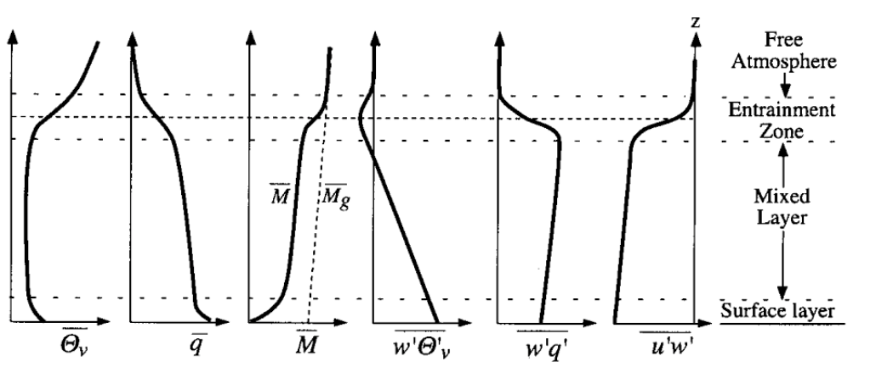
Convective Boundary Layer
Strong surface heating creates surface layer
Hartmann (1994)

Slide 6
Convective Boundary Layer
Above surface layer, well-mixed layer forms
Hartmann (1994)

Slide 7
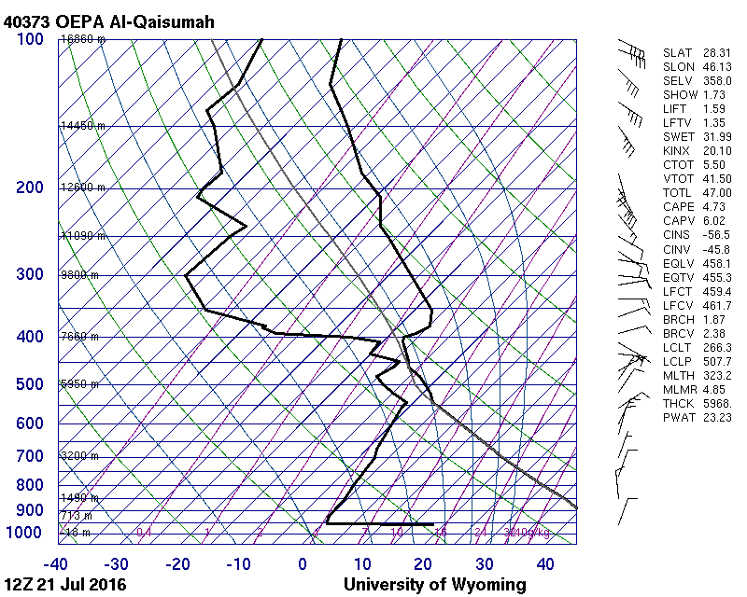
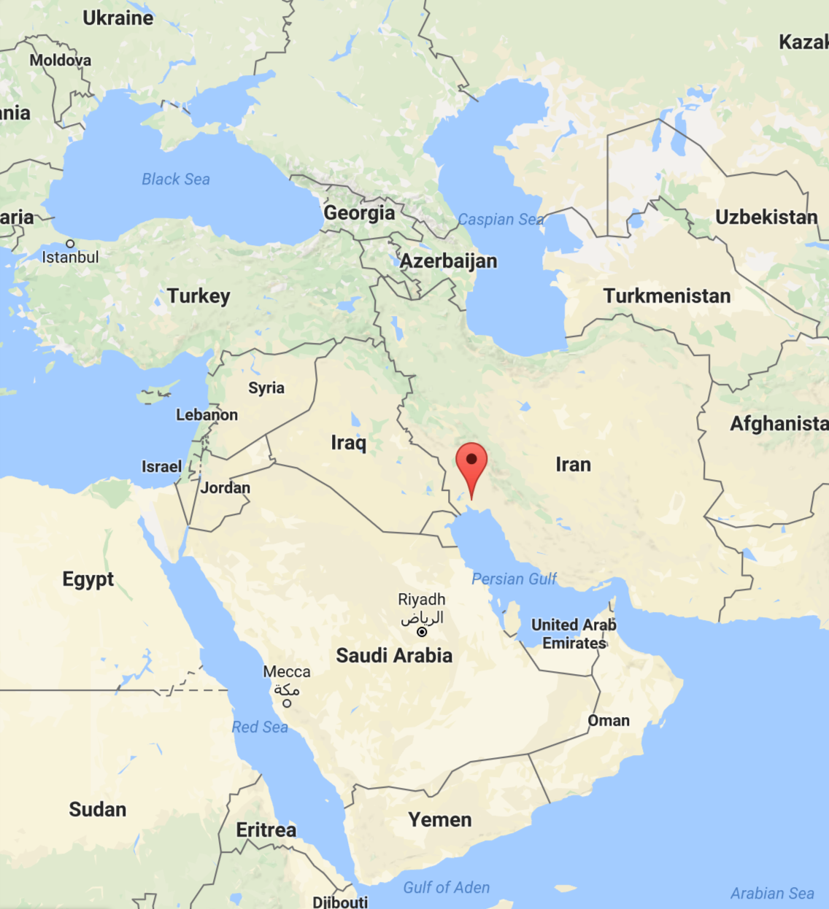
Convective Boundary layer
Above, layer is well-mixed by convection

Slide 8
Convective Boundary Layer
Entrainment zone mixes with the free atmosphere
Hartmann (1994)

Slide 9
Convective Boundary Layer
Subgeostrophic wind due to frictional effects during the daytime
Hartmann (1994)

Slide 10
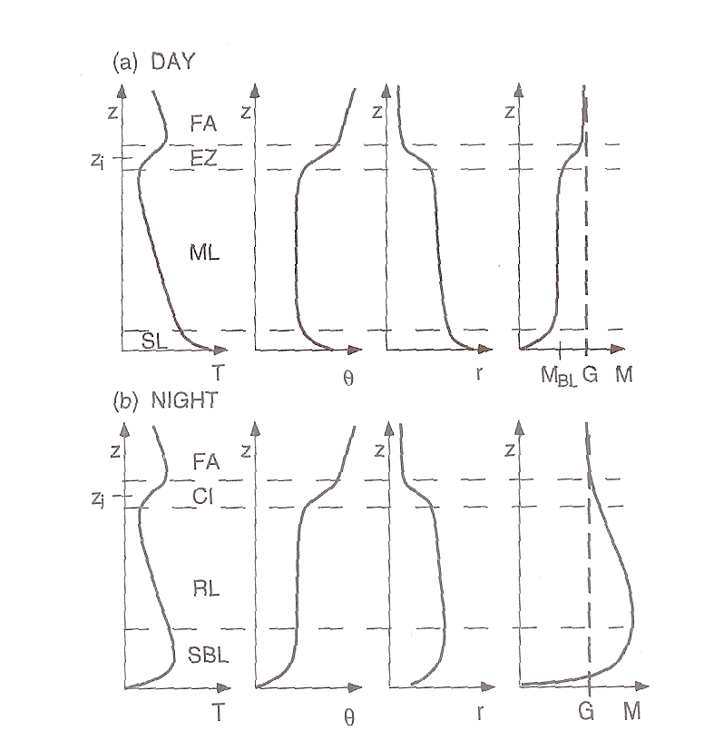
Nocturnal Boundary layer
Supergeostrophic wind can develop at night
Stable layer develops at surface
Residual layer (e.g., EML) can influence weather downstream
q
q
Stull (2000)

Slide 11
PBL Summary
Bottom layer of the troposphere influenced by the surface
Dominated by mechanically driven and buoyancy driven eddies
Controls transport of momentum, heat, and moisture between free atmosphere and the surface layer

Slide 12
PBL Processes in WRF
Turbulent PBL processes are too small to resolve for km-scale models
  Subgrid scale processes must be parameterized
Goal is to describe the mean turbulent vertical transport of heat, momentum and moisture by eddies
  Two common approaches are through local (e.g., MYJ) and nonlocal (e.g., YSU) diffusion schemes

Slide 13
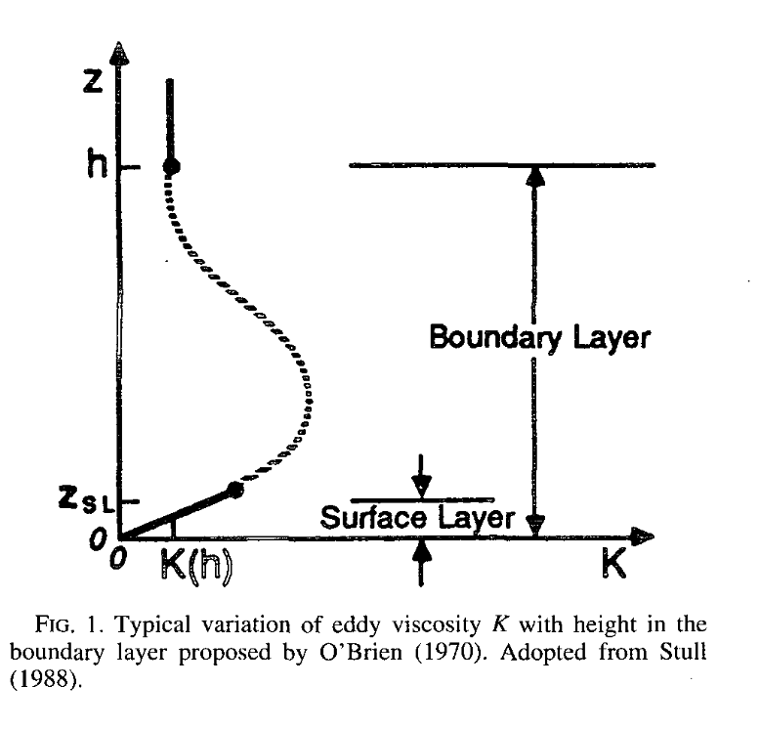

All about the eddies
How do you obtain an eddy diffusivity (K) profile?
  Develop it (MYJ)
  Impose it (YSU)
Coniglio et al. (2013)
Hong and Pan (1996)

Slide 14
Local Schemes
Local scheme like MYJ uses local vertical gradients to predict turbulent kinetic energy and use it to get K as a function of height
Hong and Pan (1996)

Slide 15
Nonlocal Schemes
Nonlocal schemes (YSU) estimate PBL height and use a prescribed profile shape to impose onto the PBL
Hong and Pan (1996)

Slide 16
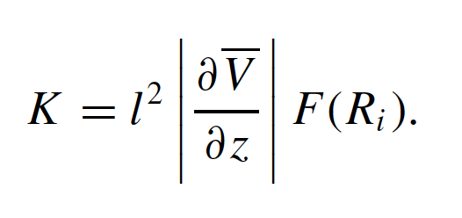
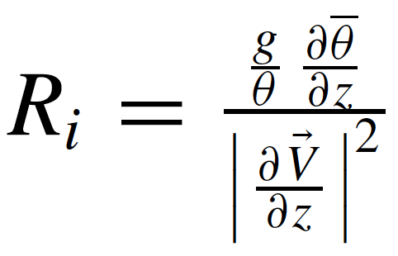
Local vs. Nonlocal
Simple local scheme that uses local gradients to establish K-profile
Krishnamurti et al. (2007)

Slide 17
Local vs. Nonlocal
Simple local scheme that uses local gradients to establish K-profile
Mixing length (function of height)
Krishnamurti et al. (2007)
Local gradients at a given level

Slide 18

Local vs. Nonlocal
Nonlocal scheme estimates PBL height and imposes K-profile shape function
Mixed-layer velocity scale (function of surface friction velocity and surface-layer physics-derived profile function)
Hong and Pan (1996)

Slide 19

Local vs. Nonlocal
Nonlocal scheme estimates PBL height and imposes K-profile shape function
Hong and Pan (1996)

Slide 20
Local vs. Nonlocal
Nonlocal scheme estimates PBL height and imposes K-profile shape function
Potential temp at lowest model level
Appropriate surface potential temp
Hong and Pan (1996)

Slide 21
Local vs. Nonlocal
Nonlocal scheme estimates PBL height and imposes K-profile shape function
Potential temp at lowest model level
Appropriate surface potential temp
Critical Richardson number. Varies with version (~0.75–0.25). Can be source of sensitivity.
Hong and Pan (1996)

Slide 22
Local vs. Nonlocal
Local scheme uses local gradients to establish K-profile
Nonlocal scheme estimates PBL height and imposes K-profile shape function
Krishnamurti et al. (2007)
Hong and Pan (1996)

Slide 23
Common biases in PBL schemes

Slide 24
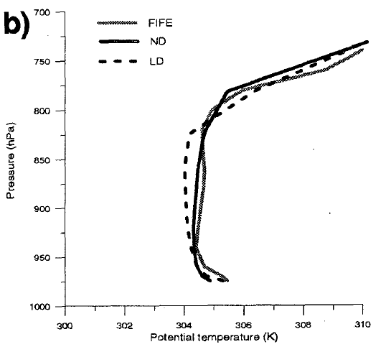
Convective PBL conditions
Nonlocal schemes tend to build mixed layers more effectively
2145 UTC 9 August 1987
Obs
Nonlocal
local
Hong and Pan (1996)

Slide 25
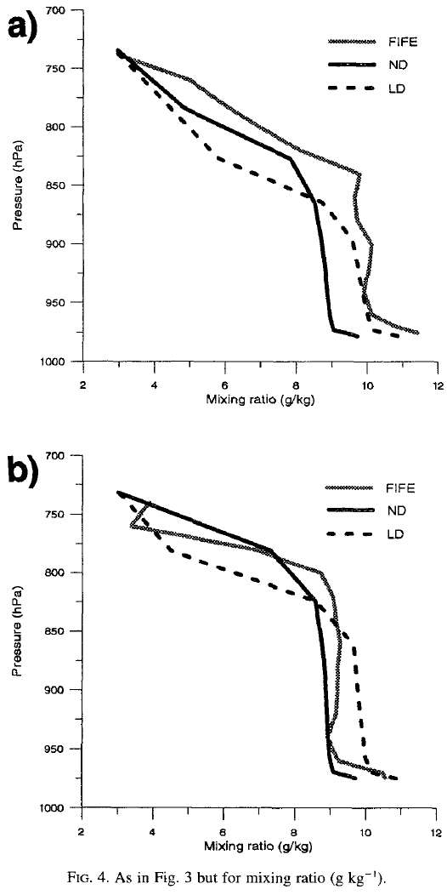
Convective PBL conditions
Obs
Nonlocal
Local
Due to efficiency of mixed-layer development, nonlocal schemes tend to overdeepen in convective environments
Can result in reduction of CIN and underestimation of MLCAPE
1845 UTC
Obs
Nonlocal
Local
2145 UTC
Hong and Pan (1996)

Slide 26
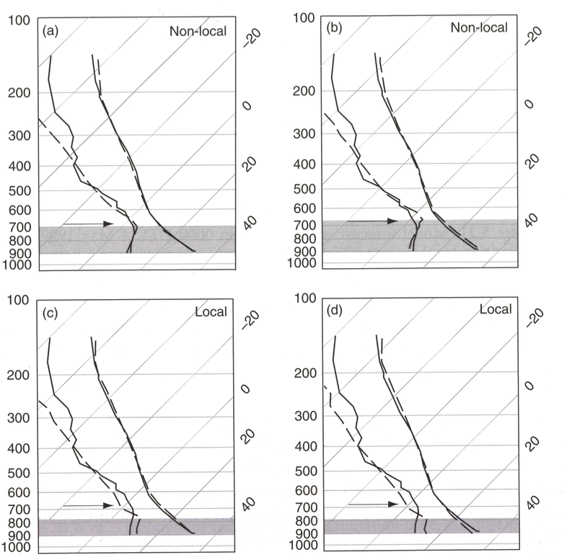
Composite Soundings for KTUS
Shading shows forecast boundary layer height. Nonlocal more accurate with PBL height in this case
Local schemes tend to keep PBL lower and more moist
Dashed are forecasts for nonlocal (a,b) and local (c,d) schemes, solid are composite obs. at 0000 UTC for Tucson, AZ. (Stensrud 2007)
Notes:
Look into Stensrud for study and PBL height estimation algorithm.

Slide 27
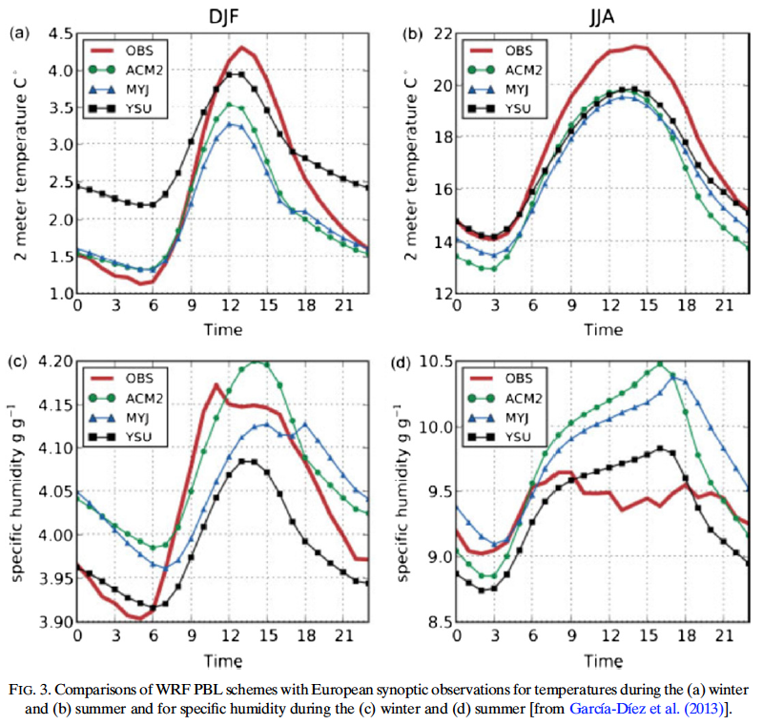
Composite Soundings for Europe
Nonlocal (YSU) DJF warm bias at night
Moisture overestimated during daytime JJA, less so with YSU.
PBL schemes for collection of European sites during winter (a) and summer (b). García-Díez (2013)
Notes:
Look into Garcia-Diez for janky (d) plot and talk about this figure

Slide 28
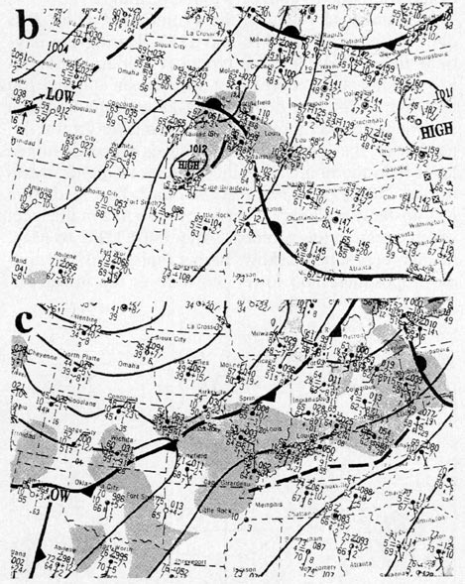
Convective Case Study
Inverted trough develops in TX while northern cyclone propagates over Great Lakes
Substantial convective rain along and ahead of cold front
Surface analysis from (b) 1200 UTC 16 May and (c) 1200 UTC 17 May 1995. Precip shaded. (Hong and Pan 1996)
Notes:
Look into Garcia-Diez for janky (d) plot and talk about this figure

Slide 29
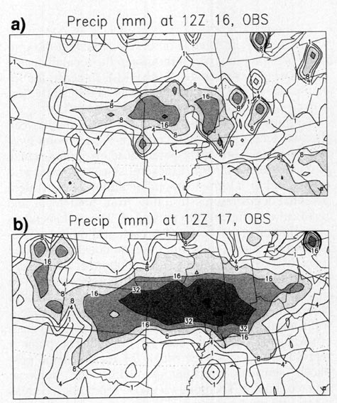
Convective Case Study
Lighter precipitation in first period
Widespread convective/large-scale rain within the warm sector in the second period
24-h accumulated precipitation (mm) ending at (a) 1200 UTC 16 May and (b) 1200 UTC 17 May 1995. (Hong and Pan 1996)
Notes:
Look into Garcia-Diez for janky (d) plot and talk about this figure

Slide 30
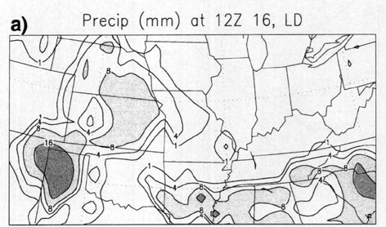
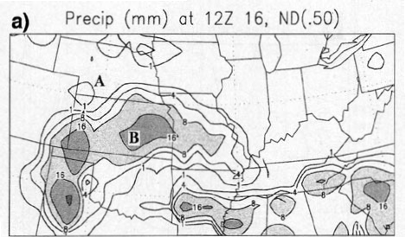
a)
24-h accumulated precipitation (mm) ending at 1200 UTC 16 May from (a) observations, (b) local scheme, (c) nonlocal scheme. (Hong and Pan 1996)
Some spurious convection in NE in local scheme
b)
c)
Notes:
Look into Garcia-Diez for janky (d) plot and talk about this figure

Slide 31
a)
24-h accumulated precipitation (mm) ending at 1200 UTC 16 May from (a) observations, (b) local scheme, (c) nonlocal scheme. (Hong and Pan 1996)
Some spurious convection in NE in local scheme
Investigate point A as to why
b)
c)
Notes:
Look into Garcia-Diez for janky (d) plot and talk about this figure

Slide 32
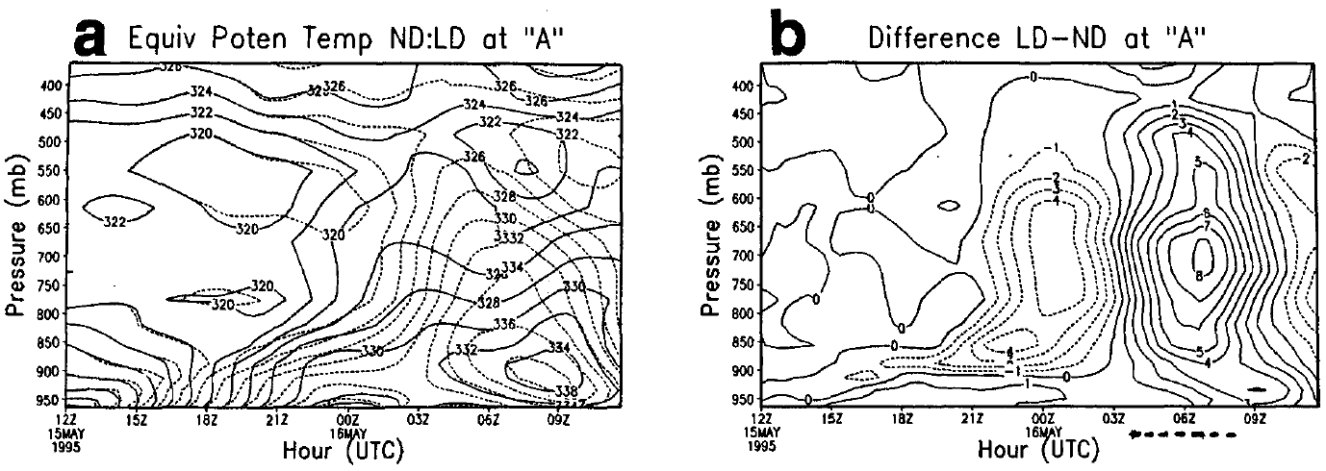
Time-pressure section of (a) equivalent potential temperature (K) for the local (dotted) and nonlocal (solid) experiments and (b) the differences (local minus nonlocal at the grid point A. Dotted line at the bottom of the difference field denotes the forecasted precipitation period for the local scheme (Hong and Pan 1996)
Local scheme has shallower boundary layer
  Traps moisture

Slide 33
Time-pressure section of (a) equivalent potential temperature (K) for the local (dotted) and nonlocal (solid) experiments and (b) the differences (local minus nonlocal at the grid point A. Dotted line at the bottom of the difference field denotes the forecasted precipitation period for the local scheme (Hong and Pan 1996)
Local scheme has shallower boundary layer
  Traps moisture
Local PBL becomes sufficiently unstable
  CAPE release around 0300 UTC

Slide 34
Time-pressure section of (a) equivalent potential temperature (K) for the local (dotted) and nonlocal (solid) experiments and (b) the differences (local minus nonlocal at the grid point A. Dotted line at the bottom of the difference field denotes the forecasted precipitation period for the local scheme (Hong and Pan 1996)
Local scheme has shallower boundary layer
  Traps moisture
Local PBL becomes sufficiently unstable
  CAPE release around 0300 UTC

Slide 35
Local vs. Nonlocal
Nonlocal scheme estimates PBL height and imposes K-profile shape function
Critical Richardson number. Varies with version (~0.75–0.25). Can be source of sensitivity.
Hong and Pan (1996)

Slide 36
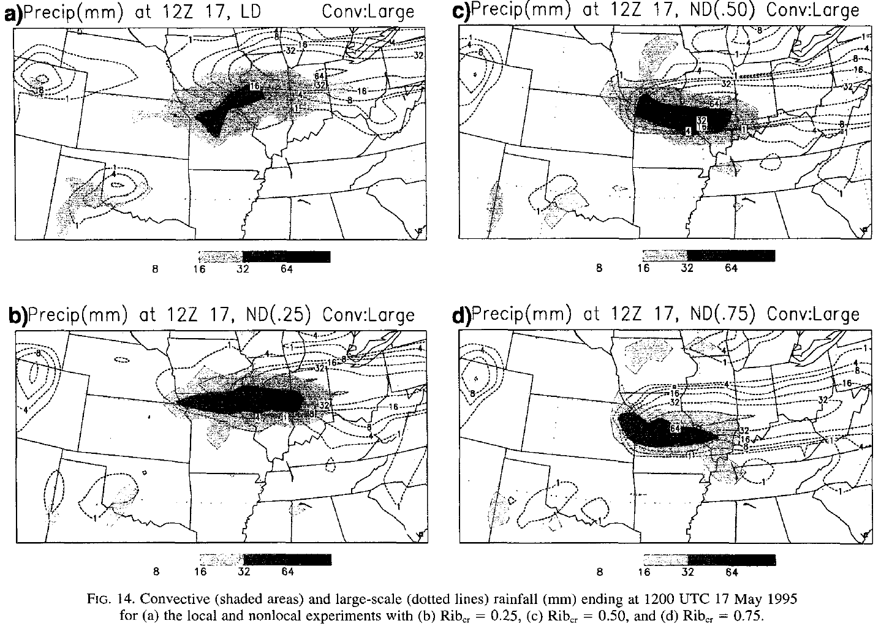
Hong and Pan (1996)

Slide 37
Thermodynamics isn’t the whole story
Previous case from paper introducing nonlocal PBL scheme
Shear also important to convective evolution
  How do local and nonlocal schemes typically handle shear in a convective environment?

Slide 38
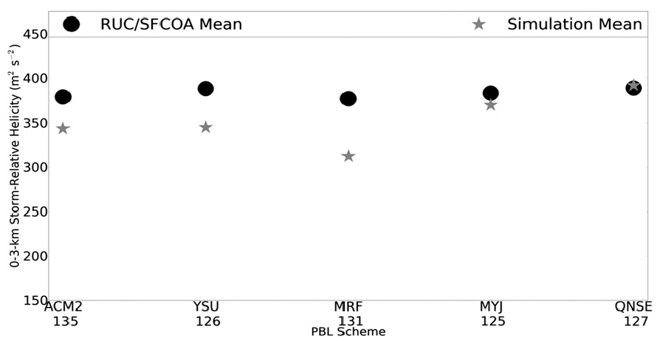
Nonlocal
Local
Mean values of simulated and RUC–SFCOA-derived 0–3-km Storm Relative Helicity among all PBL schemes. Sample sizes along abscissa. The black circles denote RUC–SFCOA values, whereas the gray stars denote simulation values. Note that minor differences in simulation means are explained by differences in analyzed times among corresponding PBLs (owing to variability in which soundings are convectively contaminated). (Cohen et al. 2013)
Nonlocal schemes have a low shear bias relative to local schemes in convective boundary layers

Slide 39
Summary and Future Work
PBLs simulate transport of heat, momentum, and moisture by turbulent eddies
  Local schemes tend to perform well in stable and neutral environments.
  Nonlocal schemes efficiently produce unstable PBLs. Less affected by localized static stability maxima
How do PBL schemes influence extratropical cyclones?
  Still a topic of research. Most literature focuses on TCs, MCSs, and severe weather environments

Slide 40
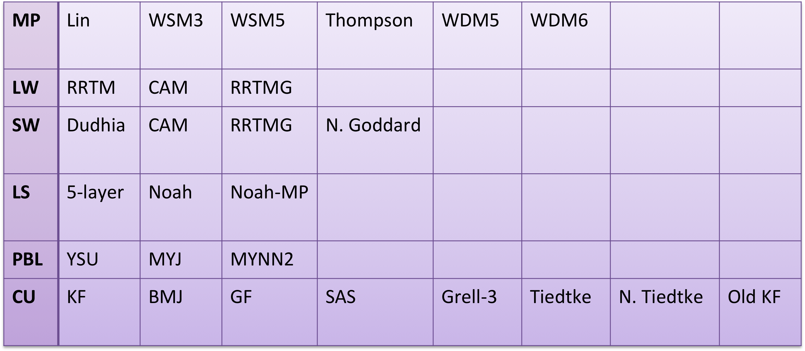
Summary and Future Work
Massive physics-based ensemble WRF simulation of March 1993 superstorm
  What’s the physics scheme that best matches ERA-Interim sea level pressure? NESIS?
  Lots of runs (>2800)
  What physics is the cyclone track/intensity most sensitive to?

Slide 43
PBL Influences on TCs

Slide 44
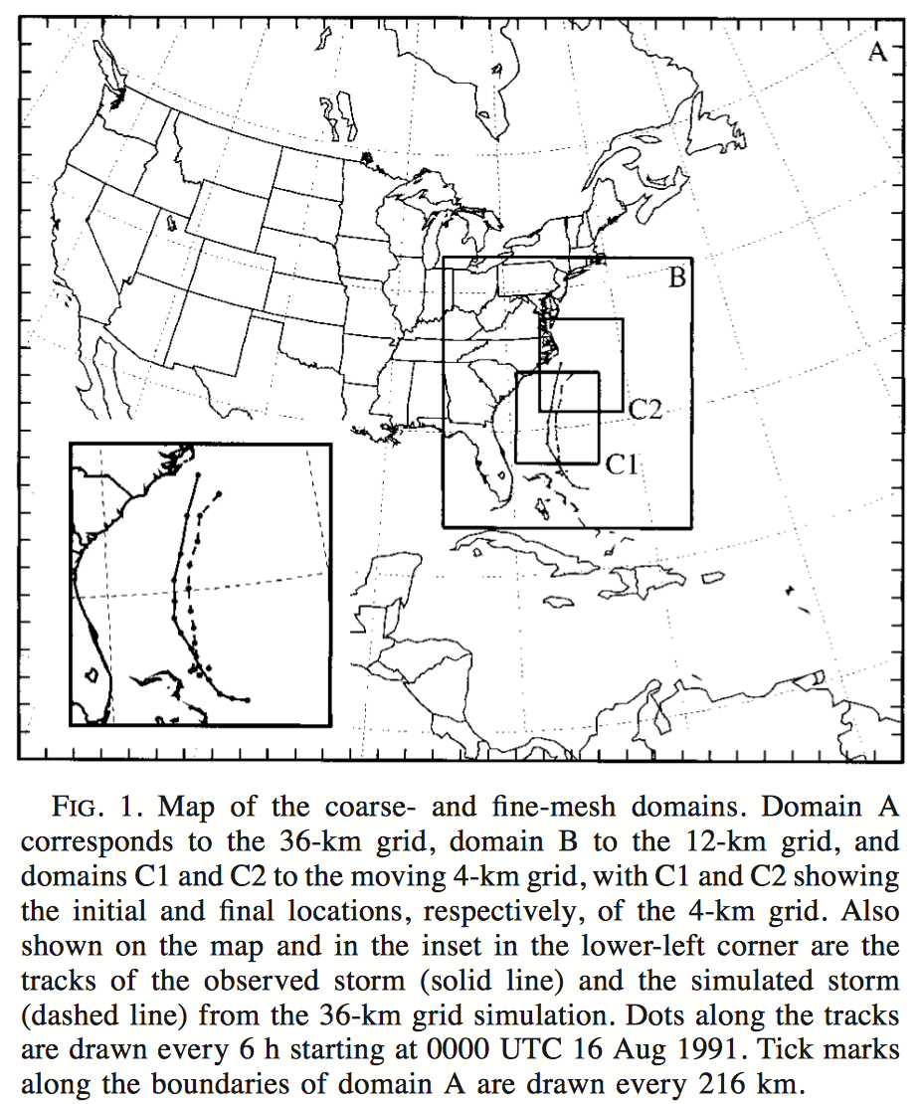
PBL Simulation of Hurricane Bob
0000 UTC 16 August 1991
Braun and Tao (2000)

Slide 45
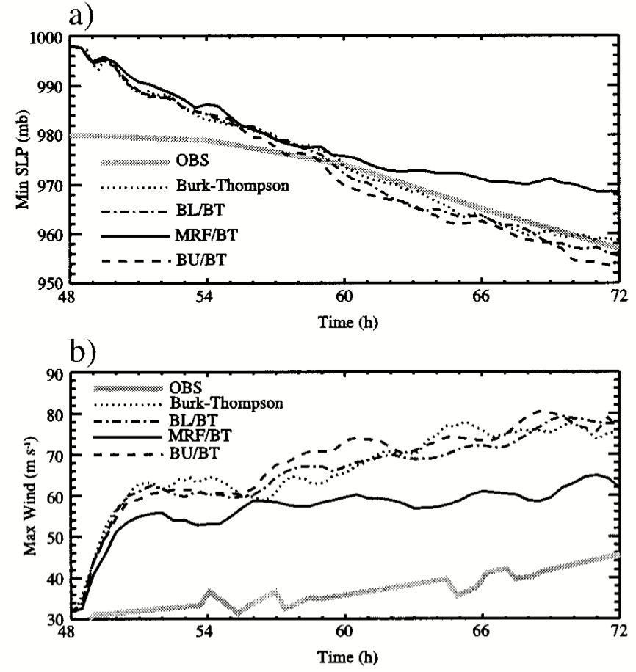
PBL Simulation of Hurricane Bob
All PBL schemes use same surface flux schemes
Most sensitivity to surface flux scheme among local PBLs
MRF (nonlocal) exception
Burk = local
BL = hybrid (local)
MRF = nonlocal
BU = local
Braun and Tao (2000)

Slide 46
Braun and Tao (2000)
MRF nonlocal scheme produced wider, weaker storm than other local schemes
“Braun and Tao (2009) did identify differences among the four schemes, with the MRF scheme identified as producing a weaker storm than the other three, with an unrealistically deep and dry boundary layer. This study led to a community-wide bias against using the MRF scheme for hurricane simulations. Early tests of WRF simulations using the MRF and then later the YSU schemes did show favorable results (Nolan and Tuleya 2002; Nolan et al. 2004). These discrepancies indicate the importance of evaluating PBL schemes and other parameterizations on a model-by-model basis.” –Nolan et al. (2009)

Slide 47
Idealized TC (MM5)
Smith and Thomsen (2010) examined TC intensification sensitivity to PBL scheme
No one scheme was found to be “ideal”

Slide 48
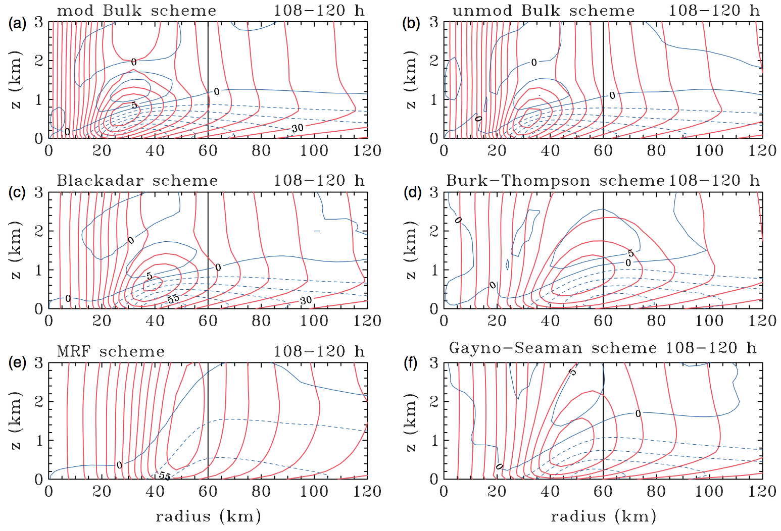
Local
Local
Local
Local
Nonlocal
Local
Radius–height cross-sections of azimuthally-averaged radial (thin/blue contours) and tangential wind-speed (thick/red contours) components in the lowest 3 km averaged at 15 minute intervals during the period 108–120 hours for the different boundary-layer schemes. (a) Modified bulk scheme, (b) unmodified bulk scheme, (c) Blackadar scheme, (d) Burk–Thompson scheme, (e) MRF scheme and (f) Gayno–Seaman scheme. Contour interval 5 m s⁻¹ (Smith and Thomsen (2010)

Slide 49
Hurricane Isabel (2003)
Nolan et al. (2009) simulate storm using high res (<4km) WRF
Compare MYJ (local) and YSU (nonlocal) schemes in outer and inner core
  Both are given the same surface roughness length formula which tops out at 30 m s^{–1}

Slide 50
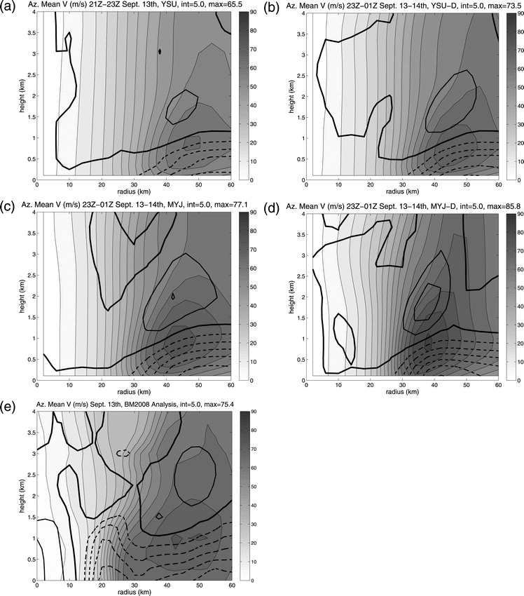
YSU
Nonlocal
MYJ
Local
Observations
(Bell and Montgomery 2008)
Azimuthally averaged and 3-h time-composited azimuthal winds (shaded) and radial winds (heavy contours) for the WRF simulations near 1800 UTC 13 Sep, and for the Bell and Montgomery (2008) analysis around the same time: (a) YSU, (b) YSU-D, (c) MYJ, (d) MYJ-D, and (e) the BM08 analysis. The thickest contour is the zero contour for the radial winds.

Slide 51
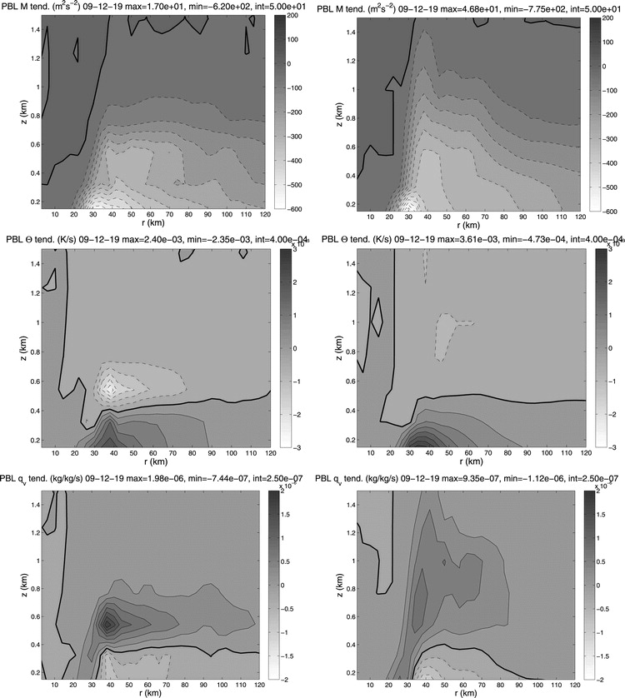
YSU
Nonlocal
MYJ
Local
Upward transport exceeds surface fluxes
PBL scheme tendencies from the WRF simulations with (left) YSU-D and (right) MYJ-D schemes around 1900 UTC 12 Sep, for the (top) absolute angular momentum, (middle) potential temperature, and (bottom) water vapor mixing ratio.Nolan (2009b)

Slide 52
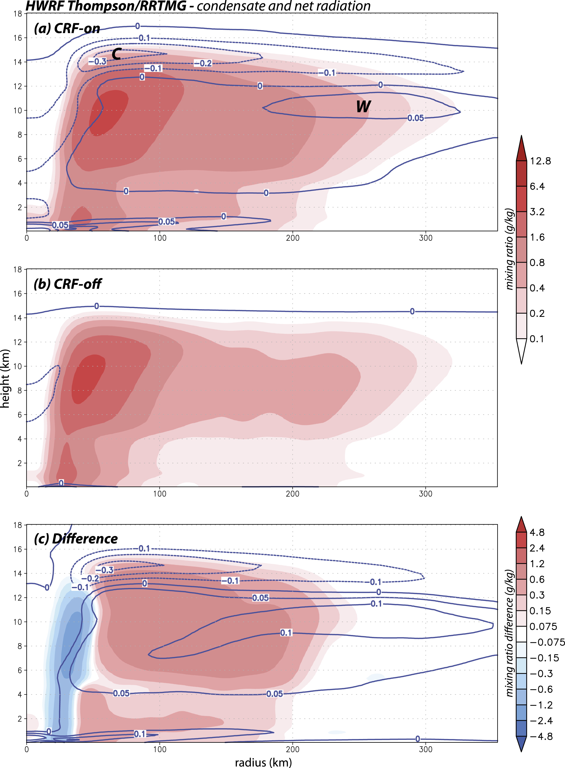
Semi-Idealized HWRF
Bu et al. (2017) examine TC size sensitivity to cloud radiative forcing and PBL mixing.
Important: Concept of cloud radiative feedback beneath anvil causes gradual lifting below to enhance TC size

Slide 53
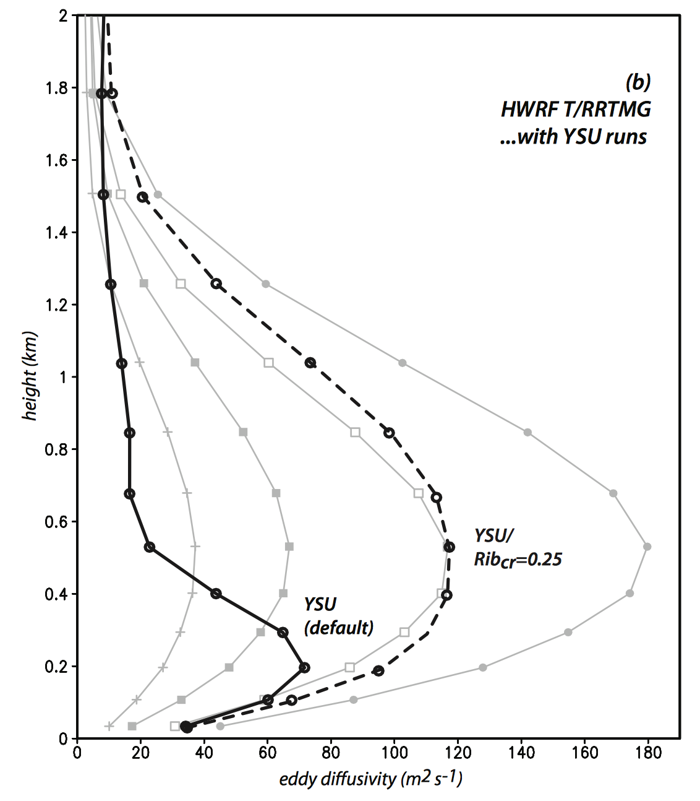
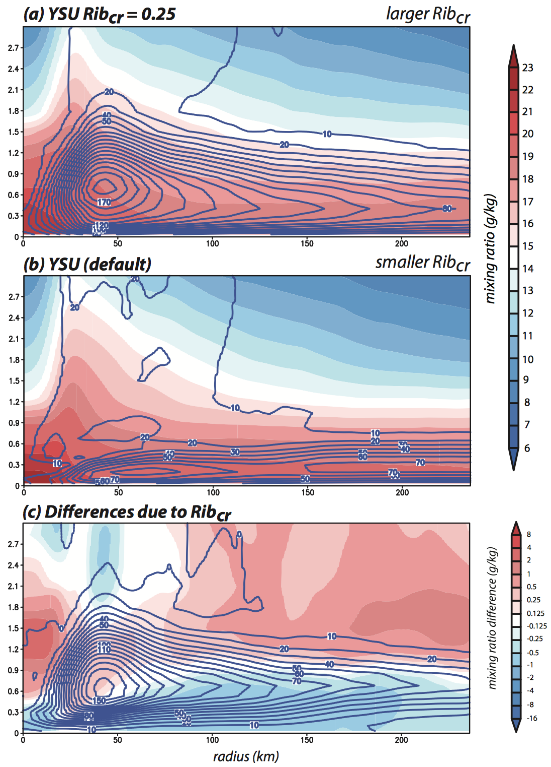
Nonlocal PBL mixing
Radius vs. height cross-sections showing the temporally-averaged symmetric components of water vapor (shaded) and eddy diffusivity applied to vapor (Kh; 10 m2 s−1 contours) using YSU with (a) Ribcr=0.25, and (b) the default setup. Panel (c) shows difference fields. (Bu et al. 2017)

Slide 54
References
Braun, S. and W. Tao, 2000: Sensitivity of High-Resolution Simulations of Hurricane Bob (1991) to Planetary Boundary Layer Parameterizations. Mon. Wea. Rev., 128, 3941–3961, doi: 10.1175/1520-0493(2000)129<3941:SOHRSO>2.0.CO;2.
Bu, Y., R. Fovell, and K. Corbosiero, 2017: The influences of boundary layer mixing and cloud-radiative forcing on tropical cyclone size. J. Atmos. Sci. doi:10.1175/JAS-D-16-0231.1, in press.
Coniglio, M., J. Correia, P. Marsh, and F. Kong, 2013: Verification of Convection-Allowing WRF Model Forecasts of the Planetary Boundary Layer Using Sounding Observations. Wea. Forecasting, 28, 842–862, doi: 10.1175/WAF-D-12-00103.1.
García-Díez, M., Fernández, J., Fita, L. and Yagüe, C. (2013), Seasonal dependence of WRF model biases and sensitivity to PBL schemes over Europe. Q.J.R. Meteorol. Soc., 139: 501–514. doi:10.1002/qj.1976
Hartmann, D. L., 1994: Global Physical Climatology. Academic Press, 411 pp.
Hong, S. and H. Pan, 1996: Nonlocal Boundary Layer Vertical Diffusion in a Medium-Range Forecast Model. Mon. Wea. Rev., 124, 2322–2339, doi: 10.1175/1520-0493(1996)124<2322:NBLVDI>2.0.CO;2.
Krishnamurti, T. N., Basu, S., Sanjay, J. and Gnanaseelan, C. (2008), Evaluation of several different planetary boundary layer schemes within a single model, a unified model and a multimodel superensemble. Tellus A, 60: 42–61. doi:10.1111/j.1600-0870.2007.00278.x
Nolan, D. S. and D. P. Stern, 2009: Evaluation of Planetary Boundary Layer Parameterizations in Tropical Cyclones by Comparison of In Situ Observations and High-Resolution Simulations of Hurricane Isabel (2003). Part II: Inner-Core Boundary Layer and Eyewall Structure. Mon. Wea. Rev., 137, 3675–3698, doi: 10.1175/2009MWR2786.1.
Smith, R. K. and Thomsen, G. L. (2010), Dependence of tropical-cyclone intensification on the boundary-layer representation in a numerical model. Q.J.R. Meteorol. Soc., 136: 1671–1685. doi:10.1002/qj.687
Stensrud D. J., 2007: Parameterization Schemes: Keys to Understanding Numerical Weather Prediction Models. Cambridge University Press, 459 pp.
Stull R., 2000: Meteorology for Scientists and Engineers. Brooks Cole, 502 pp.
Yamada, T. and G. Mellor, 1975: A Simulation of the Wangara Atmospheric Boundary Layer Data. J. Atmos. Sci., 32, 2309–2329, doi: 10.1175/1520-0469(1975)032<2309:ASOTWA>2.0.CO;2.

