Slide 1
Graduate Student Finance Seminar
Matthew Vaughan

Slide 2
What this is:
Standard info on stipends and taxes
A primer on personal finance including:
Credit cards, retirement, large purchases, investing, etc.
Overview of current financial environment
Some finance rules of thumb
A conversation starter
What this is not:
Advice on specific investments
Political commentary
Wisdom from a trained economist

Slide 3
General themes to take away
Think in terms of net worth
Especially regarding retirement and big-ticket purchases

Slide 4
General themes to take away
Think in terms of net worth
Especially regarding retirement and big-ticket purchases
Understand what is a luxury and what is a necessity (or “close” necessity)
This is particularly important the lower your salary
You make $100k and have no debt and buy 1k phone every 2 years, alright
You make $25k with $50k in loan debt and buy the same phone every 2 years…I have questions

Slide 5
General themes to take away
Think in terms of net worth
Especially regarding retirement and big-ticket purchases
Understand what is a luxury and what is a necessity (or “close” necessity)
This is particularly important the lower your salary
You make $100k and have no debt and buy 1k phone every 2 years, alright
You make $25k with $50k in loan debt and buy the same phone every 2 years…I have questions
Money is a tool, make it work for you
I’m not here to tell you what to spend your money on

Slide 6
Stipends
Congratulations, as this is likely your first salaried position!
Entering without an M.S.
$26,500 yearly
Prepare for uneven pay if you are on TA
More in summer, less during academic year
FICA taxes apply during summer (SS, Medicare)

Slide 7
Benefits
Eligible for health insurance through the GSEU agreement
$~17 every 2 weeks; great coverage; compare with your family plan
Eligible for New York State pension system
~3% of your salary, transferrable to other states, eligible to rollover contributions if you want out (i.e. money isn’t lost)

Slide 8
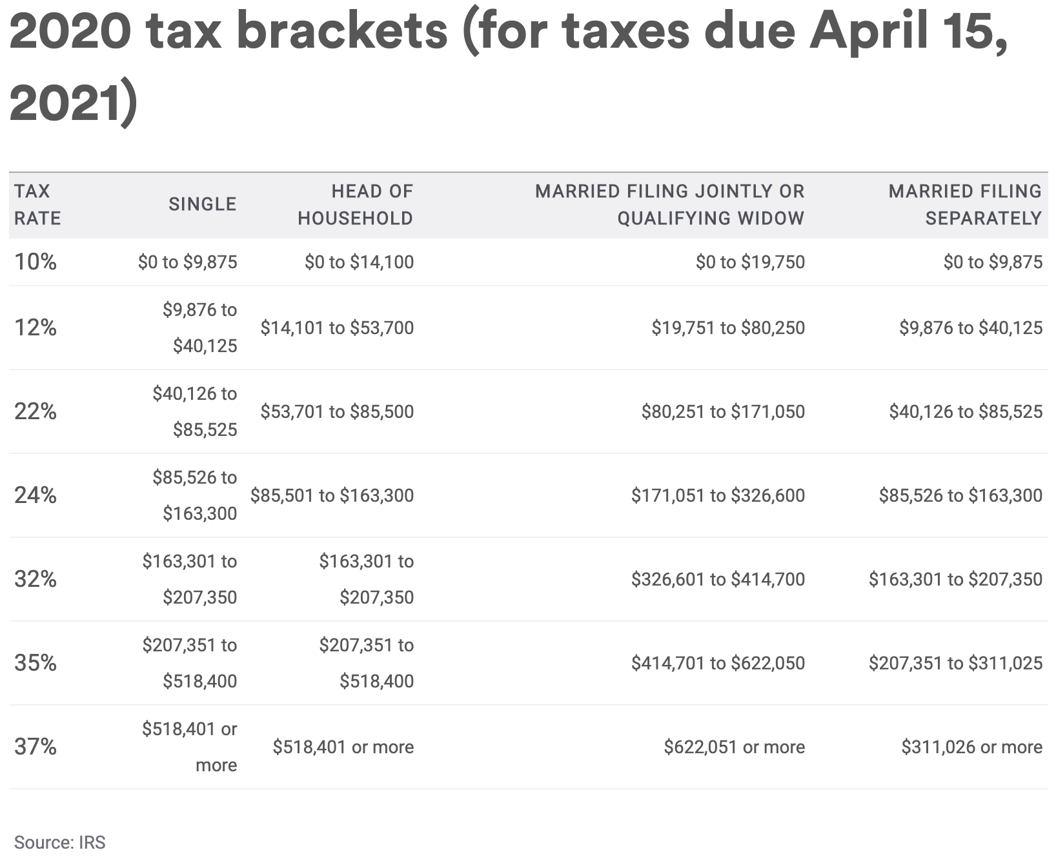
Federal Taxes
Normally taken out every paycheck
Online tools for tax returns (April 15)
Bracketed tax system
10% up to ~10k, then 12% after
Deductions deduct from your income, credits credit your final tax bill
Take a Marshawn Lynch approach to tax withholdings

Slide 9
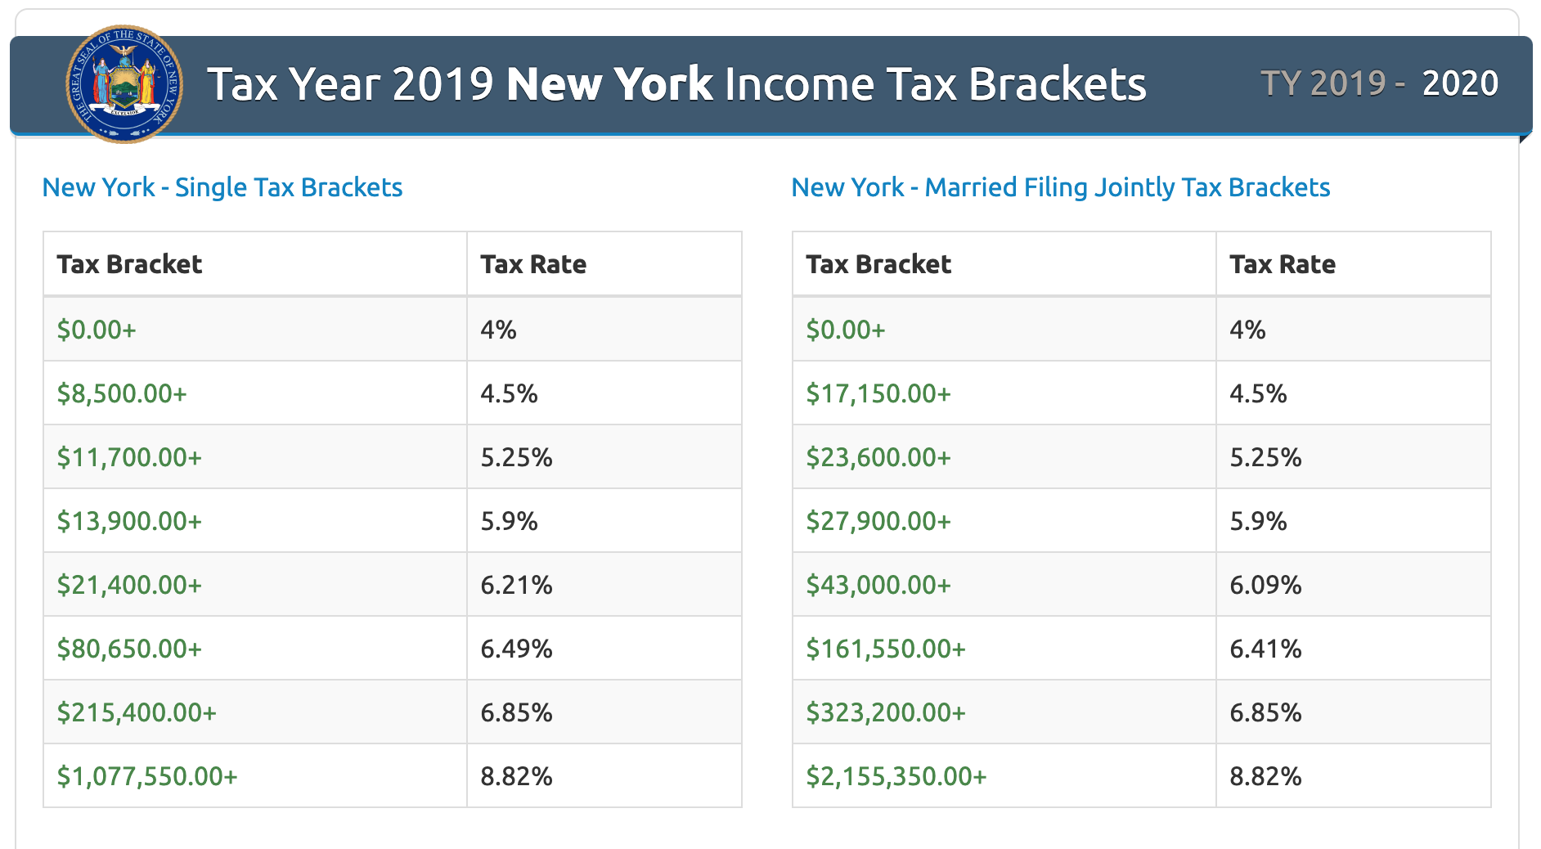
State Taxes
Same idea
Fewer credits
No tuition credit

Slide 10
Today’s Economy

Slide 11
Setting the Stage
Sources: Zumper.com
Median rent nationally is $1,233
Not terribly helpful without context

Slide 12
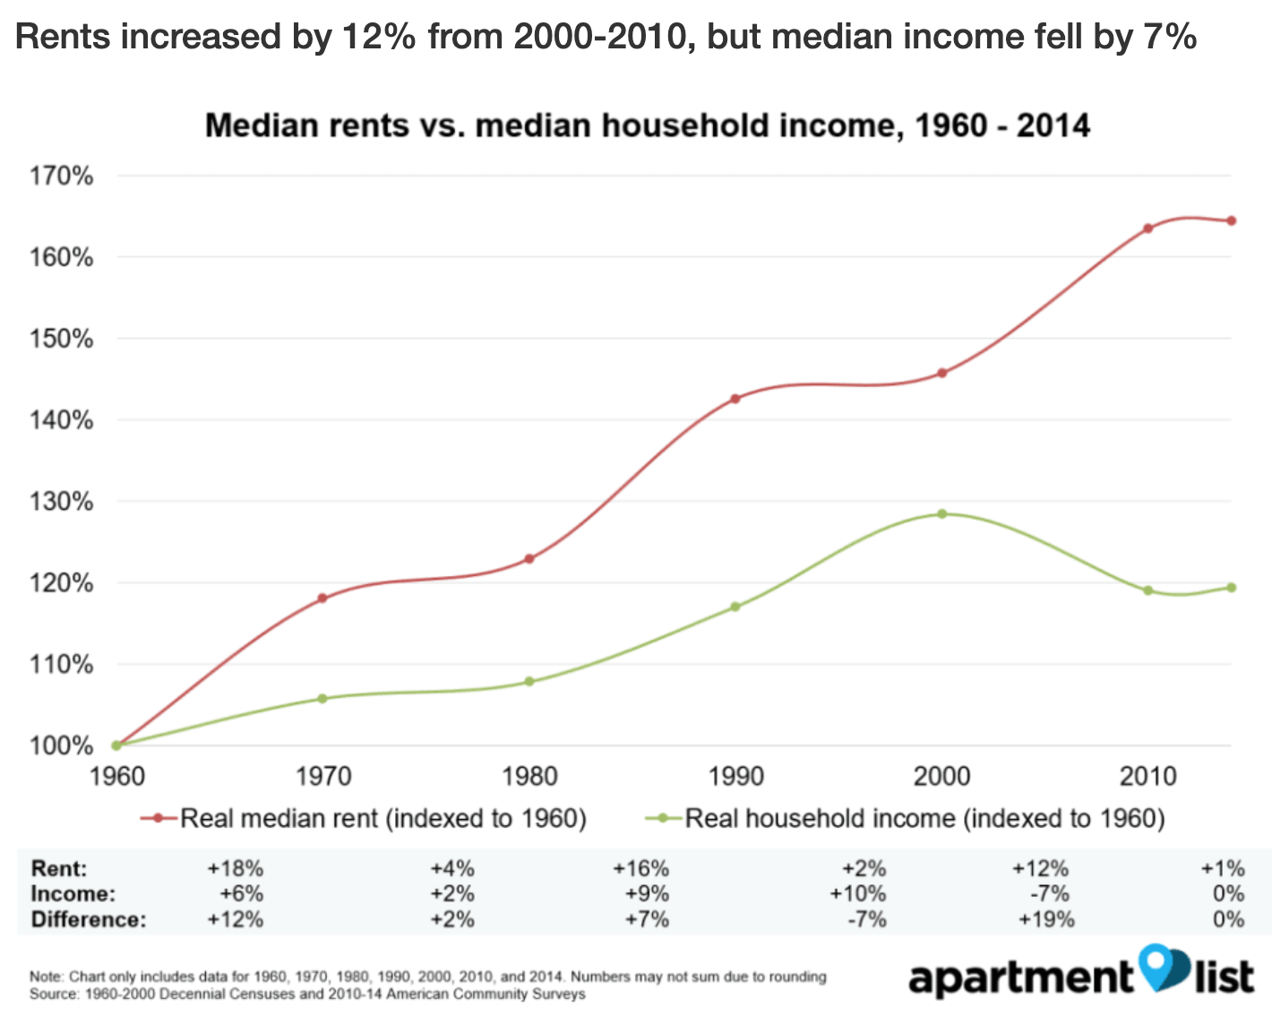
Setting the Stage
Sources: Zumper.com
Median rent nationally is $1,233

Slide 13
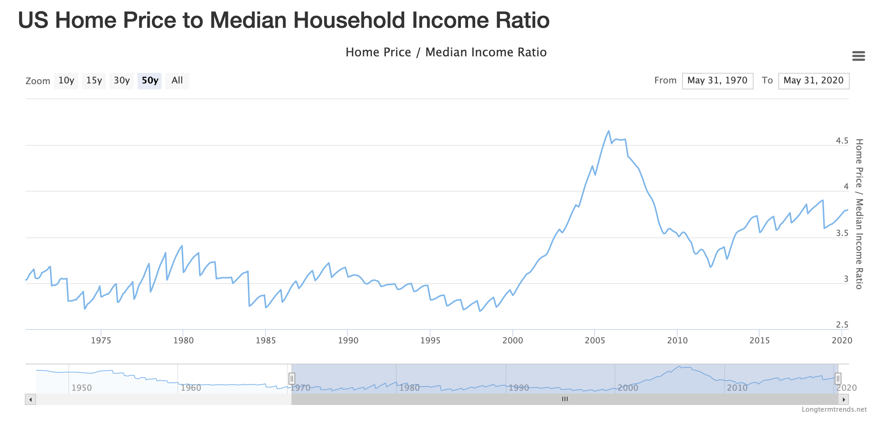
Setting the Stage
Sources: Fed Reserve Bank of St. Louis & Census.gov
Median home sells for ~4x median income
Compared to 1970–1999, prices much closer to 3x household income

Slide 14
Setting the Stage
Sources: Board of Governors for Federal Reserve
Average millennial net worth is $92k
“In 2016, the average real net worth (read: adjusted for inflation) of millennial households was about $92,000, around 20 percent less than baby boomer households in 1989 and nearly 40 percent less than Generation X households in 2001.”
Fed Reserve report (2016)

Slide 15
Education Costs
Hot topic on the national stage
Education costs outpacing almost everything
Up 1,375% since 1978; 4x rate of inflation (Labor dept.)
Average debt: ~$30,000 (2018)
Median around ~17k

Slide 16
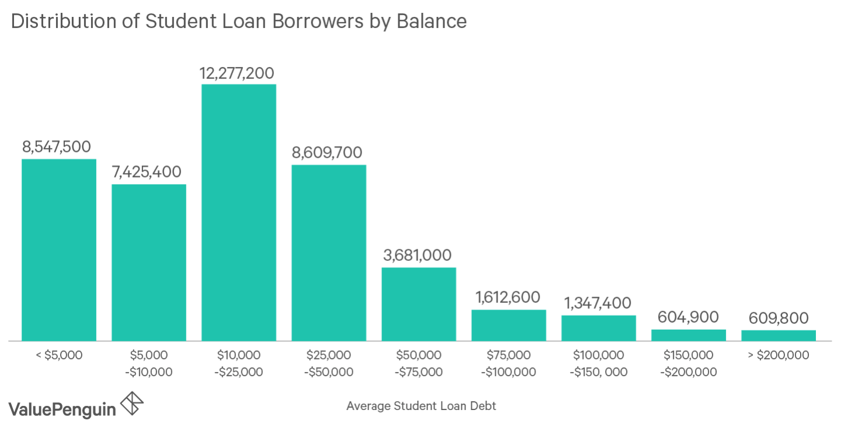
Education Costs
Sources: 2019
Hot topic on the national stage
Education costs outpacing almost everything
Up 1,375% since 1978; 4x rate of inflation (Labor dept.)
Average debt: ~$30,000 (2018)
Median around ~$17k

Slide 17
Student Loans
Flexible repayment/deferment for unemployment, school, service, etc.
Income-based repayment possible
Generally lower interest rates
Subsidized loans possible
Repayment plans are set by the issuing bank
Interest starts accruing from date of issuance
Generally higher interest rates that depend on your credit history*
Terms vary
Public Loans
Private Loans
*Refinance is a different story

Slide 18
Federal (public) Loans
Subsidized and unsubsidized
Govt pays interest during deferment of subsidized loans
Unsubsidized accrues interest from first day of loan issuance
Both are eligible for deferment during school
Repayment
At the end of the grace period, unpaid interest from deferment capitalizes onto principle

Slide 19
A case for loan payments during grad school
$25,000 principle
~$100 payments each month
$3,750 paid over 36 months
10-year monthly payments = $265
Total paid = $35,570
~5% interest
$25,000 principle
$3,750 capitalizes on principle once grace period ends
10-year monthly payments = $305
Total paid = $36,593
~5% interest
Extra $1000 paid
Interest Only Payments during school (36 months)
No Payments during school (36 months)

Slide 20
Student Loans
NOTE: The previous calculations assume no accrued interest in undergrad
Any amount that you can put towards your loans now will help in the future
Lower monthly loan payments will help with other savings goals later on
Consider refinancing to lower
rate with other lenders (e.g. Sofi)

Slide 21
Credit Cards

Slide 22
How do Credit Cards Work?
A credit card is essentially your own personal monthly loan
You are given ~1 month to pay off what you buy before interest starts accruing
You can spend up to your credit limit until you must pay off some of the balance

Slide 23
Credit Card Best Practices
PAY IT OFF EVERY MONTH!
Often have double-digit interest rates
“Minimum” payment is never the least expensive
Try to keep total credit utilization below 30%
Avoid cards with annual fees
Some exceptions apply, but do your homework. Typically need to be in a higher spending bracket to make these worth it.

Slide 24
Credit vs. Debit
Safety
Bank account remains intact if card is stolen
Improve credit history/score
Aids in getting approved for lines of credit
Credit score helps you get lower interest rates on mortgages, auto loans, etc.
Rewards
Credit rewards are far more lucrative than debit

Slide 25
Matt’s Wallet
Citi Double Cash (MC)
Effective 2% on everything
AMEX Blue Cash Everyday
3% on groceries; 2% gas/department, 1% everywhere
Chase Freedom (Visa)
5% rotating categories; 1% everywhere else
Wells Fargo Propel AMEX
3% dining, gas, travel

Slide 26
Credit card success story
Had a friend in grad school who was using a debit card only and had an average credit score
He switched to using a credit card, built up his score over 3 years
Had a wedding and needed a loan
Applied for and got a Chase Slate card (0% APR for 15 months) to pay for $5k in wedding expenses over time
Improved credit score helped him get the card with a large enough credit limit to cover expenses with a 0% “loan”

Slide 27
Banking in the 21st Century

Slide 28
Factors to consider
Checking accounts
Maintenance fees
Overdraft policies
ATM fees
Banking locations
Online features
Savings/CD Accounts
Interest rates

Slide 29
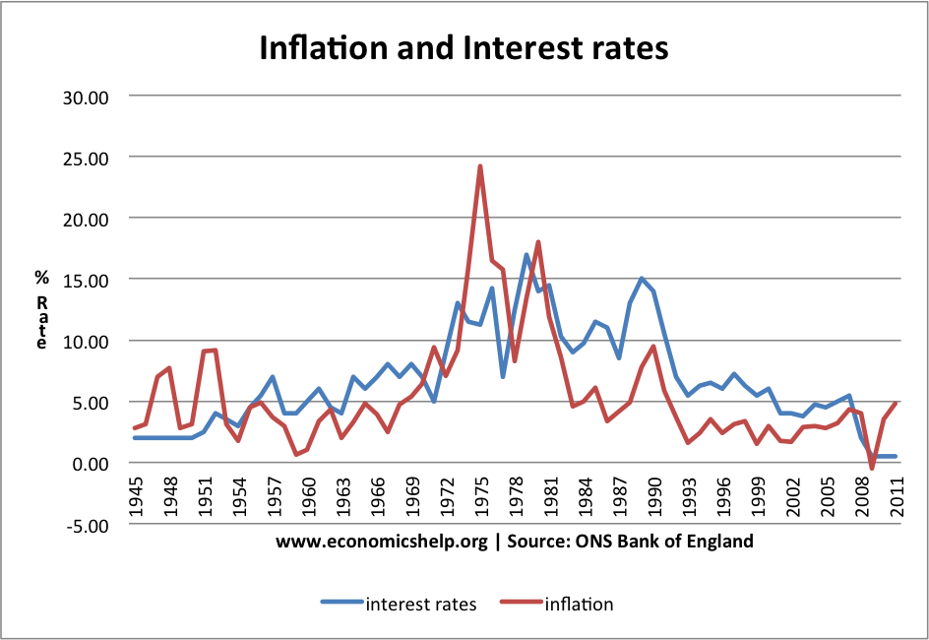
What’s the Purpose of a Savings Account?
Protect wealth

Slide 30
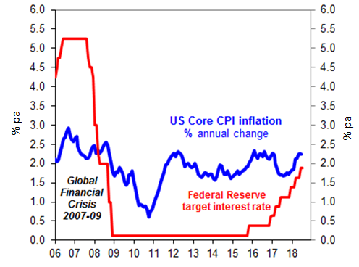
What’s the Purpose of a Savings Account?
Protect wealth

Slide 31
What’s the Purpose of a Savings Account?
Protect wealth (ehh…not so much now)
Provide liquid vehicle for wealth
Insure wealth (e.g. FDIC)

Slide 32
Savings account use
Inflation is higher than savings rates
i.e. you’re losing money every day
What’s a savings account good for in a low interest environment?
Emergency funds (3–6 months expenses)
Short-term savings (~<3 years)

Slide 33
What about checking?
Interest rates are deplorable
Inflation is the enemy
Only keep as much as you need
~1–2 months expenses

Slide 34
Matt’s Banks
Sofi Money
Online; no account minimums; 0.25% interest; reimburse ATMs; overdraft percentage fee; free mailed checks and electronic transfers
Charles Schwab
Online; reimburses all ATM fees; no account minimums
Marcus
Savings and CDs with industry-leading interest rates
Note:
Interest rates are historically bad right now
May consider chasing signing bonuses with banks rather than interest rates
e.g. $100 bonus after first deposit
$10,000 at an interest rate of 1% would make that in ~1 year

Slide 35
The stock market and you
That thing you hear about on TV

Slide 36
Why should you invest
Grow wealth through stocks and high-yield bonds
Provide income during retirement through lower-risk investments
Protect wealth from inflation

Slide 37
Ok, but why invest NOW?
Compound interest
You can’t take out a loan for retirement
Retirement numbers are large
A $80–90k salary in retirement demands a sum of ~$2.2 million using 4% rule
You could try saving $30k annually at age 25 in a savings account averaging 2% for 45 years
IMPORTANT: This doesn’t account for inflation (i.e. you need to save more)

Slide 38
Ok, but why invest NOW?
Most importantly…People are demonstrably bad at saving for retirement

Slide 39
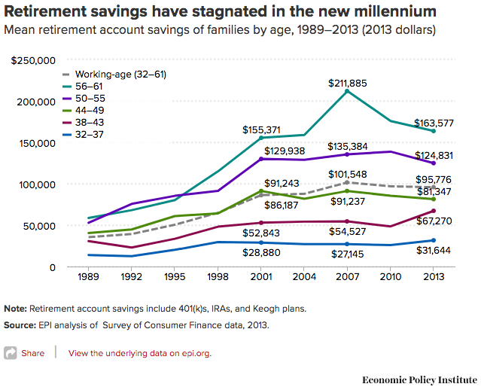
Ok, but why invest NOW?
Most importantly…People are demonstrably bad at saving for retirement

Slide 40
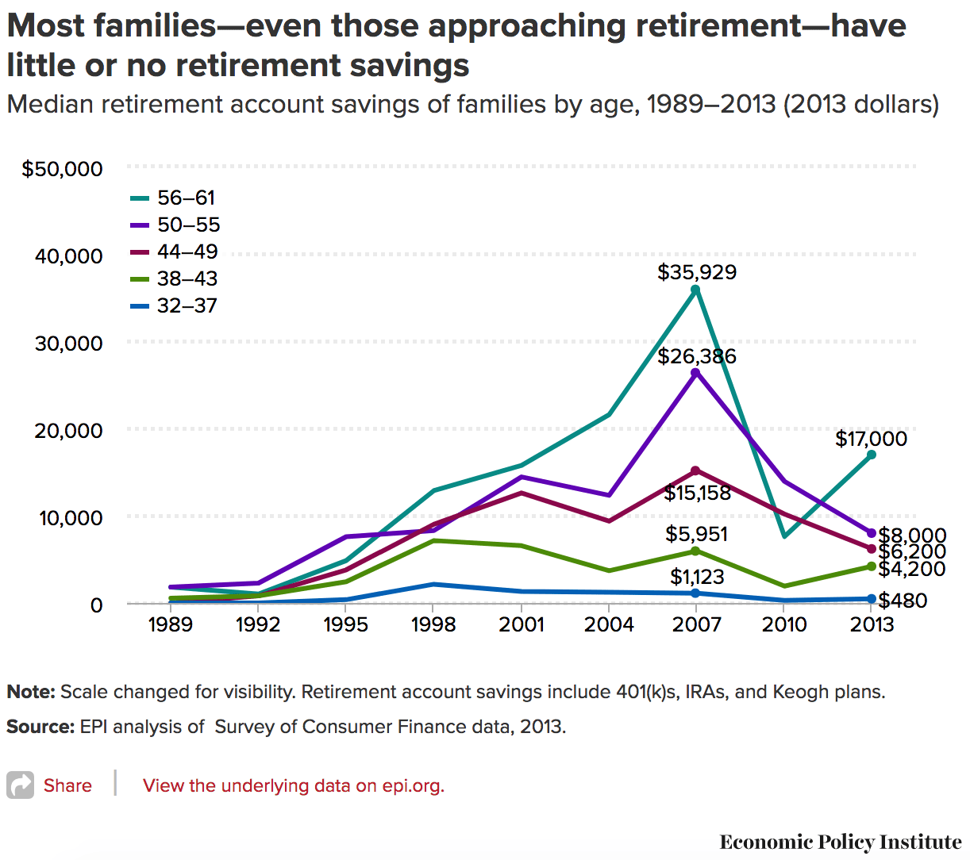
Ok, but why invest NOW?
Most importantly…People are demonstrably bad at saving for retirement

Slide 41
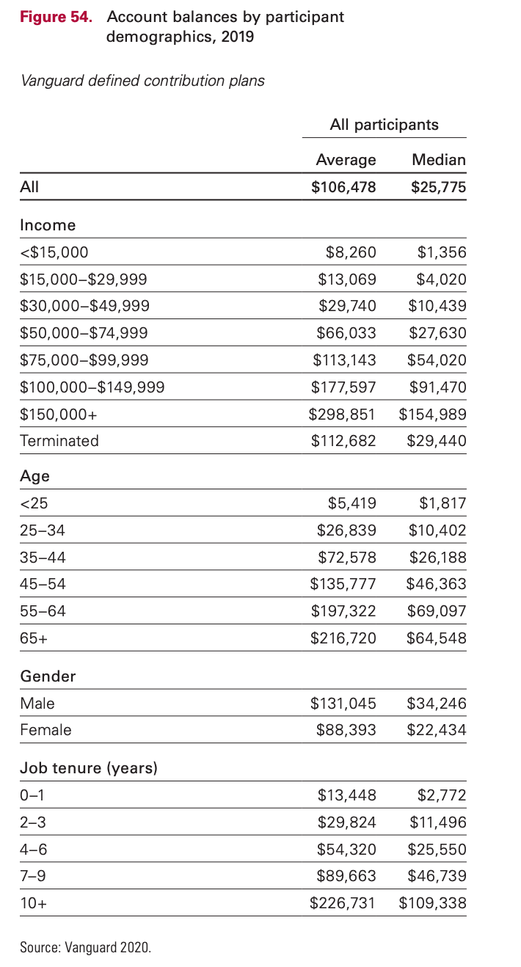
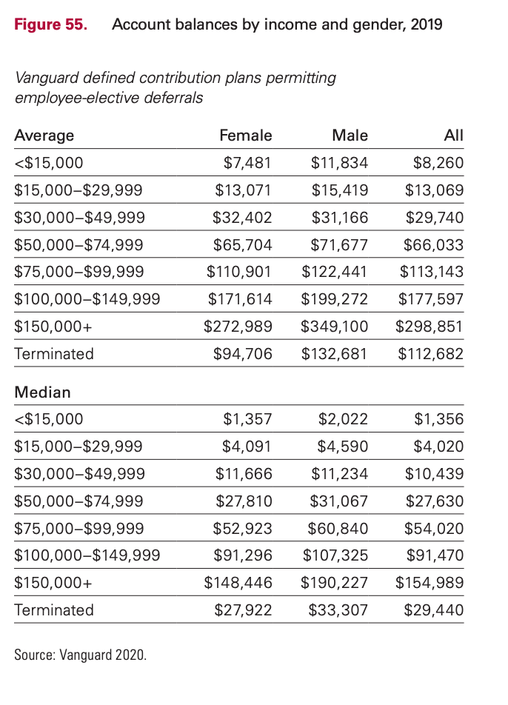
Everyone is bad at saving

Slide 42
Ok, but why invest NOW???

Slide 43
Ok, but why invest NOW???
$4,700

Slide 44
Ok, but why invest NOW???

Slide 45
Ok, but why invest NOW???
$72,000

Slide 46
Ok, but why invest NOW???
$1,000 invested at age 22 gives $4,700 at age 70 vs. $1,000 invested at age 25
A $1000 annual savings plan started at age 22 gives $72,000 vs. starting at age 25 (conservative 4% gives ~$19,000)
Even jumpstarting the annual savings plan with $4000 at age 25 lags the age 22 savings plan by ~$9,200 at age 70

Slide 47
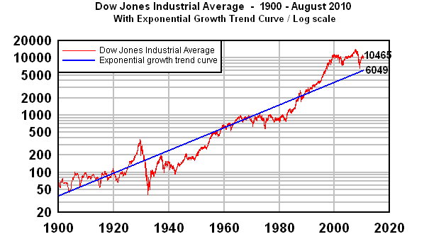
What does growth look like?
Take the Dow Jones Average over the past 110 years on a log scale

Slide 48
What does growth look like?
Source: Vanguard

Slide 49
Risk
Everything has risk; you can’t escape it
Stocks and high-yield bonds are risky due to enhanced volatility in the short-term
Savings accounts are risky due to inflation in the long-term

Slide 50
Risk
Blue line is Total Stock Market Index Fund, red line is average savings account

Slide 51
How to Invest: Overview
Accounts (i.e. How to invest)
Taxable account, IRA, Roth IRA, 401(k), 529 plan, etc.
Holdings (i.e. What to invest in)
Stocks, bonds, mutual funds, treasury notes, real estate, precious metals, etc.

Slide 52
How to Invest: Accounts
Can invest in whatever your heart desires
Can transfer money to your bank account and back at will
Responsible for paying tax on all earnings
Restrictions on annual investment amount
Withdrawal limitations
Investment options are more limited
Offers lucrative tax benefits when used properly
Taxable Account
Tax-advantaged Account

Slide 53
How to Invest: IRA vs. Roth IRA
$5500 contribution limit
Can deduct investment amount from taxable income
Grows tax-deferred, pay income tax on withdrawals after 59.5
Cannot withdrawal early*
Required distributions after 70.5
$5500 contribution limit
Withdraw contributions at any time
Earnings are tax-free after 59.5
Subject to income limits
No tax deduction
No required distributions
Traditional IRA
Roth IRA
*Penalties and some exceptions apply

Slide 54
How to Invest: 401k
Operates similar to trad. IRA
Company offers list of investment options
Contribute and deduct a portion of your income and the company often matches your contribution up to a certain %
ALWAYS CONTRIBUTE TO GET THE MATCH!
It’s free money

Slide 55
How to Invest: 529 plans
State-run program for funding post-secondary education (tax-free earnings)
Operates like a Roth IRA but with more restrictive investment options
Some states offer tax deduction
Smart to start saving early if you plan to help pay for a family member’s tuition
Remember the 6–8% growth rate of tuition?

Slide 56
How to Invest: Investment Options
There’s a lot of material here, but I’ll generalize
Stocks: Share of a company, volatile, high-risk, high-reward
Bonds: Loan to a company or govt, stable, low-risk*, low-reward
Mutual Funds: A “fund of funds”, invests in stocks and bonds, instant diversification

Slide 57
How to Invest: Rules of Thumb
DIVERSIFY!
Don’t have all your eggs in one basket
Sector- or market-wide mutual funds are a good way to diversify easily
Be aggressive (stocks) with long time horizons, conservative (bonds) with shorter horizons
Target Retirement funds are a good starting point (automatically shift toward bonds with time)

Slide 58
How to Invest: Rules of Thumb
Be wary of fees
“Active” management funds try to beat the market and therefore charge higher fees
“Passive” management funds seek to track the market indices and have lower fees
I sit firmly on one side of the active/passive fence, but feel free to research this on your own

Slide 59
Active vs. Passive Investing
A study by Barras, Scaillet and Wermers tracked 2,076 actively-managed U.S. domestic equity mutual funds between 1976 and 2006. They found that after fees, three-quarters of the funds exhibited zero “alpha,” a fund’s excess return over a benchmark index. And 24% of the funds were run by unskilled managers (who had negative alpha, or value subtraction). Only 0.6% showed any true skill at beating the market consistently.

Slide 60
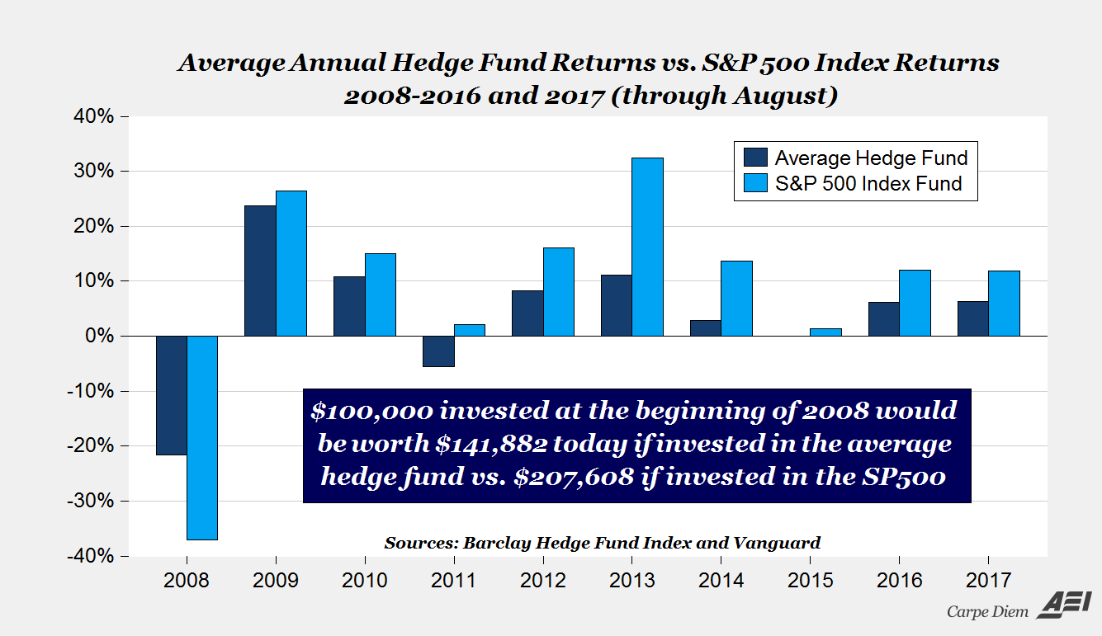
Active vs. Passive Investing
Warren Buffet bet that the S&P500 index would beat out any portfolio of hedge funds over a 10-year period. One manager took the bet…

Slide 61
Matt’s Investments
Vanguard
Investment management company, specializes in passive index-tracking mutual funds, low fees, no commissions on Vanguard products
Wealthfront
Robo-investor manages passive investments for fairly low fee; first 5k managed free (if referred)

Slide 62
Big-ticket purchases

Slide 63
Big-ticket purchases
You can pass up all the Starbucks lattes you want, but if you screw these up, it’s tough to financially recover

Slide 64
Big-ticket purchases: House
Will require mortgage unless you are a financial samurai or living in a box
Rules of thumb
Down payment at least 20% to avoid extra insurance charges
Don’t be sub-prime (if that word scares you, good); this is linked to your credit history
Median home price: ~$280k = $56k down plus closing costs (2–5%).
Aim for housing costs to be 28% or less of income (goes for rent too)

Slide 65
Big-ticket purchases: Cars
Cars, if you’re not buying outright, are usually financed (with dealer or bank)
Down payment
Interest rate (remember that credit score?)
Loan length
20%/4yr/10% rule of thumb
Down payment / loan term / percentage of income
Leasing is an option if you enjoy the security of a new car (fewer repairs) combined with the agonizing pain of renting

Slide 66
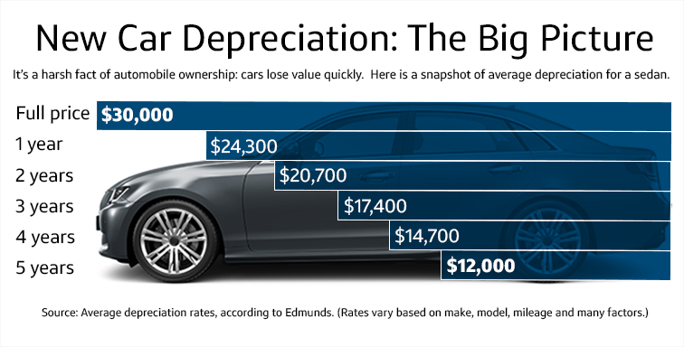
Big-ticket purchases: Cars
Personal Opinion
Think long and hard about buying a new car
CPO programs are worth considering
People are not good at calculating repair bills vs. depreciation/new car payments
Don’t take a 72-month loan on a car!!!

Slide 67
Big-ticket purchases: Saving Plan
The further away the purchase, the more risky you can be:
>5 years away: Investing is a viable option
3–5 years away: Use a more conservative plan with bonds and CDs
1–2 years away: CDs and Savings to protect down payment

Slide 68
Budgeting

Slide 69
Budgeting
Nearly essential for lower-income individuals and families
50/30/20 Rule of thumb
Necessary living expenses / discretionary / savings
Err on over-budgeting
Pay yourself first
Online tools (e.g. Mint, Personal Capital, etc.)

Slide 70
Spreadsheet time!

