Slide 1
An Analysis of High-Impact, Low-Predictive Skill Severe Weather Events in the Northeast U.S.
Mike Evans, Joe Villani
National Weather Service WFO BGM and ALY
Matthew Vaughan, Brian Tang, and Lance Bosart
Department of Atmospheric and Environmental Sciences
University at Albany/SUNY
Albany, NY 12222
Supported by the NOAA Collaborative Science,
Technology and Applied Research Program (NA13NWS4680004)
Notes:
Hi, my name is Mike Evans and I am the science operations officer at the NWS forecast office in Binghamton, NY. This is a presentation based on collaborative research between National Weather Service offices at Binghamton and Albany, and the State University of New York. The title of the project is “An analysis of high-impact, low predictive skill severe weather events in the northeast U.S. The lead researcher for this project was Matt Vaughn, who was a graduate student at SUNY Albany and this project was supported by a NOAA CSTAR grant. I’m going to be giving the first part of this presentation, Joe Villani, a general forecaster from Albany, is going to be doing the second part, then I’ll come back at the end to wrap it up.

Slide 2
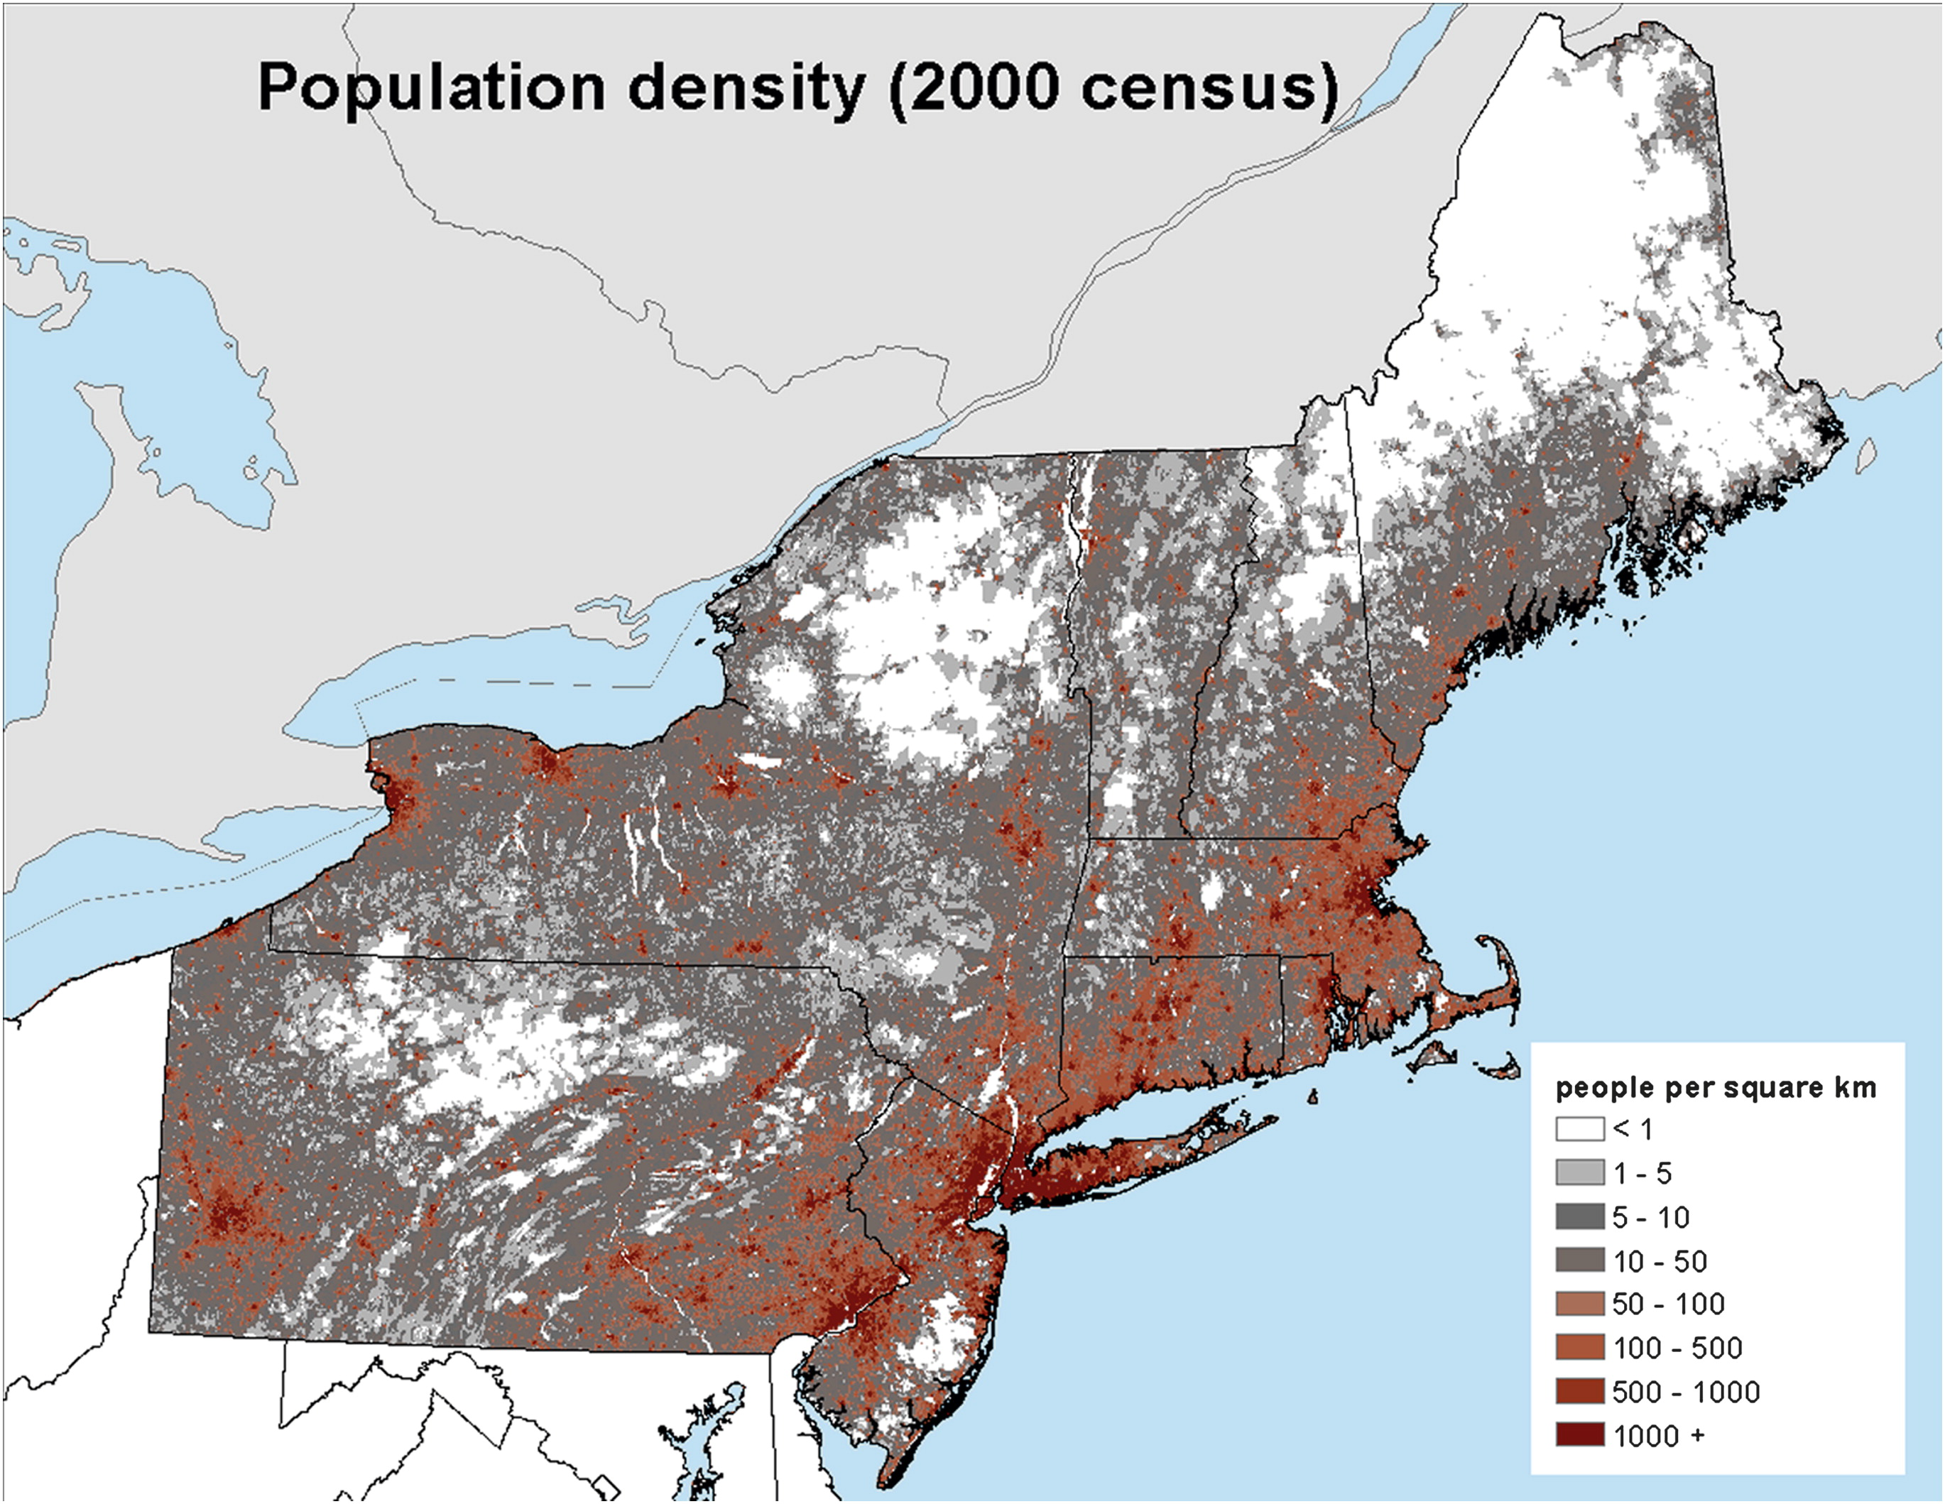
Motivation
Severe weather impacts on the Northeast
Densely populated, major metropolitan areas
Hurlbut and Cohen (2014)
Notes:
The northeast U.S. includes lots of highly populated metro areas, and lots of people in general, so the motivation for this work was to help to improve forecasts of severe weather in an area that includes lots of people.

Slide 3
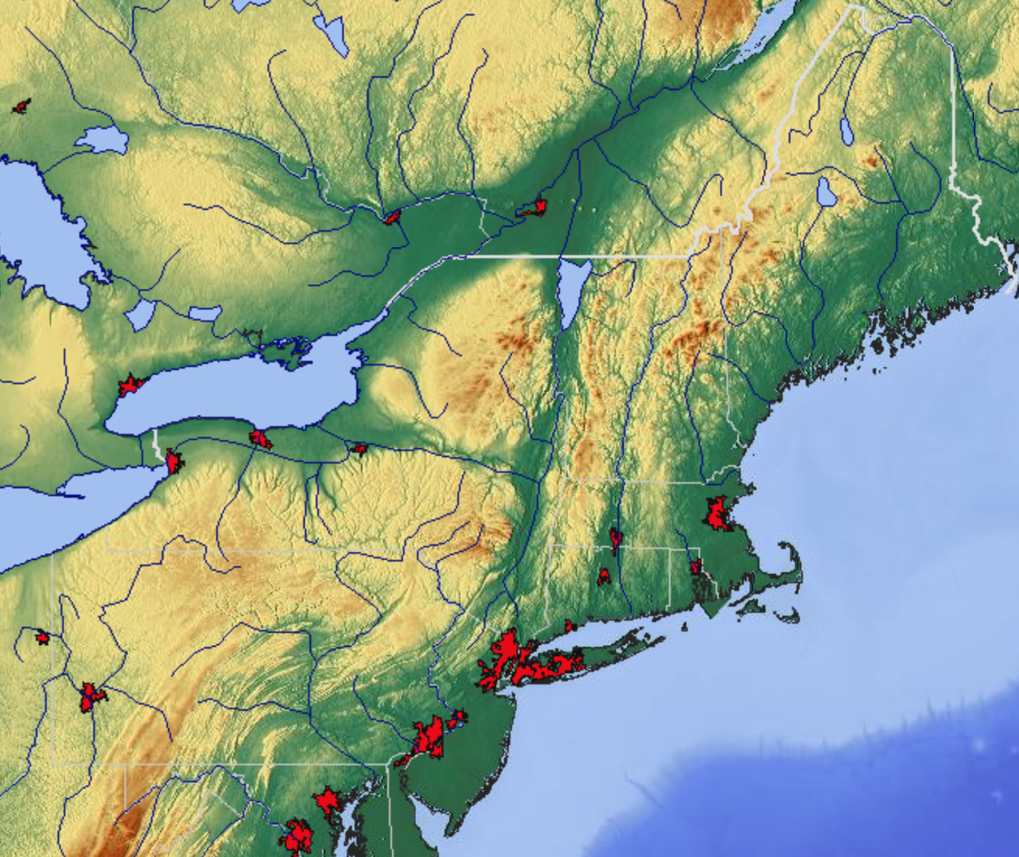
Motivation
The Northeast provides a challenging forecast environment
Complex terrain, lake-water boundaries
m
maps-for-free.com
Notes:
The complex terrain in the northeast includes low hills, mountains, valleys and large bodies of water that act in combination to influence the development and occurrence of severe weather. Therefore we are hypothesizing that there may be some unique aspects of the northeast U.S. that make convection difficult to forecast in certain flow patterns.

Slide 4
Performance metrics
POD – probability of detection = hits / events. (1 is perfect)
FAR – false alarm rate = false alarms / warnings. (0 is perfect)
FOH – frequency of hits = hits / warnings. (1 is perfect)
CSI (Threat score) – combines FAR and POD =
hits / (warnings + misses) (1 is perfect)
Notes:
Since this is going to be a presentation that examines the skillfulness of severe weather forecasts, we need to define some performance metrics up front. Probability of detection, or POD is a measure of how often significant events are identified. A perfect score is one. False alarm rate, or FAR is a measure of how often a significant event is expected, but fails to occur. Lower is better, and a perfect score is zero. Frequency of hits is similar to false alarm rate, except that a perfect score with no false alarms is one. Threat score, or CSI, is a combination of POD and FAR and gives a measure of overall skill, with 1 being a perfect score.

Slide 5
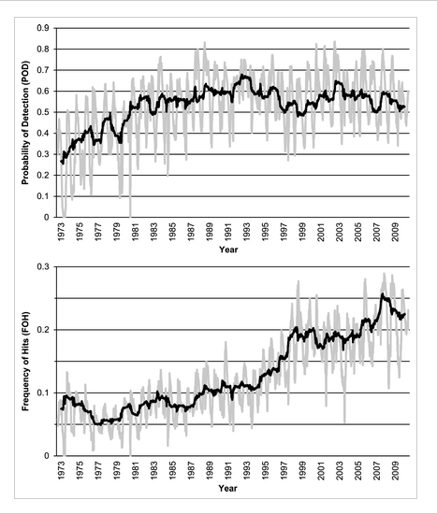
Background
Hitchens and Brooks (2012) verified SPC day-1 slight-risk convective outlooks over CONUS
Found increased forecast performance with time
Notes:
Some background - Hitchens and Brooks in 2012 did a study that measured the skill of SPC slight risk forecasts from the 1970s through the 2000s. They found that POD increased steadily from the 1970s through the 1980s, but plateaued in the 1990s and beyond. However they also found the that frequency of hits score steadily improved from the 1970s through the 2000s, leading to overall better forecast skill through the 2000s.

Slide 6
Research Goals
Evaluate slight-risk forecast performance over the Northeast
Build database of events with poor forecast skill
Analyze environments conducive to poor forecast skill
Notes:
The research goals of this study were first to evaluate the slight risk forecast skill of SPC for just the northeast U.S. Next, a data base of events with poor forecast skill was developed, then the main goal of the study could be accomplished, which was to determine environments that are conducive to poor forecast skill, in order to give forecasters and idea of event that they need to watch out for.

Slide 7
Research Goals
Evaluate slight-risk outlook performance over the Northeast
Build database of events with poor forecast skill
Evaluate environments conducive to poor forecast skill
Notes:
So first, we’ll start with the evaluation of the slight-risk outlook performance over the northeast.

Slide 8
Methodology: Game Plan
Establish Northeast domain to evaluate forecast skill
Plot slight-risk convective outlook contours over the domain
Evaluate outlooks with valid storm reports and compare to CONUS verification
Similar verification methodology to Hitchens and Brooks (2012)
Mod and high contours within slight contours were included (i.e. everywhere inside the slight was treated the same)
Notes:
The methodology was first to establish a domain over the northeast U.S. Then to plot slight risk contours and storm reports over the domain to see how well they matched up. The overall methodology was similar to Hitchens and Brooks, so we should be able to compare the results. One thing to keep in mind was that moderate and high risks were considered to be no different than slight risks for this study, so really we were comparing the issuance of any kind of risk to the subsequent occurrence of severe weather.

Slide 9
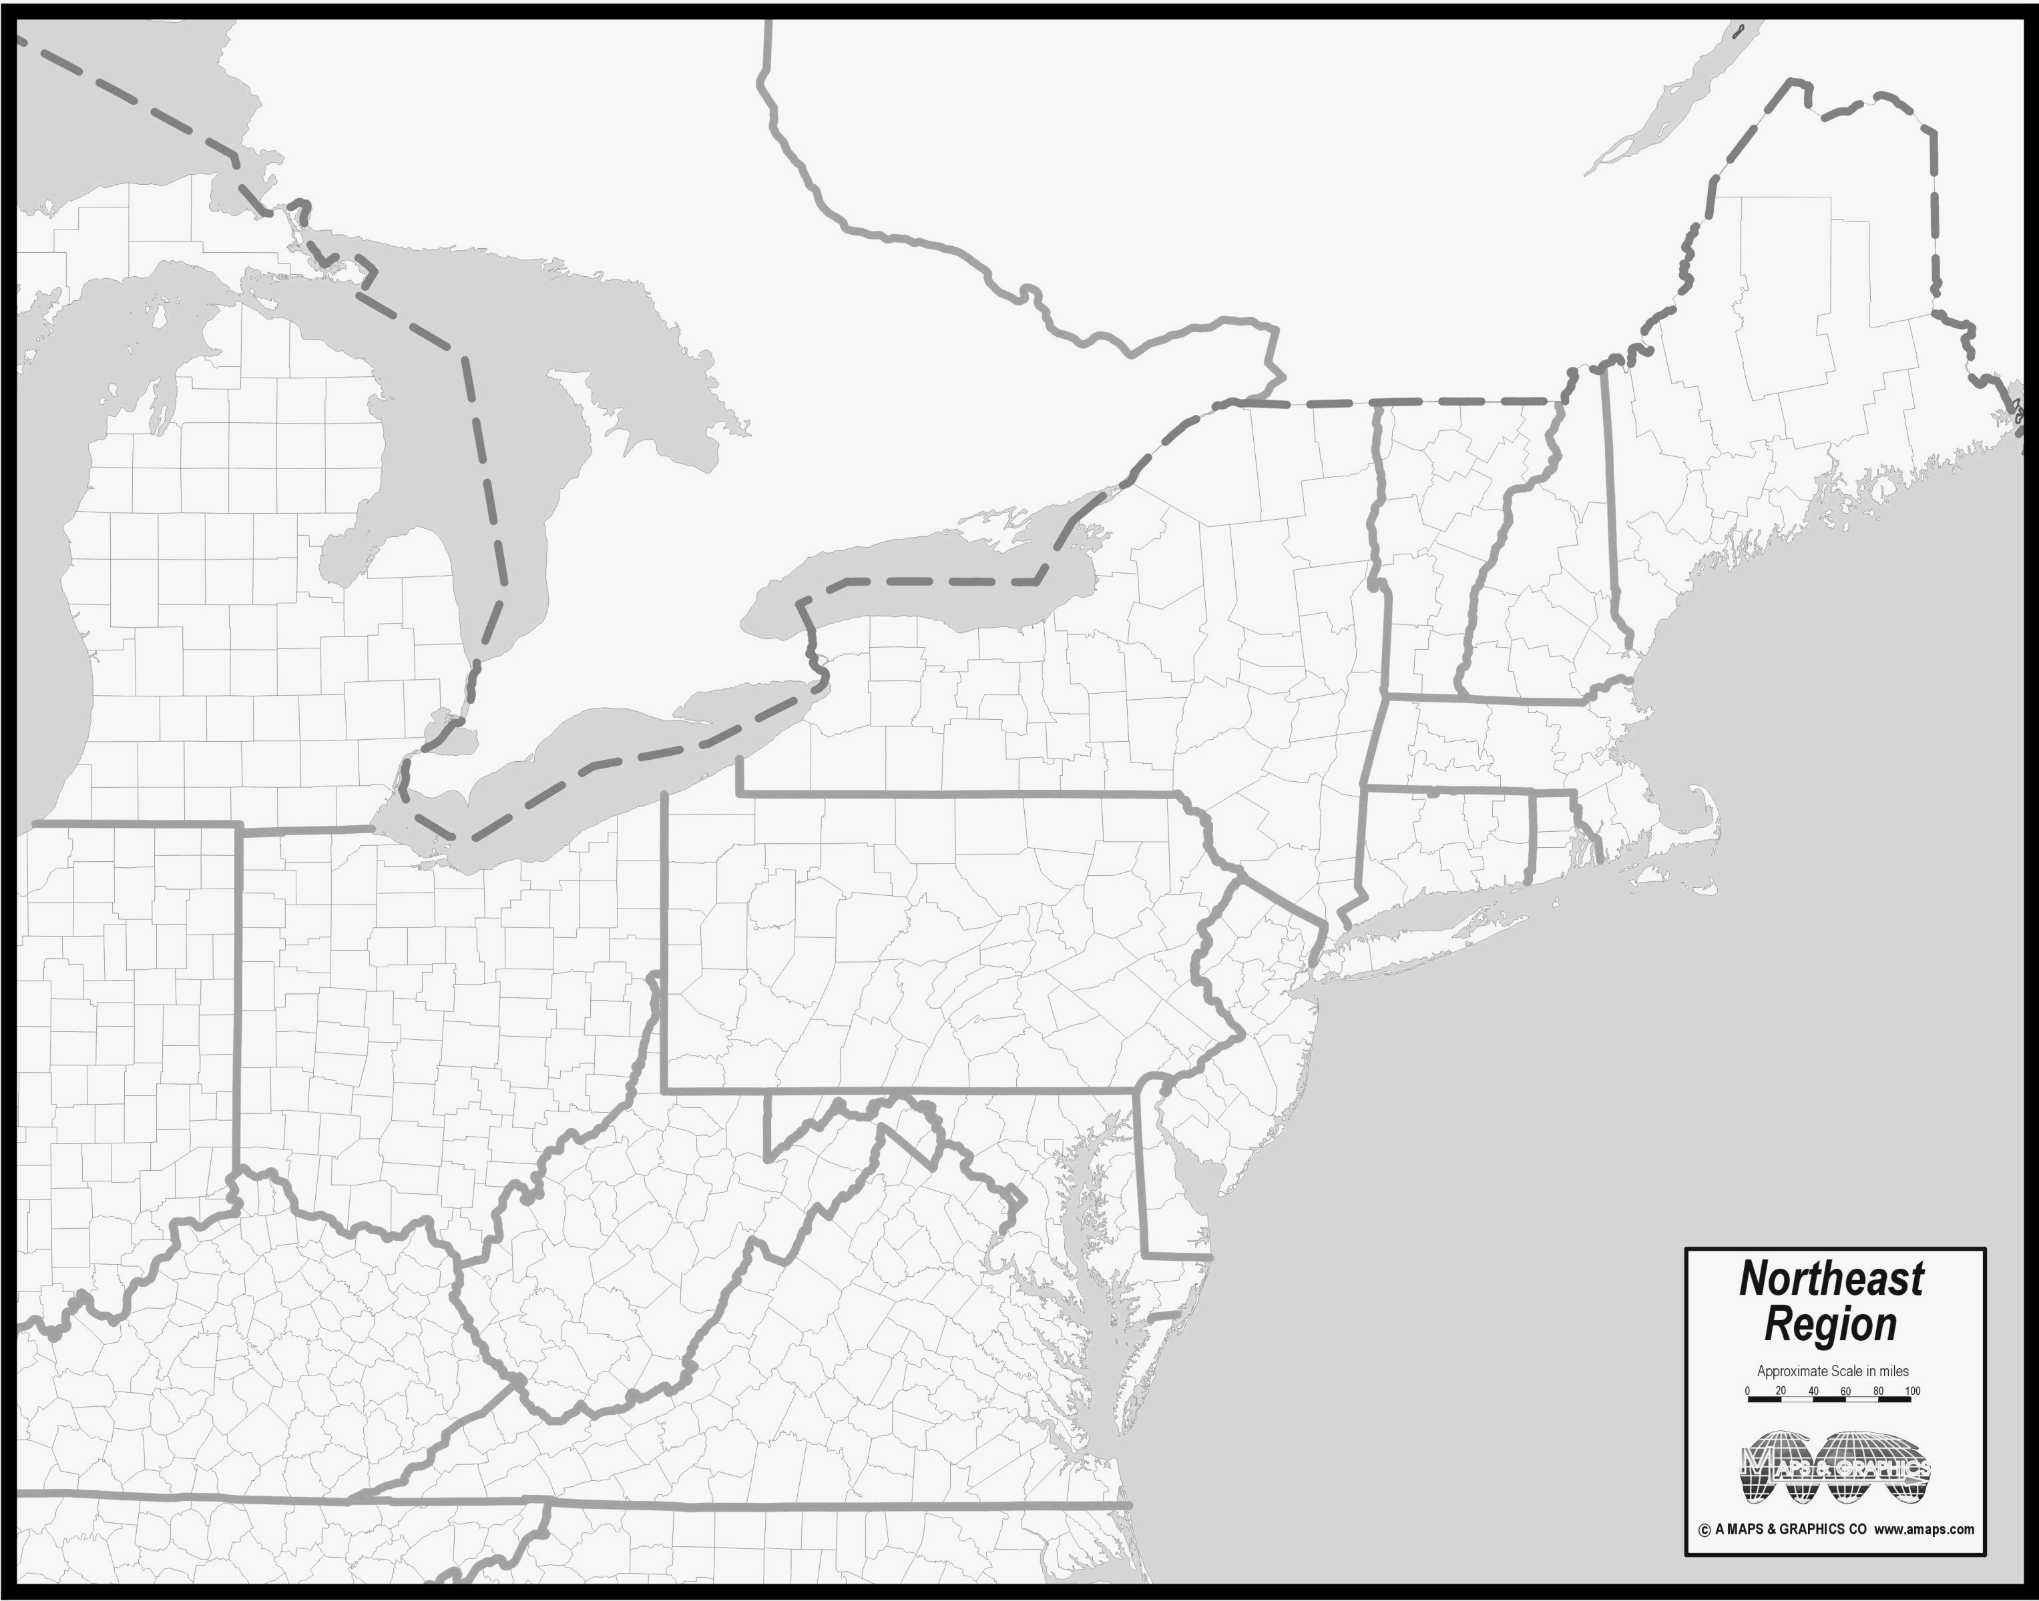
Northeast Domain
Courtesy of amaps.com
Notes:
Here is the domain that we defined for the northeast U.S. The stars are the location of NWS offices that participated in the study; Albany, Binghamton and Pittsburgh.

Slide 10
Slight risk evaluation method example
Area of Influence
40 km
40 km
Severe Report
Risk area
Notes:
Convective events were examined from 1980 through 2013. For each event, a 40 km grid was established, then the slight risk area and severe reports were plotted on the grid. For the study, slight risk areas issued at 06z were compared to severe reports that occurred during the following 12z to 12z time period. In this example, the slight risk area is the yellow shape, and the severe weather occurred at the blue dot. For each severe report, an area of influence was defined with a 40 km radius centered over the severe report. Then we could compare whether the risk area overlapped with the severe report area at each grid point.

Slide 11
Slight risk evaluation method example
40 km
Miss ☹
Correct Hit ☺
Severe Report
Risk Area
False Alarm 😐
Notes:
So in this example, there was a severe report at the blue dot, located just north of the slight risk area. However the area of influence for the severe report extended into the northern part of the slight risk area. The two red points were missed events, because the slight risk area did not extend into that part of the severe report area of influence. The two greed points are hits, because the slight risk area overlapped with the severe report area of influence at those points. The two yellow dots are false alarms, because no severe report area of influence was located within that part of the slight risk area.

Slide 12
Slight-risk skill Scores
Notes:
So after doing this for all of the convective events that occurred from 1980 to 2013 in the northeast U.S., we can develop some findings for skill.

Slide 13
Northeast and CONUS: TS
Median is plotted with the 25th and 75th percentiles in the whiskers.
Notes:
This slide shows the threat score, or overall skill score for severe risk areas nationwide from the Hitchens and Brooks study, as the blue line. The skill score for the northeast U.S. from this latest study is shown by the red line. Note that both skill scores have been increasing steadily over the past few decades. Note also that the threat scores for the northeast are persistently a little better than for the entire country.

Slide 14
Monthly threat scores for the Northeast
Notes:
Threat scores for the northeast U.S. by month are shown on this slide. The main finding from this slide is that the scores look to be a little better during the spring and fall months than during the middle of the summer. We’ll show some results later on that may explain why this is happening.

Slide 15
Research Goals
Evaluate slight-risk forecast performance over the Northeast
Build database of events with poor forecast skill
Evaluate environments conducive to poor forecast skill
Notes:
Now that we have looked at some basic skill scores for the northeast, step two in the study was to build a database of events with poor forecast skill.

Slide 16
Database Criteria
For inclusion in the 1980–2013 database, an event must meet at least 1 of 2 criteria:
Have a slight risk contour within the NE domain
Have “high impact” based on the area impacted by severe weather
Notes:
For inclusion into this data base, an event had to meet at least 1 of 2 criteria. A slight risk contour had to be located somewhere within the northeast U.S. domain. Also, the event had to have a high impact, based on the area impacted by severe weather. Coming up with a threshold for impacted area was not quite as easy as it may seem…

Slide 17
Northeast Severe Report Trend
Median is plotted with the 25th and 75th percentiles in the whiskers.
Notes:
The reason can be seen on this slide. As the NWS has increased its ability to identify severe weather reports over the years, the number of grid points affected by severe weather has increased. So an event that affected 20 grid points in 1980 was a big deal, but an event that affected 20 grids in 2010 was nothing much.

Slide 18
Northeast Severe Report Trend
55th percentile linear regression
Notes:
To account for this trend, Matt defined a 55th percentile linear regression line for each year. So for each year events that fell above the line were in the top 45 percent of events that year.

Slide 19
Northeast Severe Report Trend
High impact!
55th percentile linear regression
Notes:
Then high impact events were events that fell above the line.

Slide 20
High-Impact Database: Quick Stats
Event days = 1503
Slight-risk days = 1300
High-impact events without slight-risk = 203
Slight-risk days without high impact = 678
Notes:
After this was done, 1503 days were identified. 1300 of these days had slight risks, but 203 had no slight risk. Also, the number of slight risk days that were not “high impact” was 678.

Slide 21
Type 1 (Low POD) Example
Reports captured = 0 Reports missed = 200
POD = 0 FAR = N/A TS = 0
High impact
Lowest 25th percentile POD score
“Over-performing”
Notes:
Based on these findings, bad forecasts were partitioned into two categories. Type one were days with lots of severe weather reports but no slight risk. These would be days with low POD. We also termed these as over-performing days, in that the atmosphere produced more severe weather on these days than what was initially expected.

Slide 22
Type 2 (High FAR) Example
Reports captured = 2 Reports missed = 0
POD = 1 FAR = .986 TS = .014
Highest 25th percentile false alarm area
Lowest 25th percentile severe report area
“under-performing”
Notes:
Type 2 events were days with large slight risk areas over the northeast, but few to no reports. These would be days with high false alarm rates. We also termed these as “under-performing” in that the atmosphere appeared to be primed for severe weather, but was unable to produce severe reports.

Slide 23
Collect events with good forecast skill for comparison
Notes:
As a comparison with these bad forecasts, we also needed to make a collection of days with good forecast skill.

Slide 24
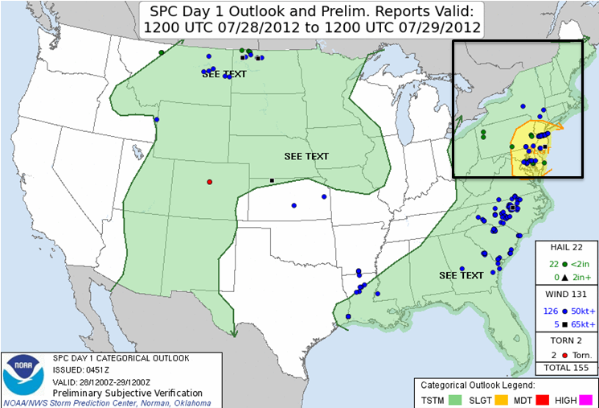
Good Event Example
Reports captured = 45 Reports missed = 9
POD = 58.6 FAR = 0.495 TS = 0.372
High impacts
Highest 25th percentile threat score
Notes:
So we defined good events as events with high impact and high threat score. This is an example, lots of severe reports over the northeast, with most of them contained within a slight risk area.

Slide 25
Summary: We have defined 4 types of events
High impact – large number of grid points affected.
Good forecast – large number of reports, well-forecast.
Bad forecast type 1 – High impact, lots of misses (over-perform).
Bad forecast type 2 – False alarm (under-perform).
Notes:
So to summarize, we now have 4 different types of event. A high impact event is an event with severe weather covering a large area, or lots of grid points. A good forecast is an event with a large number of reports and well-forecast. A type 1 bad forecast is an event with lots of severe weather that was unexpected. And a type 2 bad forecast is an event with lots of severe weather expected, but little to none occurring.

Slide 26
Annual Frequency
Notes:
Looking at how these types of forecasts have trended over the years, we can see from this graph that good forecasts have improved over the years. In fact there were no good forecasts prior to 1987; this was not because we were unable to anticipate severe weather at all in the 1980s, but more due to the fact that slight risk areas were drawn very broadly in the 1980s, and the number of reports was low, so large false alarm rates tended occur. By contrast, today’s risk areas are much more focused, and typically contain many more reports with large areas affected by severe weather.

Slide 27
Monthly Frequency
May: many type 2 events compared to high impact events (under-performing / CAPE fails?)
August: few under-performers, also percentage of good forecasts is lower than in May, despite more high impact events.
Notes:
The data plotted by month is shown on this slide. There is a lot of data on this slide and a lot that can be said about it. For one thing, recall from earlier that we found that spring and fall tend to score better than mid-summer; this data can help to explain why that was true. For example, comparing May to August, you can see more type 1 red bar cases in August than in May, indicating that for some reason severe weather more often sneeks up and surprises us in August. By contrast, May seems to be more prone to false alarms, as the green bar for May is much higher than in August. One possibility for the relatively large number of false alarms in May is what I have called “CAPE-fail” cases, where severe weather is expected but the instability is just not large enough for severe weather; this may be due to stubborn marine layers that can hang around longer than expected during the spring.

Slide 28
Research Goals
Evaluate slight-risk forecast performance over the Northeast
Build database of events with poor forecast skill
Evaluate environments conducive to poor forecast skill
Notes:
Finally, we are going to go into identifying environments that are conducive to poor forecast skill. For this I’m going to turn it over to Joe Villani from Albany.

Slide 29
PLACEHOLDER SLIDE
Joe starts here

Slide 30
Event-Centered Composites
Notes:
Thanks, Mike. We are now going to look at event-centered composites, which are based on 500 mb flow direction.

Slide 31
Event Climatology
Notes:
This graph shows a breakdown of all events for each of the four main categories (High impact, Type 1, Type 2, and Good forecast) stratified by 500 mb flow direction. You can see that Northerly and Southerly flow events made up a very small percentage, but there were enough NW, W, and SW flow events to draw some conclusions. The main point to emphasize is that for NW flow events, there were more Type 1 events relative to other categories than the W and SW events, which implies the NW flow regime had the lowest predictability. By frequency alone, W flow events had the highest occurrence percentage in general. (Good summary here. You’re right that one of the important takeaways here is that while Type 1 events occur most frequently under W-ly and SW-ly flow [not surprising since those flow directions represent the bulk of the severe weather events in the Northeast] the percentage of NW-ly flow events that are Type 1 is higher than the other categories. If anyone asks, the graph was made by taking stratifying each event class (e.g. Type 1, Type 2, etc.) into each flow regime bin and dividing by the total number of occurrences of each event class [i.e. Of the 224 Type 1 events, ~112 occurred under W-ly flow; therefore the red bar is at 50% in the W-ly bin]. This was repeated for each event class.)

Slide 32
Flow Regime Threat Scores
Notes:
Next is a plot of threat scores based on the different 500 mb flow regimes. Despite having the lowest threat score, it is important to remember N flow events had a very small sample size (N=17). So, the main point to take away here is that NW flow events really had the lowest threat score among flow regimes with a tangible sample size. This illustrates another way the NW flow direction proved to have the lowest predictability. (Surprising thing here is that even with the very low sample size, the N-ly flow events still had statistically significantly lower threat scores than the most common flow regimes (i.e. W-ly and SW-ly). We focus analysis on NW-ly flow events since, even though the results don’t reach statistical significance, there are far more events that have a high-impact as you mention.

Slide 33
Severe weather Parameter analysis (MUCAPE & Deep-layer shear)
Notes:
Now we will look at the dataset from a different perspective, using the severe weather parameters MUCAPE and deep-layer shear.

Slide 34
MUCAPE-Shear Phase Space
Low Shear, High CAPE (LSHC)
High Shear, High CAPE (HSHC)
High Shear, Low CAPE (HSLC)
Low Shear, Low CAPE (LSLC)
Notes:
This graph shows a breakdown of four types of shear/stability regimes (Low Shear, High CAPE on the top left), (High Shear, High CAPE on the top right), (Low Shear, Low CAPE on the bottom left), and High Shear, Low CAPE on the bottom right). The horizontal and vertical black lines represent median MUCAPE of (662 J/Kg) and 1000-500 mb shear of (31 kt). (If queried, the black lines are derived from the CFSR 1800z data over the point of maximum report density for all high-impact events in the database)

Slide 35
MUCAPE-Shear Phase Space
Notes:
Here is the same graph as the previous slide, but shows the phase space plotted for Type 1 and Good Forecast events. The Type 1 events are represented by red squares, and the Good Forecast events are represented by purple diamonds. (If asked, the large square and diamond represent the average for each group)

Slide 36
MUCAPE-Shear Phase Space
Notes:
This plot shows comparisons of Type 1 events and Good Forecast events for each of the four CAPE/Shear categories. The plot shows that there are more Type 1 events than Good Forecast events for (Low Shear, Low CAPE) and (Low Shear, High CAPE) regimes. In other words, the LSLC and LSHC regimes were less predictable than the HSLC and HSHC regimes. So the main point is that the shear is the main discriminator of the two parameters. (good summary here. If there’s any question about sample size issues, recall that Type 1 and Good events both use a 25th percentile threshold of the entire dataset (lowest 25th POD for Type 1, highest 25th Threat Score for Good) so their sample sizes are comparable)

Slide 37
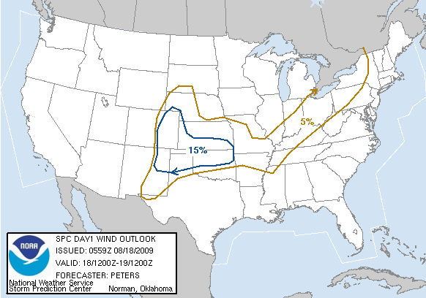
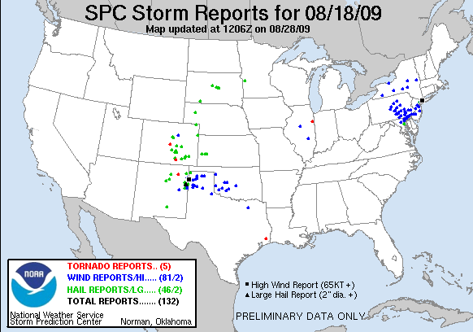
18 August 2009 Severe Wind Event (LSHC)
Type 1 under-predicted storm
SPC issued 5% wind outlook for Northeast
Notes:
Now we are going to take a look at a case study of a Type 1 event from August 18th, 2009, which was under-predicted. This was considered a LSHC regime. The map on the left shows that SPC had a general “SEE TEXT” or what would now be considered a “Marginal” outlook, with a 5% wind probability contour for parts of the Northeast. The map on the right indicated there were several severe weather reports in the Northeast on this day and most were due to wind damage. (Yes. May want to mention the production of a 77 knot SIG wind report in Nassau, NY too)

Slide 38
Synoptic Overview
250 hPa
1600 UTC 18 August 2009
250-hPa geopotential height (dam, black contours), 250-hPa winds (knots, shaded and barbed), divergence (× 10⁻⁵ s⁻¹, red contours)
Notes:
Now we are going to take a brief look at the synoptic overview for this event staring with 250 mb heights, wind barbs and isotachs, as well as divergence at 1600 UTC. The area of focus is outlined by the dashed green circle. You can see there is not much an influence of the upper level jet streak, which is displaced well north and west of the region across the upper Great Lakes. The upper level trough is also displaced fairly far upstream as well and likely not much of a factor with regards to convective development. (Good summary. If asked, these are RUC analyses. 1600 UTC is estimated time of convective initiation based on radar. May want to mention that CI took place within the high terrain of the Appalachians and along the lake boundaries so that the summary slide that mentions this isn’t unprecedented)

Slide 39
Synoptic Overview
500 hPa
1600 UTC 18 August 2009
500-hPa geopotential height (dam, black contours), 500-hPa winds (knots, barbed), 500-hPa relative vorticity (×10⁻⁵ s⁻¹, shaded)
Notes:
Next taking a look at 500 mb height contours, wind barbs and relative vorticity, you can see there is a very subtle trough over the area of focus with a relative vorticity maximum actually displaced downstream at 1600 UTC. Also note the lack of any appreciable wind speeds at 500 mb. So based on investigating the mid and upper levels, one would not expect much synoptic scale forcing on this day. (Good summary here.)

Slide 40
Synoptic Overview
SBCAPE & shear
1600 UTC 18 August 2009
700–500-hPa lapse rate (K/km, black contours), 1000–500-hPa shear (knots, barbed), surface-based CAPE(J/kg, shaded)
Notes:
Now we will take a look at the SBCAPE, 1000–500 mb shear and 700–500 mb lapse rates. Again at 1600 UTC we can see moderate to high values of SBCAPE around 1000 J/Kg to as much as 3000 J/Kg across the area of focus. Note the relatively weak shear vectors though, indicating only 5 to 15 kt of deep layer shear. This shows why this event was classified as having a LSHC environment. (Good summary here)

Slide 41
Morning Sounding: Convective Initiation
MLCAPE: 1948 J kg⁻¹
MLCIN: -167 J kg⁻¹
6-km shear: 12 kt
3-km shear: ~28 kt
DCAPE: 510 J kg⁻¹
Notes:
Next we will take a look at an observed sounding close to the area of convective initiation. This was the 12 UTC sounding from Pittsburgh. The main things to note are the moderate to high level of MLCAPE close to 2000 J/Kg, the relatively weak and mainly unidirectional 0-6 km shear of 12 kt and the DCAPE of 510 J/Kg. (Yes. May want to preface the DCAPE value by pointing out the relatively moist column below 500-hPa. In addition, the weak veering and WAA throughout the column matches the conceptual model fairly well here)

Slide 42
Morning Sounding: Severe Report Location
MLCAPE: 2192 J kg⁻¹
MLCIN: -233 J kg⁻¹
6-km shear: 12 kt
DCAPE: 1294 J kg⁻¹
Notes:
Next we will compare the Pittsburgh sounding to a sounding location closer to where most of the severe weather took place. This sounding plot of from Wallops Island at 12 UTC. Note the proximity to several severe weather reports in the upper right panel of the screen. MLCAPE values are very similar to the Pittsburgh sounding, as well as the weak 0–6 km shear. However, there is a big difference in the DCAPE, with almost 1300 J/Kg of DCAPE computed from this Wallops Island sounding compared to around 500 J/Kg at Pittsburgh. (Yes. Again, weak veering is seen in the wind profile, albeit a bit of backing near 500 hPa. This sounding is also representative of the Dulles IAD sounding [other arrow in the upper-right corner]

Slide 43
WAL Sounding Climatology
DCAPE: 1294 J/kg
Notes:
This graph from the Storm Prediction Center shows the climatology of DCAPE for Wallops Island. The nearly 1300 J/Kg of DCAPE based on the 1200 UTC sounding was in the extreme 99th percentile of based on the climo for mid August. So it appears that DCAPE could be an important discriminator for this event. (Yes. Definitely like the use of the black arrow relative to the odd green lightning bolt I had)

Slide 44
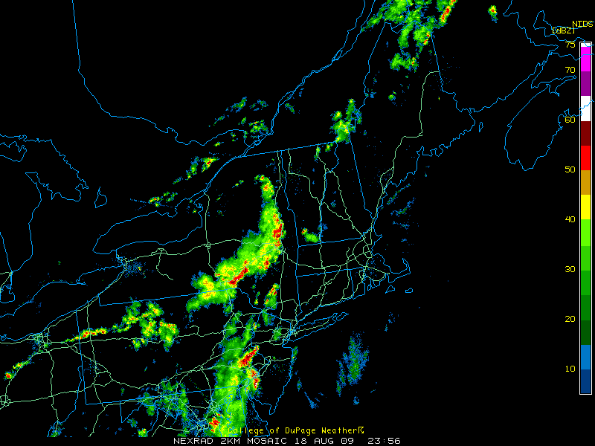
Radar 0000 UTC 19 Aug
Notes:
Here is a snapshot of a radar reflectivity mosaic from 2356 UTC on August 18th. There are multiple clusters of strong to severe thunderstorms…one across southeast PA about to enter NJ, and another across upstate NY.

Slide 45
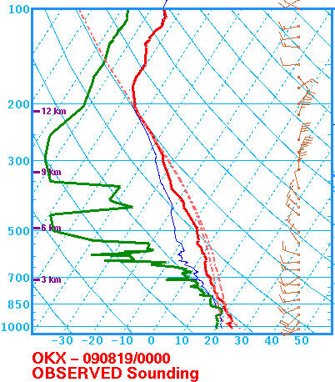
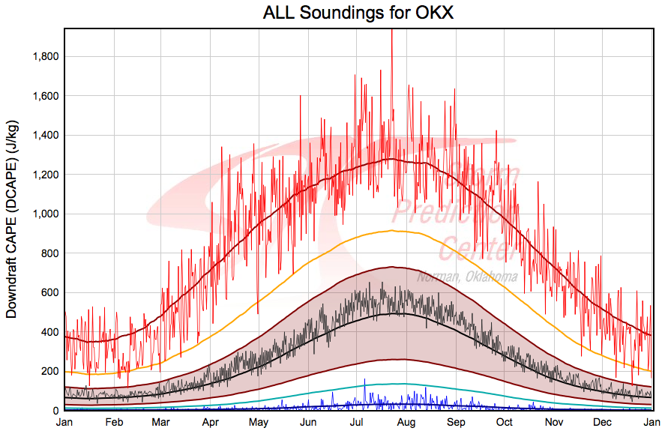
OKX Sounding - 0000 UTC 19 Aug
MLCAPE: 1945 J kg⁻¹
MLCIN: -178 J kg⁻¹
6-km shear: 16 kt
DCAPE: 1199 J kg⁻¹
77 kt wind gust at 0233 UTC
Notes:
Now we will look at another sounding location and time close to a significant severe wind report near Upton, NY on Long Island. This is the 0000 UTC August 19th sounding and again, notice the similar value of MLCAPE along with 0-6 km shear less than 20 kt. Also notice the DCAPE here at OKX is around 1200 J/Kg, which is close to the 99th percentile of climo for mid August. This observation shows further evidence that DCAPE was very crucial in the development of severe thunderstorms that produced damaging winds, as a 77 kt wind gust was observed at 0233 UTC nearby. (Good mention of the SIG wind report here. May want to move the arrow up to that it points to the 1200 J/kg line on the climo plot. It looks like it’s pointing at 1100 J/kg.

Slide 46
Case Summary
Low Shear High CAPE (LSHC) event.
Weak synoptically forced environment
Orography and lake boundaries critical in convective initiation
Convective initiation environment differed from environment to the east where most severe reports occurred.
Type 1 LSHC cases often feature storms propagating into environments with higher PBL heights and greater DCAPE
In the absence of strong low-to-mid level flow and large vertical wind shear, large DCAPE and high PBL heights likely contribute to the severe wind threat
Notes:
So wrapping up the case summary for this Type 1 event…(read summary slide) (Since I used an aircraft sounding in my thesis presentation to highlight the high PBL heights that isn’t used here, you may want to nix the “higher PBL heights” part of this or just mention that higher PBL heights were observed prior to storm passage using aircraft data.)

Slide 47
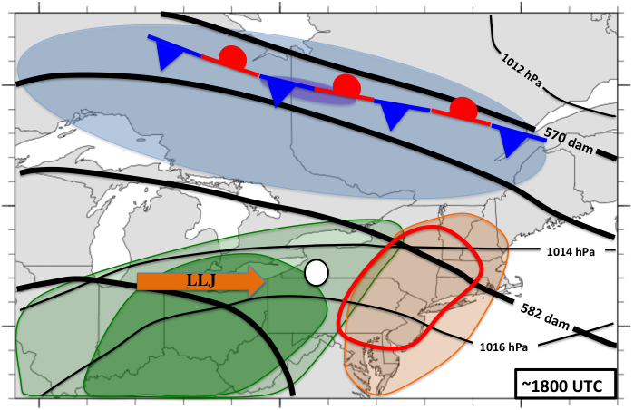
Northwesterly Flow Low-POD Event Conceptual Model
Notes:
Finally, a conceptual model was created for a Type 1 NW flow event. Time-wise, this model is at approximately 1800 UTC, with a convective initiation point near the SW NY/NW PA border. There typically is a 250 mb jet positioned poleward of the region in southern Canada, along with a stationary surface boundary. The low level jet direction is westerly and positioned just upstream of the area of convective initiation. At 500 mb, the area of enhanced severe weather threat is downstream of a mean ridge axis in the NW flow. High PWATs are impinging on the area of convective initiation, while a large magnitude of DCAPE and higher LCL heights are positioned in close proximity to the area of enhanced severe weather threat. (Note that the term “jet” is used pretty loosely here as a means of fluxing in moisture to the convective initiation area and does not extend appreciably past the area of convective initiation. If asked, this conceptual model is constructed by using CFSR composite data from all Type 1 NW-ly flow events as well as subjective compositing of individual cases.)

Slide 48
PLACEHOLDER SLIDE
Joe ends here

Slide 49
Local study outline
Examine day 1 NWS BGM forecasts issued on the midnight shift from 2011-August 2014.
Use the hazardous weather outlook product
Define a “warning” as any time the product indicates “severe”, “large hail” or “damaging wind” during the next 24 hours.
Define an “event” as a day when at least 5 severe weather reports were received.
Notes:
Ok, finally to wrap things up Joe and I did some work to test whether the findings from Matt’s work translated to our local cwa’s in Binghamton and Albany. We used a different methodology, but the idea was the same, testing expectations for severe weather vs. actual occurrences of severe weather. Instead of using SPC’s risk areas, we used our local hazardous weather outlooks issued on the midnight shift, and compared to severe weather later that day or evening. We defined a warning as any time an HWO contained the words severe, large hail or damaging wind. An event was defined as any day with at least 5 severe weather reports in our cwa’s.

Slide 50
POD, FAR and CSI
0.64
0.53
0.38
POD
FAR
CSI
Notes:
This slide shows the POD, FAR and CSI for HWO-based local study at Binghamton. The POD from the national study was around 0.60 in the late 2000s, so this study matches very well with that. The CSI was around 0.25 for the national study, so this study came up with a higher threat score for the local forecasts at Binghamton, based on a lower FAR. We need to keep in mind though that the methodologies of this study were different enough from the Hitchens and Brooks study so that we probably can’t make direct comparisons, still its interesting that the numbers are not all that different, especially regarding the POD.

Slide 51
POD and FAR by month
Events: 5 10 13 17 7 6 1 59
Warnings: 7 14 15 24 7 8 1 76
Notes:
Scores by month from the Binghamton county warning area seemed to indicate better performance in the spring and fall compared to mid-summer, which matched findings from the regional study. For example, the POD was higher than the FAR in April, May, September, and October. The POD was also higher than the FAR in July, but the FAR was higher than the POD in June and much higher than the POD in August. We’ve really had trouble in August!

Slide 52
Summary – Binghamton CWA
MLCAPE
Good forecasts
Under-achieved (high FAR)
Under-performed (high FAR)
Over-performed (low POD)
0-3 km shear
Notes:
The relationship between forecast skill, CAPE and shear can be seen on this slide for the Binghamton cwa. The high shear, high CAPE events were forecast best, while many misses occurred in the weak shear area on the left side of the diagram. There were also a few misses in the low CAPE high shear part of the diagram in the lower right.

Slide 53
Results from Albany
MLCAPE
Good forecasts
Under-performed (high FAR)
Over-performed (low POD)
0-3 km shear
Notes:
Results from the same study, except for the Albany cwa, are shown on this slide. There are many similarities with the Binghamton cwa, especially note that the high CAPE and high shear events are forecast best. Lower shear events are not forecast as well, although the area with lots of misses looks to be skewed toward slightly higher shear in the Albany cwa. Also, the few low CAPE high shear events in the data set appeared to be forecast somewhat better in Albany’s cwa as opposed to Binghamton’s.

Slide 54
General Summary
Low-predictive skill climatology results:
Northeast has better threat scores than CONUS
Peak in JJA for low-POD events, little yearly variation
Most common under westerly, southwesterly, and northwesterly 500-hPa flow regimes
High-FAR events not as common in recent years
Composite results:
Deep-layer shear discriminates between high-predictability and low-predictability events within the dataset
Northerly, northwesterly, and southerly flow regimes have lowest skill
Synoptic setup similar between good and low-POD cases but key features (trough, baroclinicity, etc.) stronger in good cases
Case study results:
Low-POD, low-shear events often propagate into higher-PBL, higher-DCAPE environments
High shear, low CAPE low-POD events often exhibit insolation-driven, high-PBL instability

Slide 55
General Summary continued
Local Study Results
- POD similar to national results, FAR/CSI slightly better than
national / regional results
- Lower performance confirmed in low shear environments
Operational Implications
- Beware of a bias to under-estimate severe potential during the
peak of the warm season.
- The bias may be particularly strong in low-shear scenarios.
- For enhanced severe potential in low shear scenarios, focus on meso-
scale forcing, low-level lapse rates, enhanced DCAPE.
Notes:
So, to summarize the findings from the local studies, the local methodology using the HWO yielded similar numbers for POD compared to the national study, but lower FAR’s and better threat scores. The local studies also confirmed the tendency for low performance in cases with low shear. It would seem likely that Binghamton and Albany are plagued by low shear less often than the nation as a whole as they are located over the northern U.S., and that may act to help reduce the FAR for these areas. However other challenges unique to this area, such as frequently marginal CAPE scenarios, may mitigate these advantages; every place has its challenges.

