Slide 1
ATM 562 Final Project:
Cold Pool Meets Mountain
By: Matthew Vaughan

Slide 2
Background & Problem
Downdrafts and microbursts from convection can have lasting impacts on the surrounding environment through the resulting density current produced at the surface
Notes:
Verification score and threat score defined
Red color for headlines
Basic definition for threat score

Slide 3
Background & Problem
Terrain complicates the evolution of terrain-hugging phenomena such as cold pools.
The following simulations compare cold pool evolution in a neutral boundary layer with no shear near a mountain while varying the height and intensity of the cold pool and the location of the mountain.
Notes:
Verification score and threat score defined
Red color for headlines
Basic definition for threat score

Slide 4
Methodology

Slide 5
Methodology
Model Task #5 was heavily utilized with a negative thermal
  DZ=50m, DX=300m, C_{s}=50m s⁻¹, NZ=92, NX=199, time step=0.1s, c’=0.1 (in vertical direction)
A triangular mountain with a 1/6 slope is added to the model bottom
Spatial diffusion is added along with time-smoothing to reign in non-linear instability and the computational mode of the leapfrog scheme, respectively

Slide 6
Thermal Properties
Negative ellipse similar to MT #5 is created
Negative thermal perturbation is the same everywhere in the bubble (i.e. −15 K)
Bubble center is at 3 km and is 10-km wide and 3-km deep
Descends through a neutral atmosphere to simulate well-mixed PBL below an approaching storm

Slide 7
Mountain Properties
Bottom boundary conditions were extended upward to mimic terrain
Mountain is a symmetrical triangle with a slope of 1/6 and is 1.2-km high. Peak is slightly higher than Mt. Greylock in Berkshire County, MA
Mountain peak located 18-km from the center

Slide 8
Diffusion and time-smoothing
An RA-time filter is added to the model using a time smoothing coefficient of 0.1
Spatial diffusion is added to all 4 model perturbation variables of u, w, th, and pi. For the model runs shown here, KDX=500 and KDZ=10

Slide 9
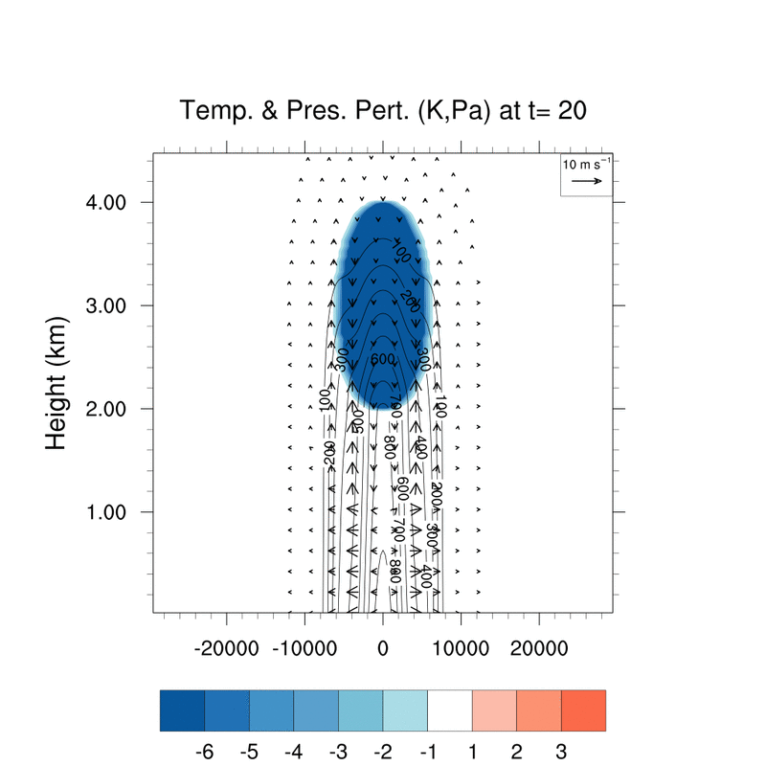
Results: Flat Run
First, a test of the model without terrain
  Thermal characteristics:
    10-km wide, 3-km deep, 3-km center, −15-K perturbation

Slide 10
Results: Flat Run
Initial pressure and field indicates high dynamic and buoyancy pressure below the thermal and a divergent wind field near the ground.
Low buoyancy pressure is created in the wake of the perturbation similar to MT_05
Density currents spread out across model bottom ~400s
Dynamic low pressure centers evident in rotating lobes of thermal perturbation at t=360s

Slide 11
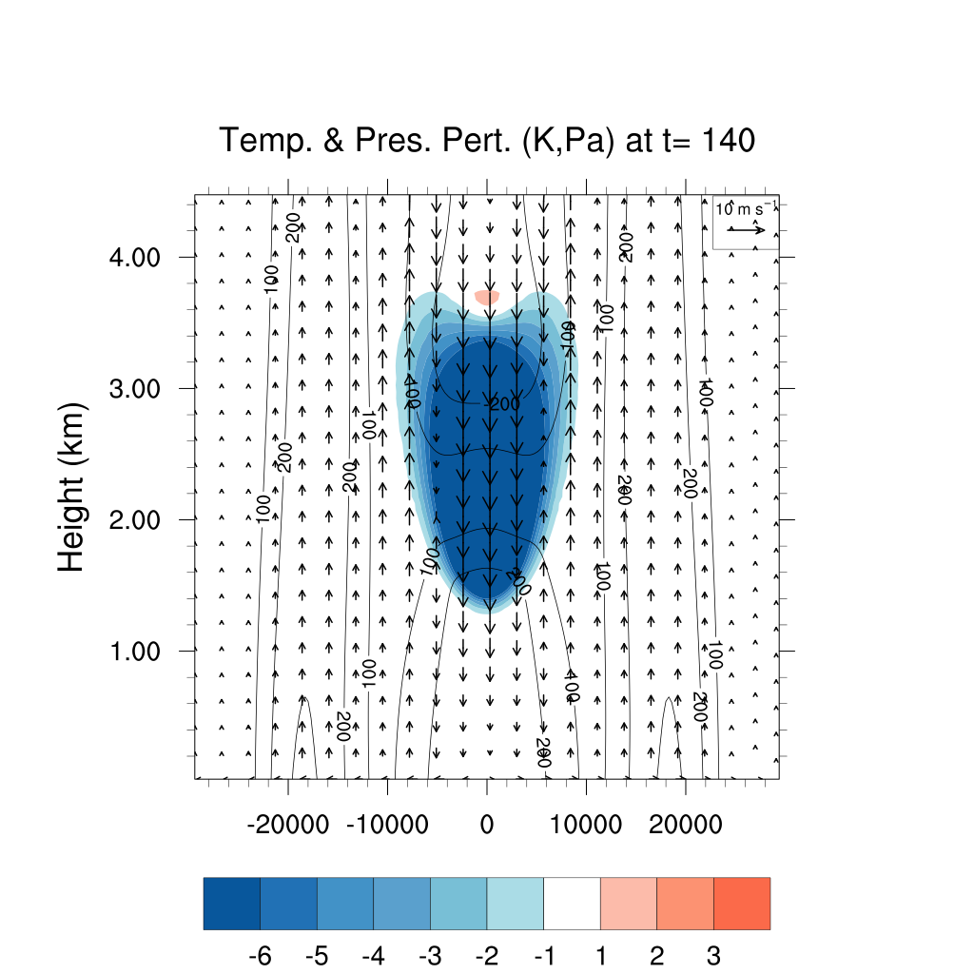
Results: Flat Run
Initial pressure and field indicates high dynamic and buoyancy pressure below the thermal and a divergent wind field near the ground.
Low buoyancy pressure is created in the wake of the perturbation similar to MT_05
Density currents spread out across model bottom ~400s
Dynamic low pressure centers evident in rotating lobes of thermal perturbation at t=360s

Slide 12
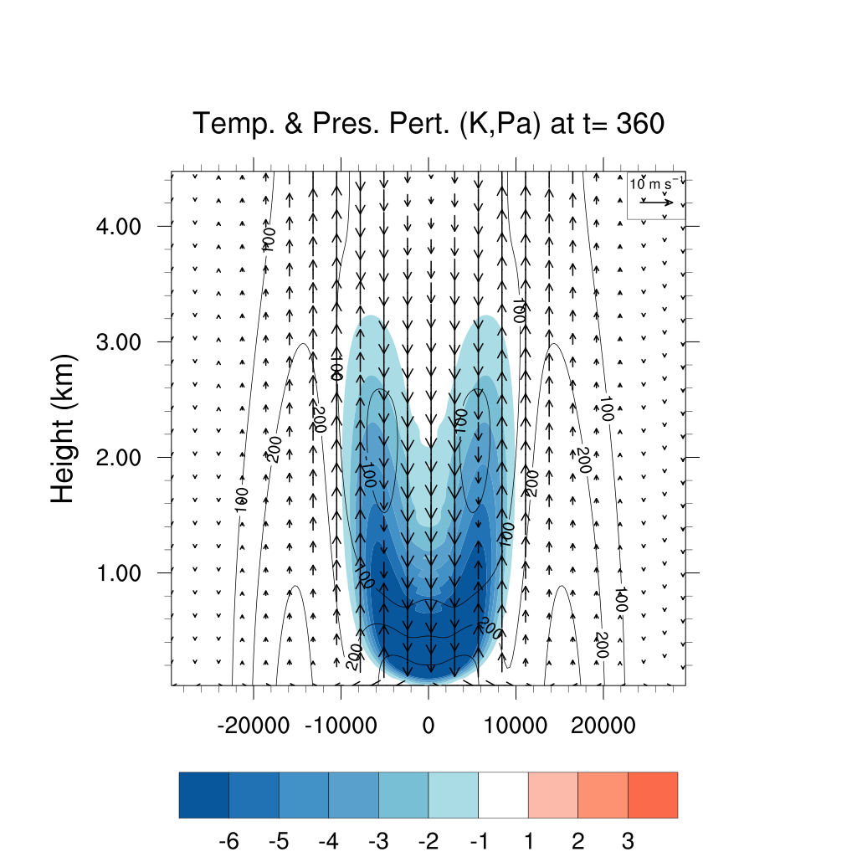
Results: Flat Run
Initial pressure and field indicates high dynamic and buoyancy pressure below the thermal and a divergent wind field near the ground.
Low buoyancy pressure is created in the wake of the perturbation similar to MT_05
Dynamic low pressure centers evident in rotating lobes of thermal perturbation
Symmetric density currents spread out across model bottom with high buoyancy pressure below

Slide 13
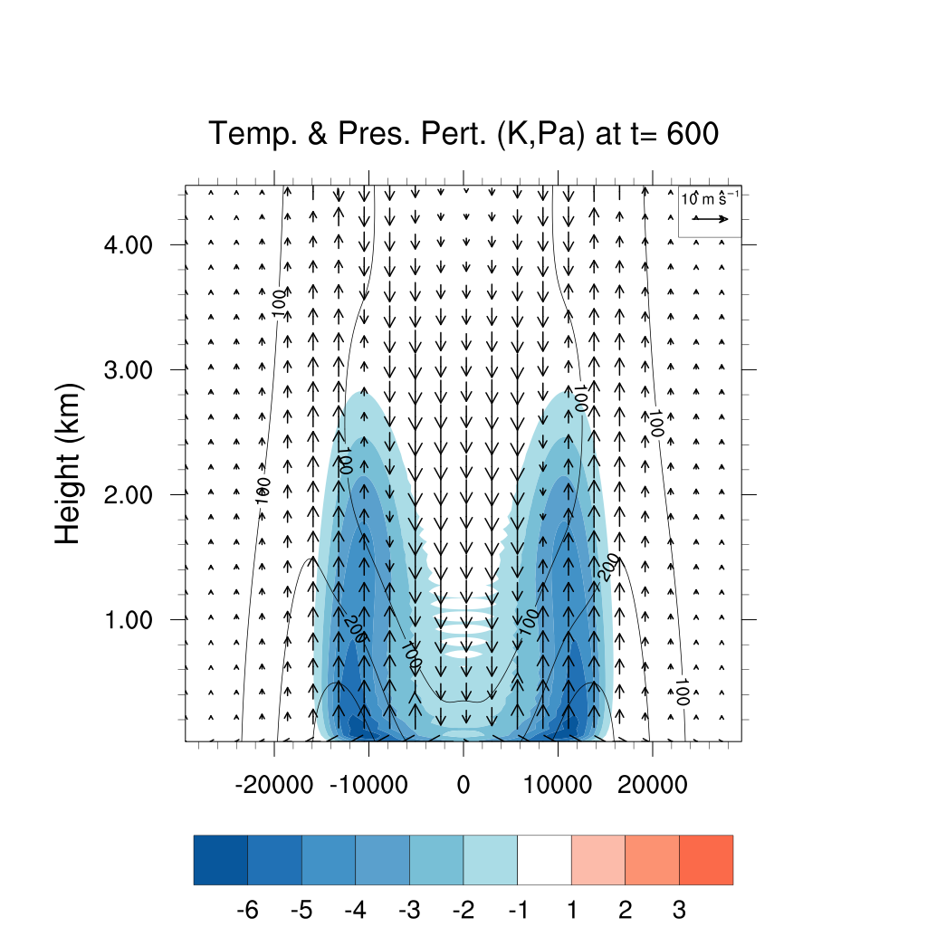
Results: Flat Run
Initial pressure and field indicates high dynamic and buoyancy pressure below the thermal and a divergent wind field near the ground.
Low buoyancy pressure is created in the wake of the perturbation similar to MT_05
Dynamic low pressure centers evident in rotating lobes of thermal perturbation
Symmetric density currents spread out across model bottom with high buoyancy pressure below and high dynamic pressure ahead

Slide 14
Results: Flat Run
Comments:
  −15K perturbation mixes quickly
    By 600s, temps are warmer than -6K everywhere
    This is likely due to the enhanced turbulence generated by the impact with the boundary relative to MT_05 where the thermal was terminated before impact with the model top
  Top of cold pool reaches ~3 km in neutral atmosphere
  Some computational mode seen in initial time steps but was damped out soon after
  Similarly, some 2Δz noise is seen as the cold pool splits, but this is damped out with time

Slide 15
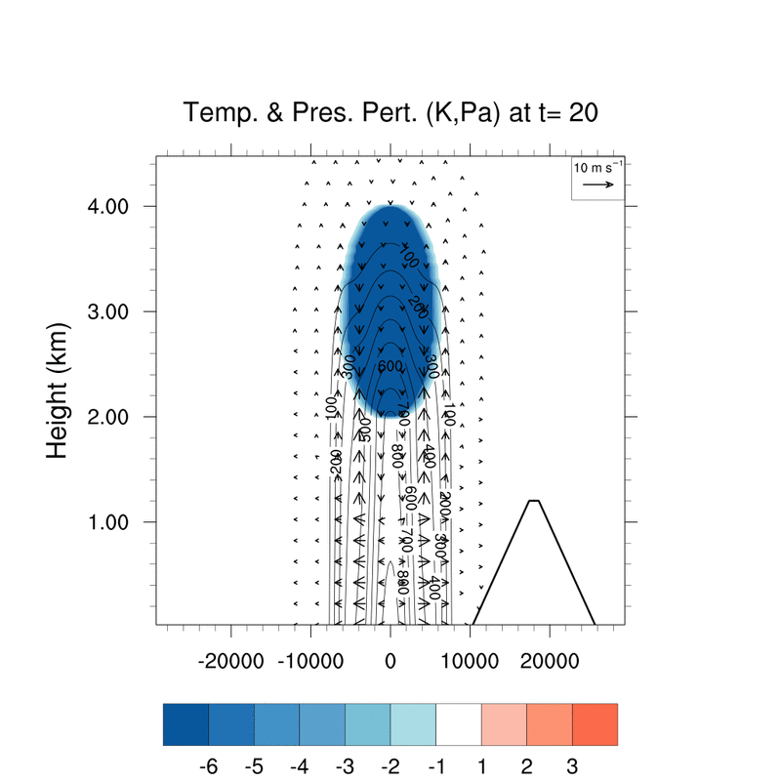
Results: Flat Run vs. Mountain
Compared flat terrain with a mountain centered 18-km east of the cold pool center
  Thermal characteristics are identical

Slide 16


Results: Flat Run vs. Mountain
Initialization and first time steps are nearly identical
  Pressure perturbation and winds are similar

Slide 17
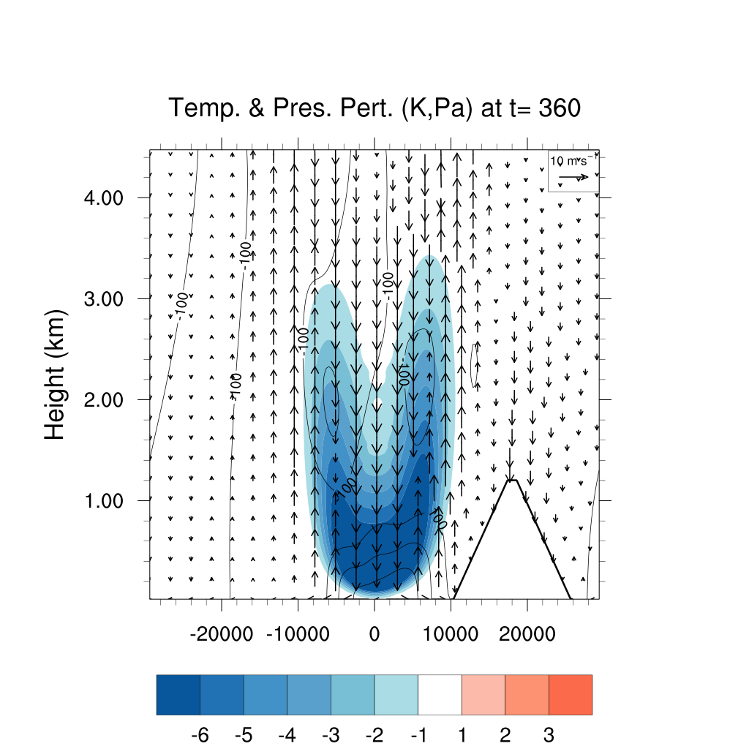
Results: Flat Run vs. Mountain
Mountain simulation has stronger eastern cold pool than western cold pool
  Higher pres. pert. and taller, more intense cold pool than western cold pool in the same mountain simulation

Slide 18
Results: Flat Run vs. Mountain
Notable downward motion induced over the mountaintop by more intense upward motion on the eastern flank of the cold pool

Slide 19
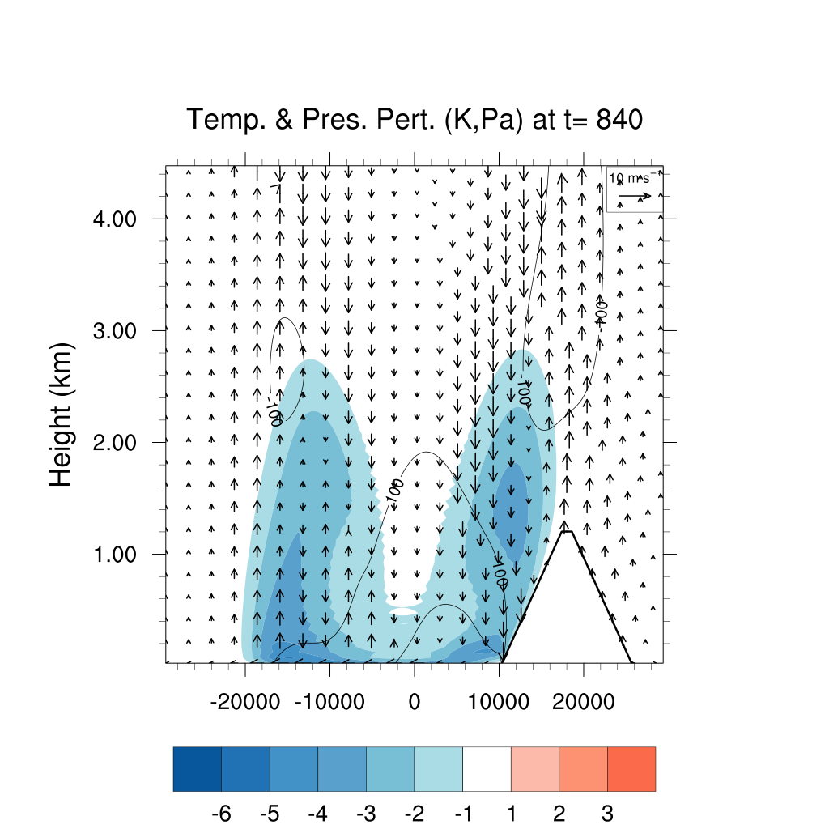
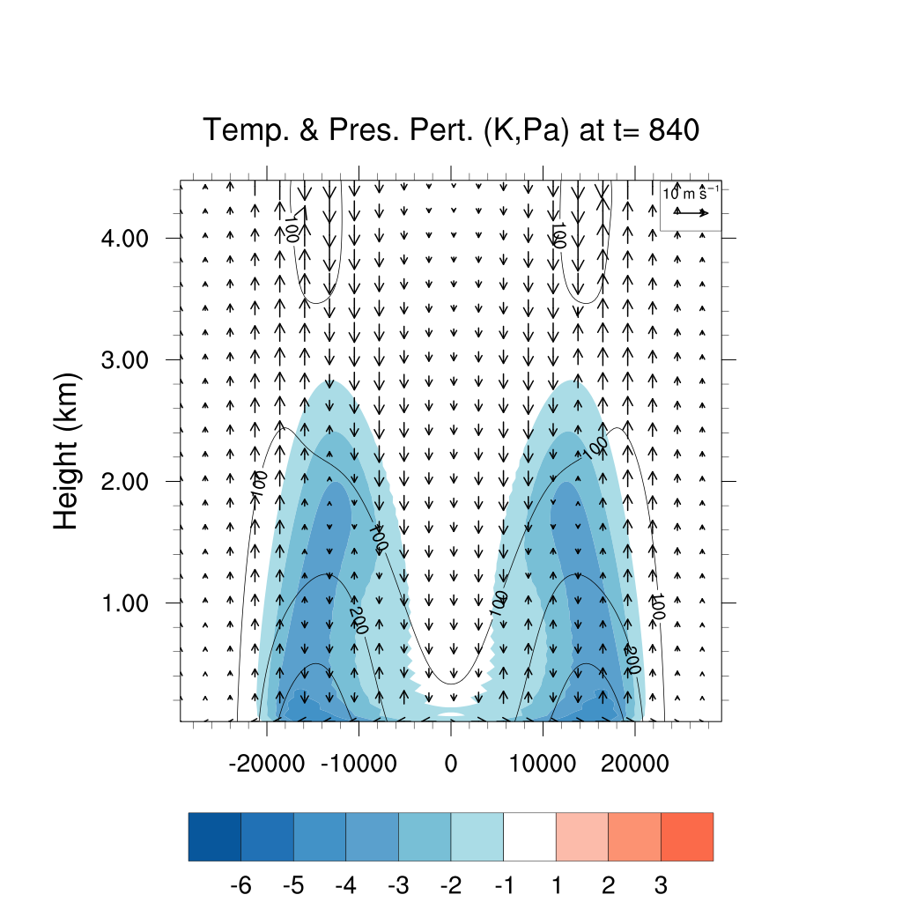
Results: Flat Run vs. Mountain
Cold pool impacts mountain and induces stronger negative press. pert. on eastern flank

Slide 20
Results: Flat Run vs. Mountain
Cold pool also begins to slosh back, creating a higher press. pert. to the west of the eastern cold pool center

Slide 21
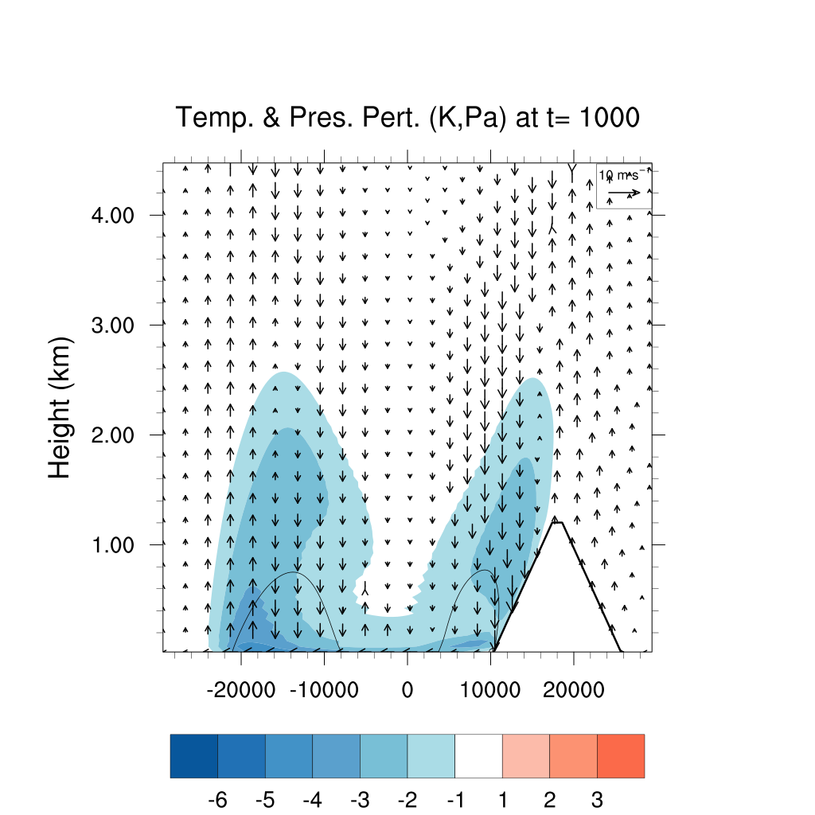
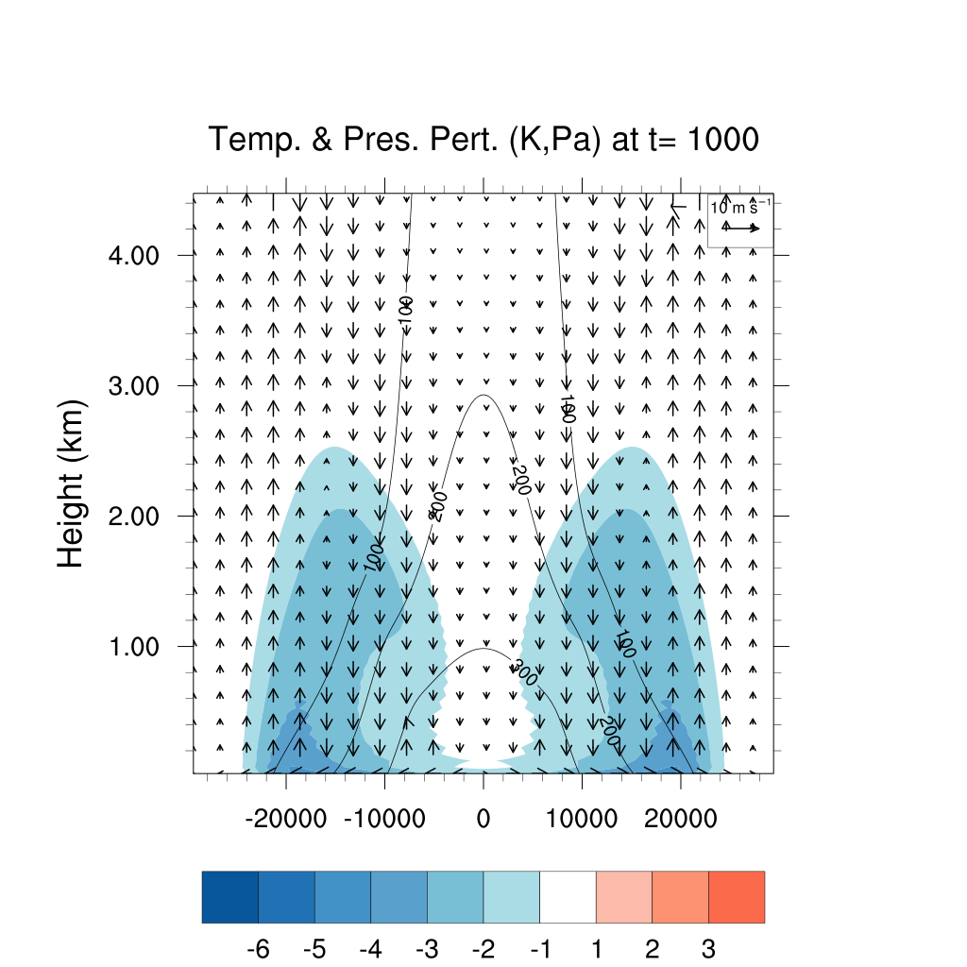
Results: Flat Run vs. Mountain
Mountain cold pool weakens more rapidly, likely due to enhanced turbulent mixing against the mountain

Slide 22
Results: Flat Run vs. Mountain
Comments:
  Stronger initial western cold pool is produced along the mountain slope but it dissipates more rapidly than the flat terrain case
  Stronger negative pressure perturbation is generated over the mountain as the cold pool impacts the slope than in the flat terrain case
  Mountainside cold pool diffuses more quickly, likely due to the enhanced turbulent motion induced allowing more efficient cascading of energy down to smaller wavelengths

Slide 23
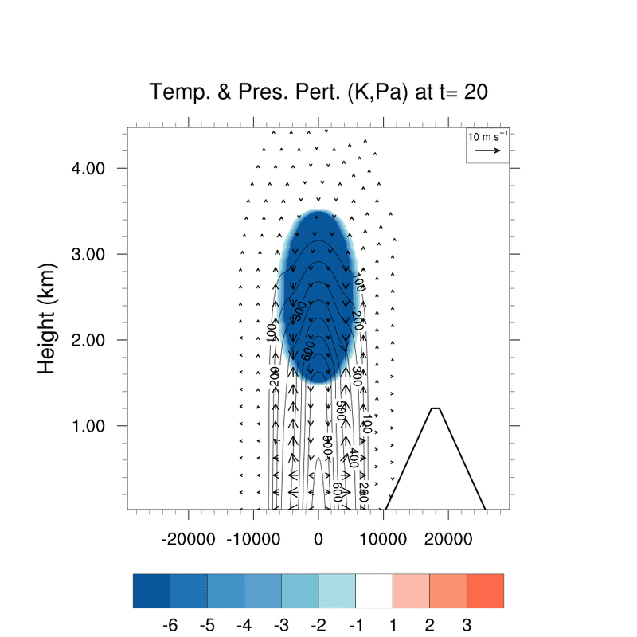
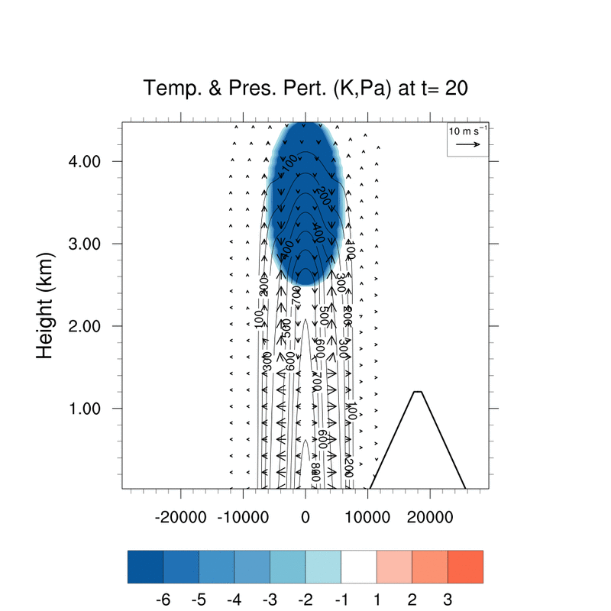
Results: Varying Cold Pool Height
Compared mountain simulation with cold pool centered at 2.5 km and 3.5-km AGL
  Thermal characteristics are identical otherwise
2.5 km
3.5 km

Slide 24
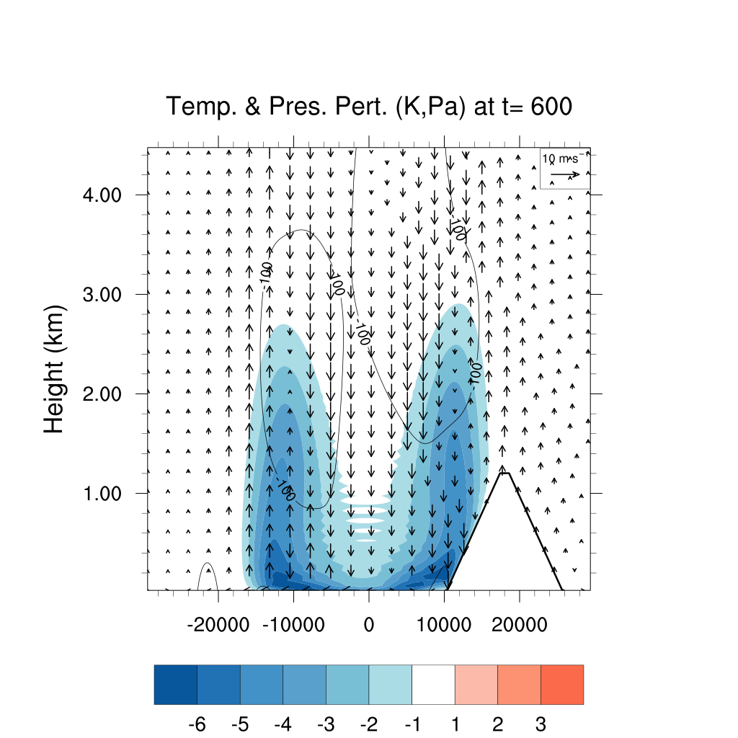
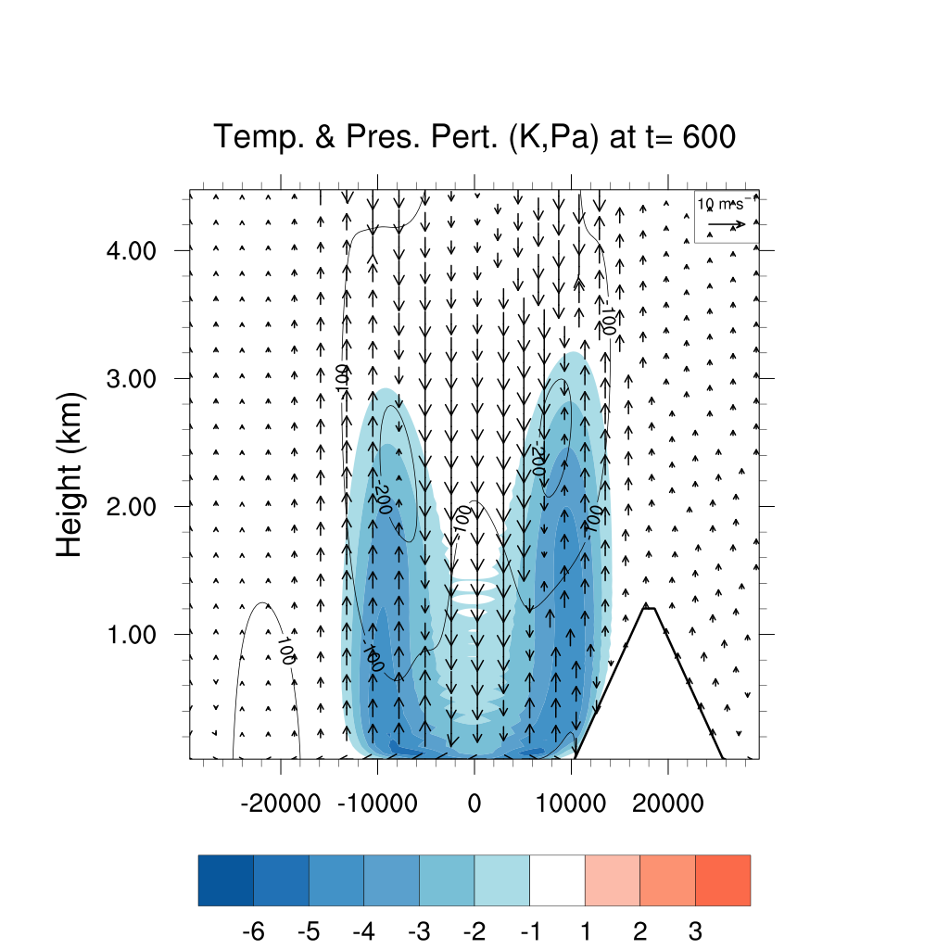
Results: Varying Cold Pool Height
3.5-km case has stronger negative dynamic press. pert. due to stronger rotation
  Likely due to stronger downward motion from higher fall height
2.5 km
3.5 km

Slide 25
Results: Varying Cold Pool Height
2.5-km case is already starting to slosh back (note downward winds near mountainside)
  This may aid the strength of the non-mountain cold pool
2.5 km
3.5 km

Slide 26
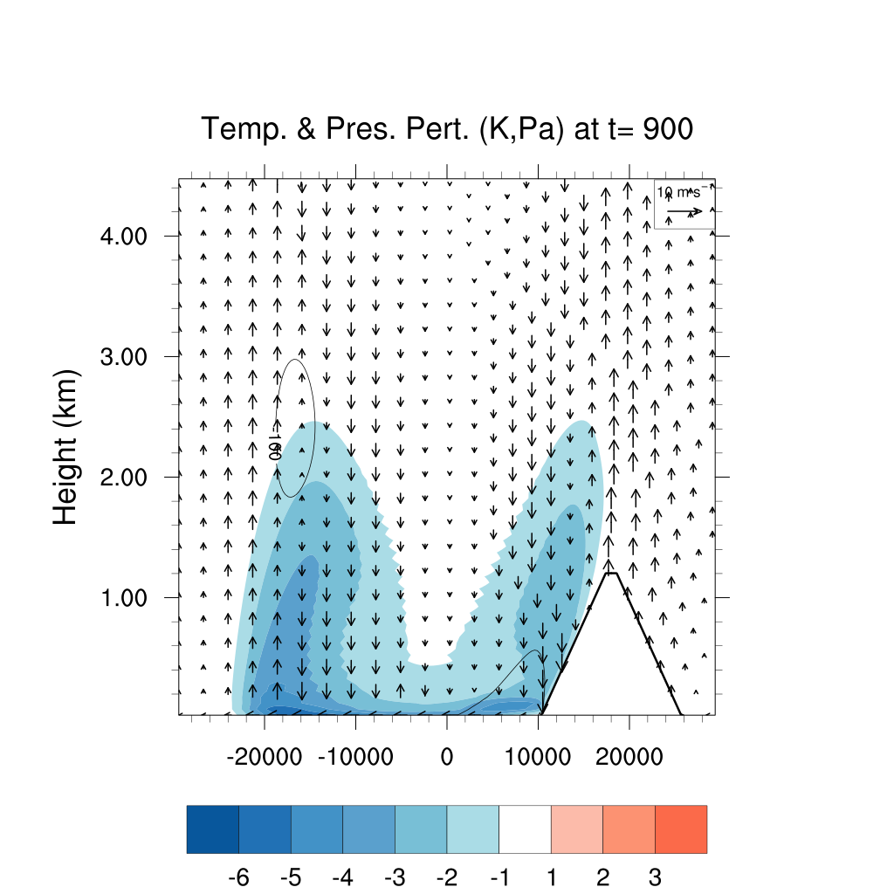
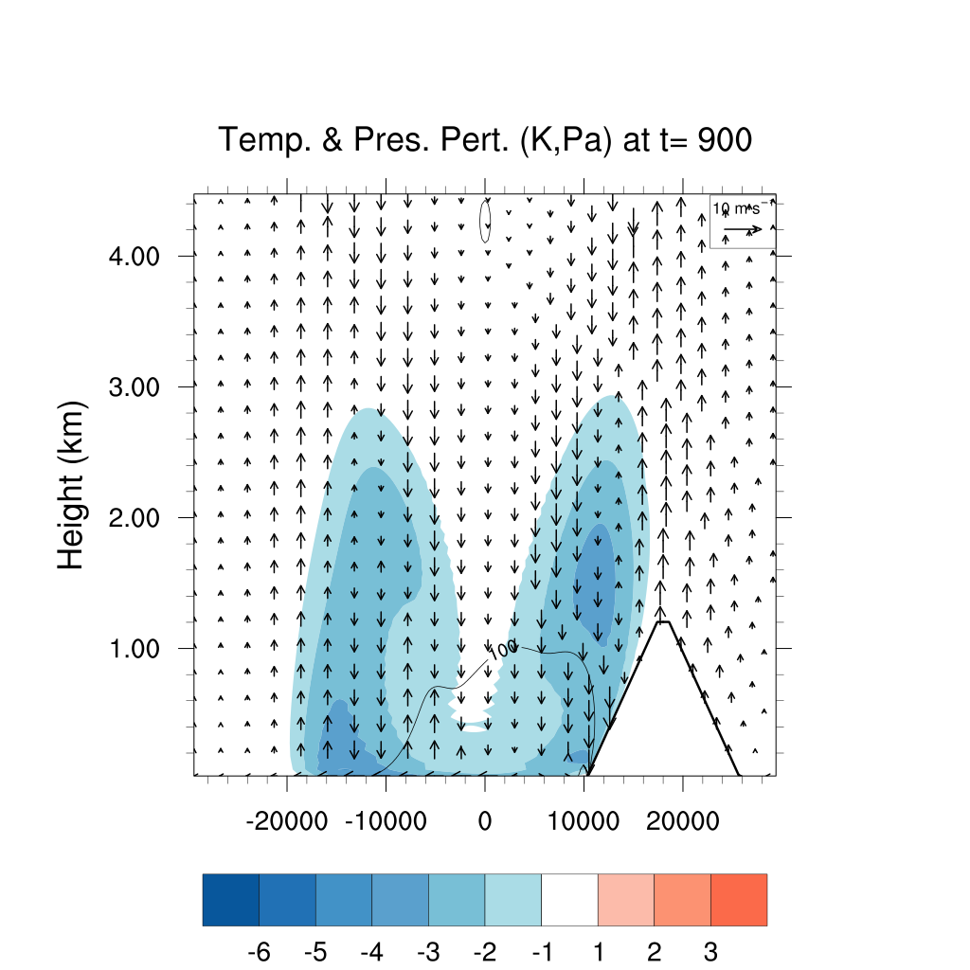
Results: Varying Cold Pool Height
3.5-km case has a more intense mountain cold pool with cooler temps. and a stronger press. pert.
  Notably, the 2.5-km western cold pool is more intense and propagates faster than in the 3.5-km case
2.5 km
3.5 km

Slide 27
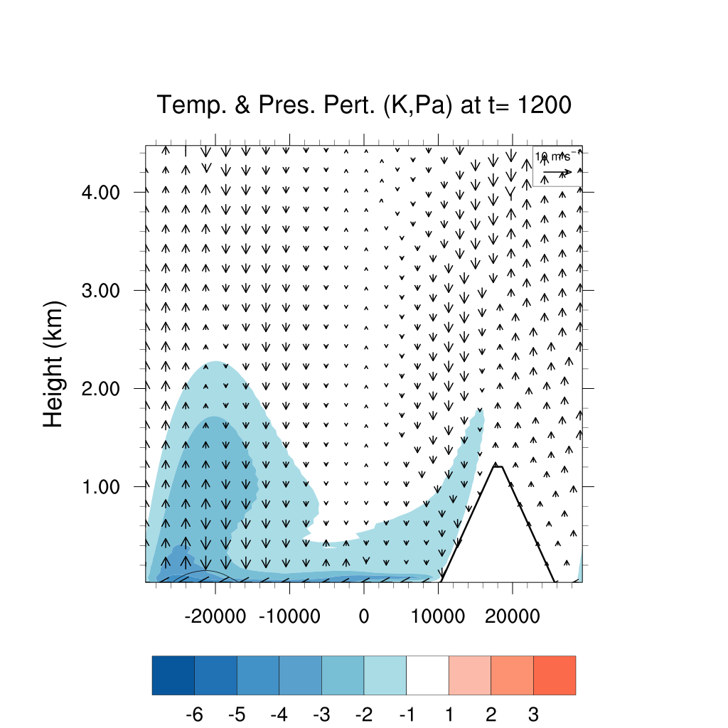
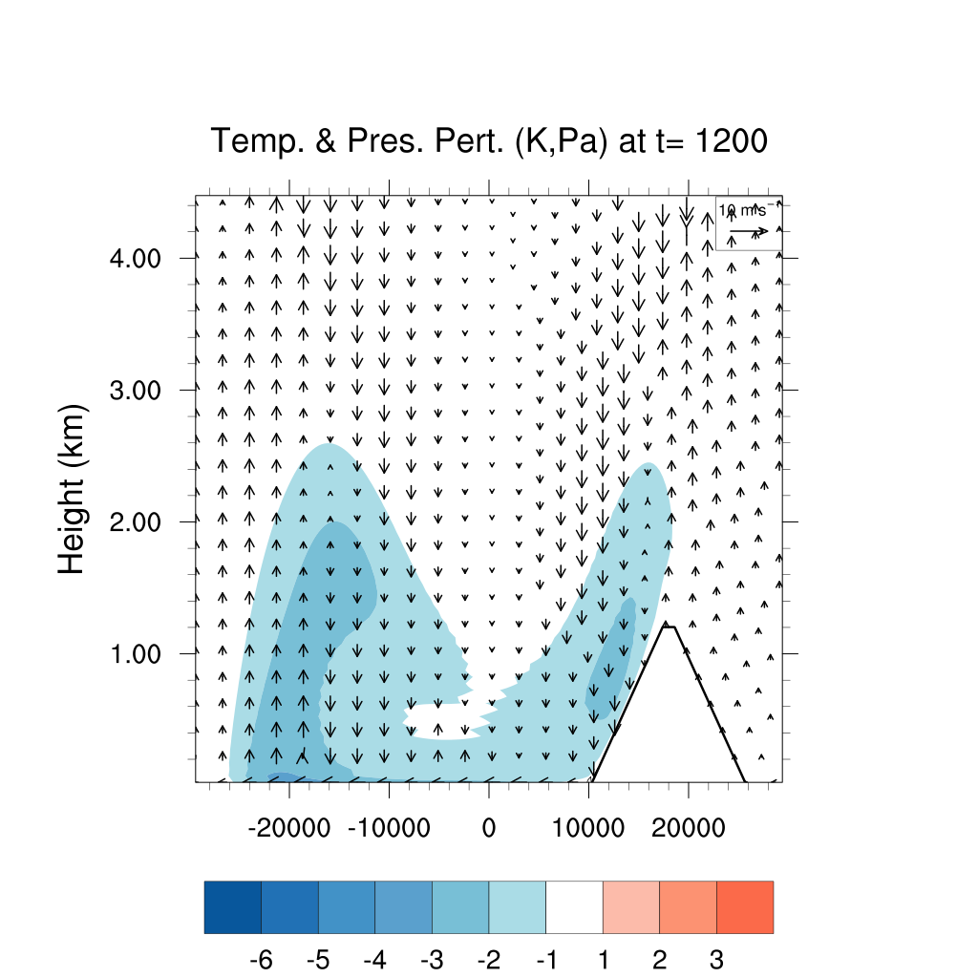
Results: Varying Cold Pool Height
By 1200s, the mountain cold pool in the 2.5-km case has sloshed back further and hugs the ground while the 3.5-km case has more cold air aloft on the mountain slope
2.5 km
3.5 km

Slide 28
Results: Varying Cold Pool Height
Comments:
  3.5-km cold pool produces more vigorous downward motion, rotation, and rotational press. pert.
  Not surprisingly, the 2.5-km case sloshes back earlier, but curiously, the non-mountain cold pool is more intense and propagates faster than the 3.5-km non-mountain cold pool
    This may be due to the earlier sloshing in the 2.5-km case which aids in maintaining easterly flow at the surface
2.5 km
3.5 km

Slide 29
Interesting Things I Learned
Cold pools mix away quite quickly if there is no heat sink to replenish them
  I did not expect the flat-terrain to dissipate the thermal perturbation so quickly
    The downward cascade of energy towards the smallest wavelengths is likely to blame as the waves meet their grave end at the hands of diffusion.
Mountains create a lot of turbulent mixing
  The rate of dissipation along the relatively gradual 1/6 sloped mountain was surprising for me
Mountains cause quite a bit of instability when subjected to strong flow
  Not shown here, but putting the slope of the mountain closer to the impact point of the cold pool causes a lot of 2Δz and 2Δx noise
    To the point where a mountain peak within ~4 km of the cold pool caused the model to blow up without increasing the diffusion coefficients substantially

Slide 30
Summary and Conclusions
Impact with terrain or the bottom boundary increases the diffusion of the thermal perturbation
  Likely an artifact of increased mixing through enhanced turbulence.
    Terrain produces more diffusion than a flat boundary
Mountains can affect the pressure perturbations from cold pools on their slopes
  The enhanced upward motion as the cold pool sloshes up the mountainside can locally increase the negative press. pert. through rotational flow
It is very hard to get a cold pool to cross a mountain in a neutral environment with no shear
  Even a cold pool of −25K could not make it over the mountain. An additional heat sink or changes to the environmental flow would have to be made to get the cold pool to flow over the mountain

Slide 31
FIN

