Slide 1
Northeast Severe Convection with Low Predictive Skill
Matthew Vaughan, Brian Tang, and Lance Bosart
Department of Atmospheric and Environmental Sciences
University at Albany/SUNY
Albany, NY 12222
Northeast Storm Conference
Holiday Inn
Saratoga Springs, New York
Sunday 8 March 2015
Supported by the NOAA Collaborative Science,
Technology and Applied Research Program

Slide 2
Motivation
CSTAR initiative to investigate severe convection with low predictive skill
Cooperation between SUNY-Albany and NWS offices at ALB, BGM, and PIT
Improve forecasting skill of severe convection by focusing study on environments with poor predictive skill
Notes:
Verification score and threat score defined
Red color for headlines
Basic definition for threat score

Slide 3
Methodology

Slide 4
Methodology: Goals
Identify and evaluate poor forecast performance
Use forecasting performance as a proxy for predictability
Underlying assumption: If forecasters had trouble, the event had low predictability.

Slide 5
Methodology: Evaluation
Contingency Table | Observed Y | Observed N
Forecast (Yes) | Hit (A) | False Alarm (B)
Forecast (No) | Miss (C) | Correct null (D)
Image credit: Meteo-swiss

Slide 6
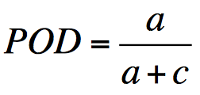
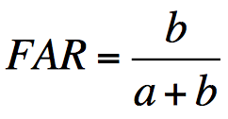
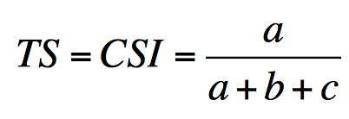
Methodology: Evaluation
Contingency Table | Observed Y | Observed N
Forecast (Y) | Hit (A) | False Alarm (B)
Forecast (N) | Miss (C) | Correct null (D)
0 ≤ POD ≤ 1, best score: POD = 1, best score ≠ perfect forecast
0 ≤ FAR ≤ 1, best score: FAR = 0, best score ≠ perfect forecast
0 ≤ TS ≤ 1, best score: TS = 1, best score = perfect forecast

Slide 7
Types of Low Predictability Events
High FAR
Low POD
Type 1 Events
Large number of missed reports
Type 2 Events
Large area under a false alarm
Type 3
Type 1
Type 2
Notes:
Type 1 and Type 2 classifications intended to capture the least predictable environments based on the worst performing forecasts. Type 1 are events with very low POD. Type 2 events not only had high FAR, but they had very large False Alarm areas (e.g. large SLIGHT contour drawn) and very few reports. Report area is used here as a first order correction for population density. The idea being urban areas may have 10 reports for a storm of a given strength whereas a more rural town may have 2 or 3 for the same strength storm. No events in the database satisfy the requirements for Type 1 AND Type 2 as defined here.

Slide 8
Type 1 (Low POD) Example
Reports captured = 0 Reports missed = 200
POD = 0 FAR = N/A TS = 0

Slide 9
Type 2 (High FAR) Example
Reports captured = 2 Reports missed = 0
POD = 1 FAR = .986 TS = .014

Slide 10
Methodology: Game-Plan
Create Northeast domain to evaluate forecast skill
Plot SPC convective outlook contours over the domain
Evaluate SLIGHT contours with storm reports
Sound familiar?
Hitchens and Brooks (2012) evaluated SLIGHT contours over CONUS domain
MOD and HIGH contours within SLIGHT contours were included (i.e. everywhere inside the SLIGHT was treated the same)

Slide 11
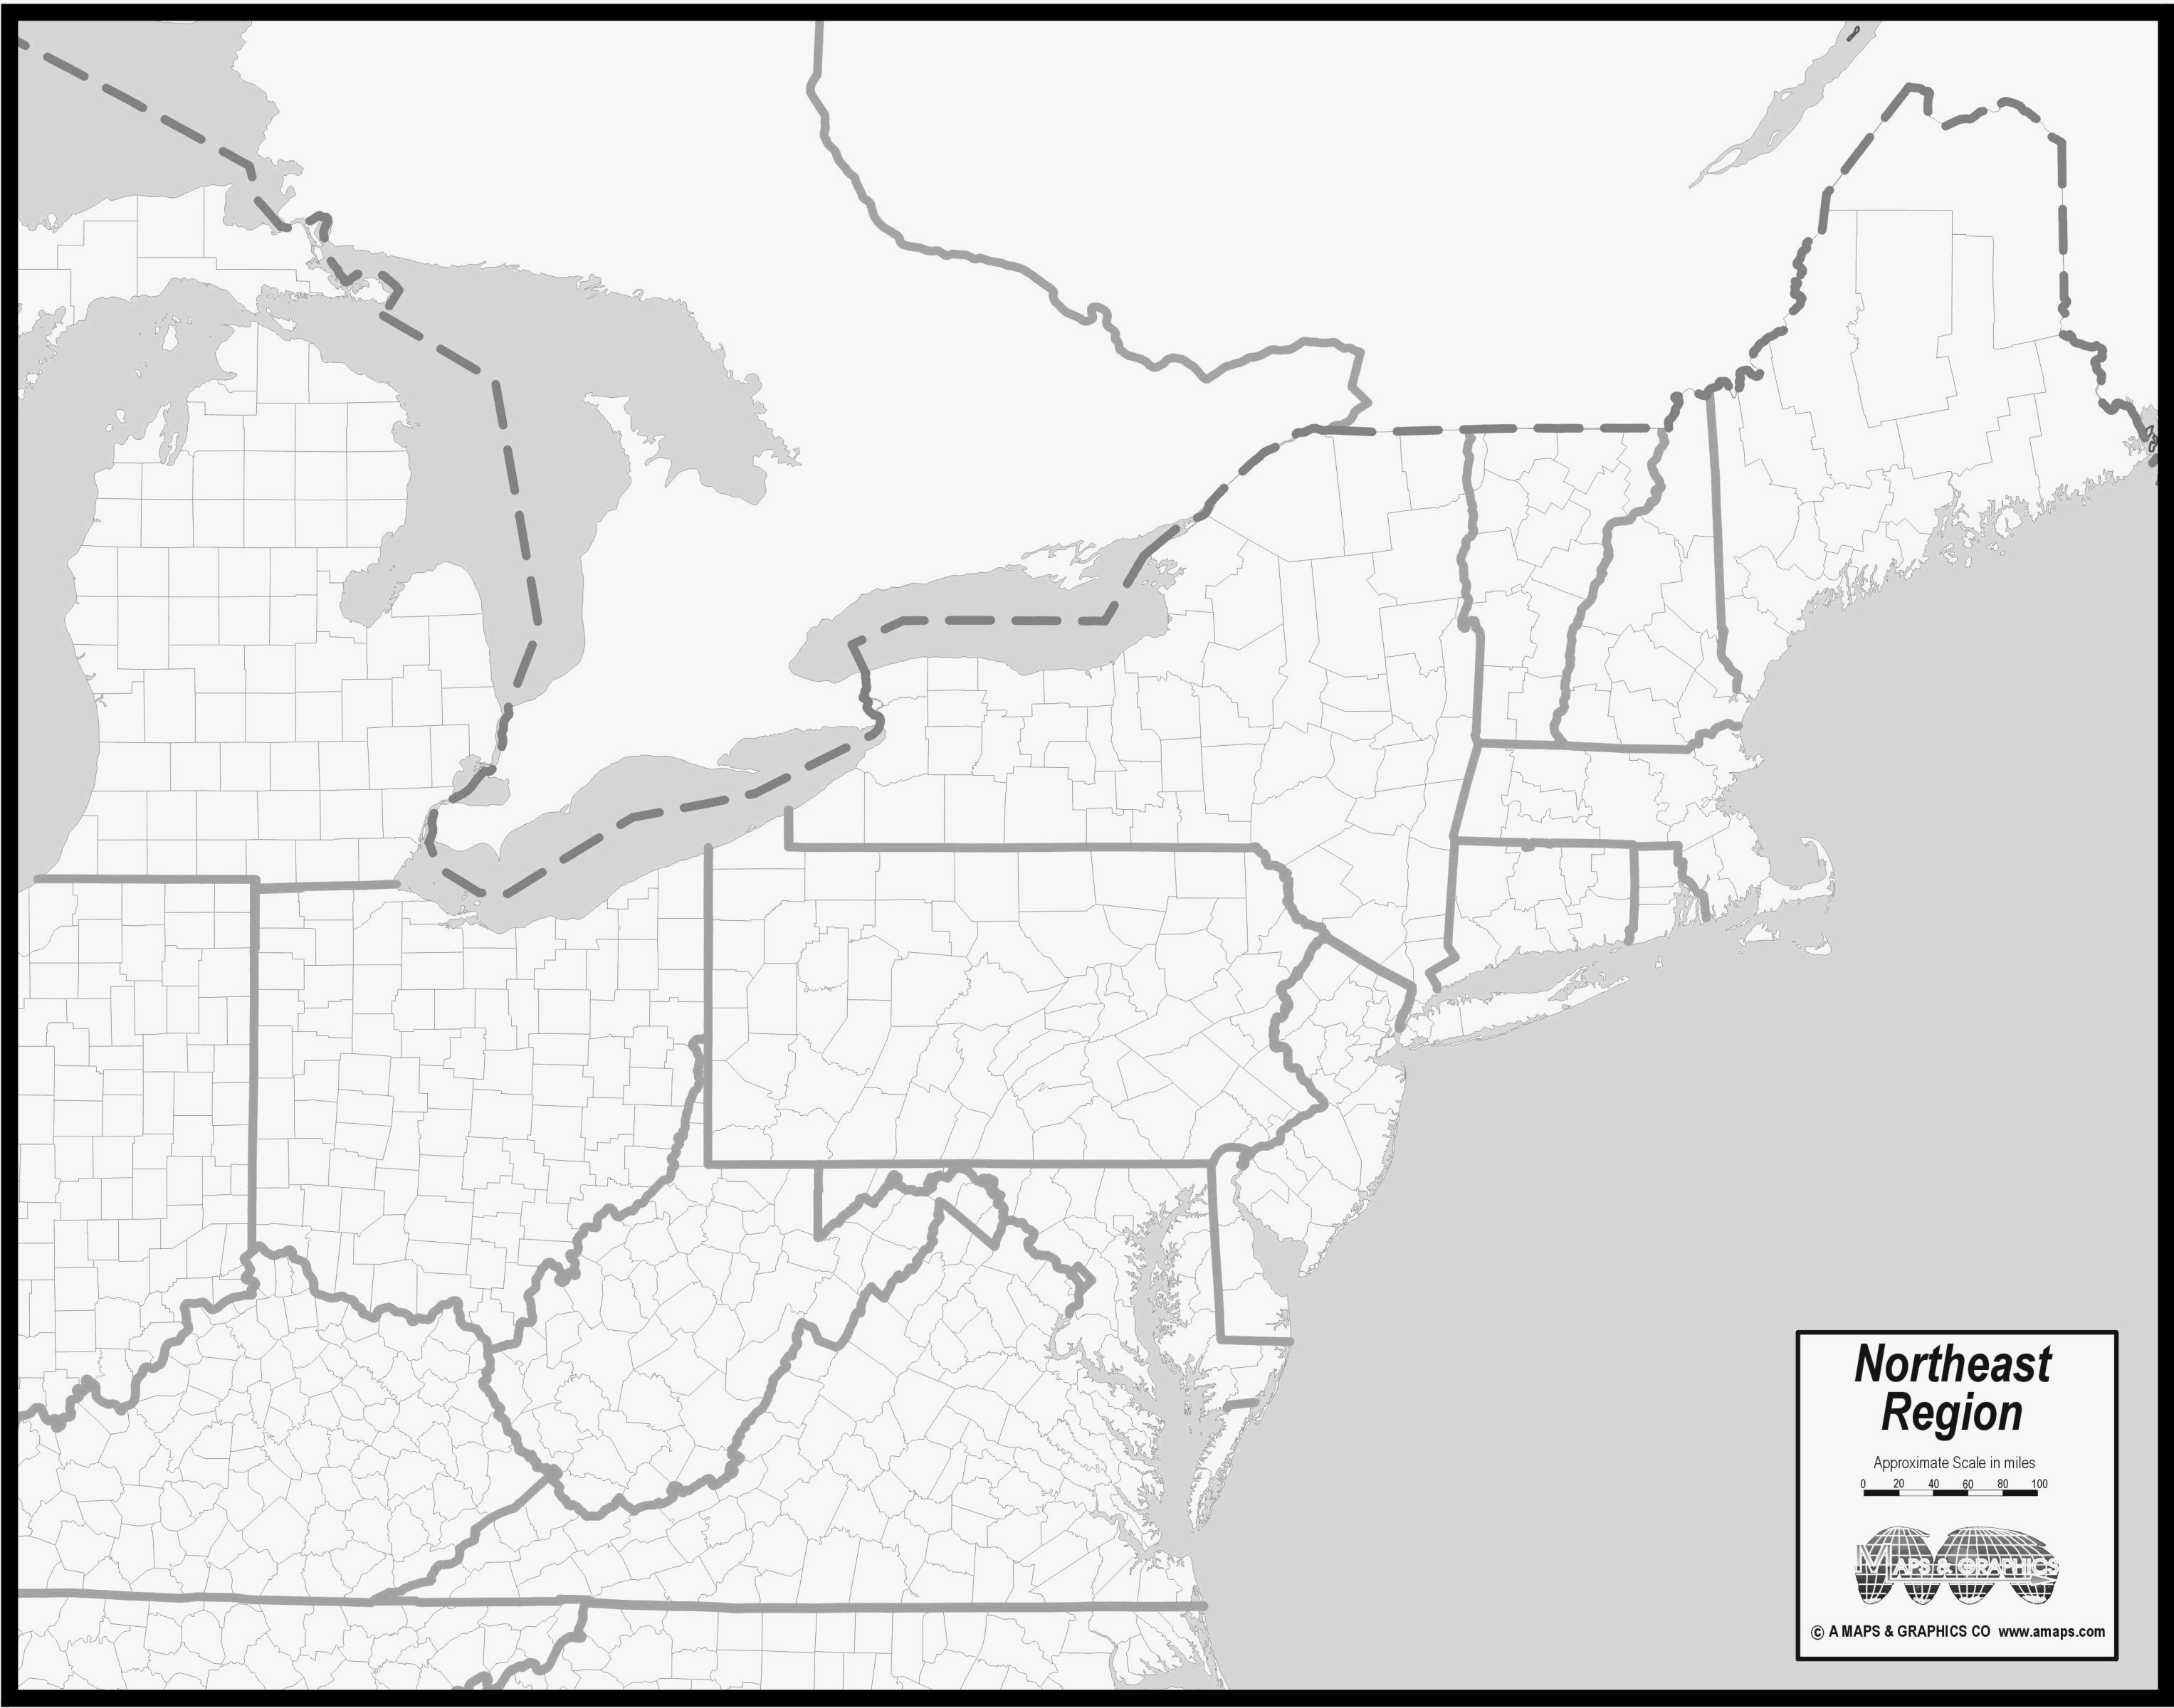
Northeast Domain
Courtesy of amaps.com
Notes:
Construct cartoon for slight risk evaluation method.
Choose cases to illustrate problem.
Move Venn Diagrams up into methodology section.

Slide 12
Northeast Domain
Here
Courtesy of amaps.com
Notes:
Construct cartoon for slight risk evaluation method.
Choose cases to illustrate problem.
Move Venn Diagrams up into methodology section.

Slide 13
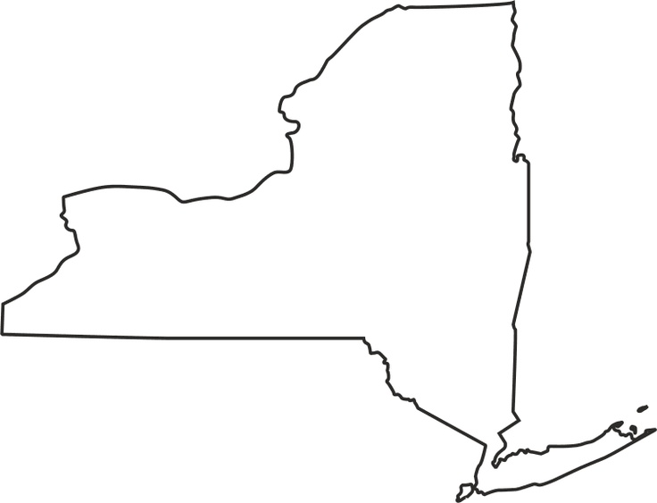
Algorithm Example
Notes:
Construct cartoon for slight risk evaluation method.
Choose cases to illustrate problem.
Move Venn Diagrams up into methodology section.

Slide 14
Algorithm Example
Notes:
Construct cartoon for slight risk evaluation method.
Choose cases to illustrate problem.
Move Venn Diagrams up into methodology section.

Slide 15
Algorithm Example
Notes:
Construct cartoon for slight risk evaluation method.
Choose cases to illustrate problem.
Move Venn Diagrams up into methodology section.

Slide 16
Algorithm Example
Slight Risk:
Issued: 0600 UTC
Valid: 1200 – 1200 UTC
40 km
Notes:
Construct cartoon for slight risk evaluation method.
Choose cases to illustrate problem.
Move Venn Diagrams up into methodology section.

Slide 17
Algorithm Example
40 km
Sev. wind
report
Notes:
Construct cartoon for slight risk evaluation method.
Choose cases to illustrate problem.
Move Venn Diagrams up into methodology section.

Slide 18
Algorithm Example
Area of Influence
40 km
40 km
Sev. wind
report
Notes:
Construct cartoon for slight risk evaluation method.
Choose cases to illustrate problem.
Move Venn Diagrams up into methodology section.

Slide 19
Algorithm Example
40 km
Notes:
Construct cartoon for slight risk evaluation method.
Choose cases to illustrate problem.
Move Venn Diagrams up into methodology section.

Slide 20
Algorithm Example
40 km
Miss ☹
Notes:
Construct cartoon for slight risk evaluation method.
Choose cases to illustrate problem.
Move Venn Diagrams up into methodology section.

Slide 21
Algorithm Example
40 km
Miss ☹
Correct Hit ☺
Notes:
Construct cartoon for slight risk evaluation method.
Choose cases to illustrate problem.
Move Venn Diagrams up into methodology section.

Slide 22
Algorithm Example
40 km
Miss ☹
Correct Hit ☺
False Alarm 😐
Notes:
Construct cartoon for slight risk evaluation method.
Choose cases to illustrate problem.
Move Venn Diagrams up into methodology section.

Slide 23
Database Criteria
For inclusion in the 1980-2013 dataset, an event must meet at least 1 of 2 criteria:
Have a SLIGHT risk contour within the NE domain
Have a sufficiently high-impact to warrant inclusion
…What does that mean?!
Notes:
For the CONUS dataset, you need either a SLIGHT contour or at least 20 reports for an event to be included. For inclusion in the Northeast Dataset, at least part of a SLIGHT risk area must be within the domain depicted on the previous slide or at least 20 reports within the same domain.

Slide 24
Northeast Report Trend

Slide 25
Northeast Report Trend
55th percentile linear regression
Notes:
Shift slides up and bolded axes.

Slide 26
Northeast Report Trend
55th percentile linear regression
Notes:
Shift slides up and bolded axes.

Slide 27
Northeast Report Trend
High-impact
55th percentile linear regression
Notes:
Shift slides up and bolded axes.

Slide 28
Database Fast Facts
Event days = 1503
SLIGHT days = 1300
“High-impact” events without SLIGHT = 203

Slide 29
Northeast low Predictive Skill Event Climatology

Slide 30
Types of Low Predictability Events
High FAR
Low POD
Type 1
High-impact;
Lowest 25th percentile POD score
Type 2
Highest 25th percentile FA area
Lowest 25th percentile severe report area
Type 3
Type 1
Type 2
No events meet Type 3 requirements as defined here
Notes:
Type 1 and Type 2 classifications intended to capture the least predictable environments based on the worst performing forecasts. Type 1 are events with very low POD. Type 2 events not only had high FAR, but they had very large False Alarm areas (e.g. large SLIGHT contour drawn) and very few reports. Report area is used here as a first order correction for population density. The idea being urban areas may have 10 reports for a storm of a given strength whereas a more rural town may have 2 or 3 for the same strength storm. No events in the database satisfy the requirements for Type 1 AND Type 2 as defined here.

Slide 31
Type 1 Annual Variability
Notes:
Increase in events likely tied to increase in reporting. I doubt the atmosphere is becoming more complex since the 80’s. I argue that we are simply becoming more aware that these events happen as reporting becomes easier.

Slide 32
Type 2 Annual Variability
Notes:
Type 2 events are becoming rarer with time. Likely related to the decrease in SLIGHT risk area with time.

Slide 33
Event-Centered Composites

Slide 34
Event-Centered Composites
0.5° Climate Forecast System Reanalysis (CFSR)
Chose morning (1200 UTC) for synoptic analysis, afternoon (1800 UTC) for convective parameter analysis
Type 1 and “Good” forecast events centered on maximum report density
“Good” Forecast = High-impact events that achieved a threat score in the highest 25th percentile.
Type 2 centered at centroid of SLIGHT risk region
Chose largest of SLIGHT risk contours for composite center
Notes:
Type 1 event composites (1200z for these slides) are centered on the gridpoint of maximum report count per 1 degree of latitude-longitude (i.e. report density). If an event has several maximum densities of the same magnitude, the case was not included. Type 2 event composites are centered at the centroid of the largest slight risk area in the Northeast domain for a given event.

Slide 35
Type 1 (Low POD)
Notes:
Composites are binned according to 500 hPa flow over the composite point. N is the number of Type 1 events per flow direction (i.e. sample size). Since Type 1 events are in the lowest 25th percentile of events that have 20+ reports, we infer from the bar graph that NW-ly, W-ly, and SW-ly cases follow climatology pretty closely with 25-30% of 20+ cases falling into the Type 1 category. The rarer S-ly, and N-ly cases have a higher occurrence rate than climatology, however the sample size is small. From the pie chart, we see that most Type 1 events have 500 hPa flow out of the west.

Slide 36
Type 2 (High FAR)
Notes:
Type 2 events also occur most frequently out of the west.

Slide 37
Event-Centered Composites
CFSR Synoptic Composite Results
Little discernable difference in synoptic set-up of Type 1 & 2 events when compared to “Good” forecast events under similar flow regimes
Higher midlevel moisture for Type 2 events than “Good” forecast events
More modest midlevel lapse rates approaching the event center in Type 1 events than “Good” forecast events with westerly 500 hPa flow

Slide 38
Event-based Composites
CFSR Convective Parameter Analysis
Compared sounding variables between Type 1 and “Good” forecast events
Constructed phase-space diagrams and Probability Density Functions
What does our phase-space look like?

Slide 39
MCAPE-Shear Phase Space
LSHC
31 knots
HSHC
662 J/kg
LSLC
Notes:
Black dot at Center
Make axes bigger
Black dot at center.
Bigger and better defined axes

Slide 40
MCAPE-Shear Phase Space
LSHC
HSHC
31 knots
662 J/kg
LSLC
HSLC
Notes:
Black dot at Center
Make axes bigger
Black dot at center.
Bigger and better defined axes

Slide 41
MCape-Shear Phase Space
LSHC
HSHC
31 knots
662 J/kg
LSLC
HSLC
Notes:
Black dot at Center
Make axes bigger
Black dot at center.
Bigger and better defined axes

Slide 42
MCape-Shear Phase Space
LSHC
HSHC
31 knots
662 J/kg
LSLC
HSLC
Notes:
Black dot at Center
Make axes bigger
Black dot at center.
Bigger and better defined axes

Slide 43
CFSR Convective Parameter Results
High shear > 31 knots
High MCAPE > 662 J/kg
Low shear cases have more Type 1 events than “good” forecast events

Slide 44
CFSR Convective Parameter Results
High shear > 31 knots
Low shear < 31 knots
High-impact cases with low shear have a lower median threat score than cases with high shear.

Slide 45
Summary and key points
NE low predictive skill event climatology
Reports per event increasing with time
Type 1: 6 median events per year
Type 2: 1 median events per year (Trending down)
Peak in warm season
High-impact events with low shear have lower threat scores than high shear cases
High-impact events with N-ly midlevel flow have a higher occurrence rate of Type 1 events than other flow regimes
Neat Result: The median percent of the SLIGHT risk area covered by severe reports in NE is 15% for the entire database

Slide 46
FIN

Slide 47
Next Steps
Mesoscale analyses of poorly-predicted, high-impact events
Analyze events grouped by flow regime and convective mode
1999-present events give access to high-resolution data
Note common forcings and thermodynamic properties across events

