Slide 1
An Analysis of High-Impact, Low-Predictive Skill Severe Weather Events in the Northeast U.S.
Matthew Vaughan, Brian Tang, and Lance Bosart
Department of Atmospheric and Environmental Sciences
University at Albany/SUNY
Albany, NY 12222
Master’s Thesis Seminar
Albany, NY
2 December 2015
Supported by the NOAA Collaborative Science,
Technology and Applied Research Program (NA13NWS4680004)
Notes:
DOUBLE check

Slide 2
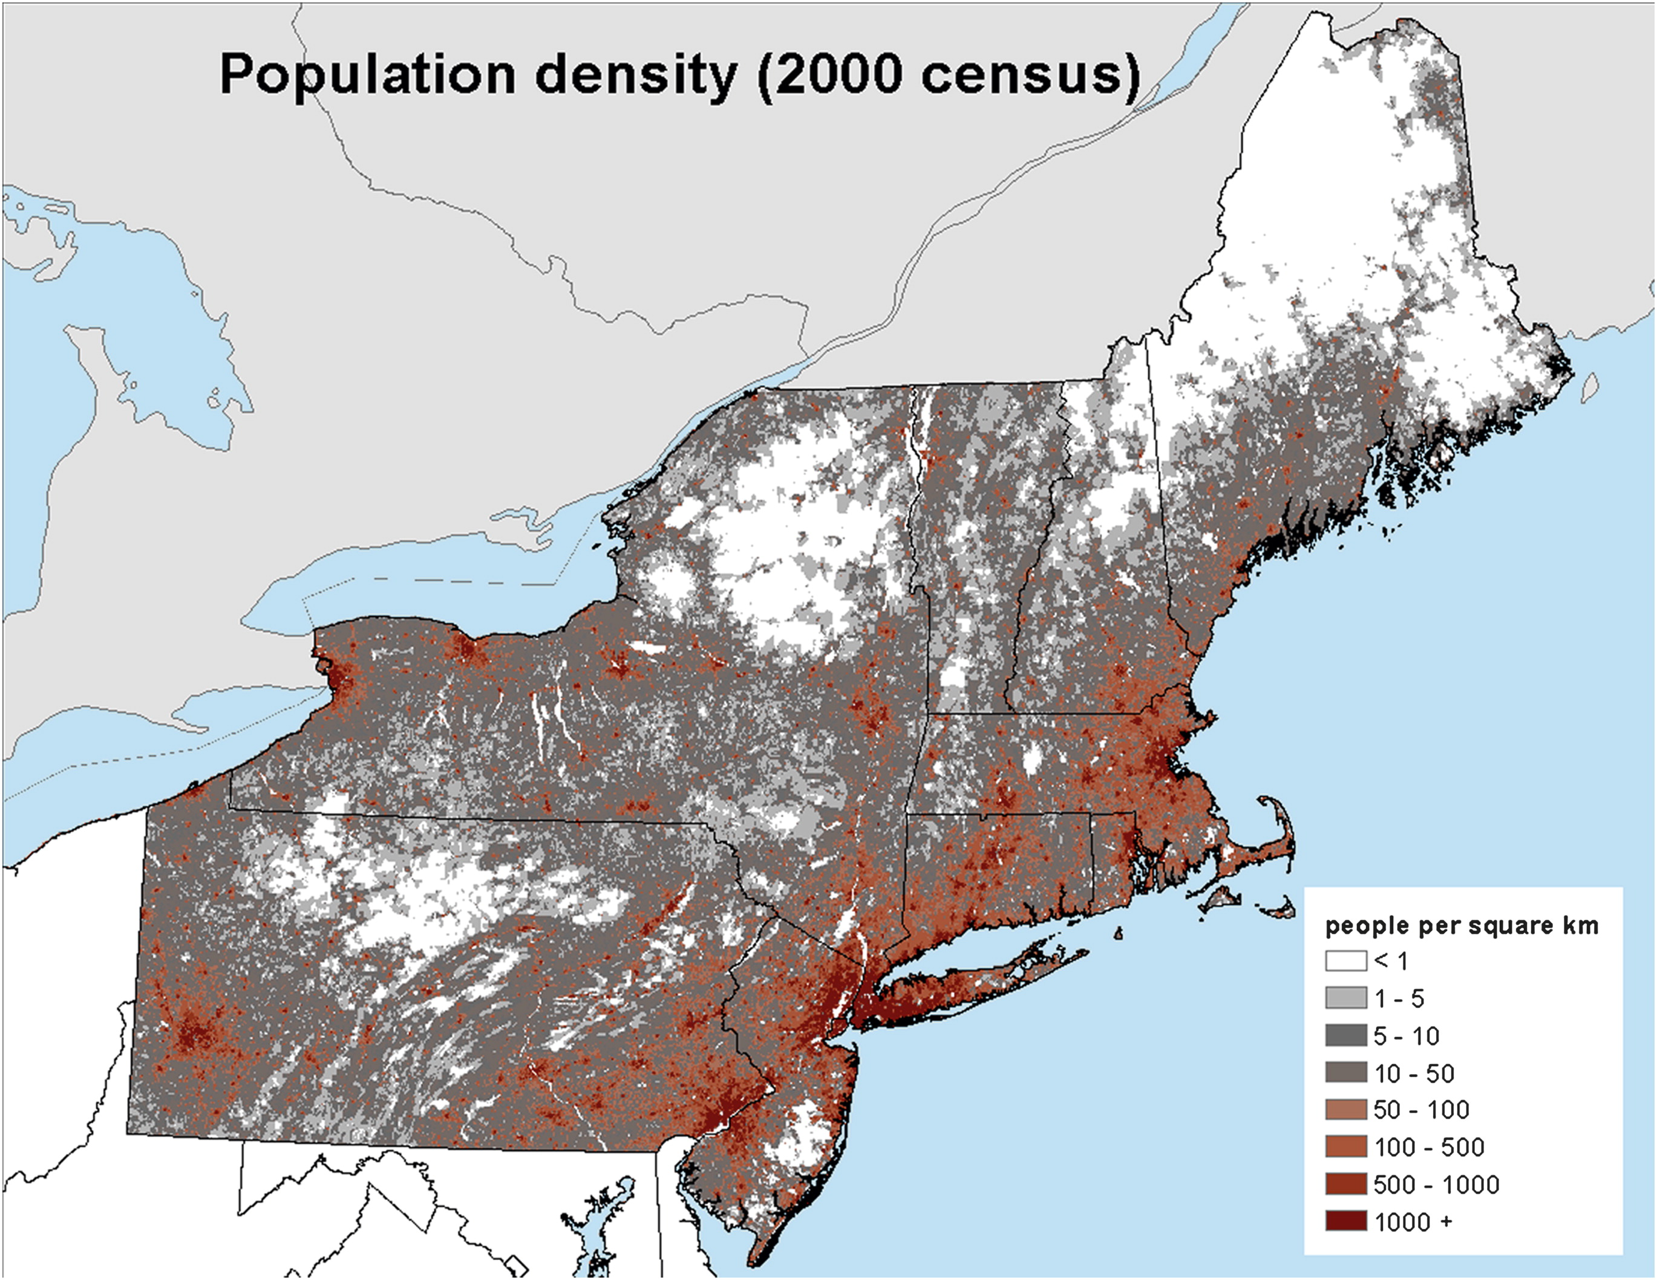
Motivation
Severe weather impacts on the Northeast
Densely populated, major metropolitan areas
Hurlbut and Cohen (2014)

Slide 3
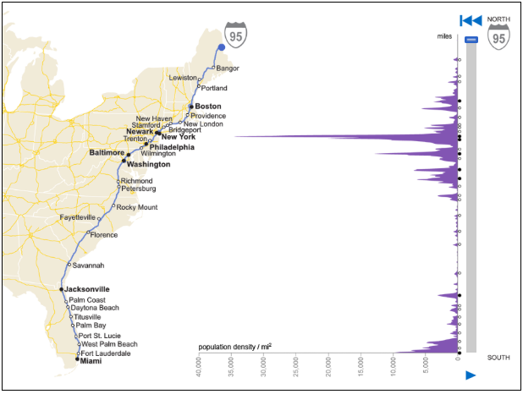
Motivation
Interstate 95 corridor from Boston through Washington D.C. = most densely populated region in U.S.
2010 Census (census.gov)

Slide 4
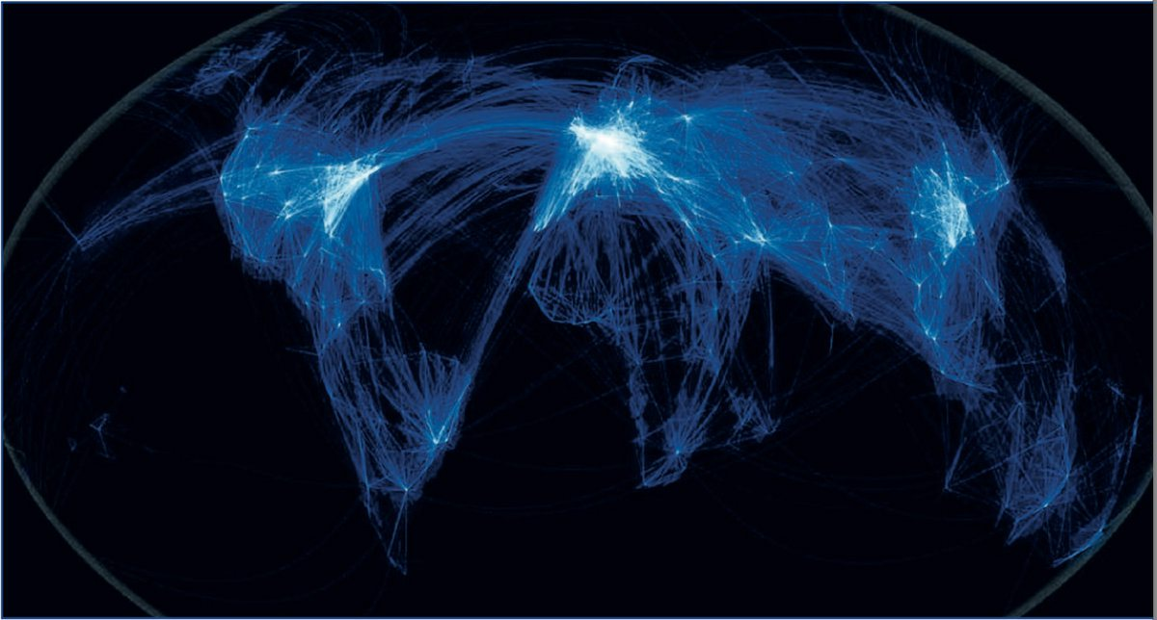
Motivation
Severe weather impacts on the aviation
8 of 25 busiest airports in the U.S. are found north of D.C. and east of Pittsburg, PA
Weather caused 63.88% of all National Airspace System delays between 2003–2015 (www.transtats.bts.gov).
ARUP Canada

Slide 5
Motivation
Severe weather impacts on the aviation
8 of 25 busiest airports in the U.S. are found north of D.C. and east of Pittsburg, PA
ARUP Canada

Slide 6
Motivation
Severe weather impacts on the aviation
8 of 25 busiest airports in the U.S. are found north of D.C. and east of Pittsburg, PA
ARUP Canada

Slide 7
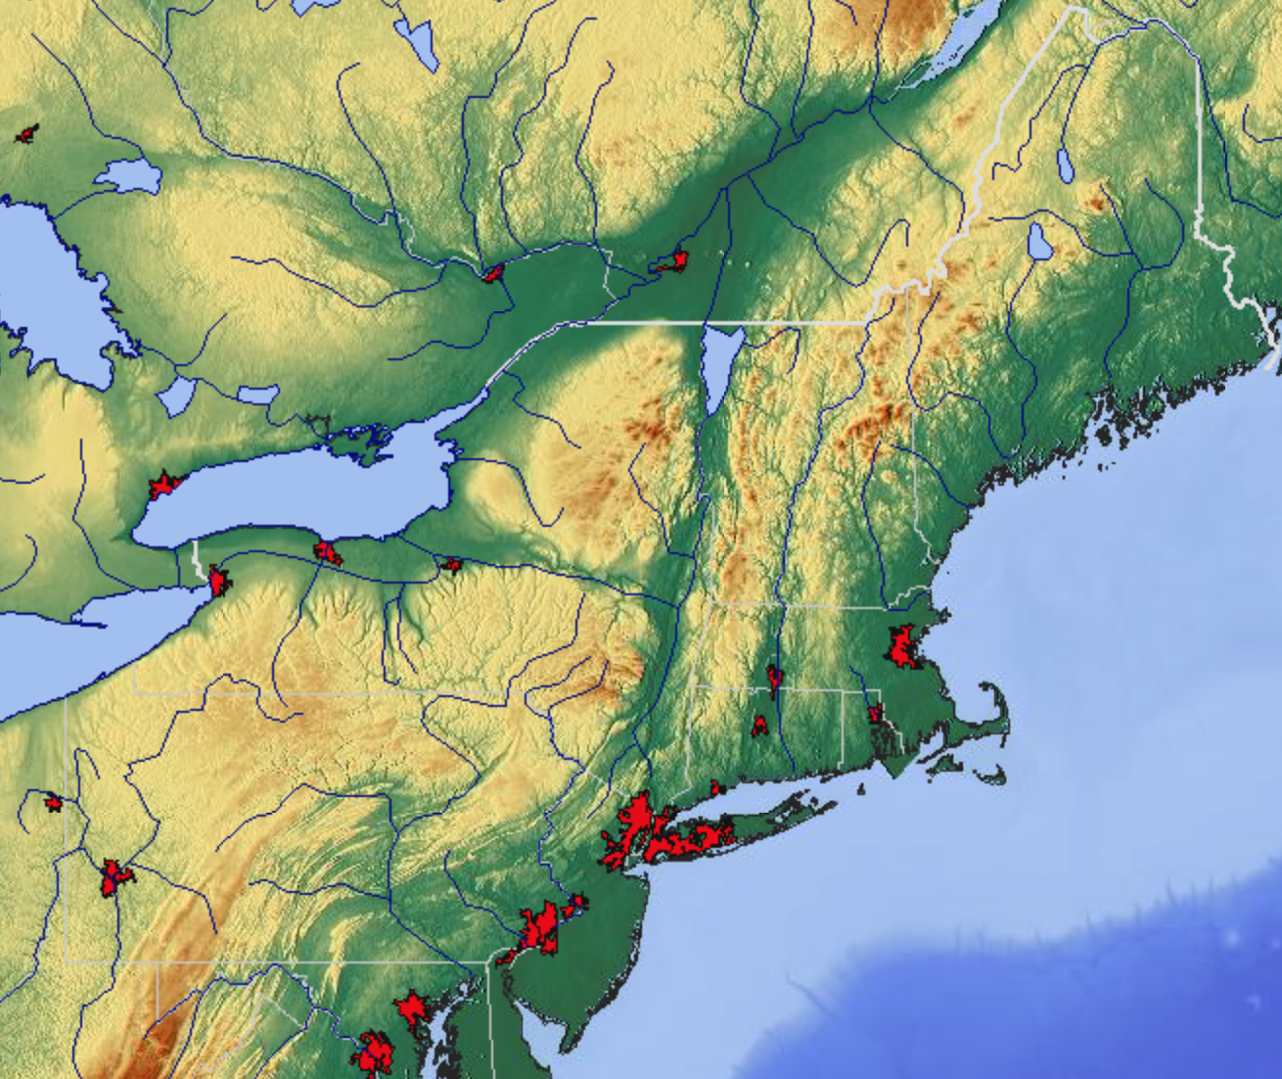
Motivation
The Northeast provides a challenging forecast environment
Complex terrain, lake-water boundaries
m
maps-for-free.com

Slide 8
Background Literature

Slide 9
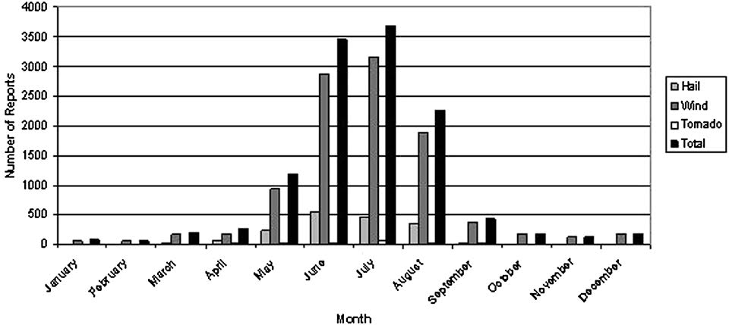
Background
Monthly climatology of severe reports in the Northeast (1999–2009)
Hurlbut and Cohen (2014)

Slide 10
Background
Monthly climatology of severe reports in the Northeast (1999–2009)
Hurlbut and Cohen (2014)

Slide 11
Background
Monthly climatology of severe reports in the Northeast (1999–2009)
Hurlbut and Cohen (2014)

Slide 12
Background
Recent research suggests MUCAPE is weaker for coastal Northeast severe linear events than non-severe MCSs in the Great Plains
Coastal Northeast
Lombardo and Colle (2011) [NARR reanalysis]

Slide 13
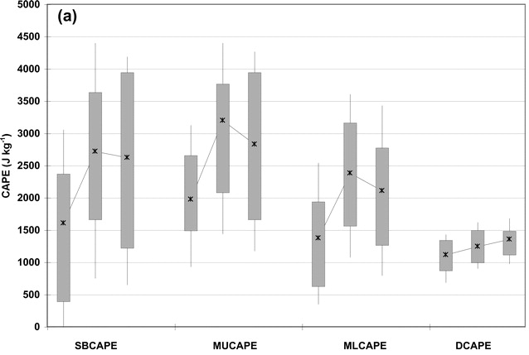
Background
Recent research suggests MUCAPE is weaker for coastal Northeast severe linear events than non-severe MCSs in the Great Plains
Great Plains
Coastal Northeast
Cohen et. al. (2007) [3-h proxy soundings]
Lombardo and Colle (2011) [NARR reanalysis]

Slide 14
Background
Recent research suggests MUCAPE is weaker for coastal Northeast severe linear events than non-severe MCSs in the Great Plains
Non-Severe MCS
Coastal Northeast
Cohen et. al. (2007) [3-h proxy soundings]
Lombardo and Colle (2011) [NARR reanalysis]

Slide 15
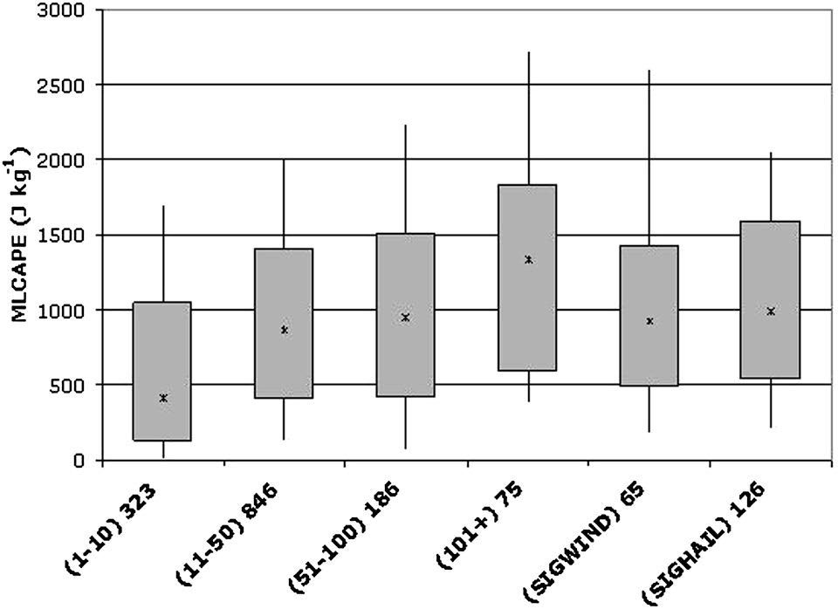
Background
Northeast CAPE
Hurlbut and Cohen (2014) used 6-h proximity soundings to evaluate Northeast severe weather environments
Hurlbut and Cohen (2014) [6-h proximity soundings]

Slide 16
Background
Northeast CAPE
Majority of events have MLCAPE < 1000 J kg⁻¹
Hurlbut and Cohen (2014) [6-h proximity soundings]

Slide 17
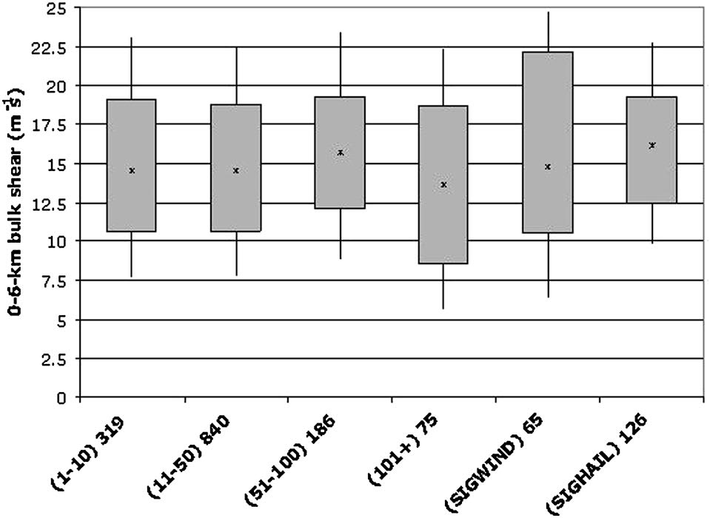
Background
Northeast deep-layer shear
Bulk wind shear (0–6 km) medians for all events hovers between ~13–16 m s⁻¹ (~25–31 kt)
Hurlbut and Cohen (2014) [6-h proximity soundings]

Slide 18
Background
Northeast deep-layer shear
Bulk wind shear (0–6 km) medians for all events hovers between ~13–16 m s⁻¹ (~25–31 kt)
Hurlbut and Cohen (2014) [6-h proximity soundings]

Slide 19
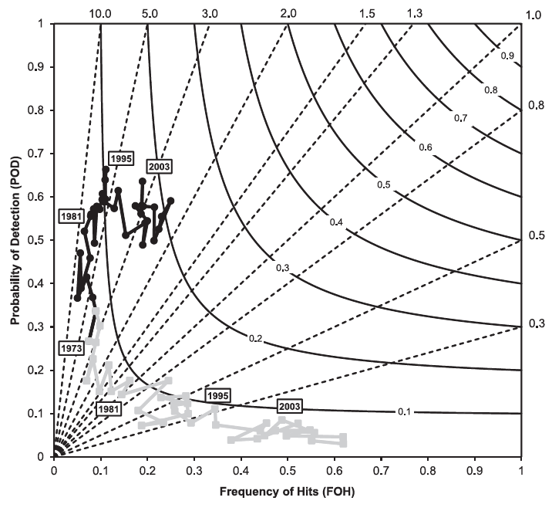
Background
Hitchens and Brooks (2012) verified SPC day-1 slight-risk convective outlooks over CONUS
Found increased forecast performance with time
Black line represents slight-risk performance
Gray line represents moderate-risk performance Source: Hitchens and Brooks(2012)

Slide 20
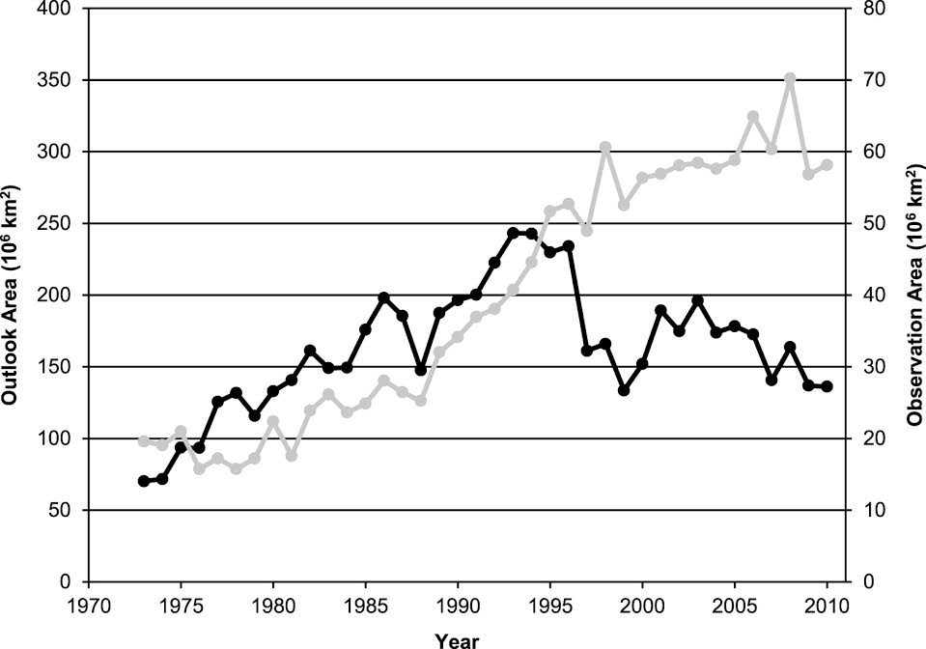
Background
Found increasing severe report areal coverage with time
Slight-risk outlook area peaks in 1994
Trend suggests better FOH scores are due to well-placed, smaller risk areas
Black line represents annual slight-risk outlook area
Gray line represents severe report area
Source: Hitchens and Brooks(2012)

Slide 21
Research Goals
Evaluate slight-risk forecast performance over the Northeast
Build database of events with poor forecast skill
Analyze environments conducive to poor forecast skill

Slide 22
Research Goals
Evaluate slight-risk outlook performance over the Northeast
Build database of events with poor forecast skill
Evaluate environments conducive to poor forecast skill

Slide 23
Methodology: Game Plan
Establish Northeast domain to evaluate forecast skill
Plot slight-risk convective outlook contours over the domain
Evaluate outlooks with valid storm reports and compare to CONUS verification
Similar verification methodology to Hitchens and Brooks (2012)
Mod and high contours within slight contours were included (i.e. everywhere inside the slight was treated the same)

Slide 24
Mod and High Outlooks Included
Notes:
Construct cartoon for slight risk evaluation method.
Choose cases to illustrate problem.
Move Venn Diagrams up into methodology section.

Slide 25
Mod and High Outlooks Included
Notes:
Construct cartoon for slight risk evaluation method.
Choose cases to illustrate problem.
Move Venn Diagrams up into methodology section.

Slide 26
Mod and High Outlooks Included
Notes:
Construct cartoon for slight risk evaluation method.
Choose cases to illustrate problem.
Move Venn Diagrams up into methodology section.

Slide 27
Mod and High Outlooks Included
Notes:
Construct cartoon for slight risk evaluation method.
Choose cases to illustrate problem.
Move Venn Diagrams up into methodology section.

Slide 28
Mod and High Outlooks Included
Notes:
Construct cartoon for slight risk evaluation method.
Choose cases to illustrate problem.
Move Venn Diagrams up into methodology section.

Slide 29
Mod and High Outlooks Included
Notes:
Construct cartoon for slight risk evaluation method.
Choose cases to illustrate problem.
Move Venn Diagrams up into methodology section.

Slide 30
Mod and High Outlooks Included
✓
Notes:
Construct cartoon for slight risk evaluation method.
Choose cases to illustrate problem.
Move Venn Diagrams up into methodology section.

Slide 31
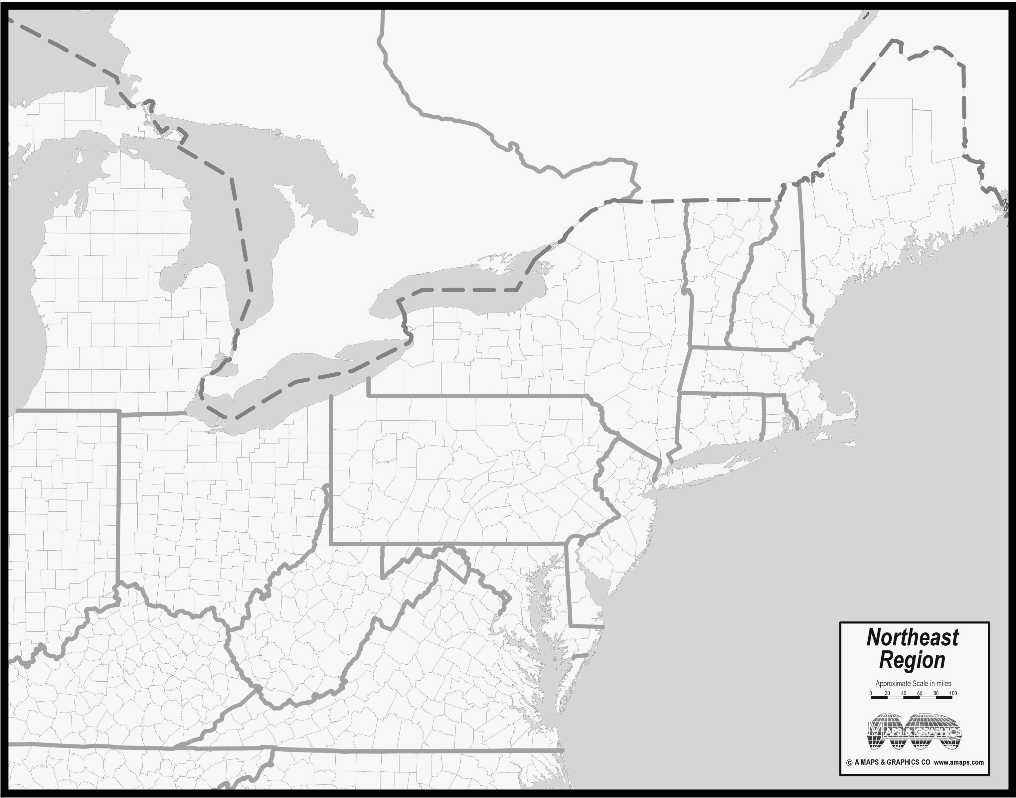
Northeast Domain
Courtesy of amaps.com
Notes:
Construct cartoon for slight risk evaluation method.
Choose cases to illustrate problem.
Move Venn Diagrams up into methodology section.

Slide 32
Northeast Domain
Here
Courtesy of amaps.com
Notes:
Construct cartoon for slight risk evaluation method.
Choose cases to illustrate problem.
Move Venn Diagrams up into methodology section.

Slide 33
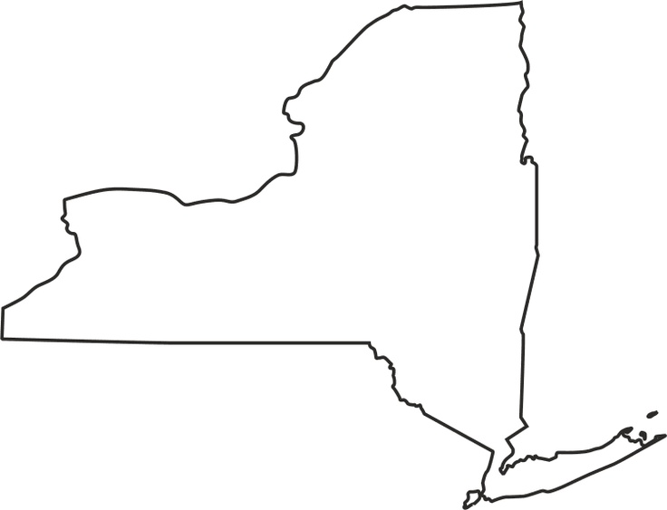
Algorithm Example
Notes:
Construct cartoon for slight risk evaluation method.
Choose cases to illustrate problem.
Move Venn Diagrams up into methodology section.

Slide 34
Algorithm Example
Notes:
Construct cartoon for slight risk evaluation method.
Choose cases to illustrate problem.
Move Venn Diagrams up into methodology section.

Slide 35
Algorithm Example
Slight Risk:
Issued: 0600 UTC
Valid: 1200 – 1200 UTC
40 km
Notes:
Construct cartoon for slight risk evaluation method.
Choose cases to illustrate problem.
Move Venn Diagrams up into methodology section.

Slide 36
Algorithm Example
40 km
Severe
report
Notes:
Construct cartoon for slight risk evaluation method.
Choose cases to illustrate problem.
Move Venn Diagrams up into methodology section.

Slide 37
Algorithm Example
Area of Influence
40 km
40 km
Severe
report
Notes:
Construct cartoon for slight risk evaluation method.
Choose cases to illustrate problem.
Move Venn Diagrams up into methodology section.

Slide 38
Algorithm Example
40 km
Notes:
Construct cartoon for slight risk evaluation method.
Choose cases to illustrate problem.
Move Venn Diagrams up into methodology section.

Slide 39
Algorithm Example
40 km
Miss ☹
Notes:
Construct cartoon for slight risk evaluation method.
Choose cases to illustrate problem.
Move Venn Diagrams up into methodology section.

Slide 40
Algorithm Example
40 km
Miss ☹
Correct Hit ☺
Notes:
Construct cartoon for slight risk evaluation method.
Choose cases to illustrate problem.
Move Venn Diagrams up into methodology section.

Slide 41
Algorithm Example
40 km
Miss ☹
Correct Hit ☺
False Alarm 😐
Notes:
Construct cartoon for slight risk evaluation method.
Choose cases to illustrate problem.
Move Venn Diagrams up into methodology section.

Slide 42
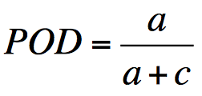
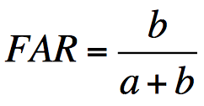
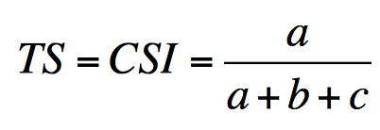
Methodology: Evaluation
Contingency Table | Observed Y | Observed N
Forecast (Y) | Correct Hit (A) | False Alarm (B)
Forecast (N) | Miss (C) | Correct null (D)
0 ≤ POD ≤ 1, best score: POD = 1, best score ≠ perfect forecast
0 ≤ FAR ≤ 1, best score: FAR = 0, best score ≠ perfect forecast
0 ≤ TS ≤ 1, best score: TS = 1, best score = perfect forecast
Notes:
Make a note on title position

Slide 43
Slight-risk skill Scores

Slide 44
Northeast and CONUS: TS
Median is plotted with the 25th and 75th percentiles in the whiskers.

Slide 45
Northeast and CONUS: Slight Risk Frequency

Slide 46
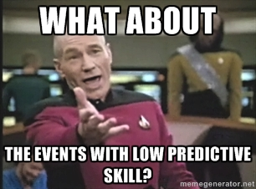

Slide 47
Research Goals
Evaluate slight-risk forecast performance over the Northeast
Build database of events with poor forecast skill
Evaluate environments conducive to poor forecast skill

Slide 48
Database Criteria
For inclusion in the 1980–2013 database, an event must meet at least 1 of 2 criteria:
Have a slight risk contour within the NE domain
Have a sufficiently high impact to warrant inclusion
How do we define “high impact”?
Notes:
For the CONUS dataset, you need either a SLIGHT contour or at least 20 reports for an event to be included. For inclusion in the Northeast Dataset, at least part of a SLIGHT risk area must be within the domain depicted on the previous slide or at least 20 reports within the same domain.

Slide 49
Northeast Severe Report Trend
Notes:
For the CONUS dataset, you need either a SLIGHT contour or at least 20 reports for an event to be included. For inclusion in the Northeast Dataset, at least part of a SLIGHT risk area must be within the domain depicted on the previous slide or at least 20 reports within the same domain.

Slide 50
Northeast Severe Report Trend
55th percentile linear regression
Notes:
Shift slides up and bolded axes.

Slide 51
Northeast Severe Report Trend
55th percentile linear regression
Notes:
Shift slides up and bolded axes.

Slide 52
Northeast Severe Report Trend
High impact!
55th percentile linear regression
Notes:
Shift slides up and bolded axes.

Slide 53
High-Impact Database: Quick Stats
Event days = 1503
Slight-risk days = 1300
High-impact events without slight-risk = 203

Slide 54
Types of Low-Predictability Events

Slide 55
Type 1 (Low POD) Example
Reports captured = 0 Reports missed = 200
POD = 0 FAR = N/A TS = 0

Slide 56
Type 1 (Low POD) Example
Reports captured = 0 Reports missed = 200
POD = 0 FAR = N/A TS = 0

Slide 57
Types of Low Predictability Events
Type 1
Low POD
Type 1
High impact
Lowest 25th percentile POD score
Expected little severe wx
Ends up over-performing
Notes:
Have only two circles and no overlap. Address hyphens in high impact

Slide 58
Type 2 (High FAR) Example
Reports captured = 2 Reports missed = 0
POD = 1 FAR = .986 TS = .014

Slide 59
Types of Low Predictability Events
Type 1
Low POD
Type 2
High FAR
Type 1
High impact
Lowest 25th percentile POD score
Type 2
Highest 25th percentile FA area
Lowest 25th percentile severe report area
Expected to perform well
Ends up under-performing
Notes:
Have only two circles and no overlap. Address hyphens in high impact

Slide 60
Types of Low Predictability Events
Type 1
Low POD
Type 2
High FAR
Type 1
High impact
Lowest 25th percentile POD score
Red Sox Events
Highest 25th percentile FA area
Lowest 25th percentile severe report area
Expected to perform well
Ends up under-performing
Notes:
Have only two circles and no overlap. Address hyphens in high impact

Slide 61
Types of Low Predictability Events
Type 1
High impact
Lowest 25th percentile POD score
Packers Events
Highest 25th percentile FA area
Lowest 25th percentile severe report area
Type 1
Low POD
Type 2
High FAR
Expected to perform well
Ends up under-performing
Notes:
Have only two circles and no overlap. Address hyphens in high impact

Slide 62
Types of Low Predictability Events
Type 1
Low POD
Type 2
High FAR
Type 1
High impact
Lowest 25th percentile POD score
Type 2
Highest 25th percentile FA area
Lowest 25th percentile severe report area
No events meet both requirements
Notes:
Have only two circles and no overlap. Address hyphens in high impact

Slide 63
Collect events with good forecast skill for comparison

Slide 64
Type of High Predictability Events
Good Event
High TS
Good Event
High impact
Highest 25th percentile threat score
Expected to perform well
Performs well (perhaps too well)
Notes:
Have only two circles and no overlap. Address hyphens in high impact

Slide 65
Type of High Predictability Events
Patriots Events
High impact
Highest 25th percentile threat score
Expected to perform well
Ends up performing well (perhaps too well)
Notes:
Have only two circles and no overlap. Address hyphens in high impact

Slide 66
Type of High Predictability Events
Patriots Events
High impact
Highest 25th percentile threat score
Expect to perform well
Performs well (perhaps too well)
Notes:
Have only two circles and no overlap. Address hyphens in high impact

Slide 67
Types of Low Predictability Events
Good Event
High TS
Good Event
High impact
Highest 25th percentile threat score
Expect to perform well
Performs well (perhaps too well)
Notes:
Have only two circles and no overlap. Address hyphens in high impact

Slide 68
High-impact, low-predictive skill Climatology

Slide 69
Annual Frequency
Notes:
Add in parenthetical reminder for low POD

Slide 70
Monthly Frequency
Notes:
Add in parenthetical reminder for low POD

Slide 71
Monthly Frequency
Notes:
Add in parenthetical reminder for low POD

Slide 72
Research Goals
Evaluate slight-risk forecast performance over the Northeast
Build database of events with poor forecast skill
Evaluate environments conducive to poor forecast skill

Slide 73
Event-Centered Composites

Slide 74
Event Centering Technique
0.5° NCEP Climate Forecast System Reanalysis (CFSR)
Chose morning (1200 UTC) for synoptic analysis, afternoon (1800 UTC) for severe weather parameter analysis
Type 1 and Good forecast events centered on the point of maximum report density
Composited April–September to capture majority (93%) of high-impact events
Type 2 events centered at centroid of the slight-risk region
Notes:
Type 1 event composites (1200z for these slides) are centered on the gridpoint of maximum report count per 1 degree of latitude-longitude (i.e. report density). If an event has several maximum densities of the same magnitude, the case was not included. Type 2 event composites are centered at the centroid of the largest slight risk area in the Northeast domain for a given event.

Slide 75
Event Climatology
Notes:
Add in parenthetical reminder for low POD

Slide 76
Event Climatology
Notes:
Add in parenthetical reminder for low POD

Slide 77
Event Climatology
Numbers indicate raw number of events. Green line indicates expected value based on methodology.
Notes:
Add in parenthetical reminder for low POD

Slide 78
Event Climatology
Numbers indicate raw number of events. Green line indicates expected value based on methodology.
Notes:
Add in parenthetical reminder for low POD

Slide 79
Severe weather Parameter analysis (MUCAPE & Deep-layer shear)

Slide 80
MUCAPE-Shear Phase Space
Low Shear, High CAPE (LSHC)
High Shear, High CAPE (HSHC)
High Shear, Low CAPE (HSLC)
Low Shear, Low CAPE (LSLC)
Notes:
Black dot at Center.
Make axes bigger
Black dot at center.
Bigger and better defined axes

Slide 81
MUCAPE-Shear Phase Space
LSHC
HSHC
31 knots
662 J kg⁻¹
LSLC
HSLC
Notes:
Black dot at Center.
Make axes bigger
Black dot at center.
Bigger and better defined axes

Slide 82
MUCAPE-Shear Phase Space
Notes:
Add in parenthetical reminder for low POD

Slide 83
MUCAPE-Shear Phase Space
Notes:
Add in parenthetical reminder for low POD

Slide 84
Threat Scores of High-Impact Events
Average threat scores of high-impact events occurring under low (< 31 kt) and high (≥ 31 kt) 1000–500-hPa shear. Whiskers are confidence intervals at the 99% level.
Notes:
Add in parenthetical reminder for low POD

Slide 85
Example Case

Slide 86
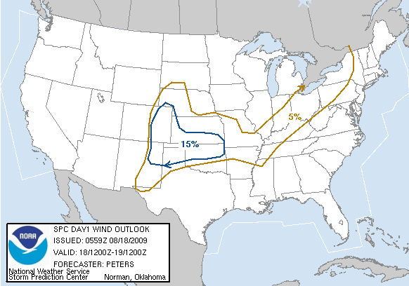
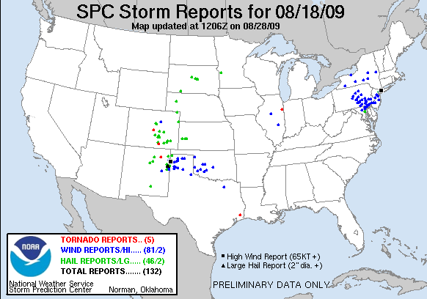
18 August 2009 Severe Wind Event (LSHC)
Type 1 under-predicted storm
SPC issued 5% wind outlook for Northeast
Notes:
Be consistent with acronyms

Slide 87
Synoptic Overview
250 hPa
1600 UTC 18 August 2009
250-hPa geopotential height (dam, black contours), 250-hPa winds (knots, shaded and barbed), divergence (× 10⁻⁵ s⁻¹, red contours)
Notes:
Title format. Check caption exponentiation

Slide 88
Synoptic Overview
500 hPa
1600 UTC 18 August 2009
500-hPa geopotential height (dam, black contours), 500-hPa winds (knots, barbed), 500-hPa relative vorticity (×10⁻⁵ s⁻¹, shaded)

Slide 89
Synoptic Overview
SBCAPE & shear
1600 UTC 18 August 2009
700–500-hPa lapse rate (K/km, black contours), 1000–500-hPa shear (knots, barbed), surface-based CAPE(J/kg, shaded)
Notes:
FORMAT FORMAT FORMAT. Exponentials and capitalizations. Make barbs a different color and bold. Remove words

Slide 90
Morning Sounding: Convective Initiation
MLCAPE: 1948 J kg⁻¹
MLCIN: -167 J kg⁻¹
6-km shear: 12 kt
3-km shear: ~28 kt
DCAPE: 510 J kg⁻¹
Notes:
Think about just one sounding for CI locations. Look at abbreviations and correct them in Titles

Slide 91
Morning Sounding: Severe Report Location
MLCAPE: 2192 J kg⁻¹
MLCIN: -233 J kg⁻¹
6-km shear: 12 kt
DCAPE: 1294 J kg⁻¹
Notes:
Crop out Hodo and down for clarity

Slide 92
WAL Sounding Climatology
DCAPE: 1294 J/kg

Slide 93
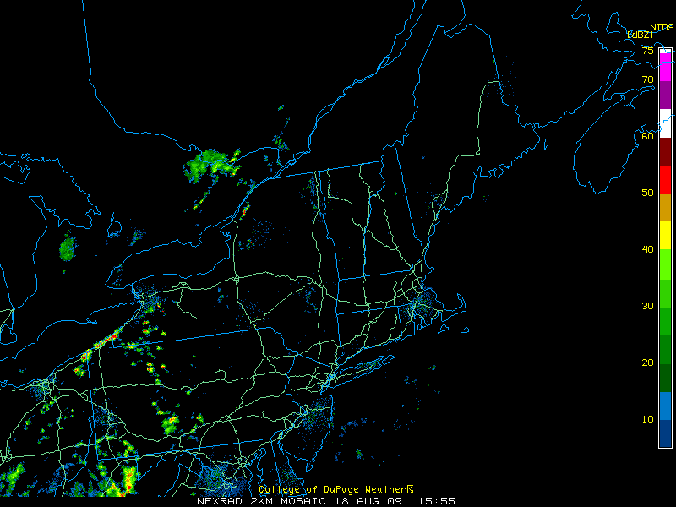
Radar 1600 UTC 18 Aug
Notes:
Over the great Lakes instead of off the coast.
Just radar image lead off

Slide 94
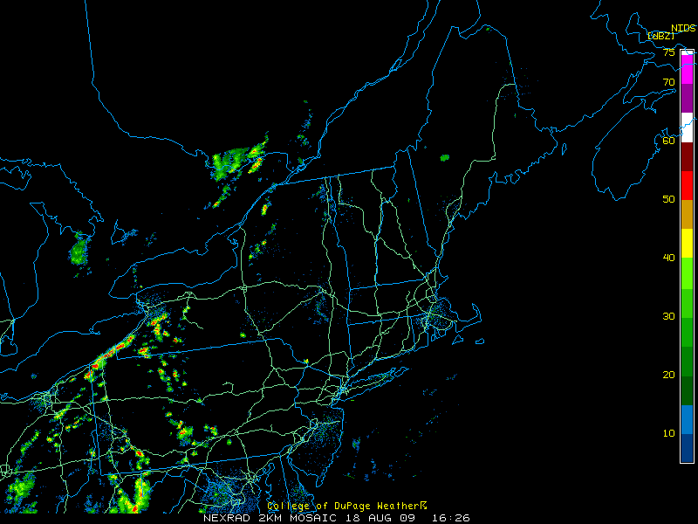
Radar 1630 UTC 18 Aug
Notes:
Over the great Lakes instead of off the coast.
Just radar image lead off

Slide 95
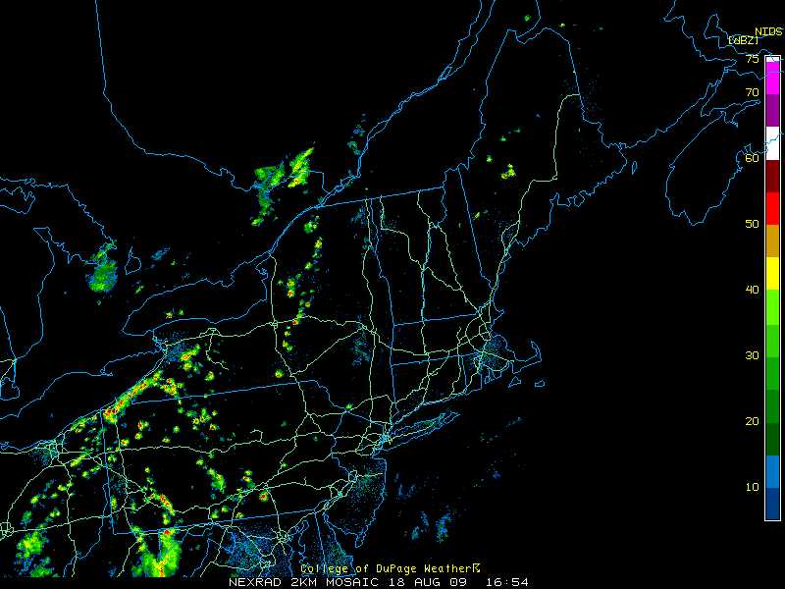
Radar 1700 UTC 18 Aug
Notes:
Over the great Lakes instead of off the coast.
Just radar image lead off

Slide 96
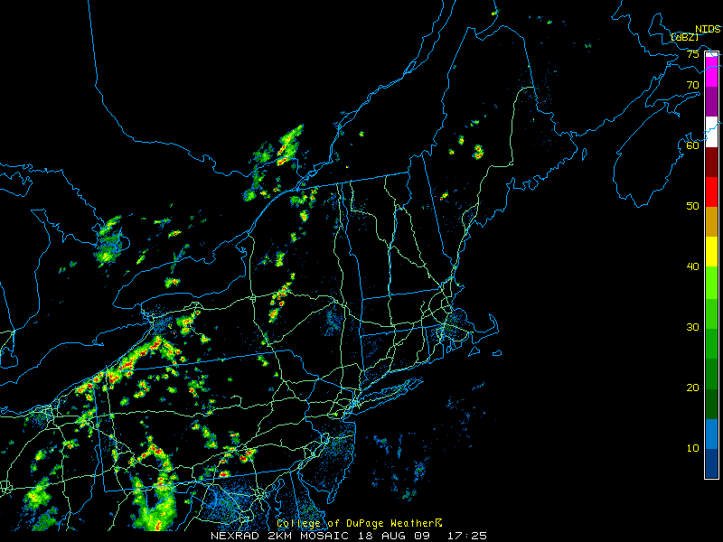
Radar 1730 UTC 18 Aug
Notes:
Over the great Lakes instead of off the coast.
Just radar image lead off

Slide 97
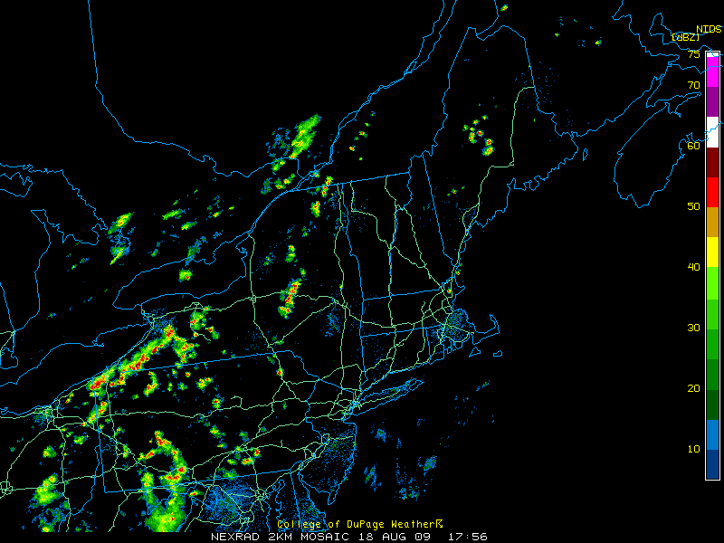
Radar 1800 UTC 18 Aug
Notes:
Over the great Lakes instead of off the coast.
Just radar image lead off

Slide 98
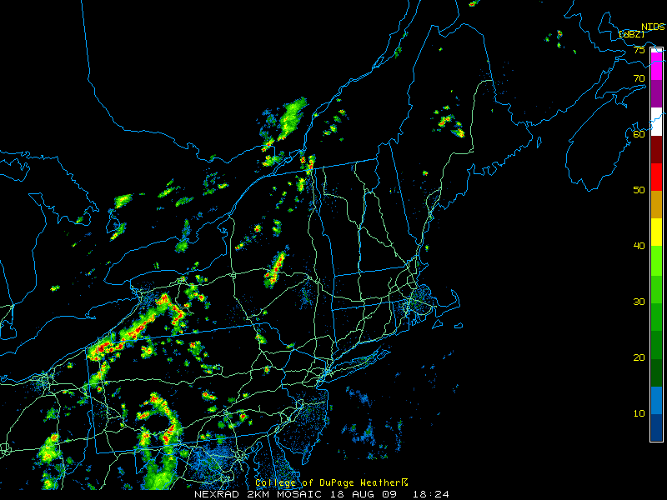
Radar 1830 UTC 18 Aug
Notes:
Over the great Lakes instead of off the coast.
Just radar image lead off

Slide 99
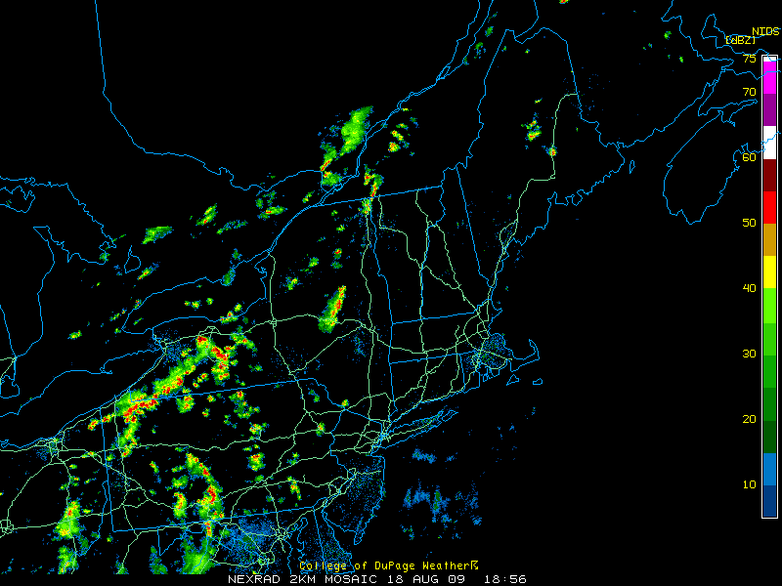
Radar 1900 UTC 18 Aug
Notes:
Over the great Lakes instead of off the coast.
Just radar image lead off

Slide 100
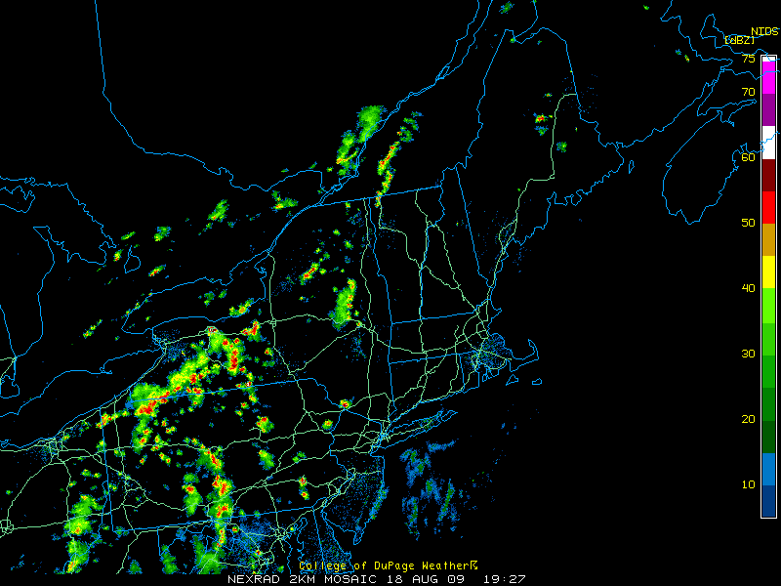
Radar 1930 UTC 18 Aug

Slide 101
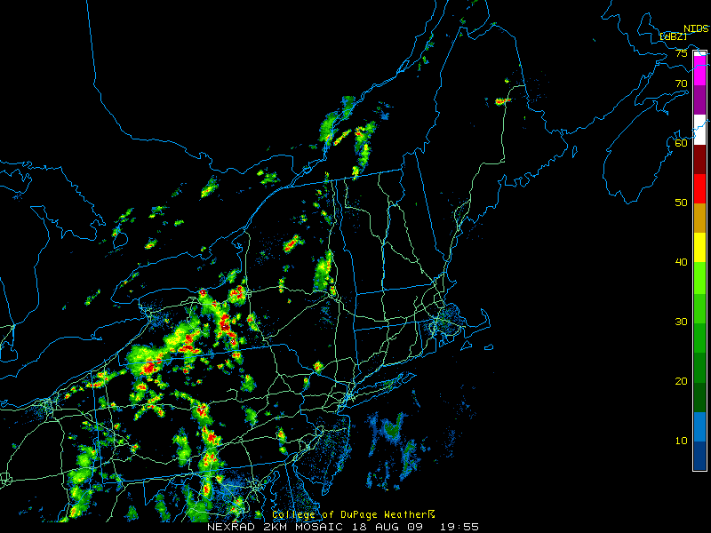
Radar 2000 UTC 18 Aug

Slide 102
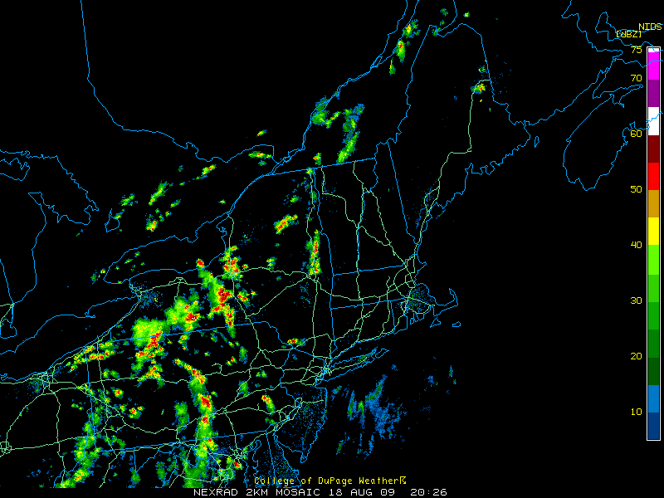
Radar 2030 UTC 18 Aug
Source: UCAR

Slide 103
Radar 2100 UTC 18 Aug

Slide 104
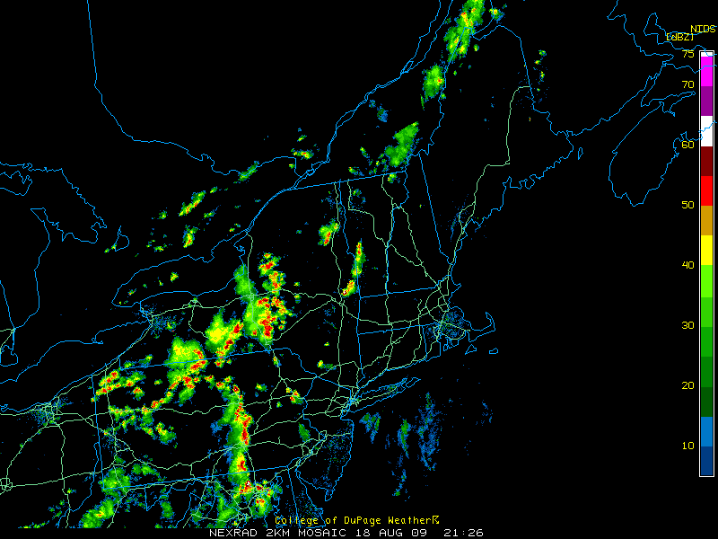
Radar 2130 UTC 18 Aug

Slide 105
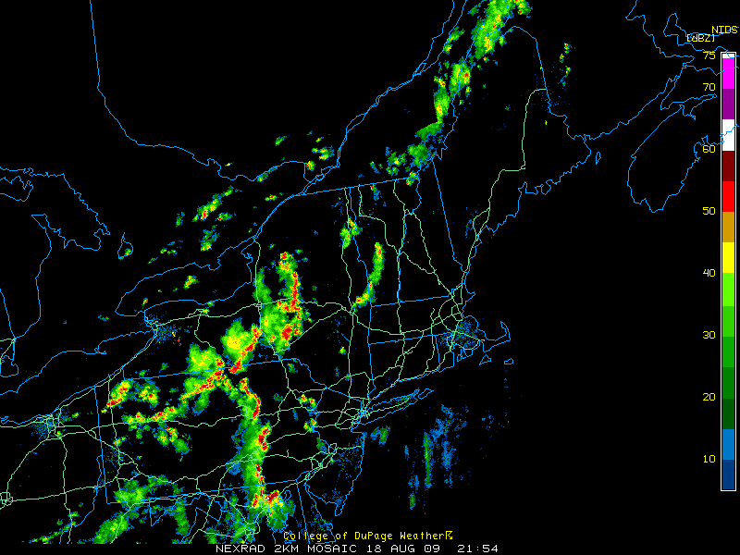
Radar 2200 UTC 18 Aug

Slide 106
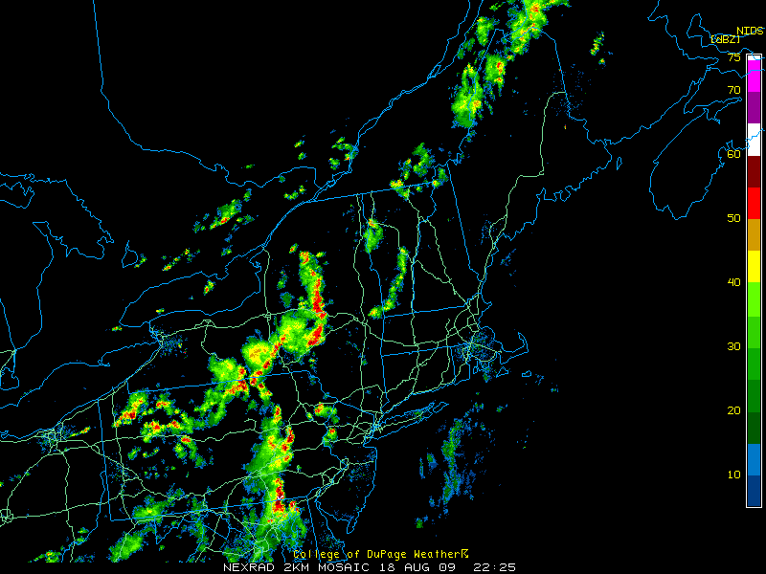
Radar 2230 UTC 18 Aug

Slide 107
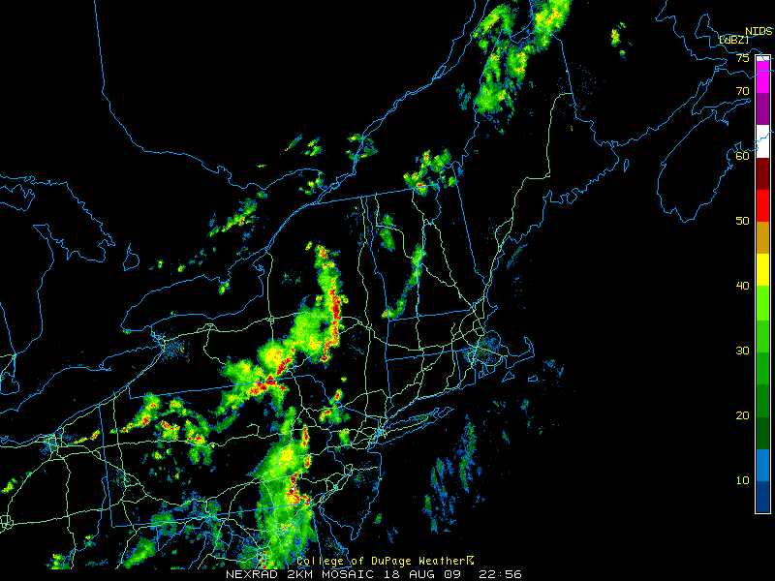
Radar 2300 UTC 18 Aug

Slide 108
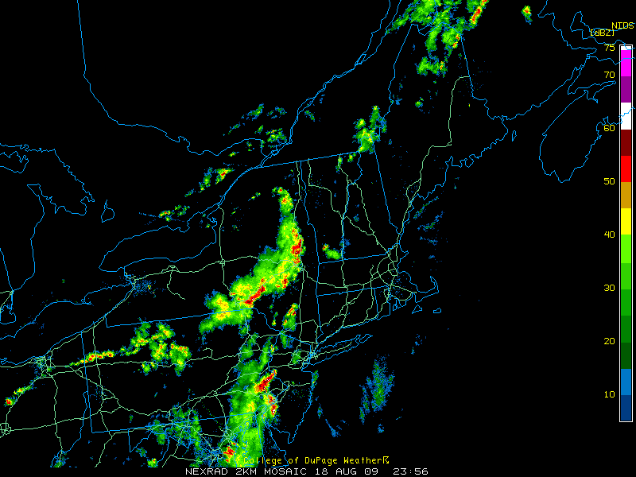
Radar 0000 UTC 19 Aug

Slide 109
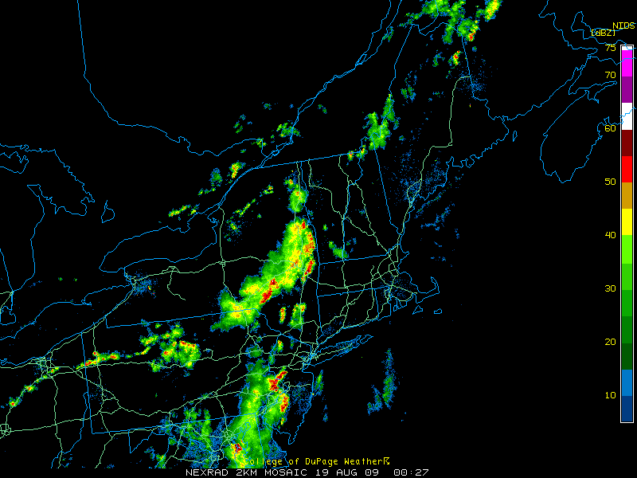
Radar 0030 UTC 19 Aug

Slide 110
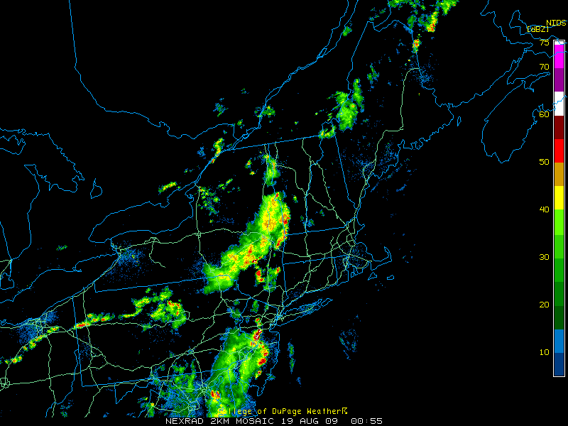
Radar 0100 UTC 19 Aug

Slide 111
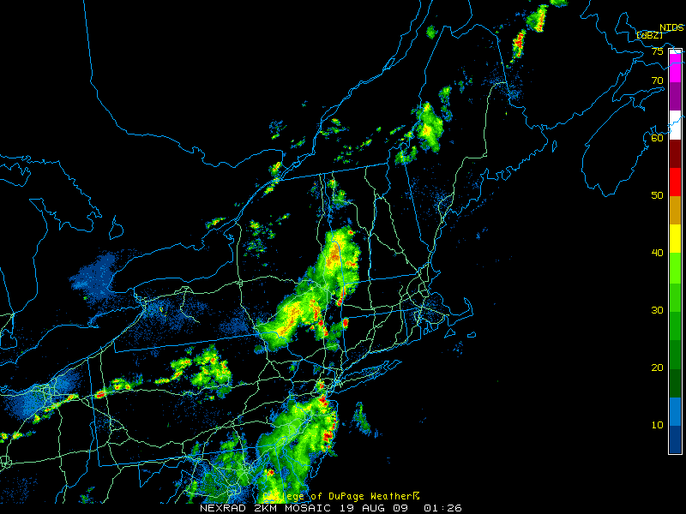
Radar 0130 UTC 19 Aug

Slide 112
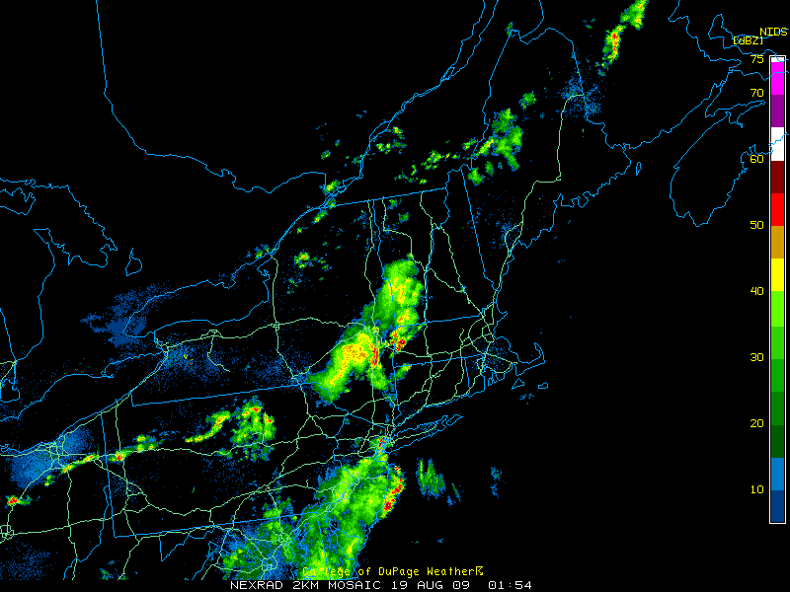
Radar 0200 UTC 19 Aug

Slide 113
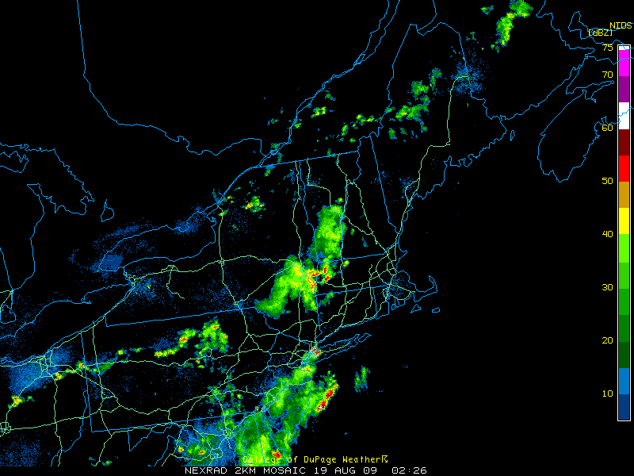
Radar 0230 UTC 19 Aug

Slide 114
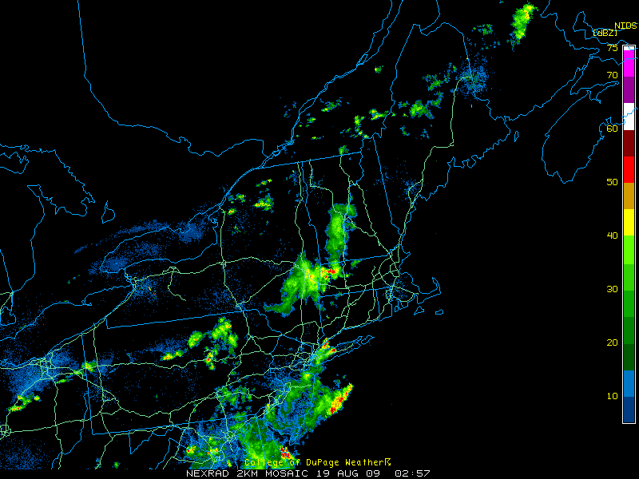
Radar 0300 UTC 19 Aug

Slide 115
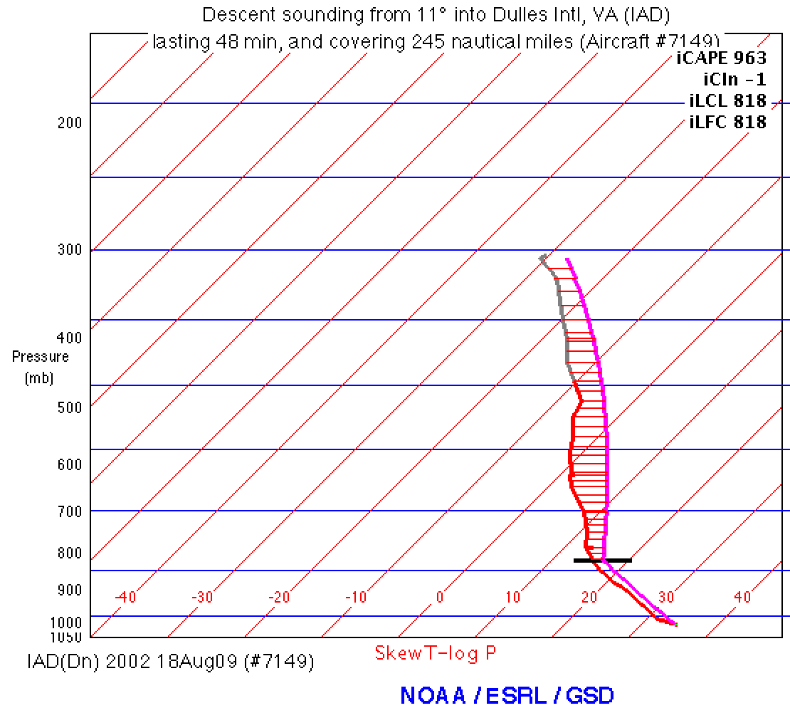
Radar 2000 UTC 18 Aug
Surface parcel: T = 35 °C and T_{D} = 17 °C

Slide 116
Radar 0000 UTC 19 Aug

Slide 117
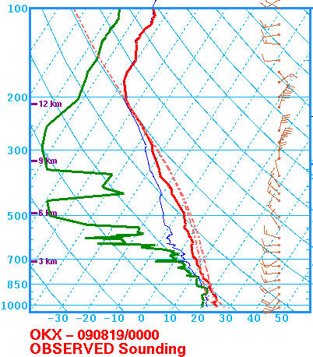
Radar 0000 UTC 19 Aug
MLCAPE: 1945 J kg⁻¹
MLCIN: -178 J kg⁻¹
6-km shear: 16 kt
DCAPE: 1199 J kg⁻¹
77 kt wind gust at 0233 UTC

Slide 118
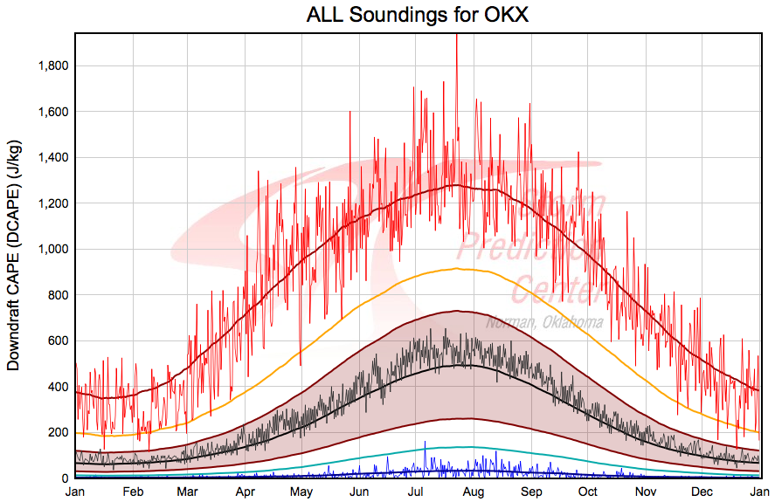
Radar 0000 UTC 19 Aug
MLCAPE: 1945 J kg⁻¹
MLCIN: -178 J kg⁻¹
6-km shear: 16 kt
DCAPE: 1199 J kg⁻¹
77 kt wind gust at 0233 UTC

Slide 119
Case Summary
Low Shear High CAPE (LSHC) event.
Weak synoptically forced environment
Orography and lake boundaries critical in convective initiation
Convective initiation environment differed from environment to the east where most severe reports occurred.
Type 1 LSHC cases often feature storms propagating into environments with higher PBL heights and greater DCAPE
In the absence of strong low-to-mid level flow and large vertical wind shear, large DCAPE and high PBL heights likely contribute to the severe wind threat

Slide 120
General Summary
Low-predictive skill climatology results:
Northeast has better threat scores than CONUS
Peak in JJA for low-POD events, little yearly variation
Most common under westerly, southwesterly, and northwesterly 500-hPa flow regimes
High-FAR events not as common in recent years
Composite results:
Deep-layer shear a significant predictive skill discriminator
Northerly, northwesterly, and southerly flow regimes have lowest skill
Synoptic setup similar between good and low-POD cases but key features (trough, baroclinicity, etc.) stronger in good cases
Case study results:
Low-POD, low-shear events often propagate into higher-PBL, higher-DCAPE environments
High shear, low CAPE low-POD events often exhibit insolation-driven, high-PBL instability
Notes:
CAPITALIZATION. Hyphens for modification only.

Slide 121
Acknowledgements
Family (parents, siblings Meghan and Chris)
Drs. Lance Bosart & Brian Tang
UAlbany faculty and staff
Teachers at ERAU and in Berkshire County
Fellow graduate students
Notes:
CAPITALIZATION. Hyphens for modification only.

Slide 122
FIN

Slide 123
Northeast and CONUS: POD
Median is plotted with the 25th and 75th percentiles in the whiskers.

Slide 124
Northeast and CONUS: FAR
Median is plotted with the 25th and 75th percentiles in the whiskers.

Slide 125
