Slide 1
The Influence of Boundary Layer Mixing on the Evolution of an Extratropical Cyclone
Matthew Vaughan and Robert Fovell
WRF Workshop
14 June 2018

Slide 2
Motivating Question
How do boundary layer (PBL) turbulent mixing processes impact the development and evolution of baroclinic cyclones?

Slide 3
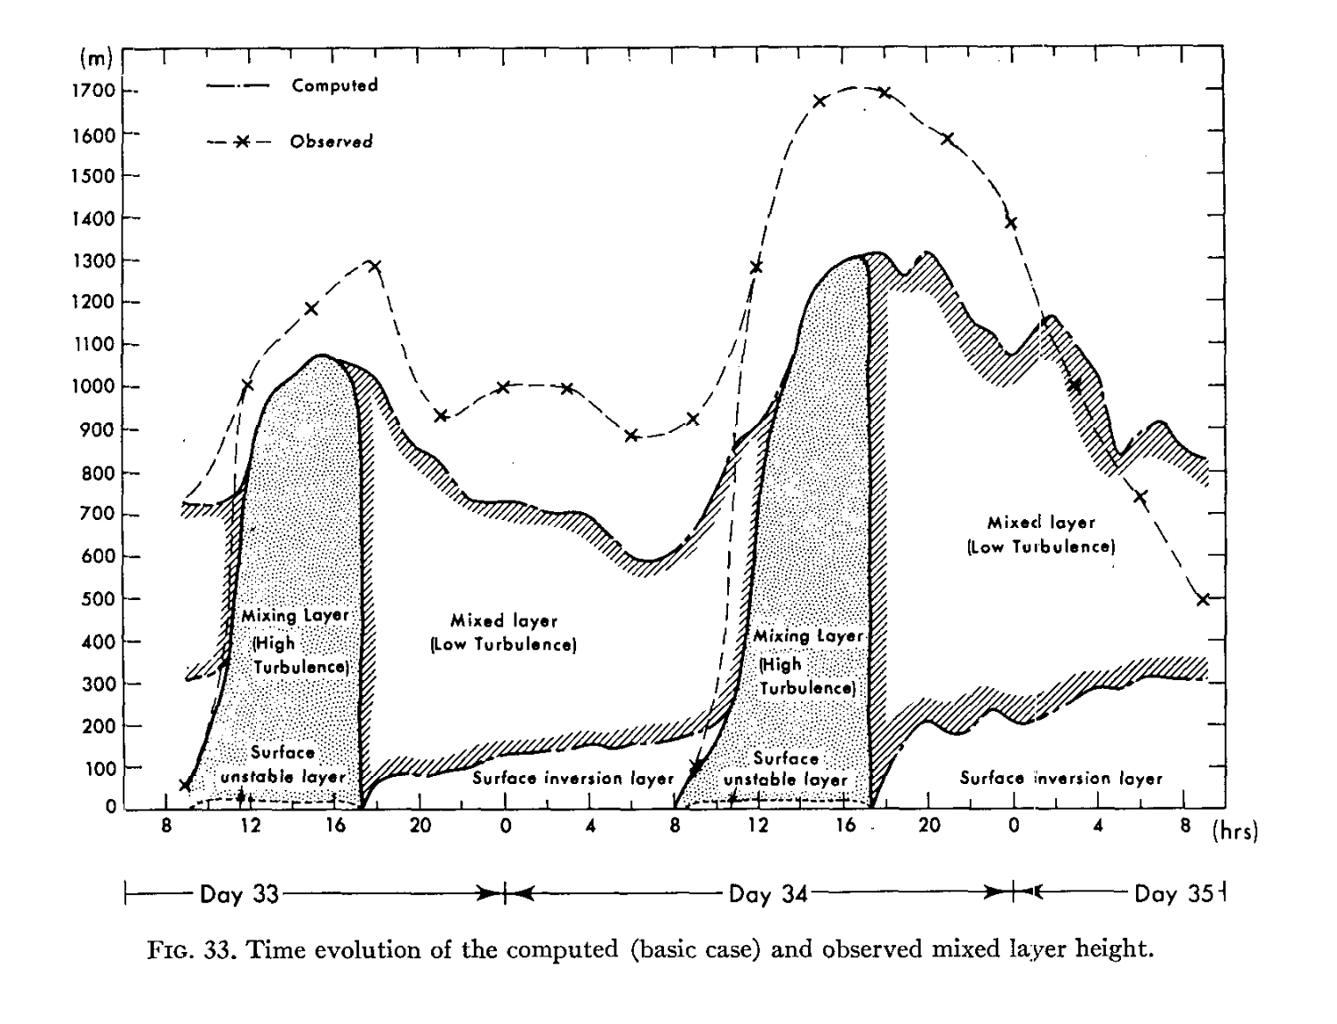
Motivating Question
How do boundary layer (PBL) turbulent mixing processes impact the development and evolution of baroclinic cyclones?
Yamada and Mellor (1975)
Nasa.gov

Slide 4
Background
How can the boundary layer affect cyclone development and evolution?

Slide 5
Background
How can the boundary layer affect cyclone development and evolution?
Dry processes
PV generation (dry) through Ekman pumping and baroclinic processes (Adamson et al. 2005, Beare 2007)

Slide 6
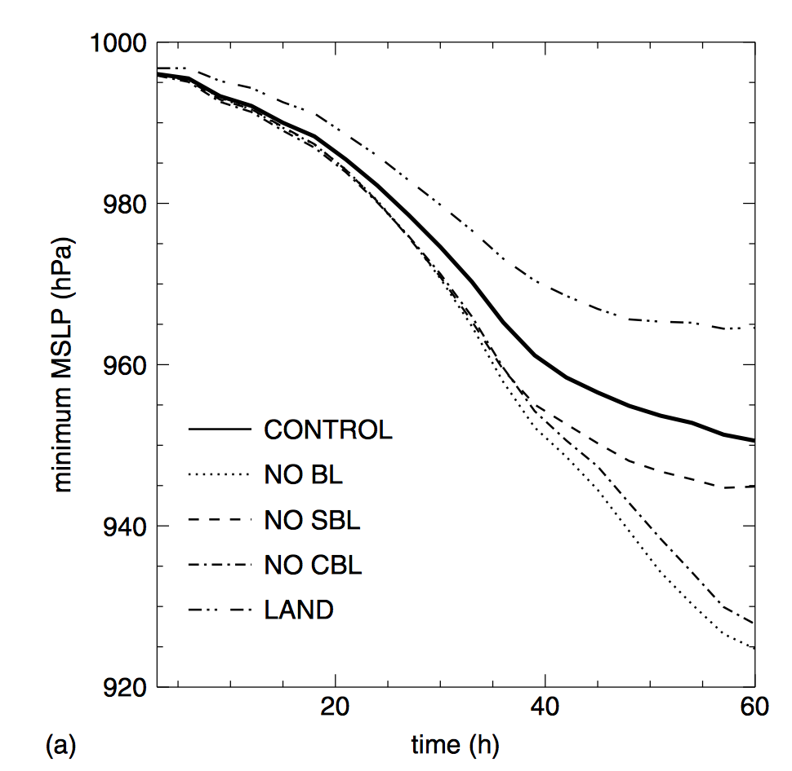
Background
Beare (2007) found sensitivity to cyclone evolution through stable/unstable PBL mixing activation
PBL Mixing Sensitivity
Turning off PBL mixing in the unstable cold-sector boundary layer increased deepening by 22.5 hPa
Turning off all mixing produced ~25hPa of deepening
Ekman pumping crucial
Figure 10. Time series of (a) the minimum mean-sea-level pressure over the cyclone for the coarse sensitivity experiment. (Beare 2007)
Notes:
----- Meeting Notes (9/26/17 13:44) -----
Keep this slide in and focus on it. The mention Adamson and Stoelinga (1995). Slim down and give a summary background slide, then a slide from Beare (2007). Not clear which PBL scheme is better, but focus on one for now.

Slide 7
Background
How can the boundary layer affect cyclone development and evolution?
Dry processes
PV generation (dry) through Ekman pumping and baroclinic processes (Adamson et al. 2005, Beare 2007)
Moist processes
Latent heating from parcels within the PBL can alter cyclone behavior
~70% of the low-level nondivergent circulation due to latent heating (Stoelinga 1996)

Slide 8
Does the PBL mixing matter in a real case?

Slide 9
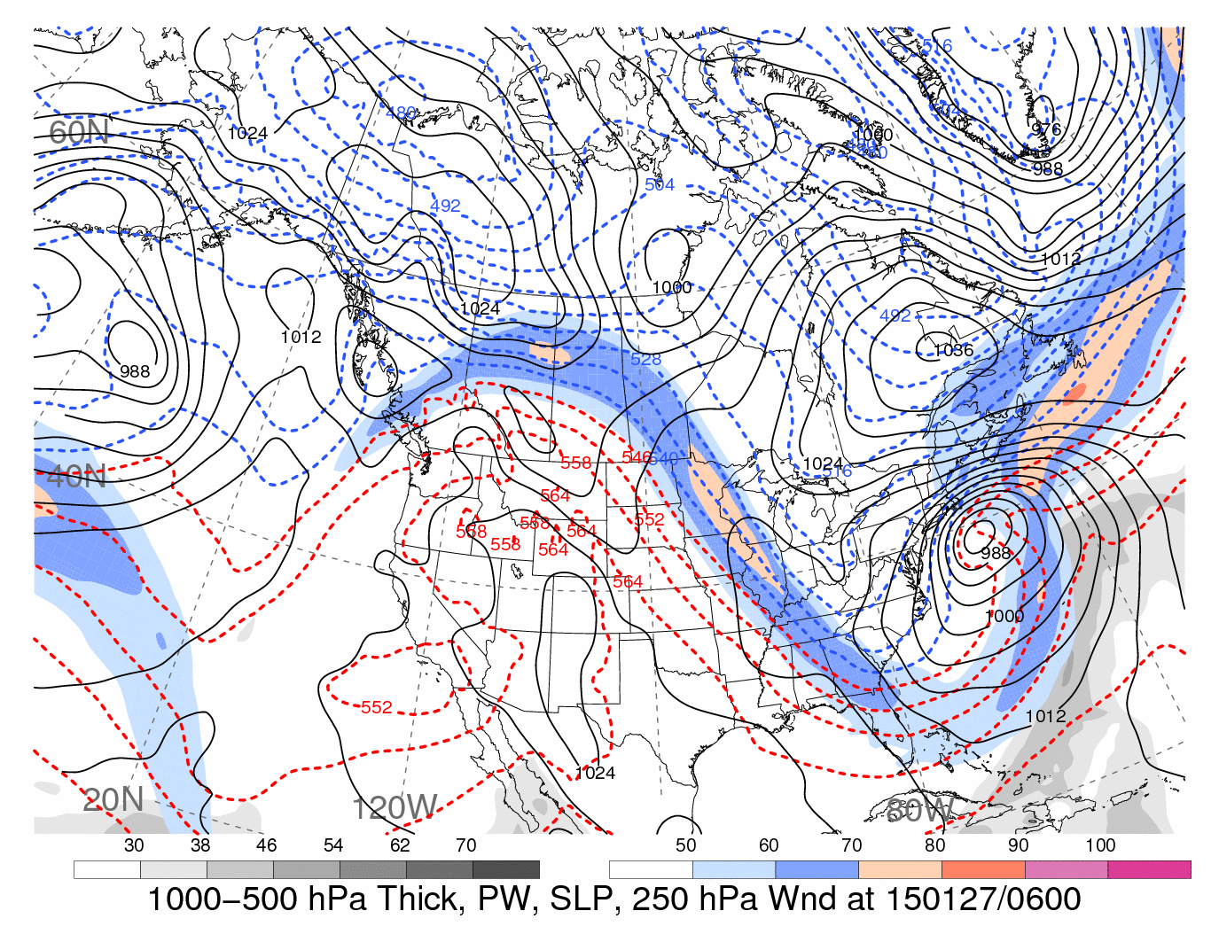
26–28 January 2015 Snowstorm
Coastal extratropical cyclone impacting New England and parts of the Mid-Atlantic
0600 UTC 27 January 2015 “Twitter” snowstorm
Courtesy: H. Archambault

Slide 10
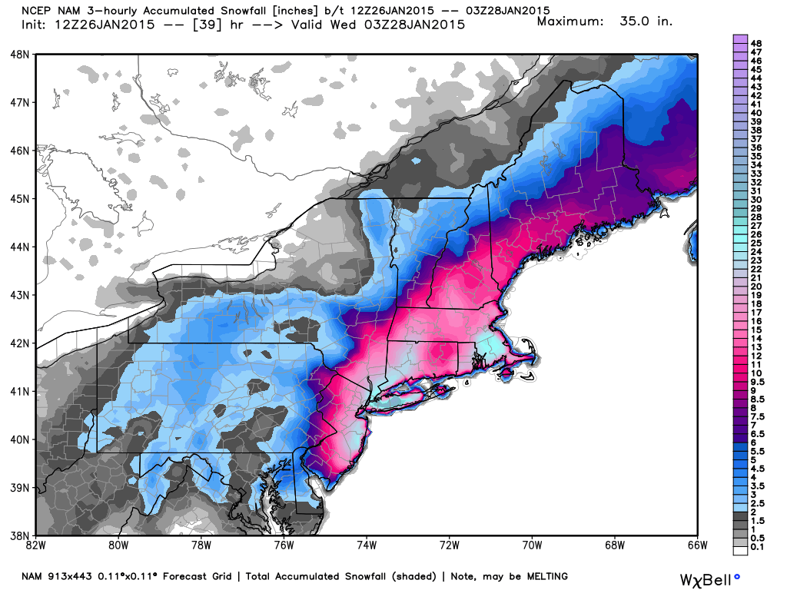
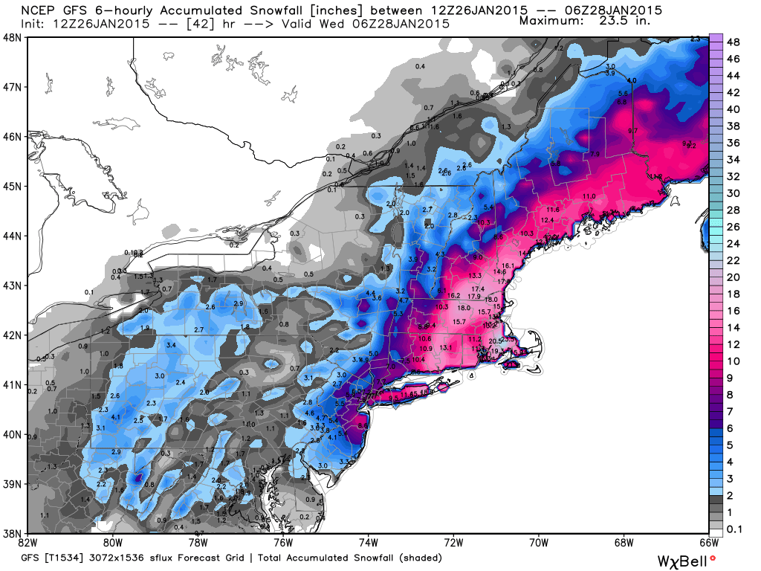
26–28 January 2015 Snowstorm
Substantial spread within the models
NAM
WeatherBell
GFS

Slide 11
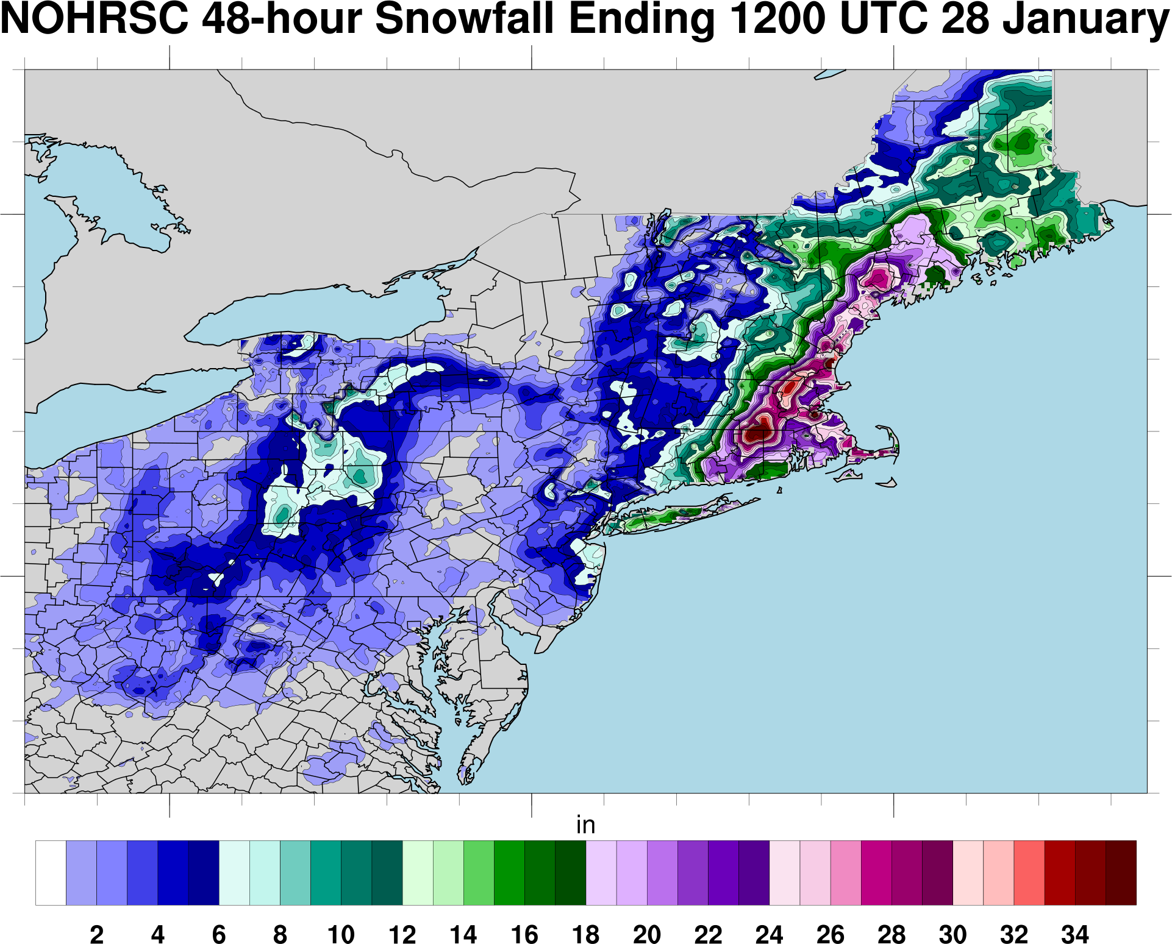
26–28 January 2015 Snowstorm
Crippling snowfall over much of the Northeast. Sharp gradient on western flank
National Operational Hydrologic Remote Sensing Center 48-h snowfall accumulation (in., shaded) ending 1200 UTC 28 January 2015.

Slide 12
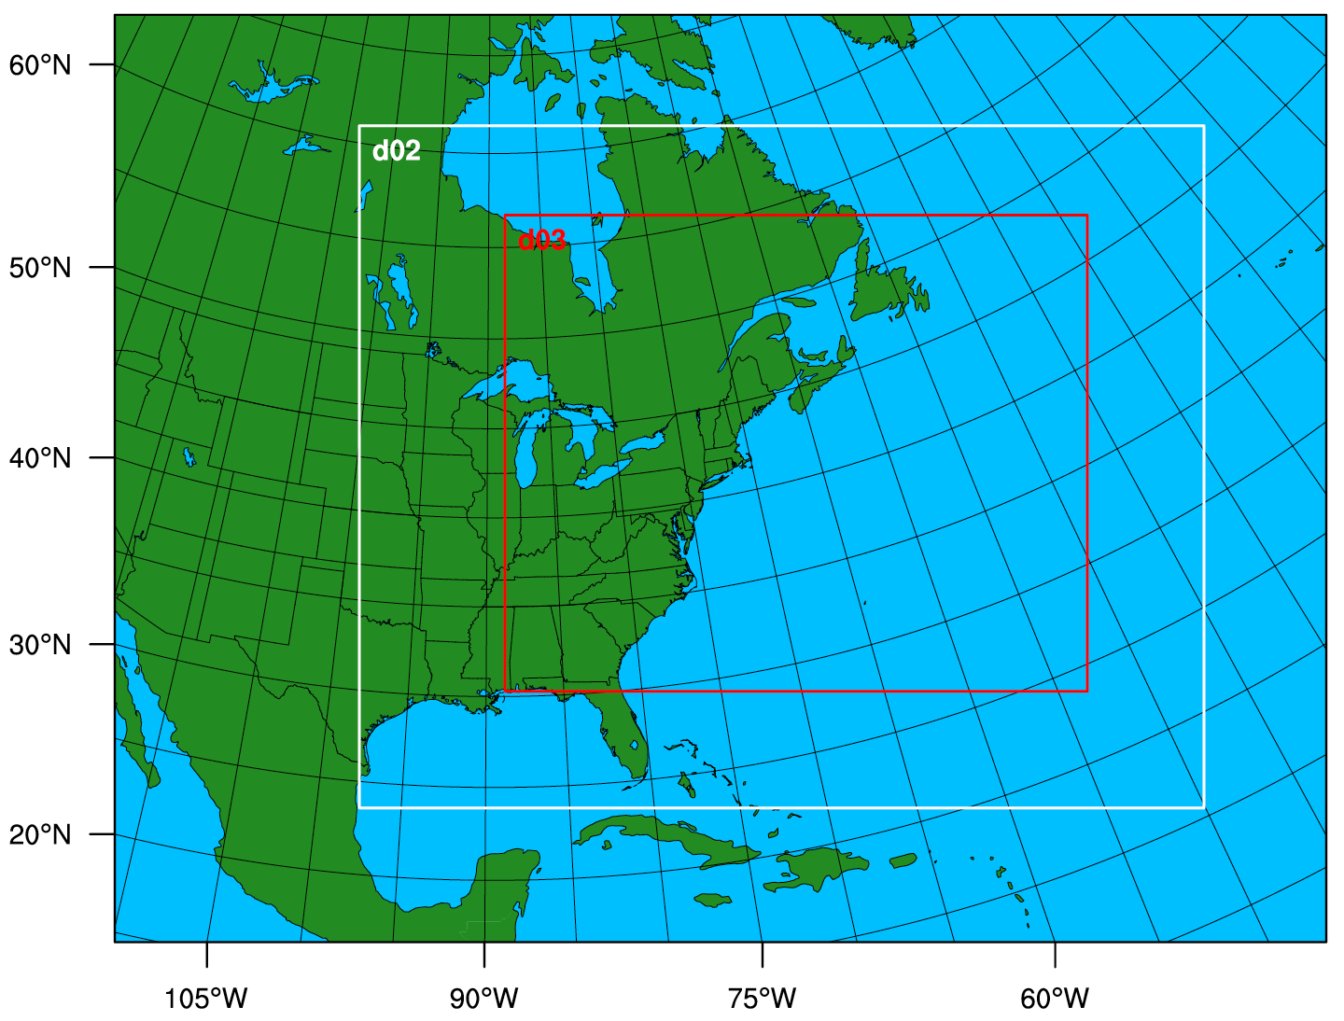
Experimental Design
Initialized: 0000 UTC 26 January 2015
72-h runtime
Data: ERA-I
4-km inner domain
Similar physics to RAP
Tested various PBL schemes

Slide 13
Results

Slide 14
YSU and ACM2

Slide 15
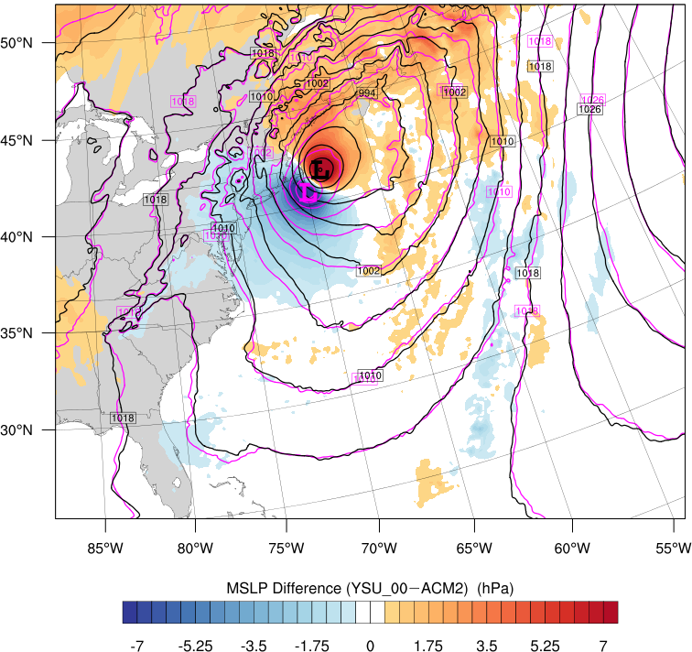
YSU and ACM2
MSLP Difference (hPa, fill; less mixing–more mixing) and MSLP (contoured; magenta = less mixing, black = more mixing)
Valid: 0800 UTC 28 Jan 2015

Slide 16
Impact of the Bulk Critical Richardson Number (BCR)
YSU and ACM2 have many differences, but both use a BCR to some degree to determine mixing

Slide 17
Impact of the Bulk Critical Richardson Number (BCR)
YSU and ACM2 have many differences, but both use a BCR to some degree to determine mixing
The BCR has a large influence on the behavior of various K-profile PBL schemes

Slide 18
Impact of the Bulk Critical Richardson Number (BCR)
The BCR has a large influence on the behavior of various K-profile PBL schemes
YSU_00 – ACM2
MSLP Difference (fill; less mixing–more mixing) and MSLP (contoured; magenta = less mixing, black = more mixing)
Valid: 0800 UTC 28 Jan 2015

Slide 19
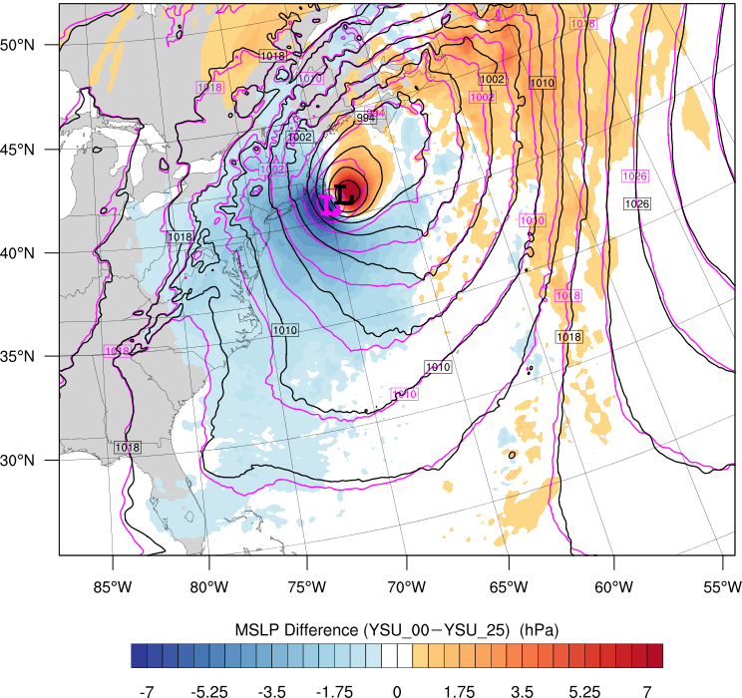
Impact of the Bulk Critical Richardson Number (BCR)
The BCR has a large influence on the behavior of various K-profile PBL schemes
YSU_00 – ACM2
YSU_00 – YSU_25
MSLP Difference (fill; less mixing–more mixing) and MSLP (contoured; magenta = less mixing, black = more mixing)
Valid: 0800 UTC 28 Jan 2015

Slide 20
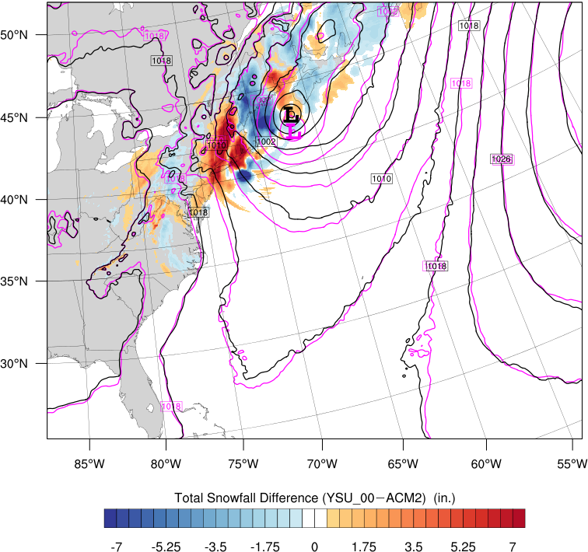
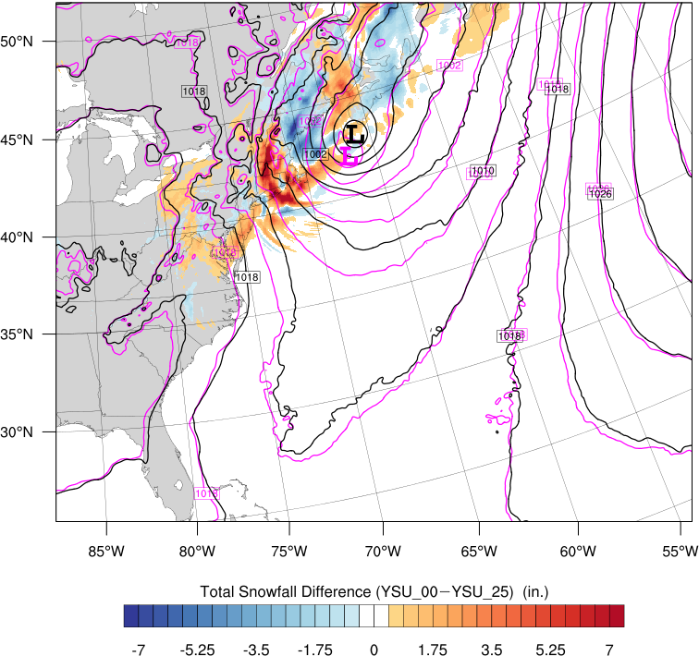
Impact of the Bulk Critical Richardson Number (BCR)
The BCR has a large influence on the behavior of various K-profile PBL schemes
YSU_00 – ACM2
YSU_00 – YSU_25
Snowfall Difference (fill; less mixing–more mixing) and MSLP (contoured; magenta = less mixing, black = more mixing)
Valid: 1200 UTC 28 Jan 2015

Slide 21
How does the Bulk Critical Richardson number work?

Slide 22
PBL Processes in WRF
Turbulent PBL processes are too small to resolve for km-scale models
Subgrid scale processes must be parameterized
Goal is to describe the mean turbulent vertical transport of heat, momentum and moisture by eddies
One common approach is through a nonlocal (e.g., YSU), K-profile scheme
Notes:
----- Meeting Notes (9/26/17 13:44) -----
Much easier to constrain the experiment using the YSU scheme.

Slide 23
Eddy Diffusivity
How do you obtain an eddy diffusivity (K) profile?
Develop it (MYJ)
Impose it (YSU)
Stensrud (2007)
Hong and Pan (1996)

Slide 24
YSU Scheme
YSU scheme estimates PBL height and imposes K-profile shape function
First guess PBL height (h) is where the bulk Richardson number equals the bulk critical Richardson number (BCR)
Hong et al. (2006)

Slide 25
YSU Scheme
Strength and height of PBL mixing are functions of BCR

Slide 26
YSU Scheme
Strength and height of PBL mixing are functions of BCR
Can leverage BCR to control mixing strength
Benefit of using YSU scheme for this study
Less mixing = 0.00 BCR
More mixing = 0.25 BCR
BCR changed for unstable surface layers only

Slide 27
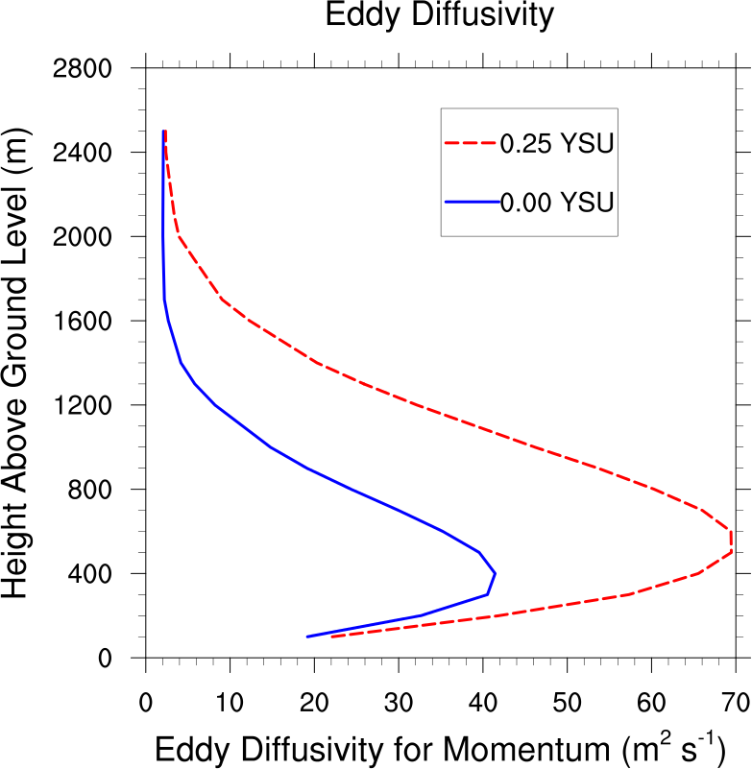
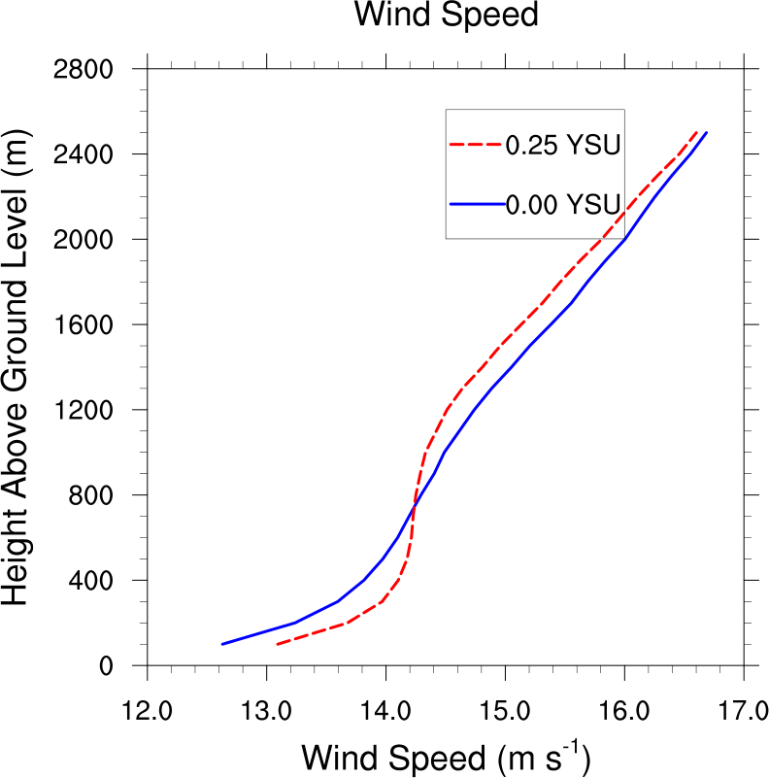
Sample Vertical Profiles in the Warm Sector
Enhanced eddy diffusivity in the warm sector results in expected changes to vertical profiles of wind speed and mixing ratio

Slide 28
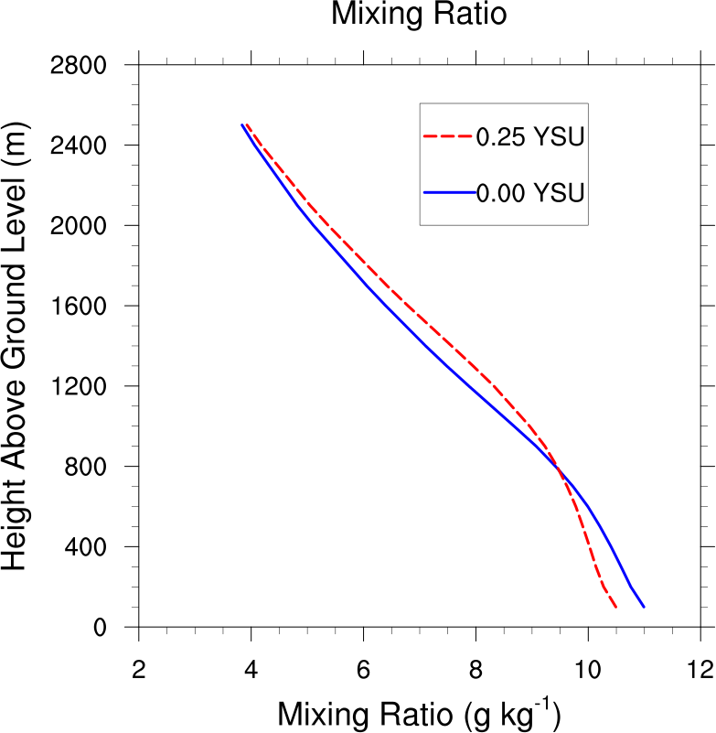
Sample Vertical Profiles in the Warm Sector
Enhanced eddy diffusivity in the warm sector results in expected changes to vertical profiles of wind speed and mixing ratio

Slide 29
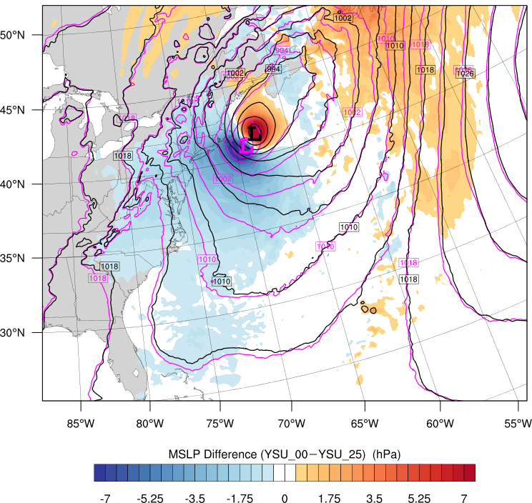
MSLP Difference (fill; less mixing–more mixing) and MSLP (contoured; magenta = less mixing, black = more mixing)
0600 UTC 28 January

Slide 30
Snowfall accumulation difference (in., shaded) and MSLP (hPa, contoured) for (magenta) less mixing run and (black) more mixing run valid 1200 UTC 28 January.
1200 UTC 28 January

Slide 31
26–28 January Snowstorm
Less mixing surface cyclone lags behind more mixing surface cyclone
More snowfall on western flank with less mixing

Slide 32
26–28 January Snowstorm
Less mixing surface cyclone lags behind more mixing surface cyclone
More snowfall on western flank with less mixing
Robust with regard to:
Terrain

Slide 33
26–28 January Snowstorm
Less mixing surface cyclone lags behind more mixing surface cyclone
More snowfall on western flank with less mixing
Robust with regard to:
Terrain
Surface friction

Slide 34
26–28 January Snowstorm
Less mixing surface cyclone lags behind more mixing surface cyclone
More snowfall on western flank with less mixing
Robust with regard to:
Terrain
Surface friction
Random noise perturbations

Slide 35
26–28 January Snowstorm
Less mixing surface cyclone lags behind more mixing surface cyclone
More snowfall on western flank with less mixing
Robust with regard to:
Terrain
Surface friction
Random noise perturbations
Microphysics

Slide 36
However, when latent heating was turned off…

Slide 37
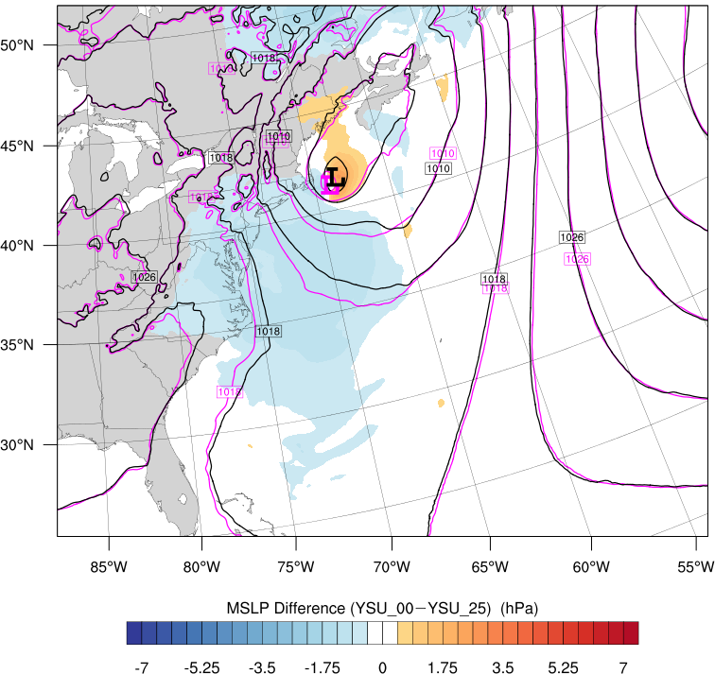
MSLP Difference (fill; less mixing–more mixing) and MSLP (contoured; Magenta = less mixing, Black = more mixing) for NO LATENT HEATING
0000 UTC 28 January

Slide 38
This suggests moisture and latent heating differences between the two mixing regimes may be responsible for the differences

Slide 39
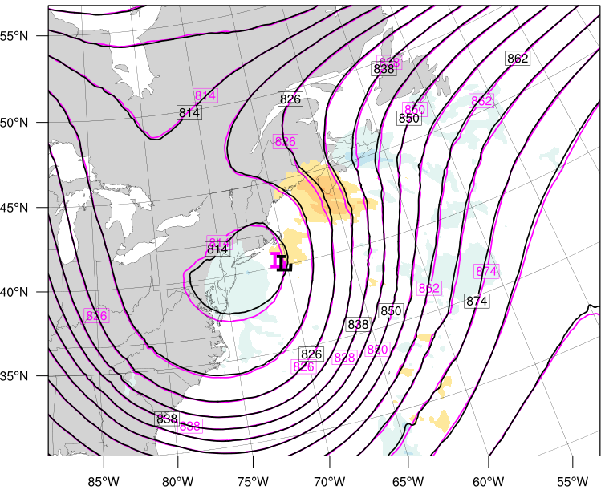
500–200-hPa geopotential height difference (less mixing – more mixing, m, shaded) and 300–200-hPa geopotential heights (dm, contoured) for (magenta) less mixing run and (black) more mixing run. Less (more) mixing minimum MSLP location denoted with magenta (black) L.
1700 UTC 27 January

Slide 40
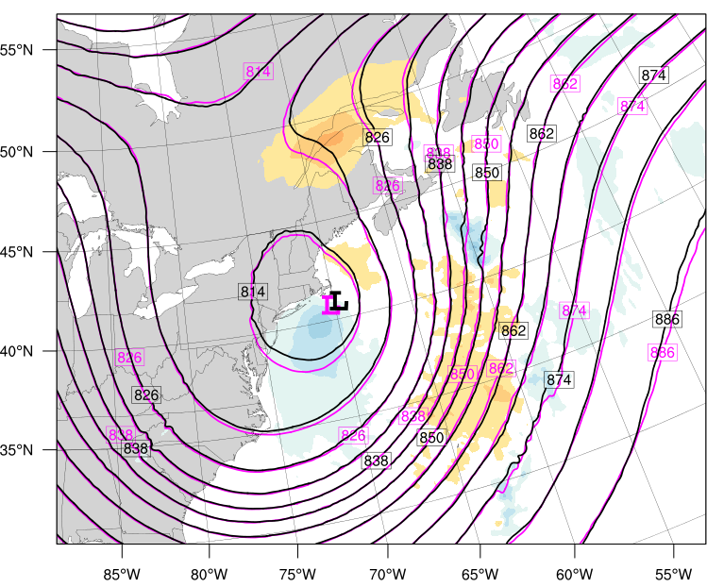
500–200-hPa geopotential height difference (less mixing – more mixing, m, shaded) and 300–200-hPa geopotential heights (dm, contoured) for (magenta) less mixing run and (black) more mixing run. Less (more) mixing minimum MSLP location denoted with magenta (black) L.
0000 UTC 28 January

Slide 41
26–28 January Snowstorm
Less mixing surface cyclone has higher upper-level heights downstream and a deeper trough
Similar to Stoelinga (1996) when latent heating is turned off

Slide 42
26–28 January Snowstorm
Less mixing surface cyclone has higher upper-level heights downstream and a deeper trough
Similar to Stoelinga (1996) when latent heating is turned off
We investigate the ascending air parcels using LAGRANTO (Sprenger and Wernli 2015)

Slide 43
26–28 January Snowstorm
Launched 12-h forward trajectory swarm from the lowest 1 km within 500 km of the surface cyclone at 0900 UTC 27 January 2015

Slide 44
26–28 January Snowstorm
Launched 12-h forward trajectory swarm from the lowest 1 km within 500 km of the surface cyclone at 0900 UTC 27 January 2015
Selected top 10th percentile of ascending parcels

Slide 45
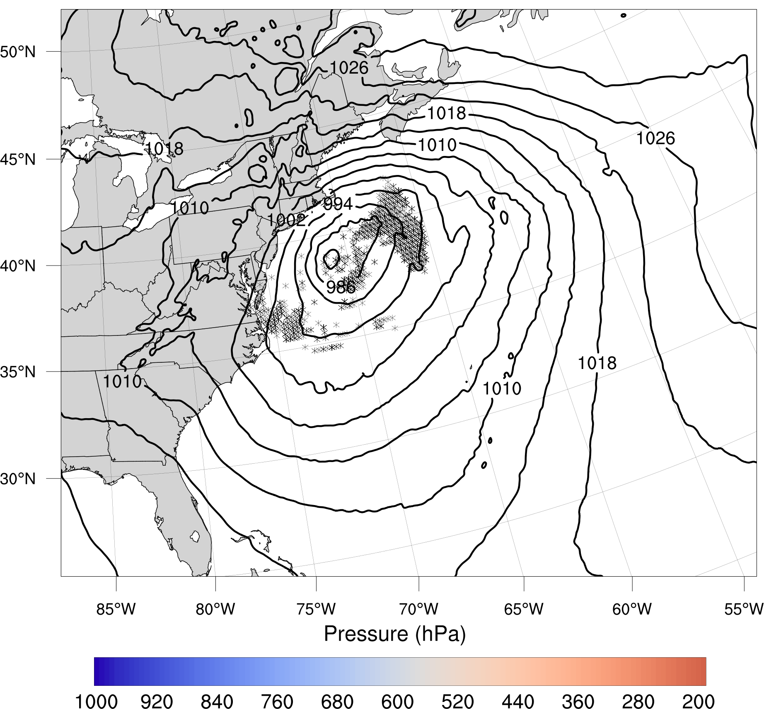
Pressure (hPa, shaded) of the top 10th-percentile ascending 12-h forward trajectories for the less mixing run ending 2100 UTC 27 Jan and MSLP (hPa, contoured) valid 0900 UTC 27 Jan. Black X’s mark trajectory starting points.

Slide 46
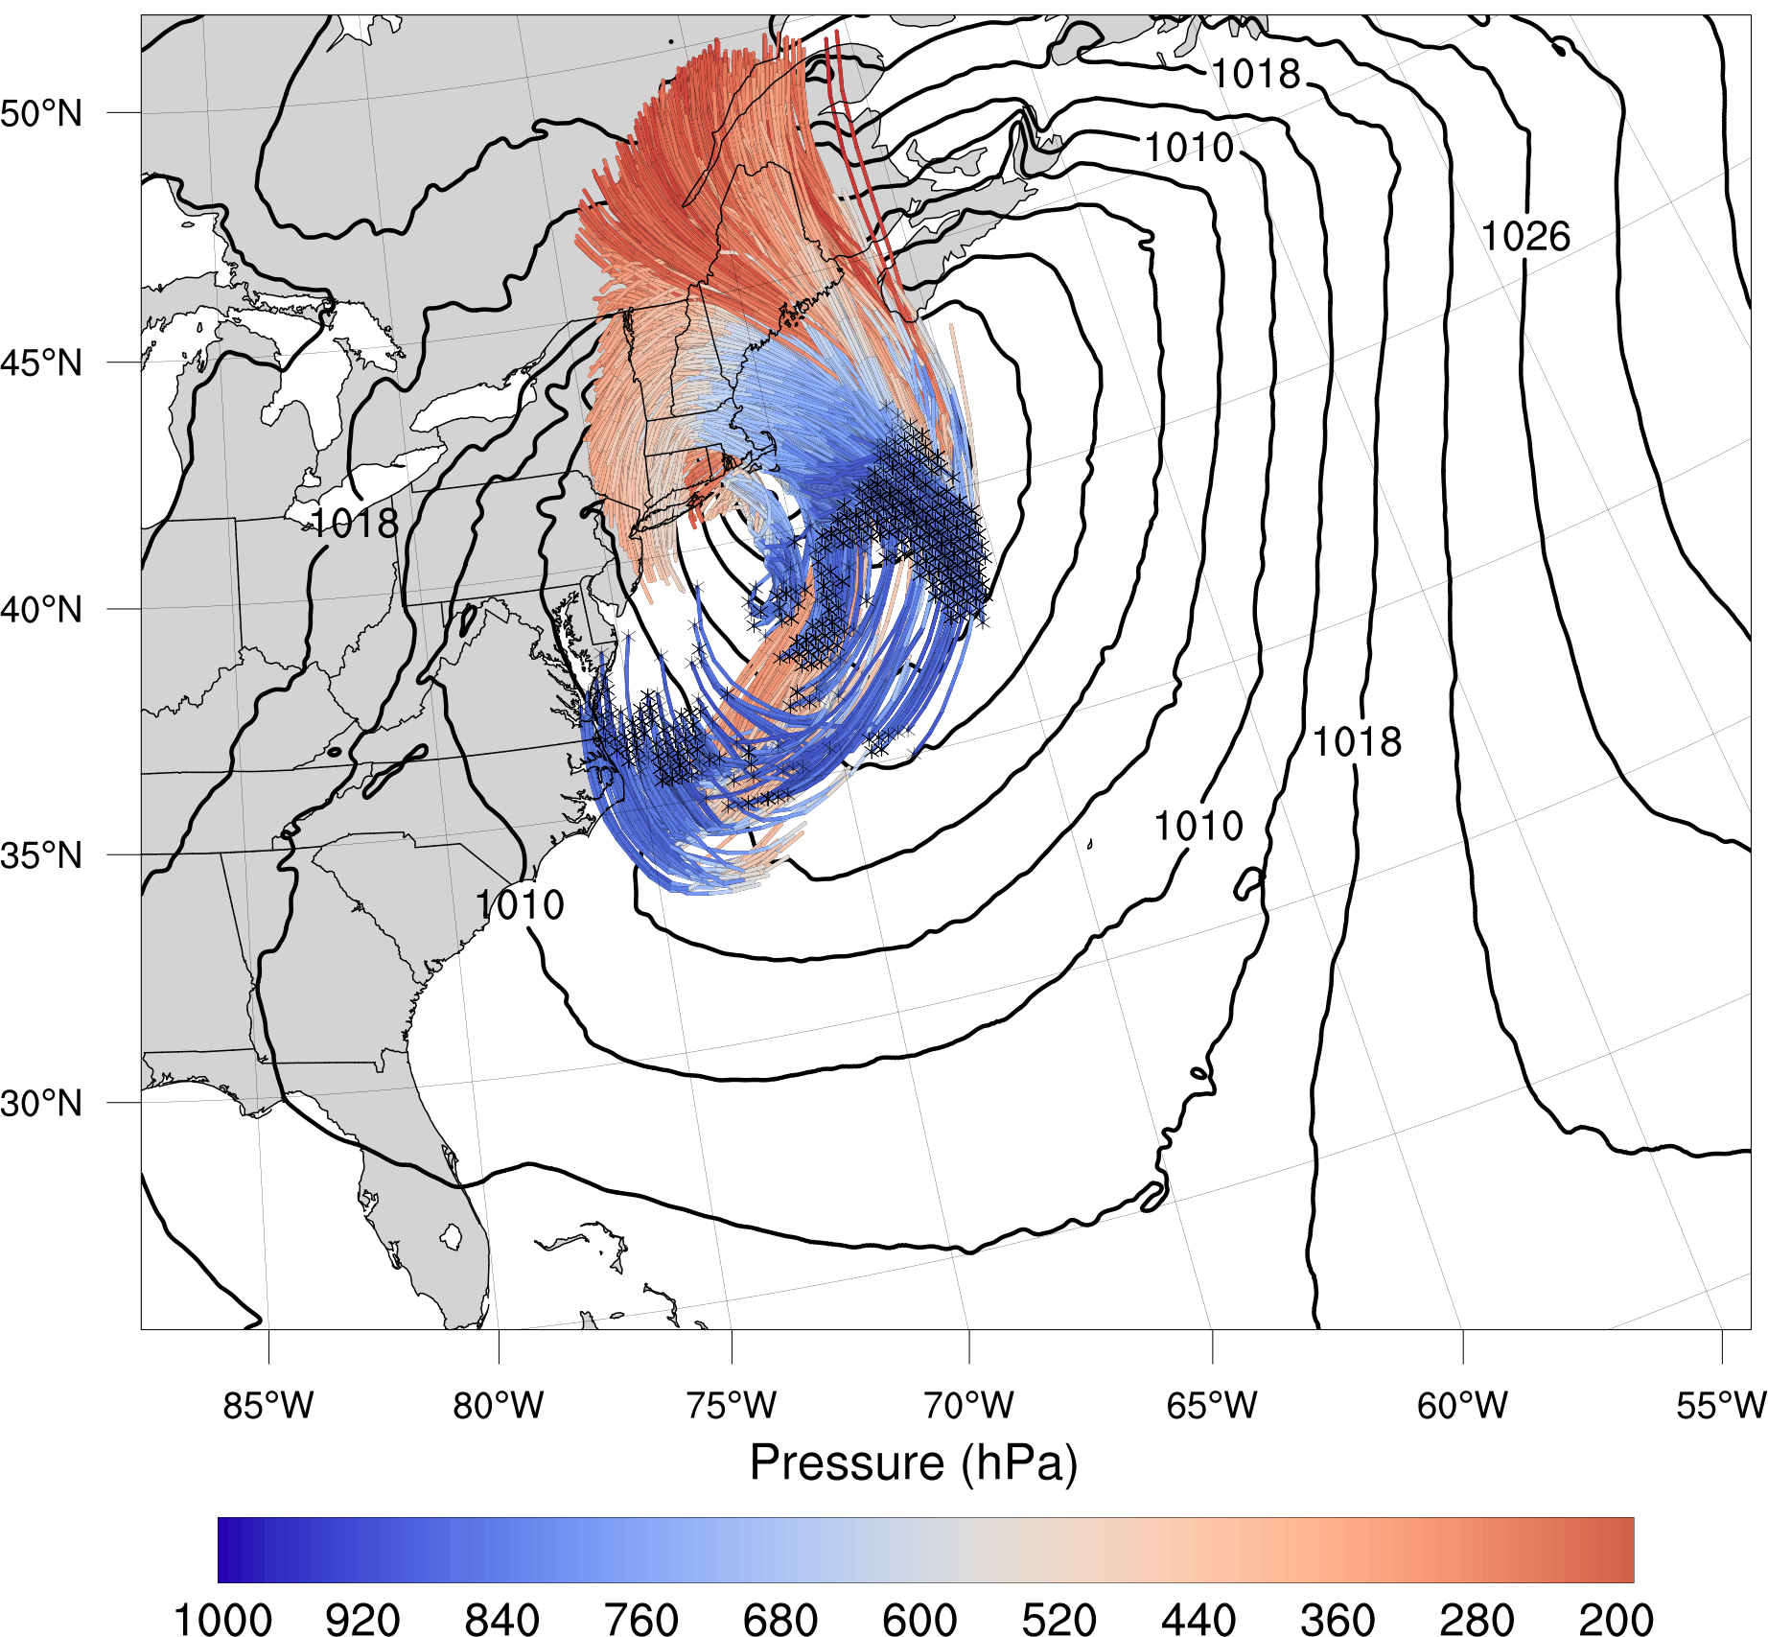
Pressure (hPa, shaded) of the top 10th-percentile ascending 12-h forward trajectories for the less mixing run ending 2100 UTC 27 Jan and MSLP (hPa, contoured) valid 2100 UTC 27 Jan. Black X’s mark trajectory starting points.

Slide 47
26–28 January Snowstorm
Launched 12-h forward trajectory swarm from the lowest 1 km within 500 km of the surface cyclone at 0900 UTC 27 January 2015
Selected top 10th percentile of ascending parcels
Plot distributions of these ascending trajectories for the less mixing and more mixing runs

Slide 48
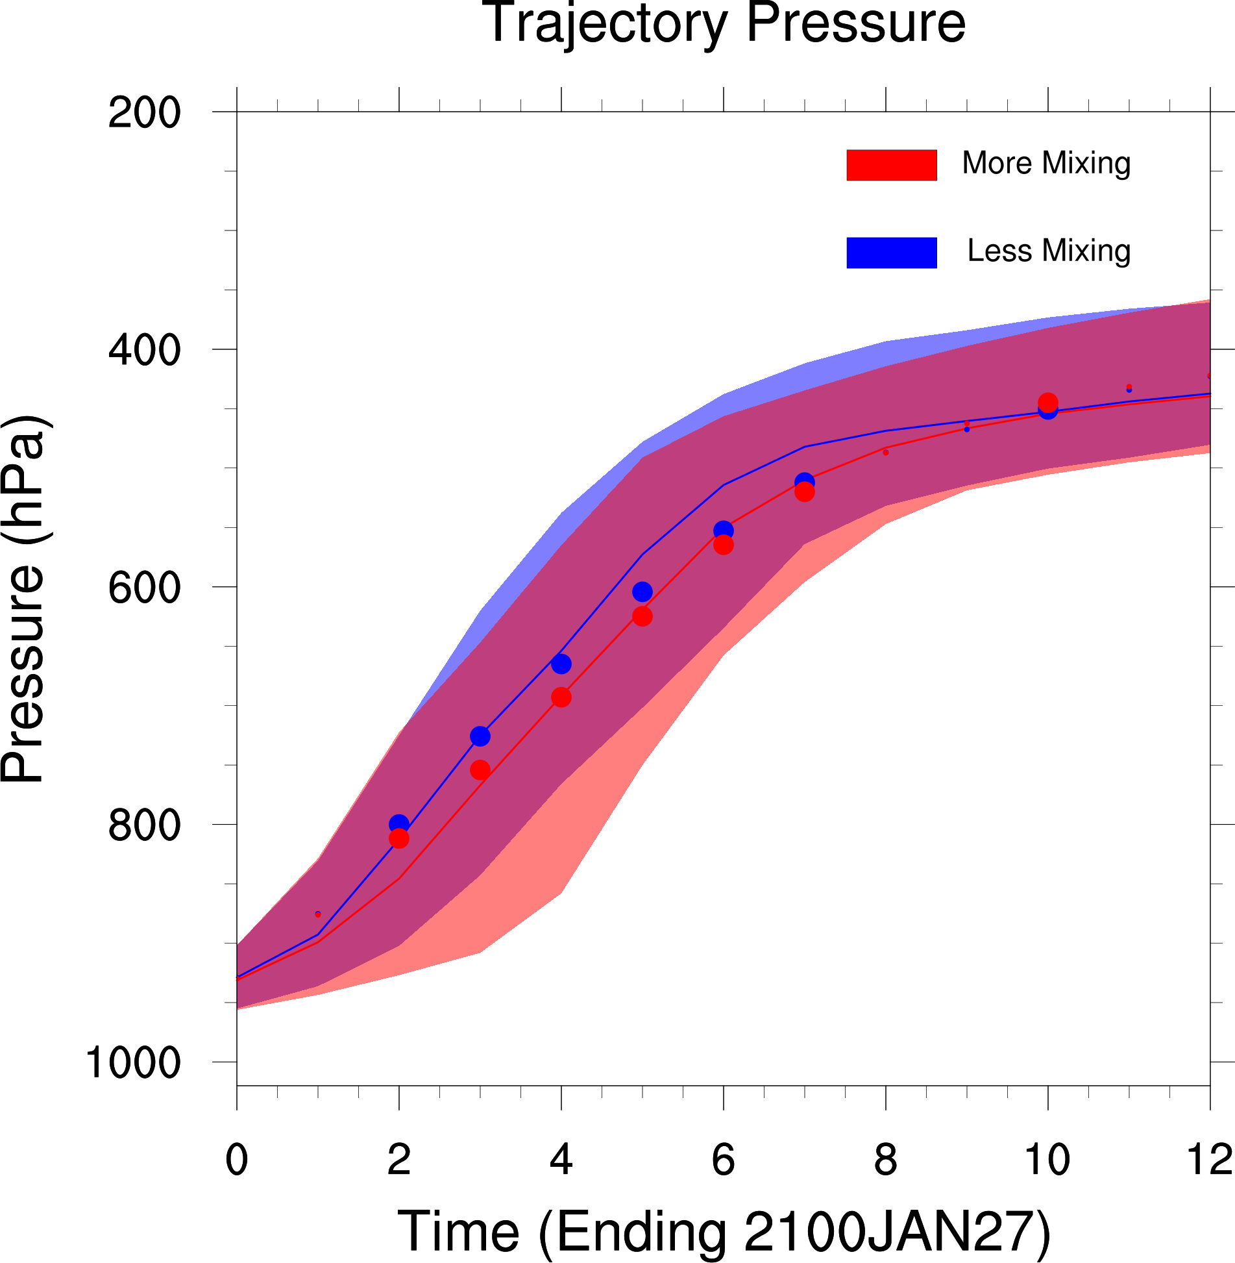
Distributions of top 10th-percentile 12-h ascending trajectories ending 2100 UTC 27 January, for the (blue) less mixing run and (red) more mixing run for pressure. The distribution median (solid lines) along with interquartile range (shading) and distribution means (dots) are plotted. Bold dots indicate statistical significance at the 95% confidence level.

Slide 49
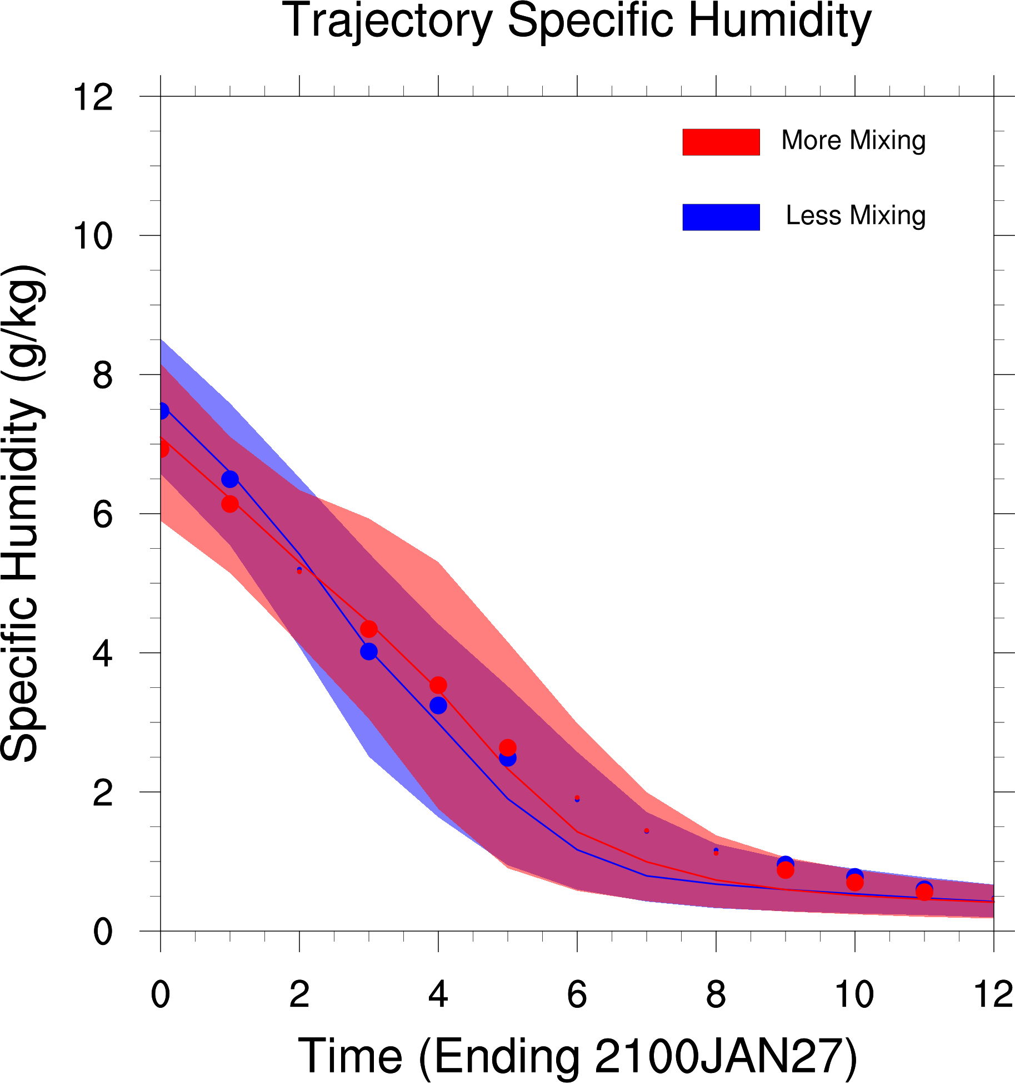
Distributions of top 10th-percentile 12-h ascending trajectories ending 2100 UTC 27 January, for the (blue) less mixing run and (red) more mixing run for specific humidity. The distribution median (solid lines) along with interquartile range (shading) and distribution means (dots) are plotted. Bold dots indicate statistical significance at the 95% confidence level.

Slide 50
Distributions of top 10th-percentile 12-h ascending trajectories ending 2100 UTC 27 January, for the (blue) less mixing run and (red) more mixing run for specific humidity. The distribution median (solid lines) along with interquartile range (shading) and distribution means (dots) are plotted. Bold dots indicate statistical significance at the 95% confidence level.

Slide 51
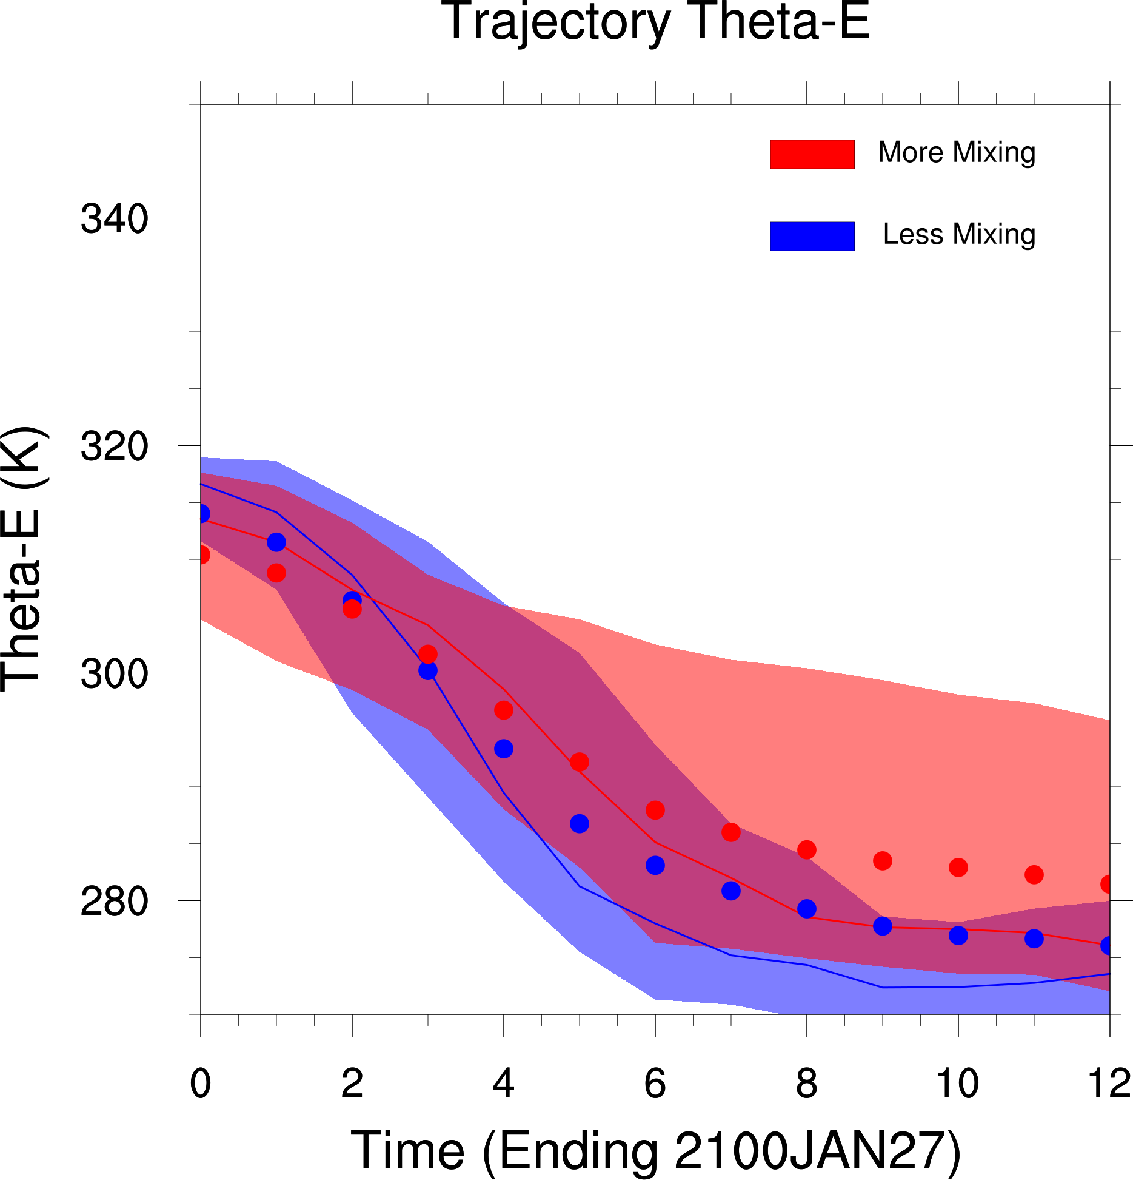
Distributions of top 10th-percentile 12-h ascending trajectories ending 2100 UTC 27 January, for the (blue) less mixing run and (red) more mixing run for equivalent potential temperature. The distribution median (solid lines) along with interquartile range (shading) and distribution means (dots) are plotted. Bold dots indicate statistical significance at the 95% confidence level.

Slide 52
26–28 January Snowstorm
The ascending parcels in the less mixing case experience more vigorous ascent and lose more water vapor
This suggests the less mixing case, through preservation of PBL moisture, experienced more latent heating
More amplified upper-level flow pattern
Reduced downstream propagation

Slide 53
Concluding Remarks
Email: mvaughan@albany.edu
Less mixing leads to westward-shifted precipitation and a less progressive storm
Preservation of PBL moisture within the less-mixing case may lead to more vigorous latent heating.
Storm may be less progressive due more amplified flow pattern stemming from enhanced latent heat release
Test using an idealized cyclone in various moisture environments
I was supported by the Department of Defense (DoD) through the National Defense Science & Engineering Graduate Fellowship (NDSEG) Program.

Slide 54
Extra Slides
950–700-hPa PV (00Z 28 Jan)
300–200-hPa PV (00Z 28 Jan)

Slide 55
Poor Man’s Warm Sector
Used layer-averaged 950–800-hPa theta to compute anomalies for each time-step within the domain
Used positive anomalies for designating the warm sector

Slide 56
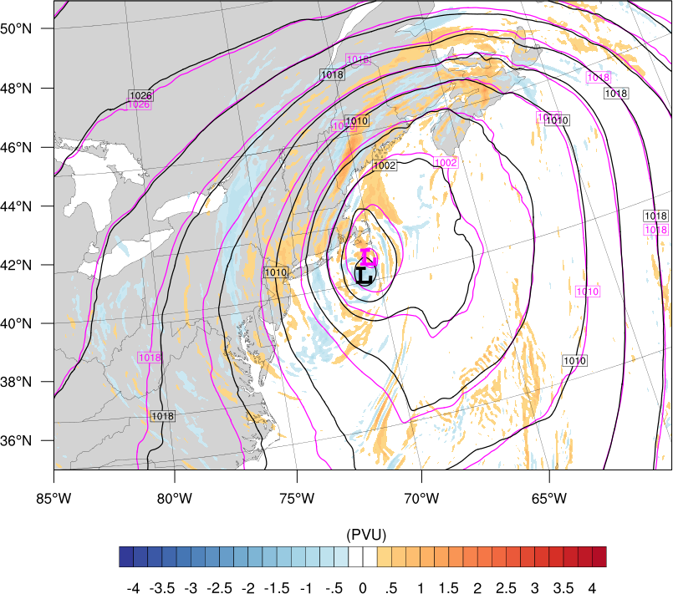
NOLH & Control
950–700-hPa PV (00Z 28 Jan)
950–700-hPa PV (00Z 28 Jan)

