Slide 1
An Examination of PBL Scheme Influences on the 2 March 2018 Snowstorm
Heavily borrowed from a 2019 NESC presentation of the same name.
Matthew Vaughan and Robert Fovell
Notes:
NAM = MYJ

Slide 2
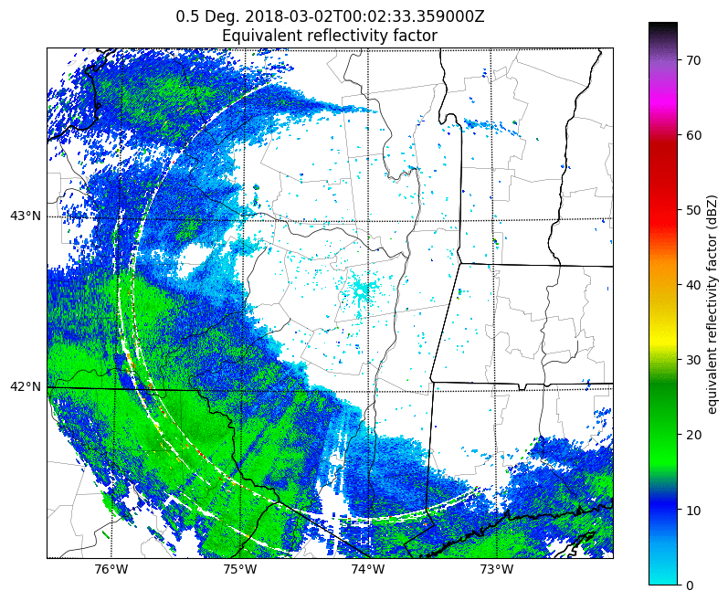
2 March 2018 Event Overview
  2 March 2018 snowstorm brought notable snowfall to the NYS Capital Region
  Particularly infamous for large snowfall uncertainty

Slide 3
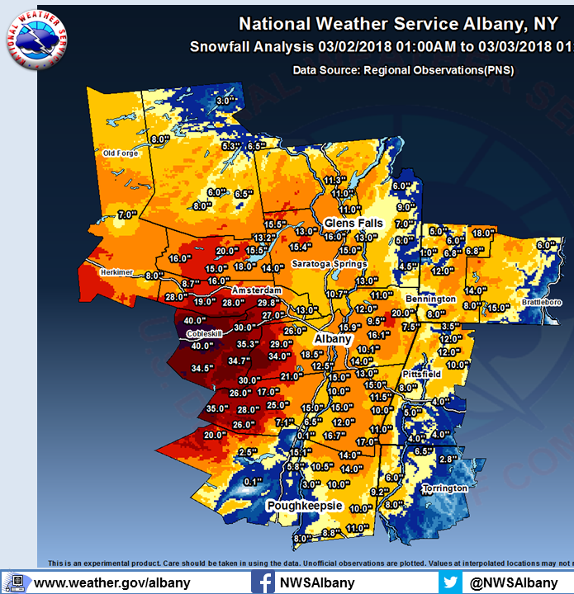
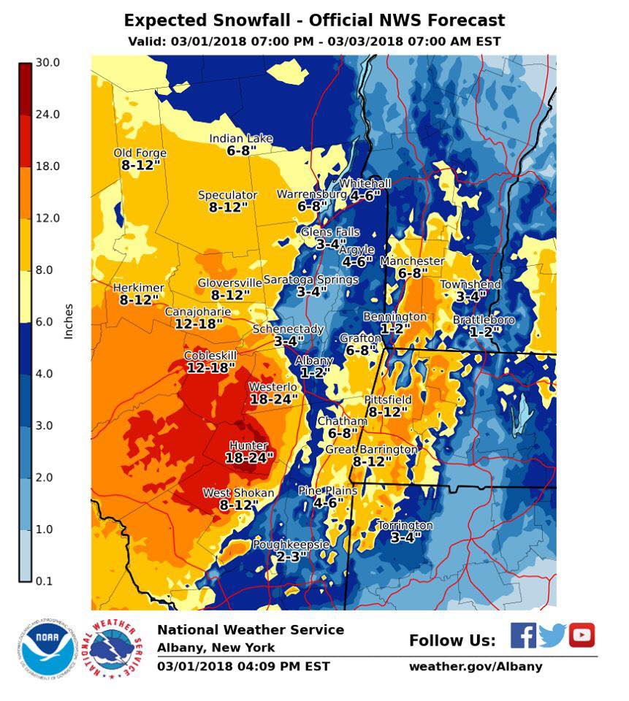
Forecast Performance
Notes:
Add in inch animations for Valley.

Slide 4
Forecast Performance
Verified 12–16”
1–2” for ALB
Notes:
Add in inch animations for Valley.

Slide 5
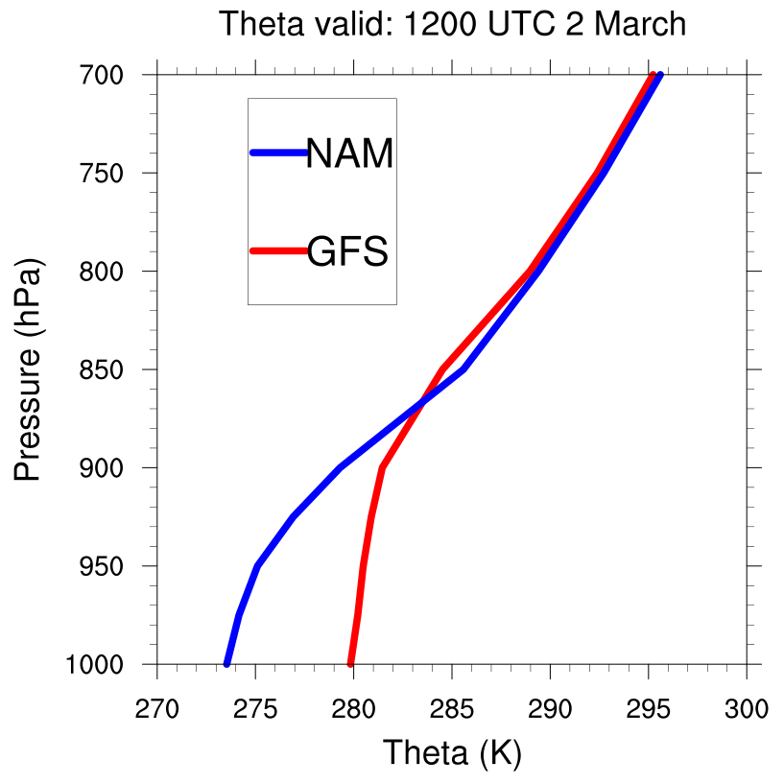
1200 UTC 2 March GFS and NAM Forecast

Slide 6
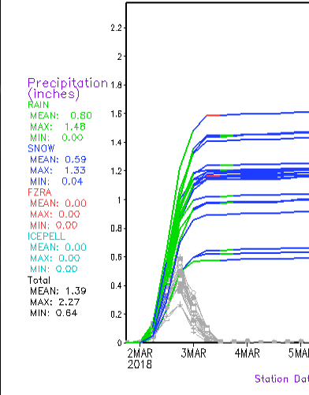
Model Uncertainty
GEFS P-type Plume Forecast
The GFS forecast leaned towards rain in the valley around ALB
Other models (NAM, HRRR) favored winter precipitation
RAIN
SNOW
Courtesy: M. Evans (NROW 2018)

Slide 7
Research Question:

Slide 8
Research Question:
The NAM and GFS use 2 different PBL schemes…

Slide 9
Research Question:
The NAM and GFS use 2 different PBL schemes…
  Are the different PBL schemes responsible for the differences in the thermal profiles between the NAM and the GFS around ALB?

Slide 10
WRF-ARW 4.0.3 Setup
Initialized: 0000 UTC 1 March 2018
  72-h runtime
Data: ERA5, GFS Forecast
12-4-1.33-km domains
Tested 2 PBL schemes (GFS, NAM)
Inner 1.33-km domain
Microphysics | Longwave | Shortwave | Surface layer | Land surface | Cumulus (outer 1)
Thompson (8) | RRTMG | RRTMG | MM5, ETA | Noah | Tiedtke

Slide 11
Note on GFS vs. NAM PBL Schemes
Two main schools of thought

Slide 12
Note on GFS vs. NAM PBL Schemes
Two main schools of thought
GFS scheme calculates PBL height via column stability and surface fluxes
Imposes mixing profile using a shape function
NAM calculates turbulent kinetic energy (TKE) at each grid point
Develops mixing profile based on TKE at each point

Slide 13
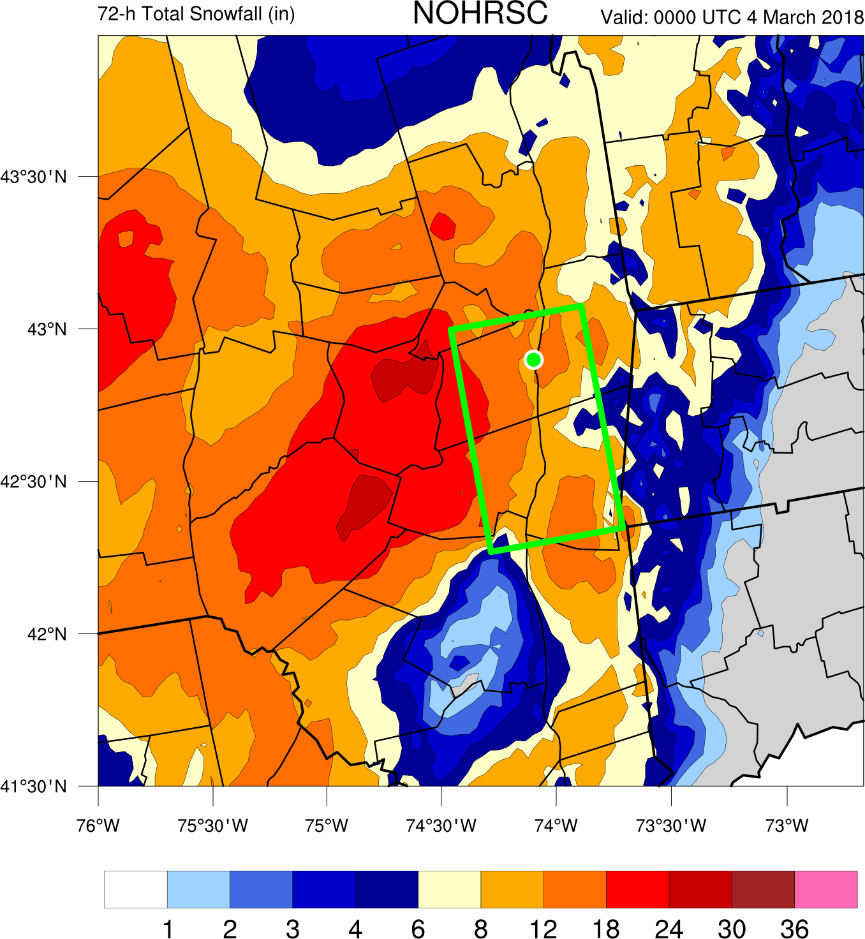
NOHRSC Snowfall Analysis
Green dot is Albany, NY
National Operational Hydrologic Remote Sensing Center (NOHRSC)

Slide 14
NOHRSC Snowfall Analysis

Slide 15
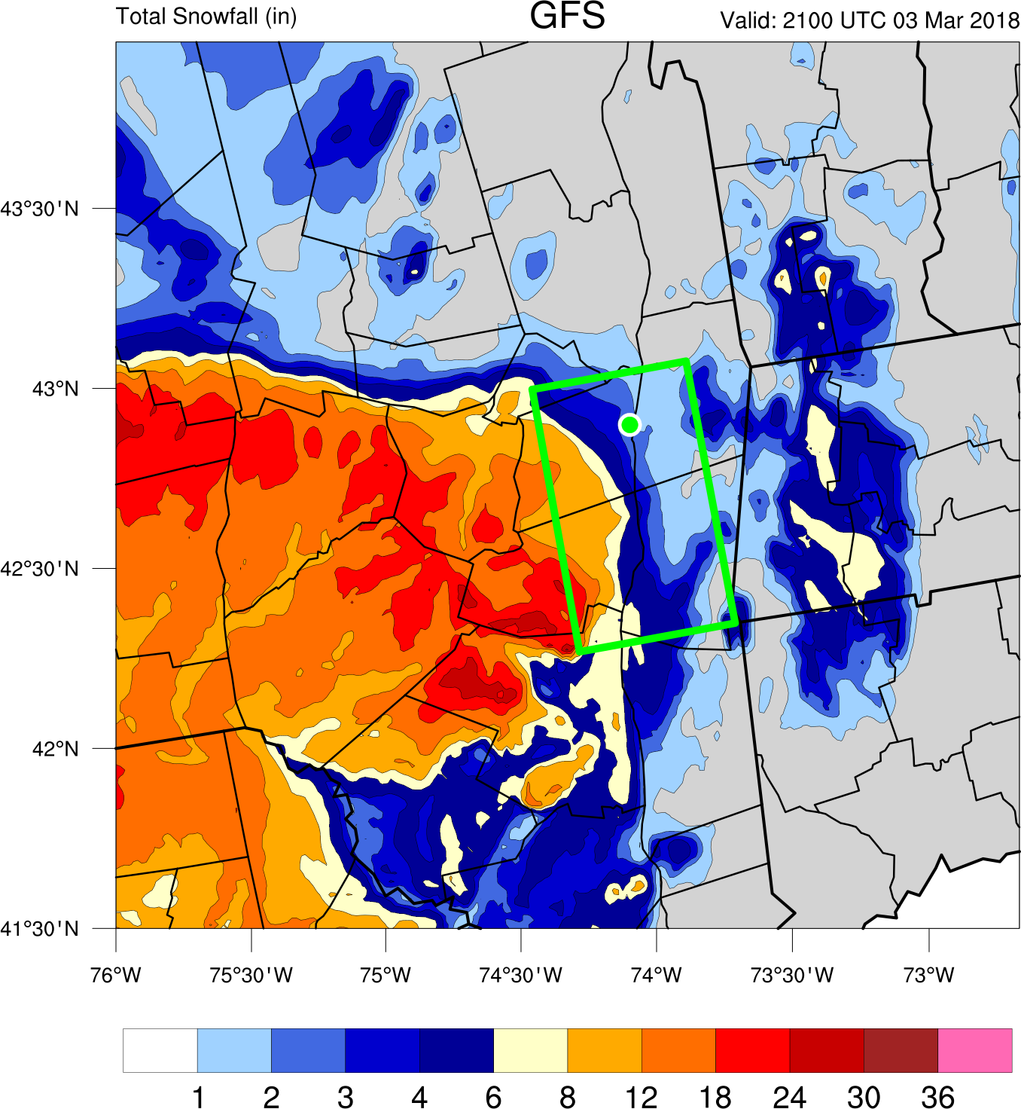
GFS Snowfall

Slide 16
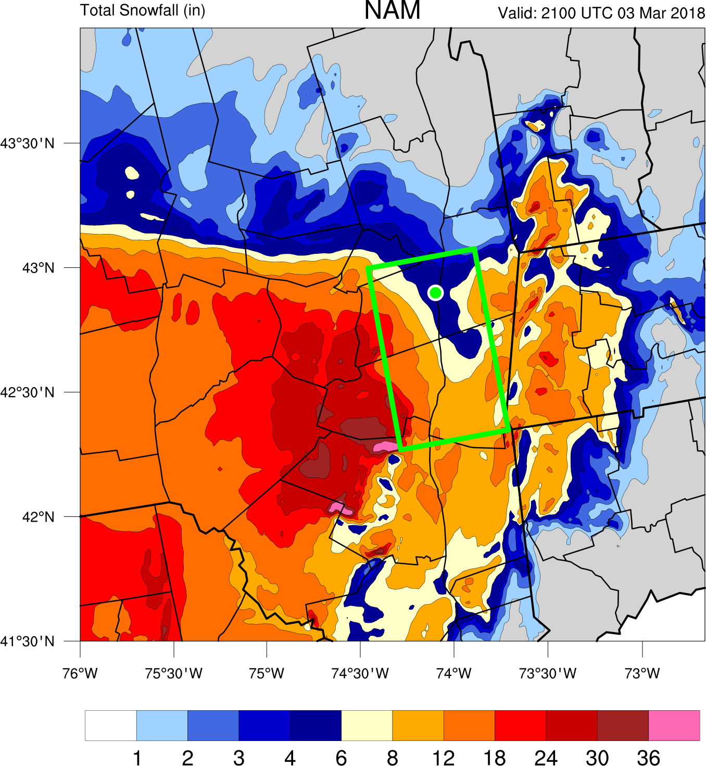
NAM Snowfall

Slide 17
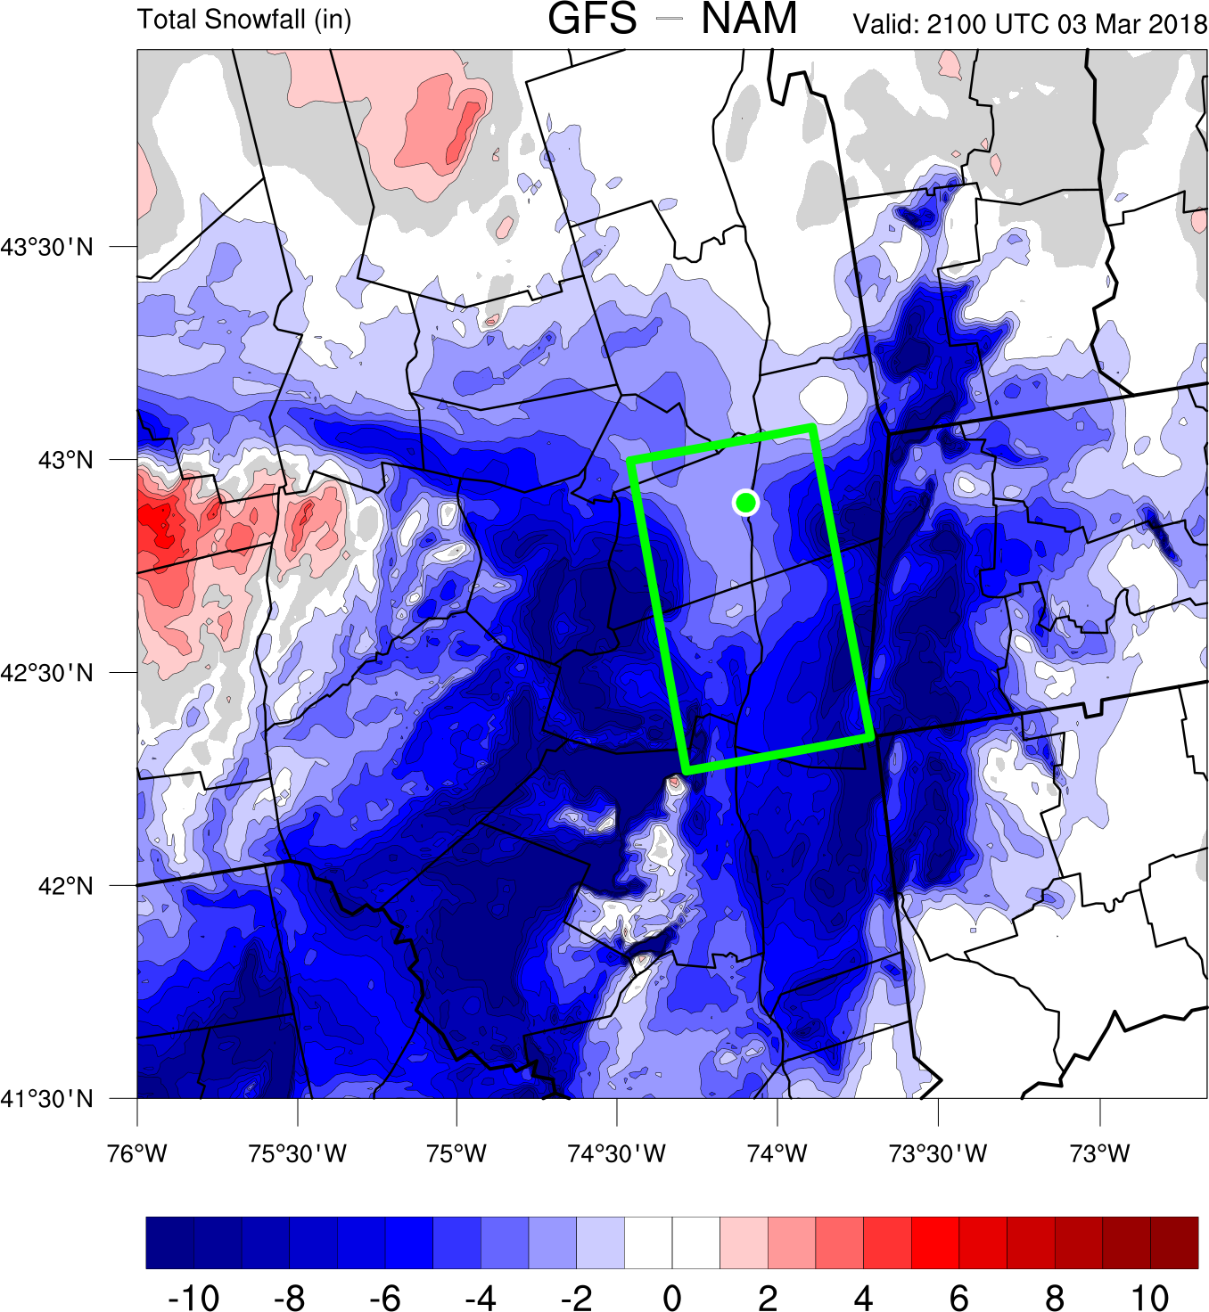
GFS – MYJ Snowfall Difference (in)

Slide 18
Modeled Snowfall
GFS scheme produces less snowfall than NAM
Do differences in the total QPF forecasts account for the snowfall differences?
  i.e. Did the NAM just precipitate more than the GFS?
Notes:
Stronger negative bias

Slide 19
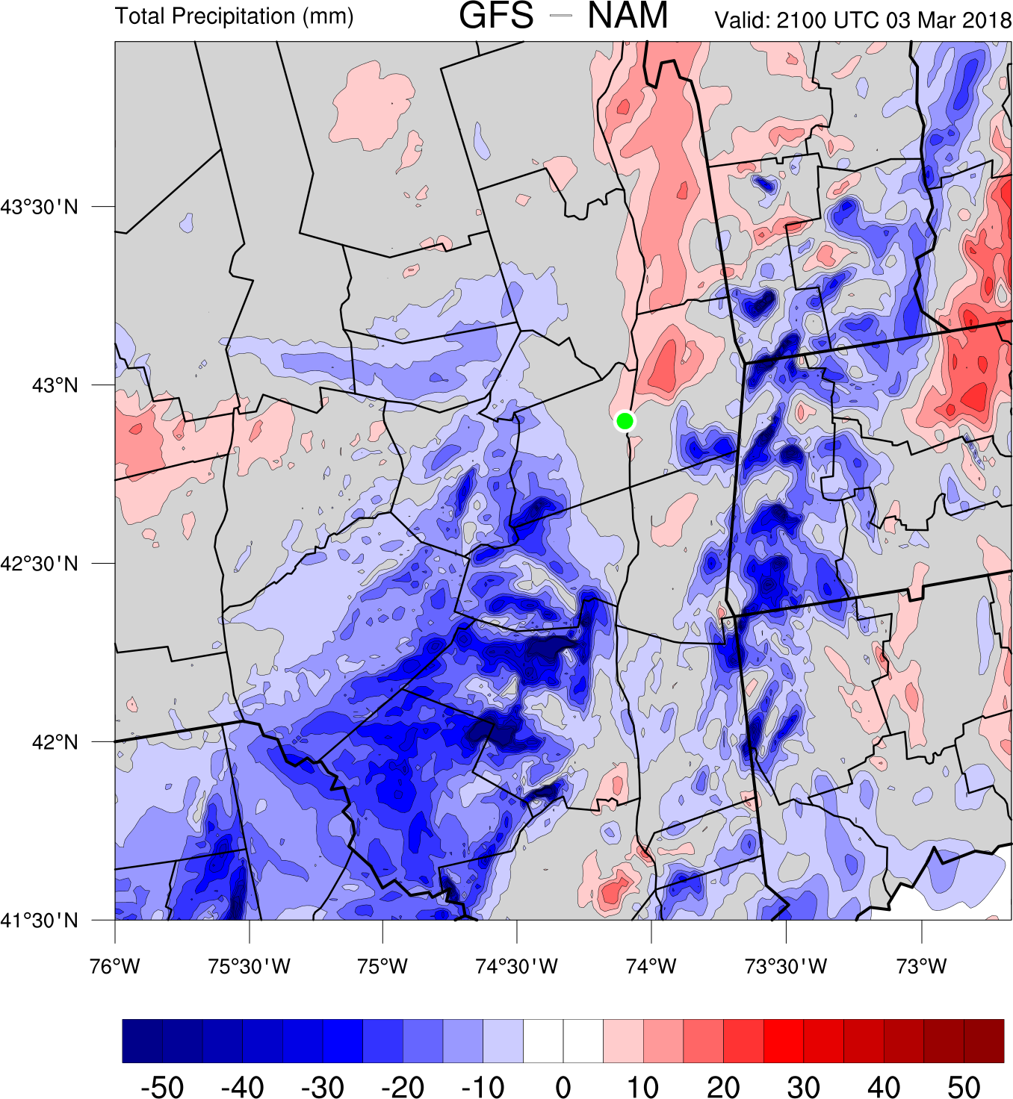
GFS – MYJ Precipitation Difference (mm)

Slide 20

GFS – MYJ Precipitation Difference (mm)

Slide 21
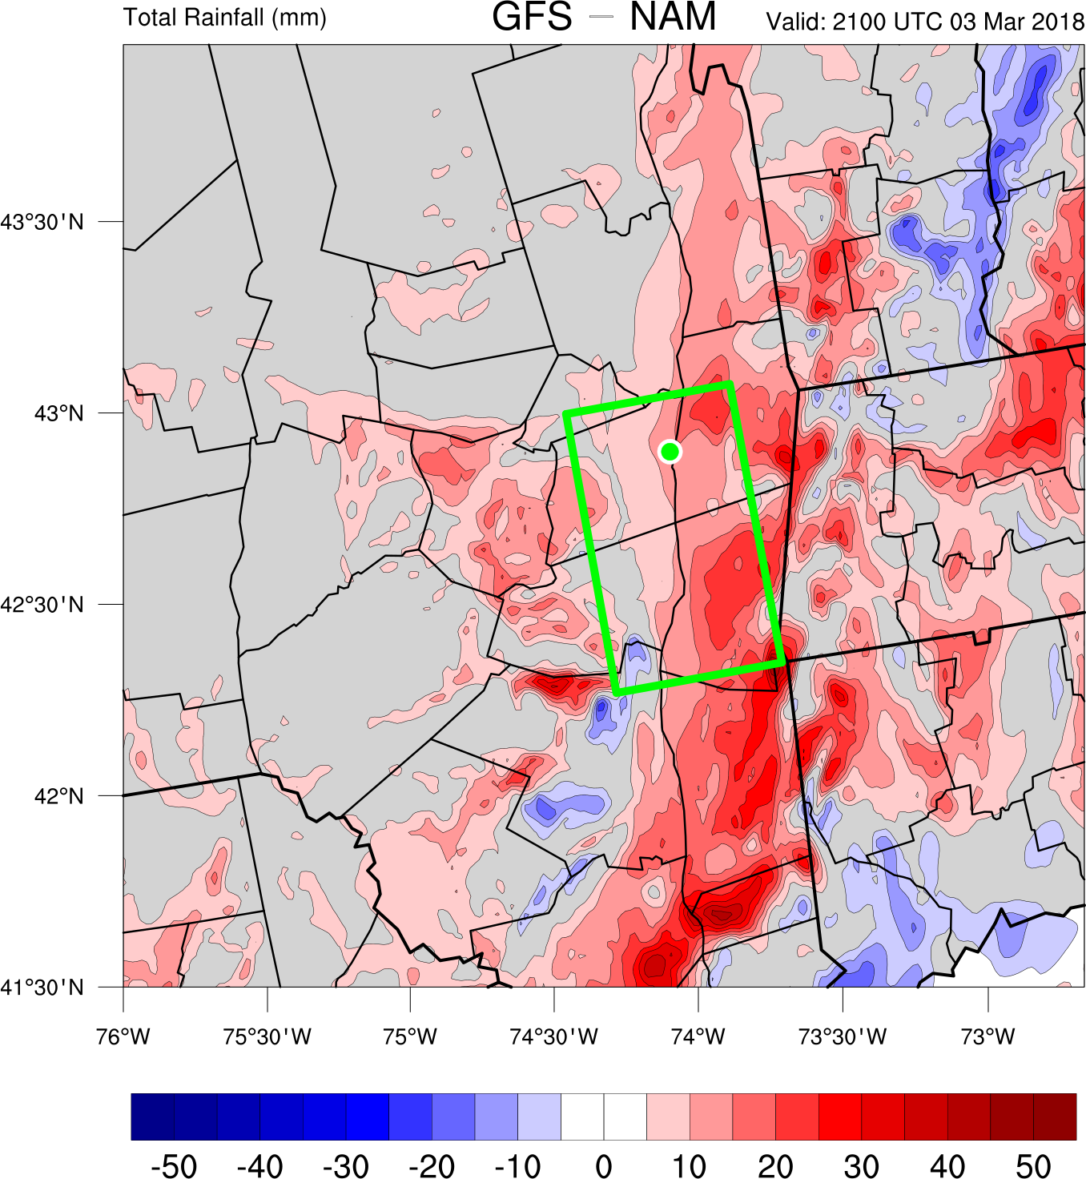
GFS – MYJ Rainfall Difference (mm)

Slide 22
Modeled Precipitation
Both PBL schemes produce similar precipitation amounts along the Hudson Valley
  Differences in snowfall accumulation are due to precipitation type differences
Are the thermal profiles different in the Hudson valley?

Slide 23
Area Average Temperature in Box

Slide 24
Area Average Temperature in Box

Slide 25
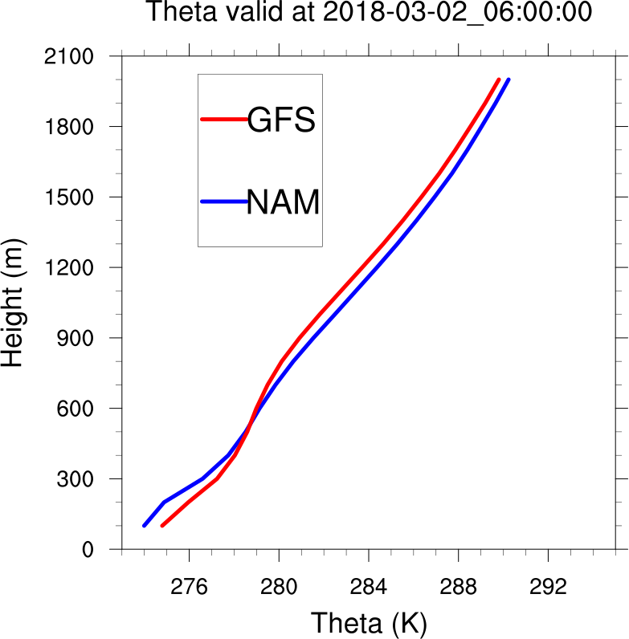
Potential Temperature Valid: 0600 UTC 2 March
Area-averaged theta profiles for GFS and NAM over the mid-Hudson Valley

Slide 26
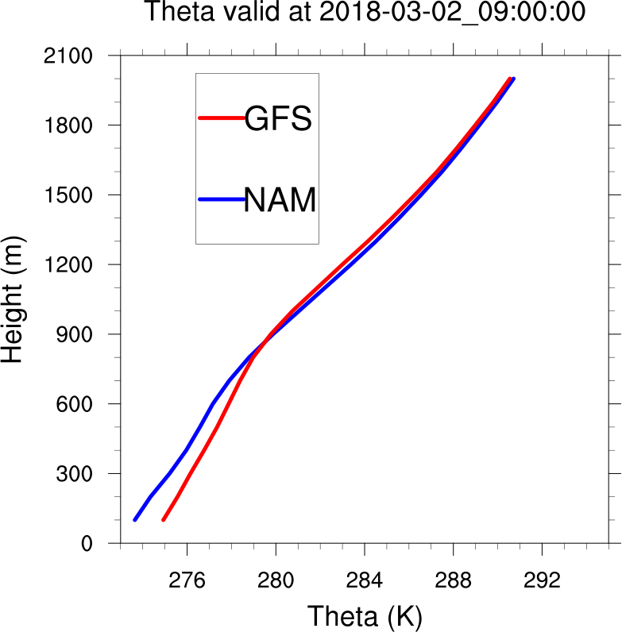
Potential Temperature Valid: 0900 UTC 2 March
Area-averaged theta profiles for GFS and NAM over the mid-Hudson Valley

Slide 27
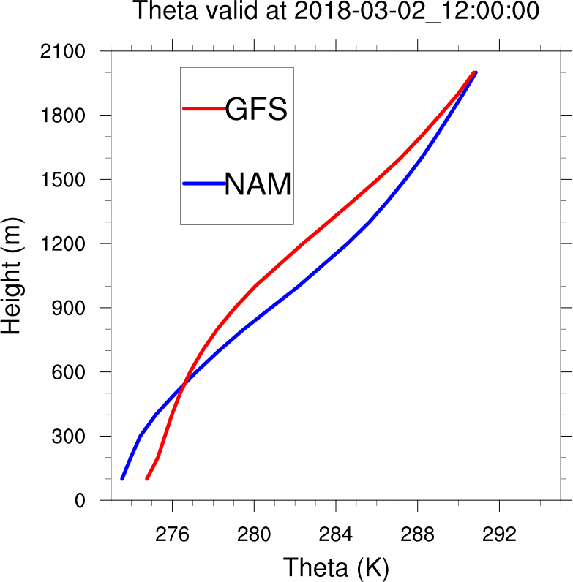
Potential Temperature Valid: 1200 UTC 2 March
Area-averaged theta profiles for GFS and NAM over the mid-Hudson Valley

Slide 28
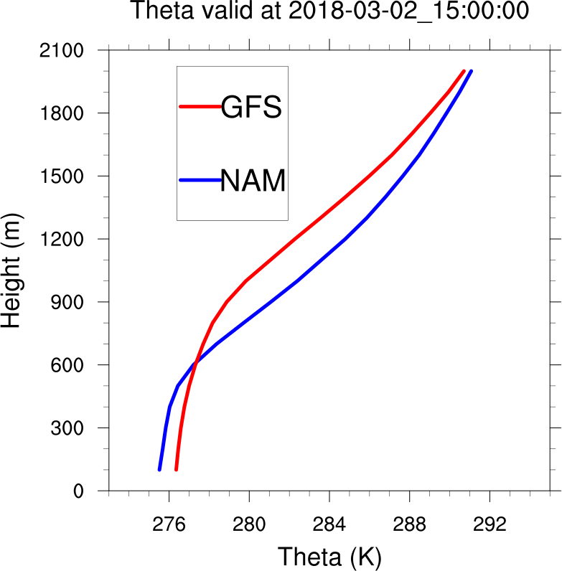
Potential Temperature Valid: 1500 UTC 2 March
Area-averaged theta profiles for GFS and NAM over the mid-Hudson Valley

Slide 29
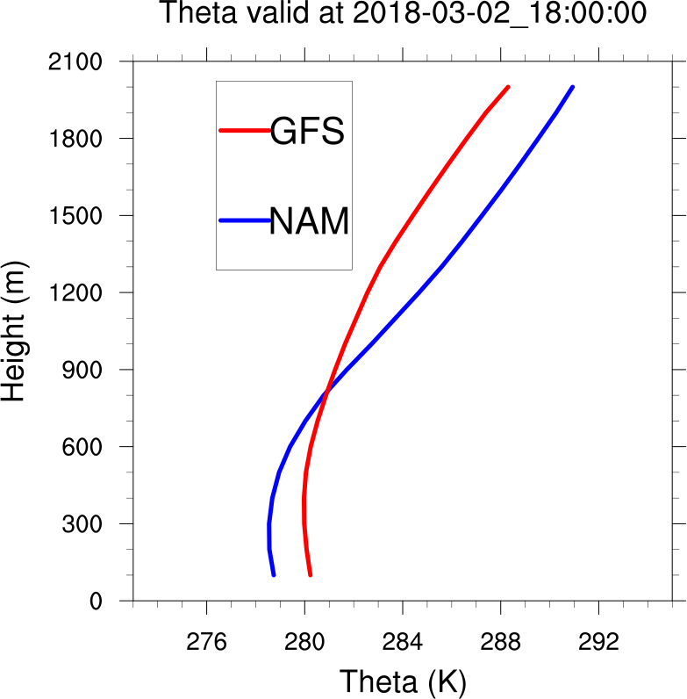
Potential Temperature Valid: 1800 UTC 2 March
Area-averaged theta profiles for GFS and NAM over the mid-Hudson Valley

Slide 30
Hudson Valley Profiles
Despite similar PBL structures before dawn, the GFS simulation warms and deepens the PBL more than the NAM simulation
  Suggests GFS may change over to mixed precipitation/rain more readily
Are the different PBL schemes responsible for the differences in the thermal profiles?

Slide 31
PBL Potential Temperature Budget
Add accumulated PBL Theta variable to WRF
Units: (K) (K/s) (s)
  ACCUM_PBL_THETA = PBL_THETA_TEND * timestep
Compare accumulated GFS PBL Theta and accumulated NAM PBL Theta
  Hypothesis: GFS PBL accumulates more potential temperature in the lower boundary layer, contributing to simulated liquid precipitation

Slide 32
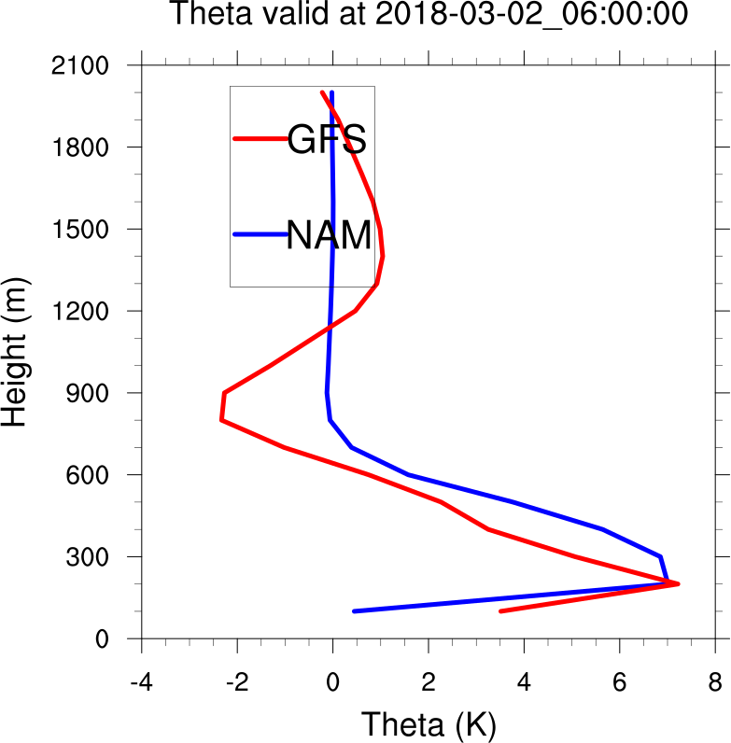
Accumulated PBL Theta Valid: 0600 UTC 2 March
Accumulated Area-averaged PBL theta profiles for GFS and NAM over the mid-Hudson Valley

Slide 33
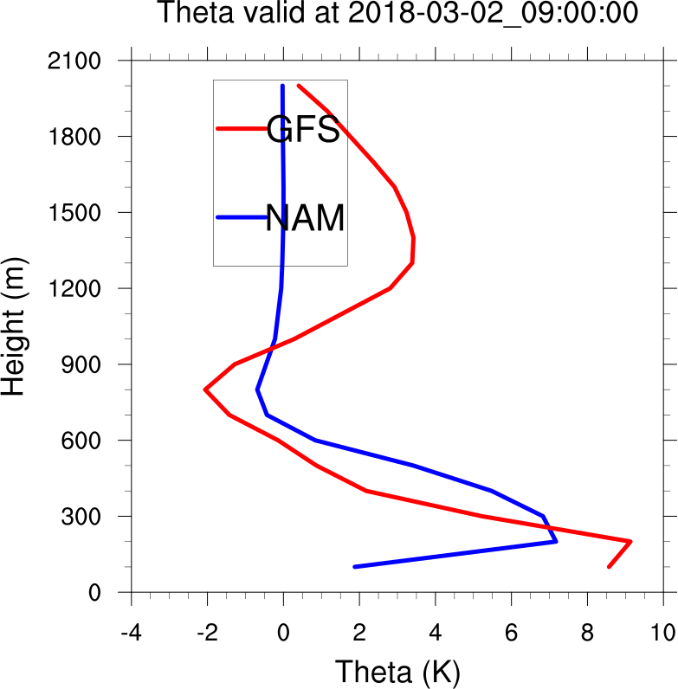
Accumulated PBL Theta Valid: 0900 UTC 2 March
Accumulated Area-averaged PBL theta profiles for GFS and NAM over the mid-Hudson Valley

Slide 34
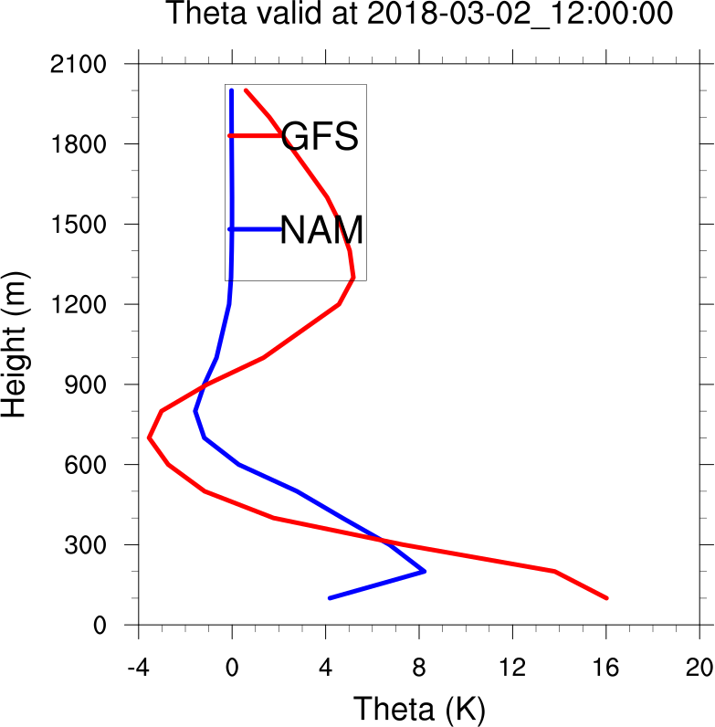
Accumulated PBL Theta Valid: 1200 UTC 2 March
Accumulated Area-averaged PBL theta profiles for GFS and NAM over the mid-Hudson Valley

Slide 35
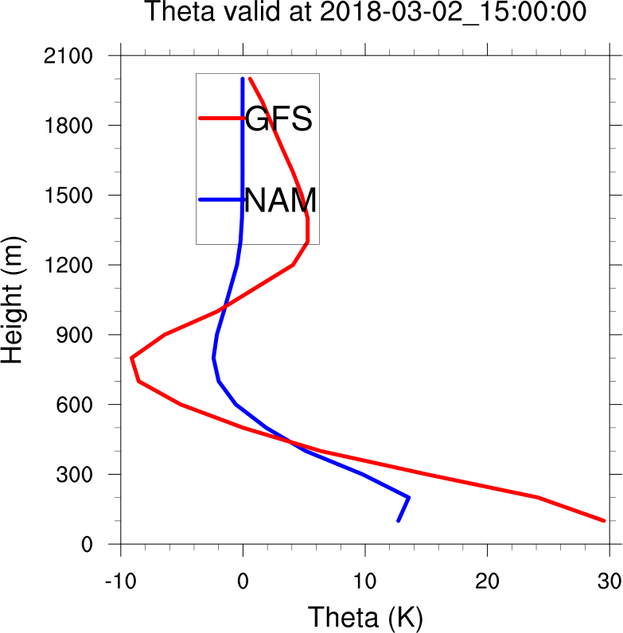
Accumulated PBL Theta Valid: 1500 UTC 2 March
Accumulated Area-averaged PBL theta profiles for GFS and NAM over the mid-Hudson Valley

Slide 36
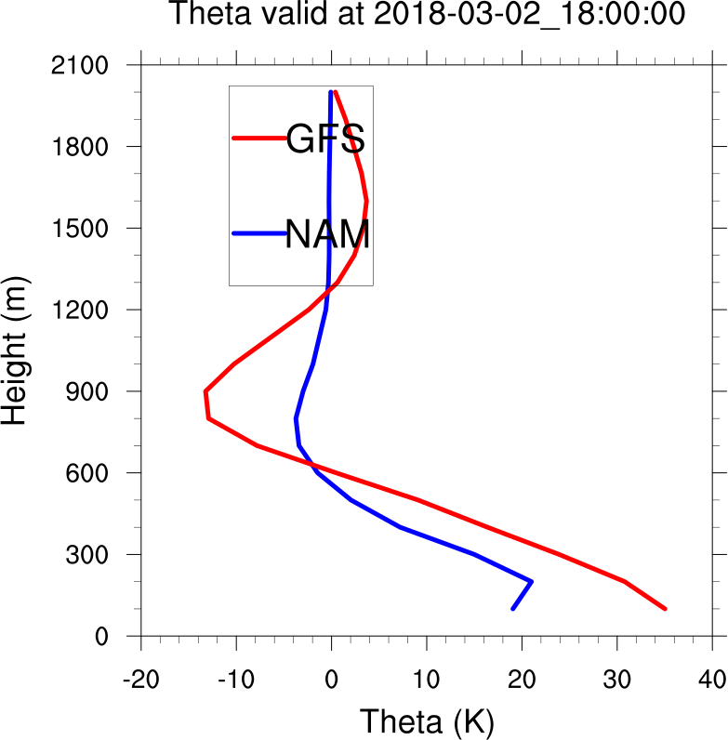
Accumulated PBL Theta Valid: 1800 UTC 2 March
Accumulated Area-averaged PBL theta profiles for GFS and NAM over the mid-Hudson Valley

Slide 37
Hudson Valley Profiles
The GFS PBL scheme has a stronger warming tendency in the lower boundary layer during the day than the NAM
  Further suggests the GFS may change over to mixed precipitation/rain more readily
Does the GFS PBL scheme warm the lower profile more than NAM PBL scheme in similar conditions?

Slide 38
Single Column Model Simulations
Initialize with similar conditions as 1200 UTC 2 March 2018 ALB sounding
Integrate 12 hours with GFS and NAM PBL schemes without microphysics (no clouds)
No advection; only radiative/surface forcing

Slide 39
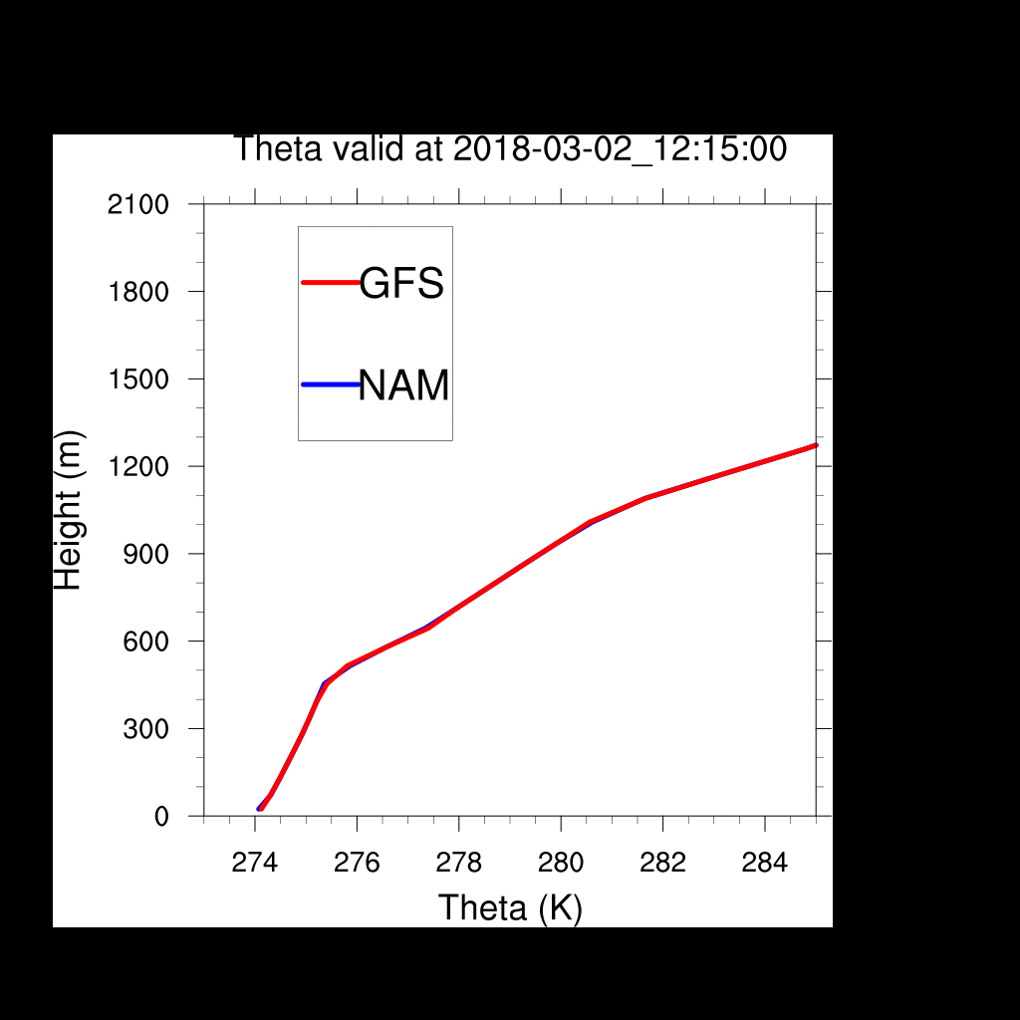
Single Column Model Simulations
Notes:
Warm bias most apparent near surface in soundings.

Slide 40
Summary
Email: mvaughan@albany.edu
WRF using the GFS PBL produces less snow and warmer lower profiles during the 2 March simulation than WRF using the NAM PBL
GFS PBL develops a taller, warmer boundary layer than NAM PBL for similar wintertime conditions
Future work involves:
  Getting this darn theta budget to work for all physics packages

