Slide 1

An Examination of PBL Scheme Influences on the 2 March 2018 Snowstorm
Matthew Vaughan and Robert Fovell
University at Albany
44th Northeastern Storm Conference
Saratoga, New York
10 March 2019
Notes:
NAM = MYJ

Slide 2
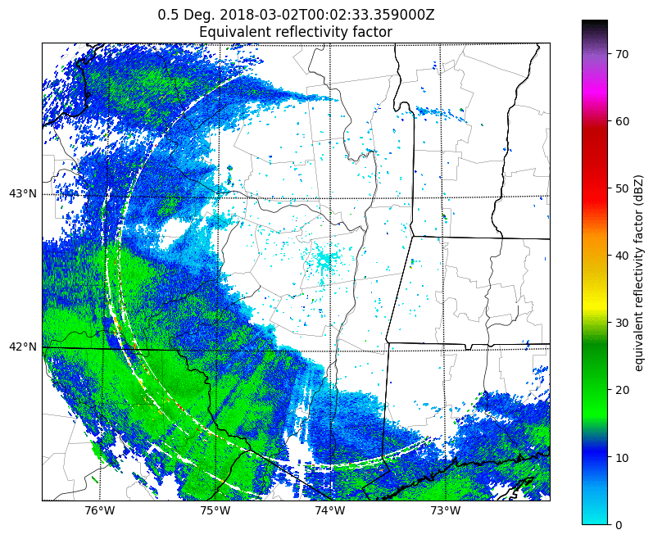
2 March 2018 Event Overview
  2 March 2018 snowstorm brought notable snowfall to the NYS Capital Region
  Particularly infamous for large snowfall uncertainty

Slide 3
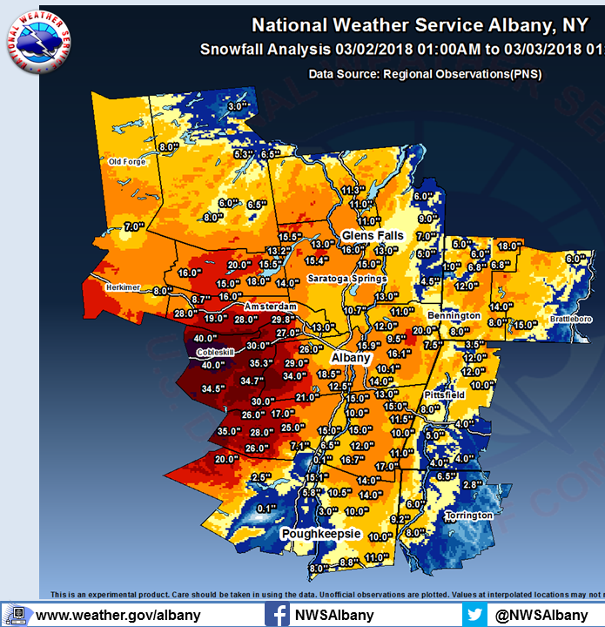
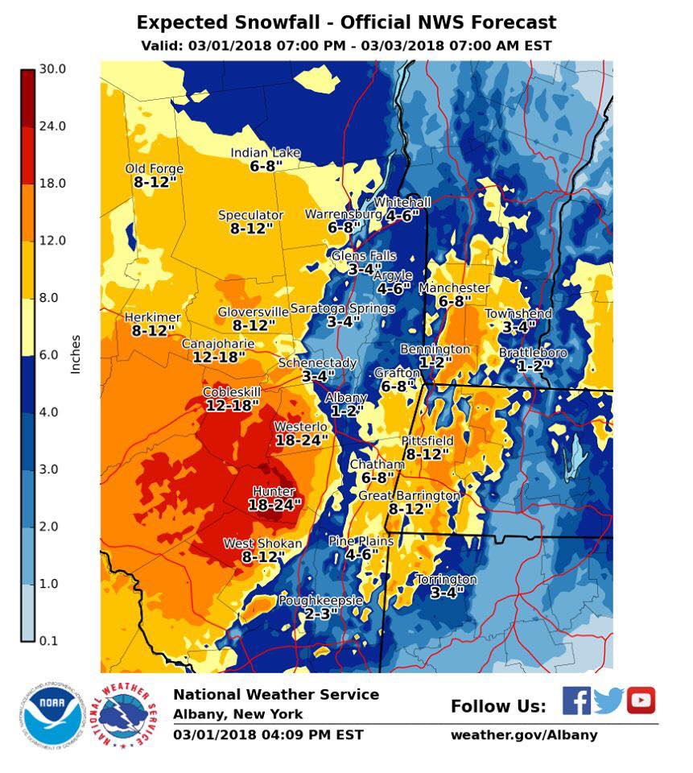
Forecast Performance
Notes:
Add in inch animations for Valley.

Slide 4
Forecast Performance
Verified 12–16”
1–2” for ALB
Notes:
Add in inch animations for Valley.

Slide 5
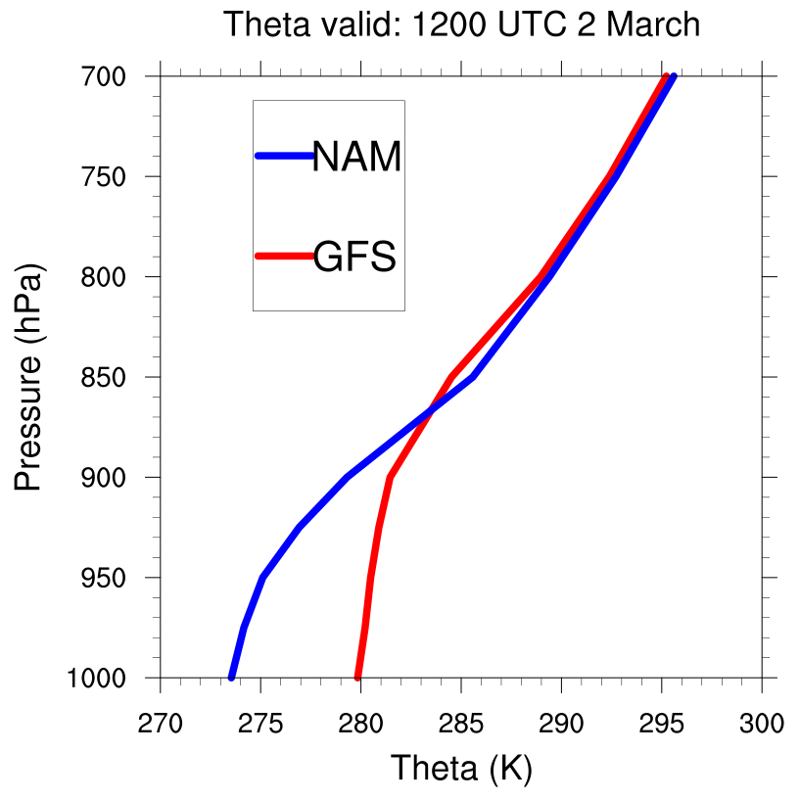
0000 UTC 1 March GFS and NAM Forecast

Slide 6
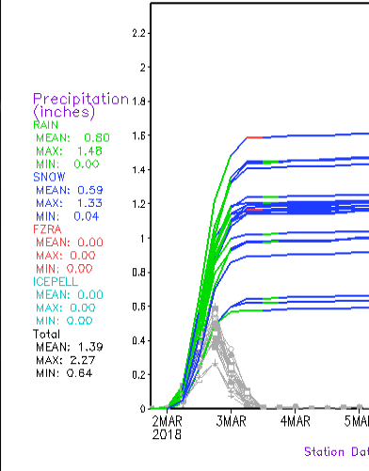
Model Uncertainty
GEFS P-type Plume Forecast
The GFS forecast leaned towards rain in the valley around ALB
Other models (NAM, HRRR) favored winter precipitation
RAIN
SNOW
Courtesy: M. Evans (NROW 2018)

Slide 7
Research Question:

Slide 8
Research Question:
The NAM and GFS use 2 different PBL schemes…

Slide 9
Research Question:
The NAM and GFS use 2 different PBL schemes…
  Are the different PBL schemes responsible for the differences in the thermal profiles between the NAM and the GFS around ALB?

Slide 10
WRF-ARW 4.0.3 Setup
Initialized: 0000 UTC 1 March 2018
  72-h runtime
Data: ERA5, GFS Forecast
12-4-1.33-km domains
Tested 2 PBL schemes (GFS, NAM)
Inner 1.33-km domain
Microphysics | Longwave | Shortwave | Surface layer | Land surface | Cumulus (outer 1)
Thompson (8) | RRTMG | RRTMG | MM5, ETA | Noah | Tiedtke

Slide 11

Note on GFS vs. NAM PBL Schemes

Slide 12
Note on GFS vs. NAM PBL Schemes
Two main schools of thought

Slide 13
Note on GFS vs. NAM PBL Schemes
Two main schools of thought
GFS scheme calculates PBL height via column stability and surface fluxes
Imposes mixing profile using a shape function
NAM calculates turbulent kinetic energy (TKE) at each grid point
Develops mixing profile based on TKE at each point

Slide 14
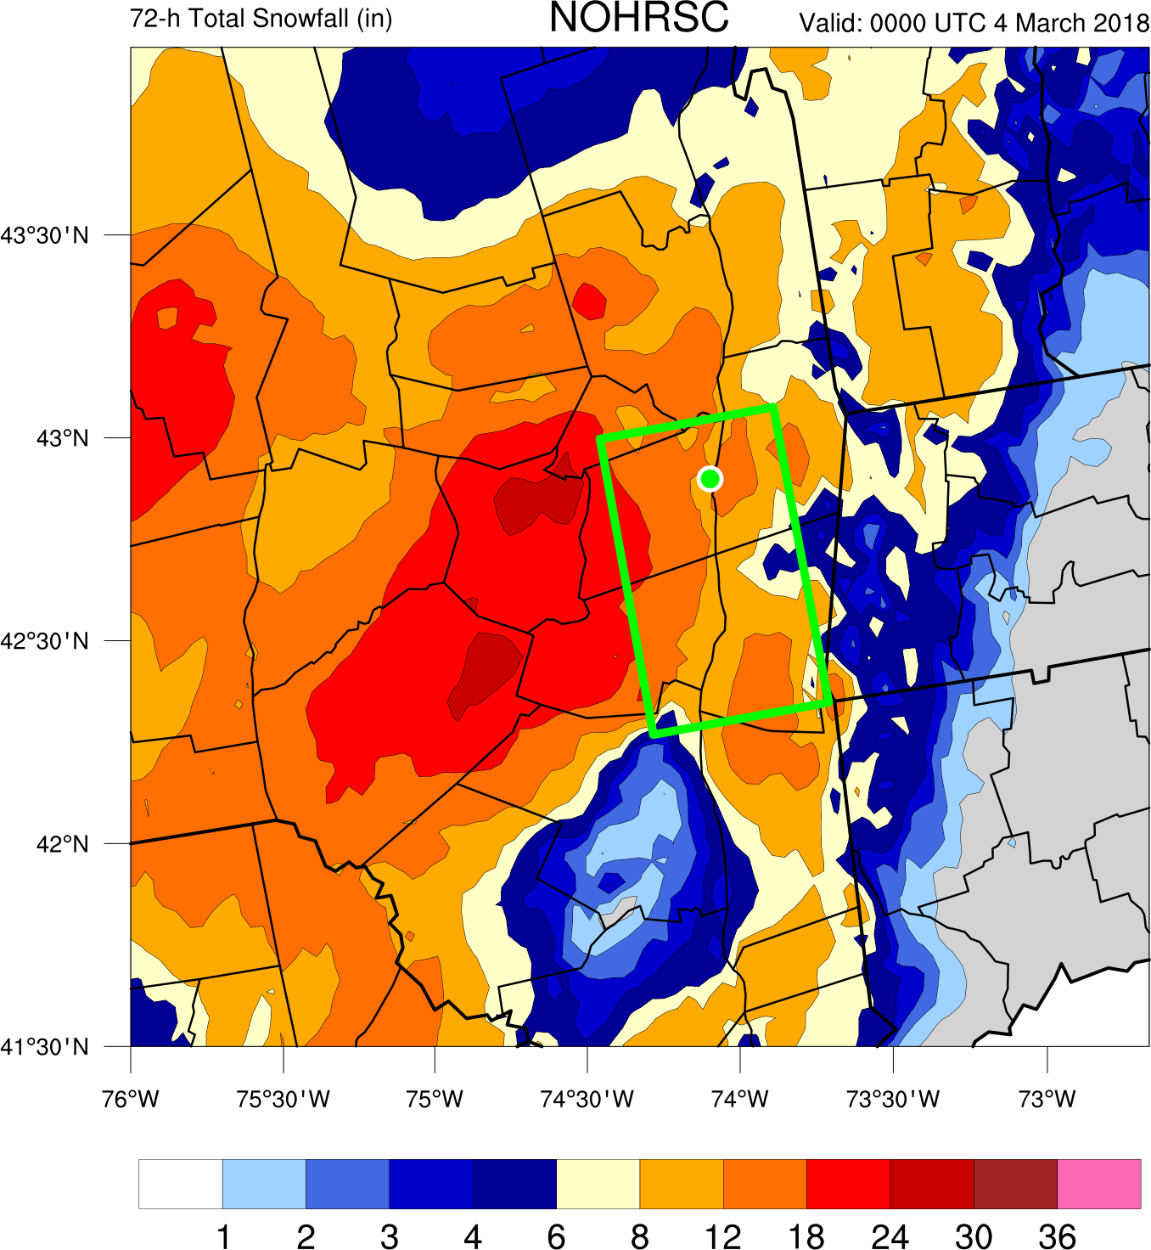
NOHRSC Snowfall Analysis
Green dot is Albany, NY
National Operational Hydrologic Remote Sensing Center (NOHRSC)

Slide 15


Slide 16
NOHRSC Snowfall Analysis

Slide 17
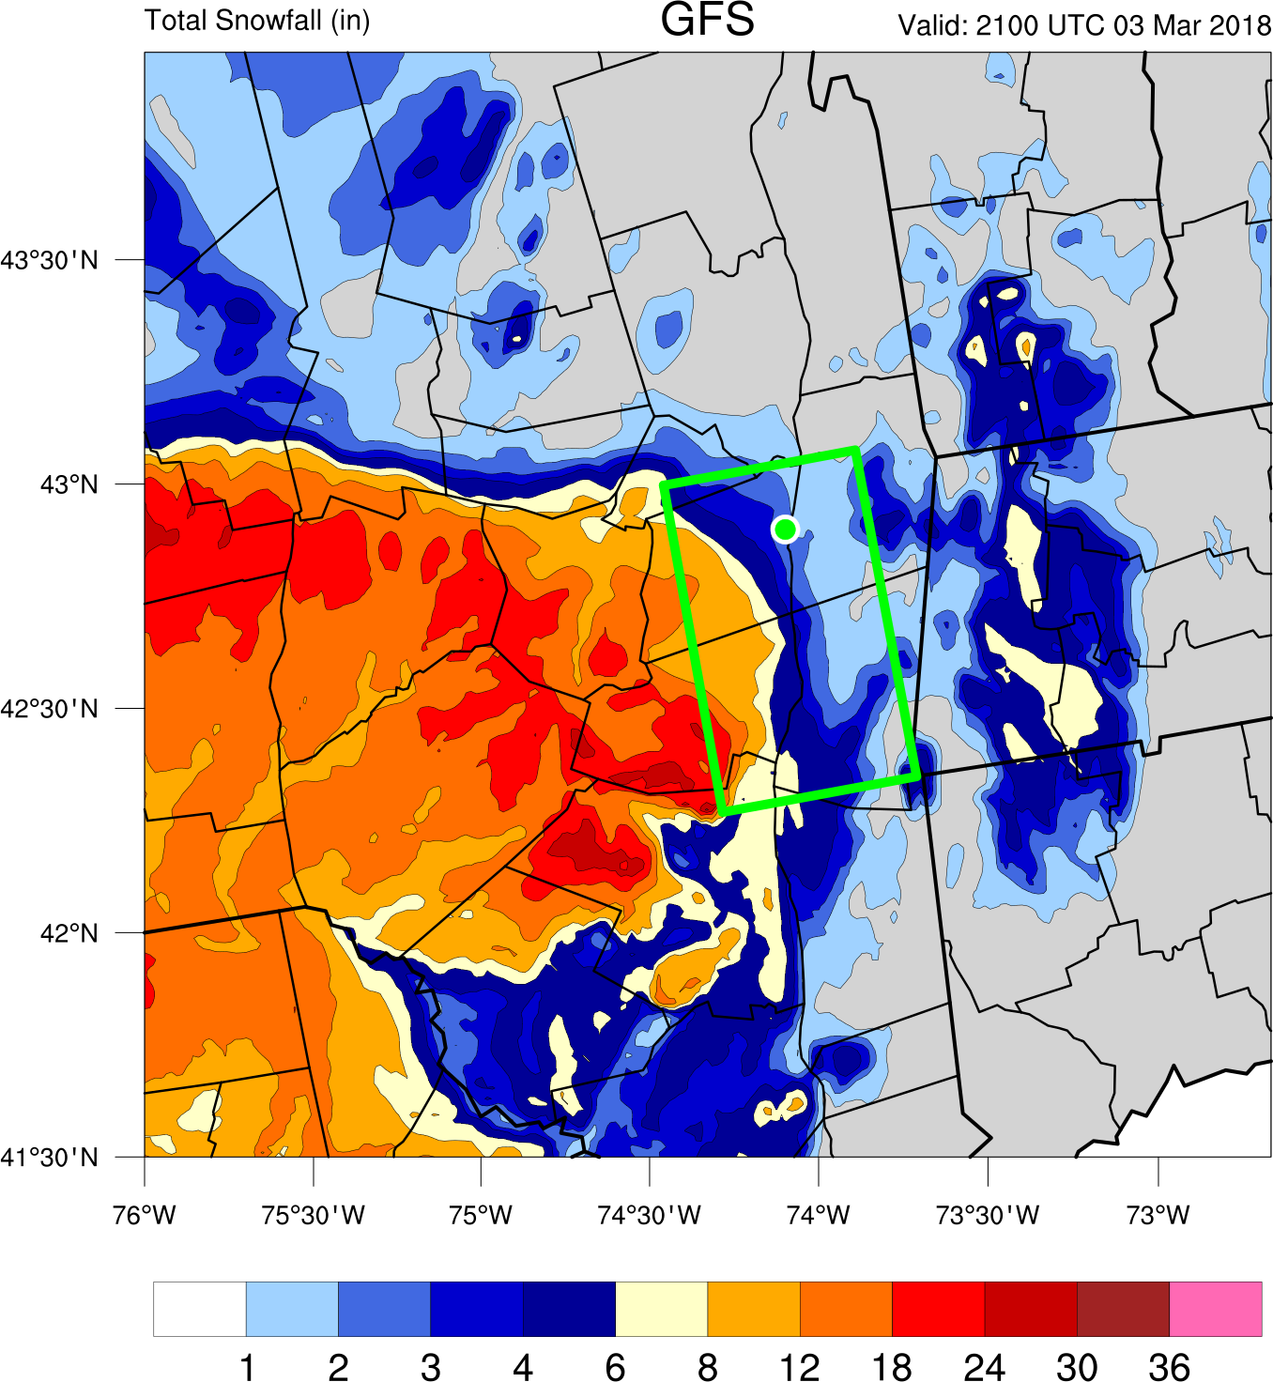
GFS Snowfall

Slide 18
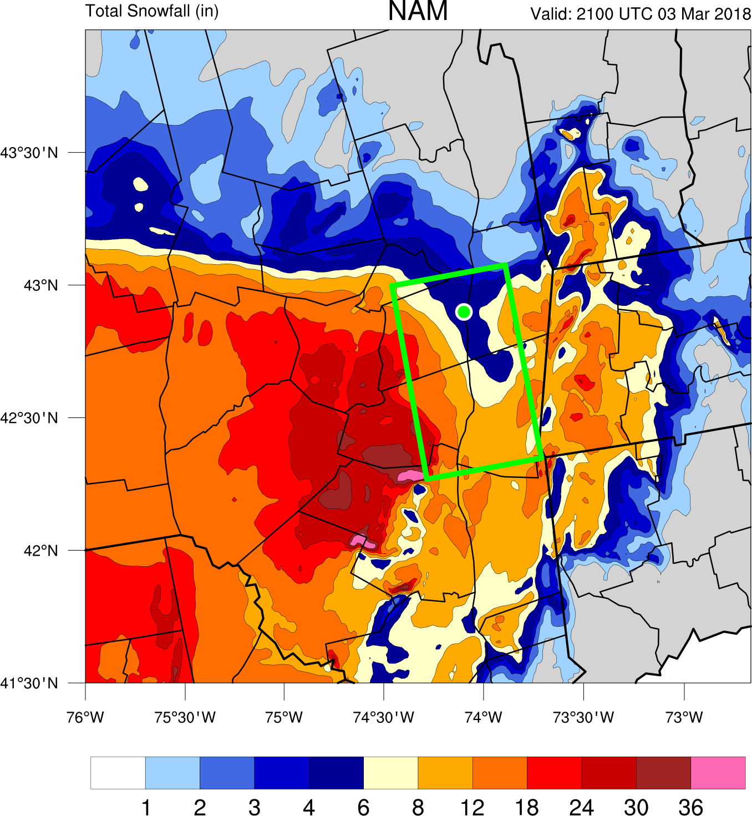
NAM Snowfall

Slide 19
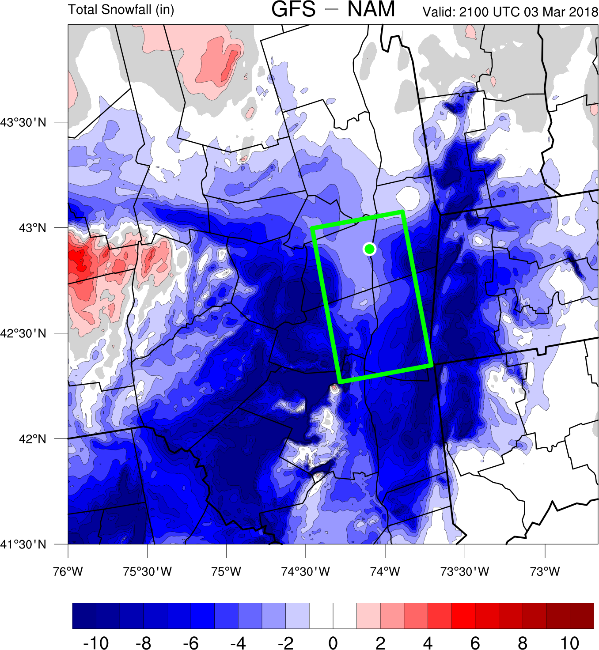
GFS – MYJ Snowfall Difference (in)

Slide 20
Modeled Snowfall
GFS scheme produces less snowfall than NAM
Do differences in the total QPF forecasts account for the snowfall differences?
  i.e. Did the NAM just precipitate more than the GFS?
Notes:
Stronger negative bias

Slide 21
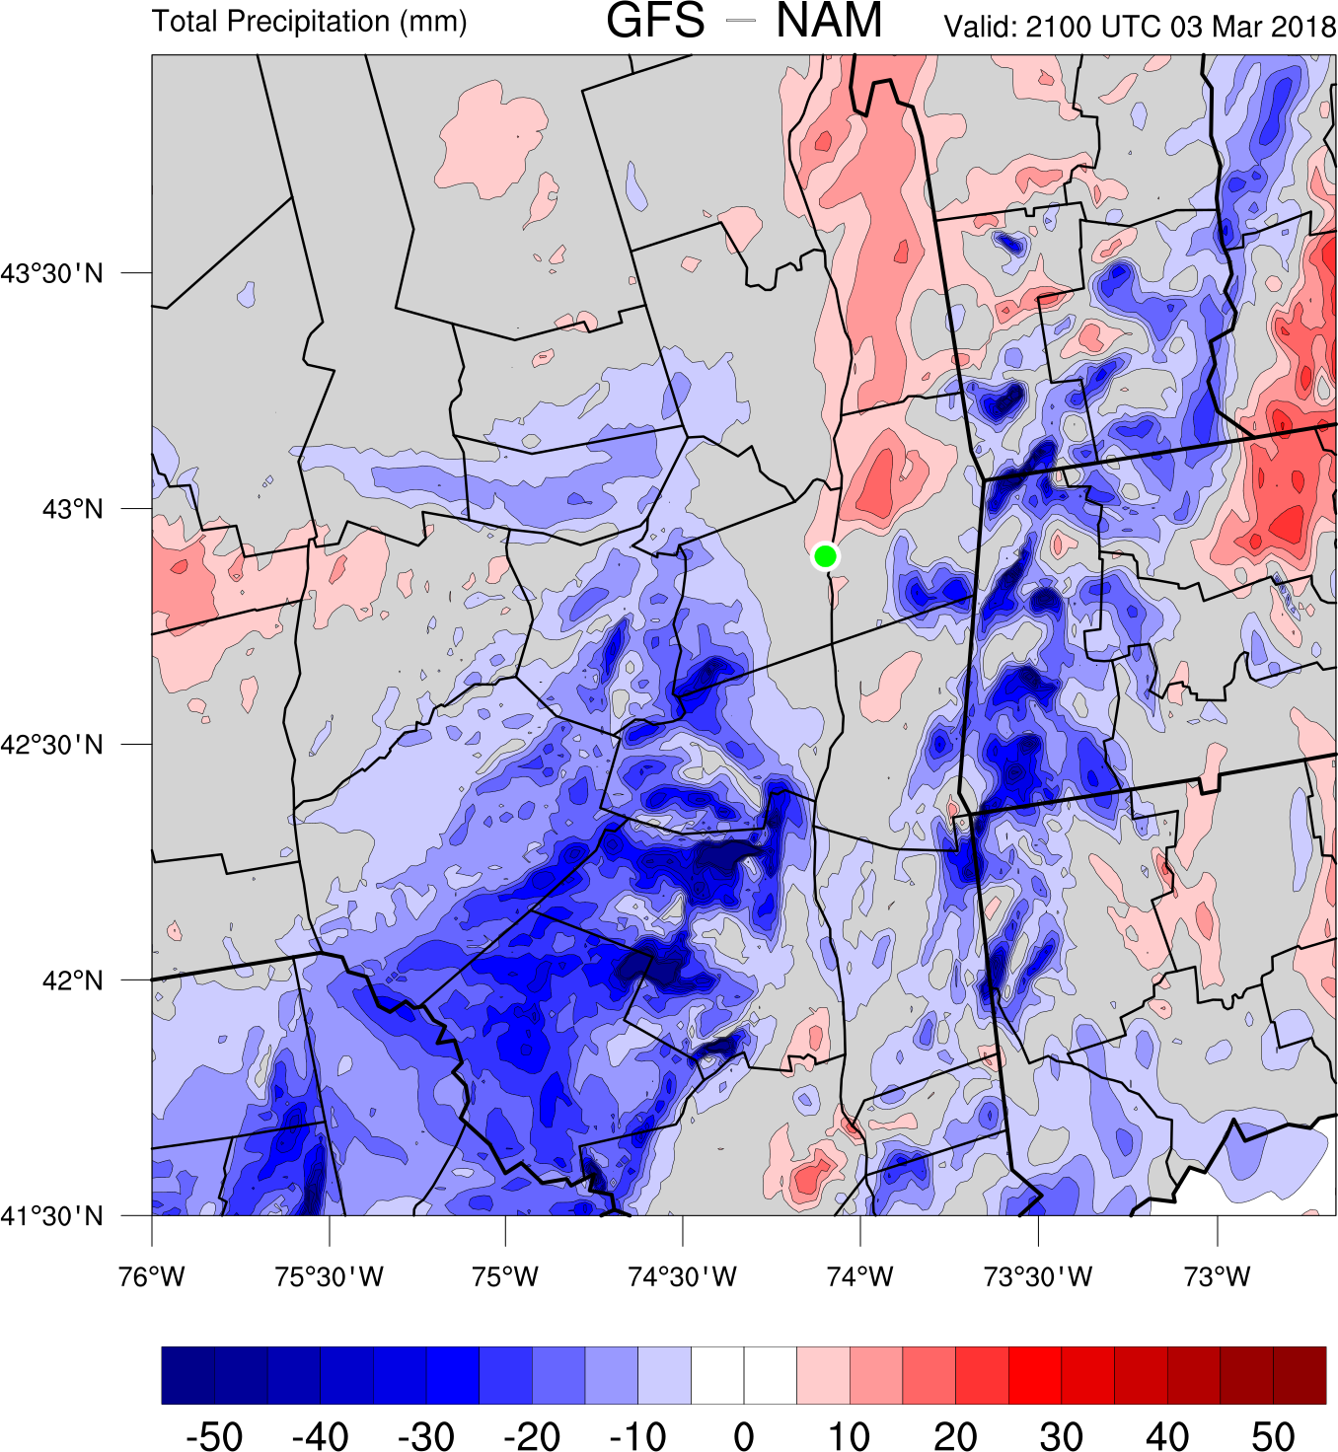
GFS – MYJ Precipitation Difference (mm)

Slide 22

GFS – MYJ Precipitation Difference (mm)

Slide 23
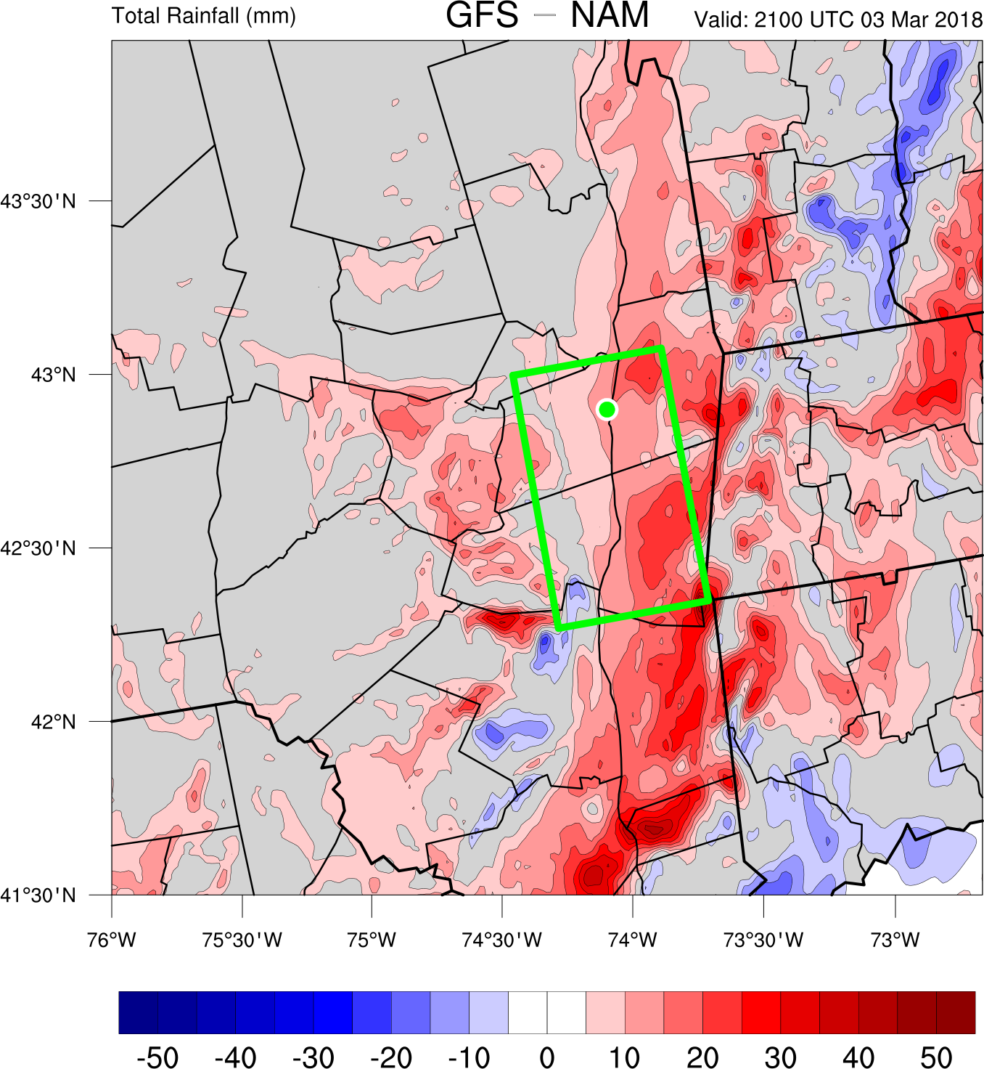
GFS – MYJ Rainfall Difference (mm)

Slide 24
Modeled Precipitation
Both PBL schemes produce similar precipitation amounts along the Hudson Valley
  Differences in snowfall accumulation are due to precipitation type differences
Are the thermal profiles different in the Hudson valley?

Slide 25
Remember the box?

Slide 26
Area Average Temperature in Box

Slide 27
Area Average Temperature in Box

Slide 28
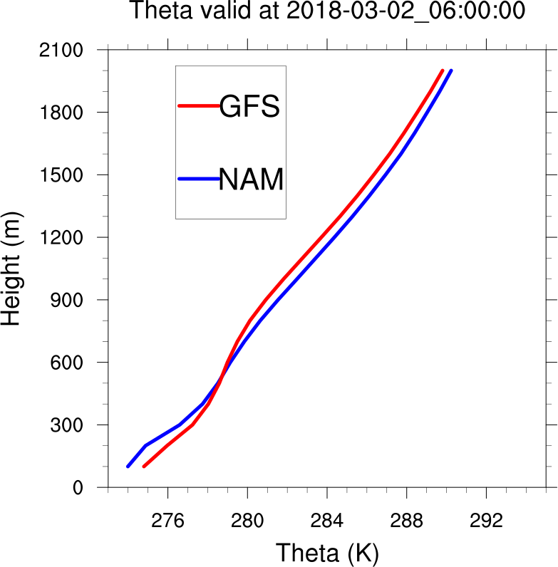
Potential Temperature Valid: 0600 UTC 2 March
Area-averaged theta profiles for GFS and NAM over the mid-Hudson Valley

Slide 29
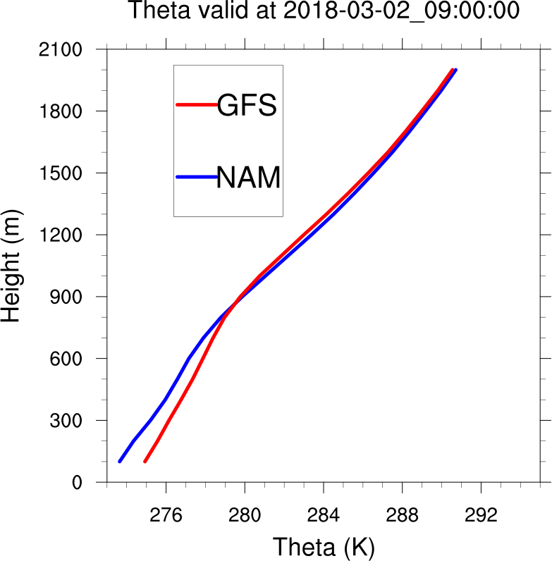
Potential Temperature Valid: 0900 UTC 2 March
Area-averaged theta profiles for GFS and NAM over the mid-Hudson Valley

Slide 30
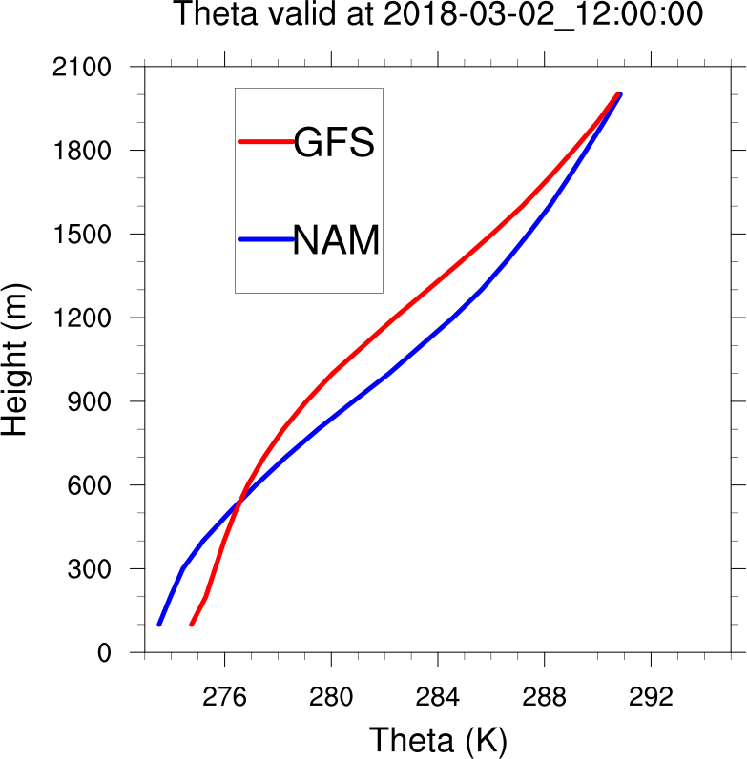
Potential Temperature Valid: 1200 UTC 2 March
Area-averaged theta profiles for GFS and NAM over the mid-Hudson Valley

Slide 31
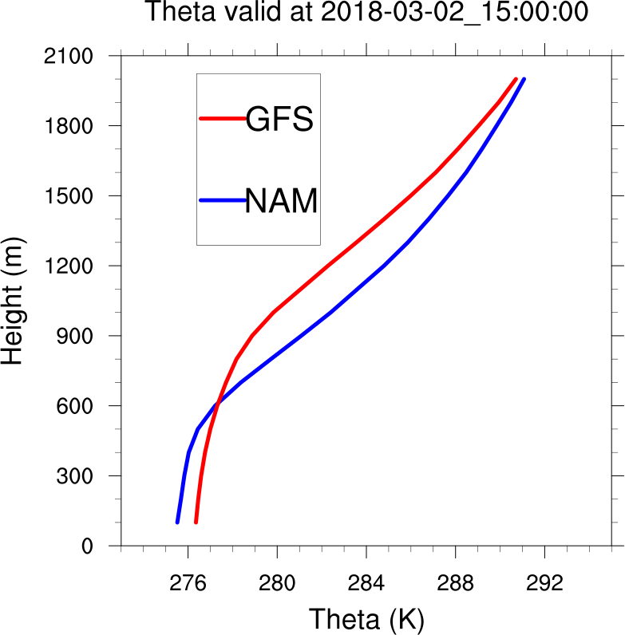
Potential Temperature Valid: 1500 UTC 2 March
Area-averaged theta profiles for GFS and NAM over the mid-Hudson Valley

Slide 32
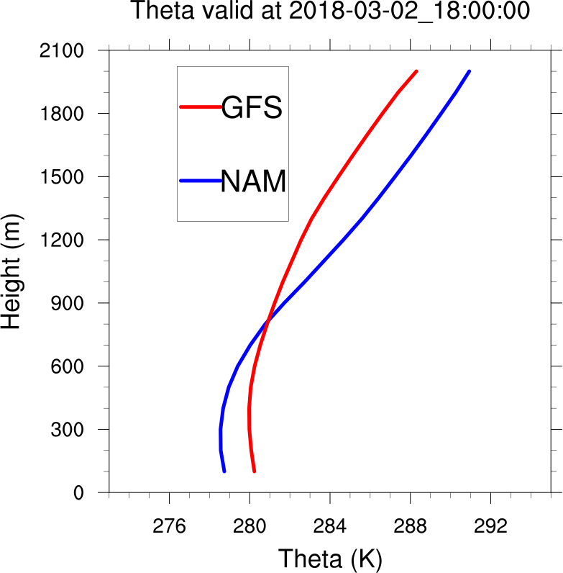
Potential Temperature Valid: 1800 UTC 2 March
Area-averaged theta profiles for GFS and NAM over the mid-Hudson Valley

Slide 33
Hudson Valley Profiles
Despite similar PBL structures before dawn, the GFS simulation warms and deepens the PBL more than the NAM simulation
  Suggests GFS may change over to mixed precipitation/rain more readily
Does the GFS PBL scheme warm the lower profile more than NAM PBL scheme in similar conditions?

Slide 34
Single Column Model Simulations
Initialize with similar conditions as 1200 UTC 2 March 2018 ALB sounding
Integrate 12 hours with GFS and NAM PBL schemes without microphysics (no clouds)
No advection; only radiative/surface forcing

Slide 35
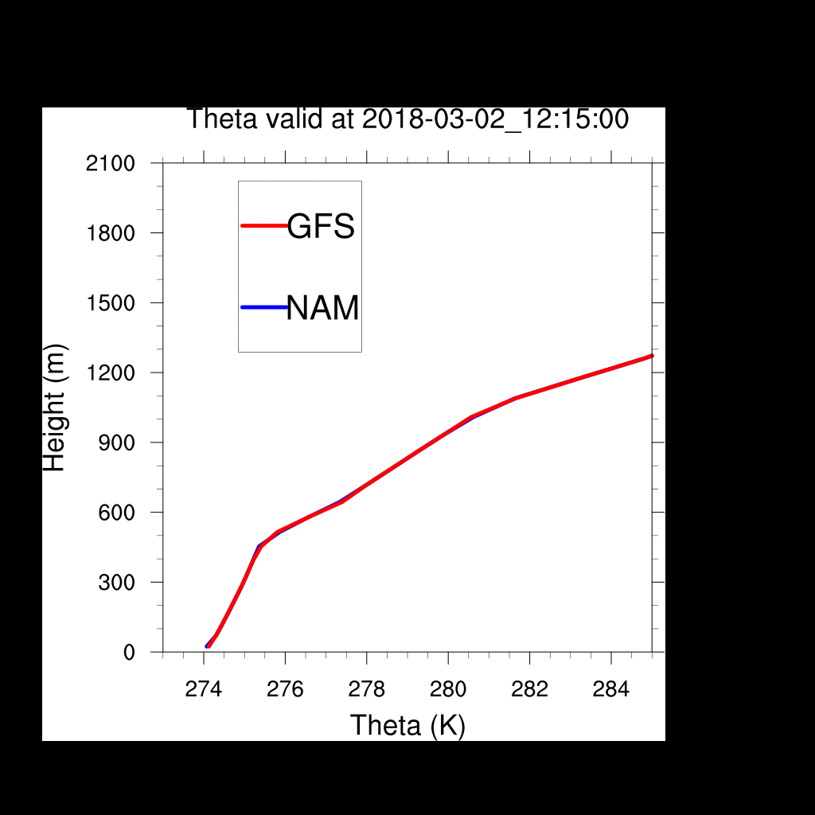
Single Column Model Simulations
Notes:
Warm bias most apparent near surface in soundings.

Slide 36
Summary
Email: mvaughan@albany.edu
WRF using the GFS PBL produces less snow and warmer lower profiles during the 2 March simulation than WRF using the NAM PBL
GFS PBL develops a taller, warmer boundary layer than NAM PBL for similar wintertime conditions
Future work involves:
  Testing robustness through ensembles
  Determining critical parameters in the GFS scheme

