Slide 1
The Projection of Parameterized PBL Turbulence on Baroclinic Cyclones
Matthew Vaughan and Robert Fovell

Slide 2
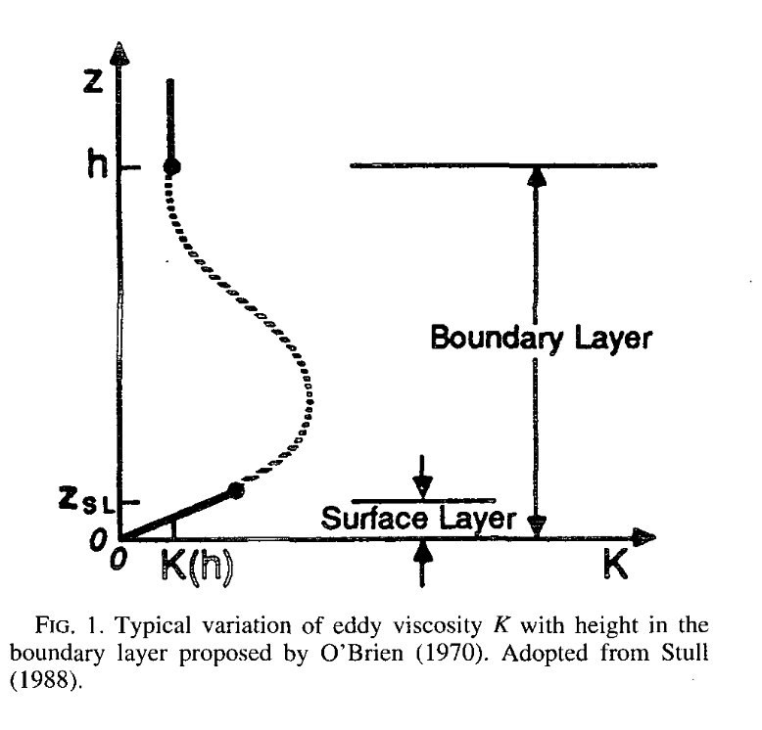
Turbulence in NWP
Simulations by :Xiaoming Cai
Turbulent motions are too small to model explicitly
Must impose the effects of turbulence into the model
How do turbulence parameterizations impact sensible weather forecasts?

Slide 3
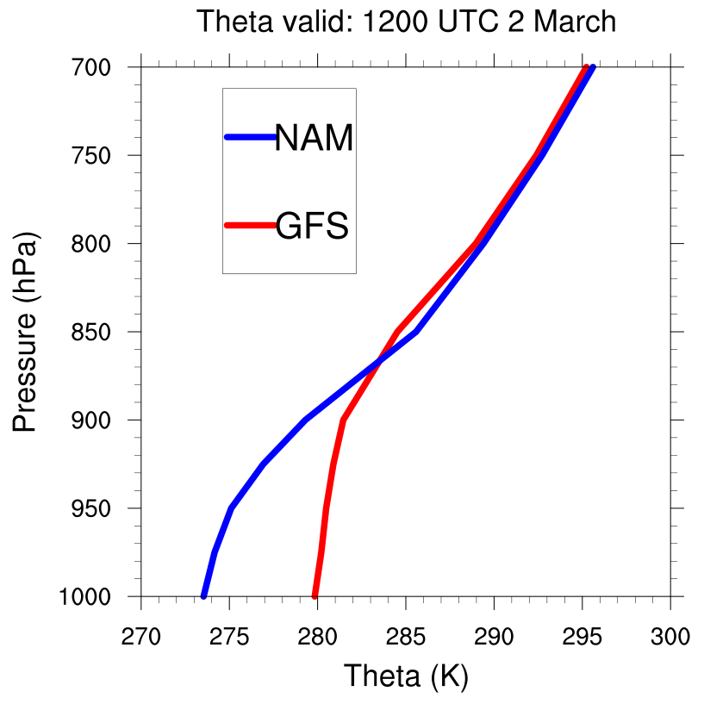
Research
1–2” for ALB
Verified 12–16”

Slide 4
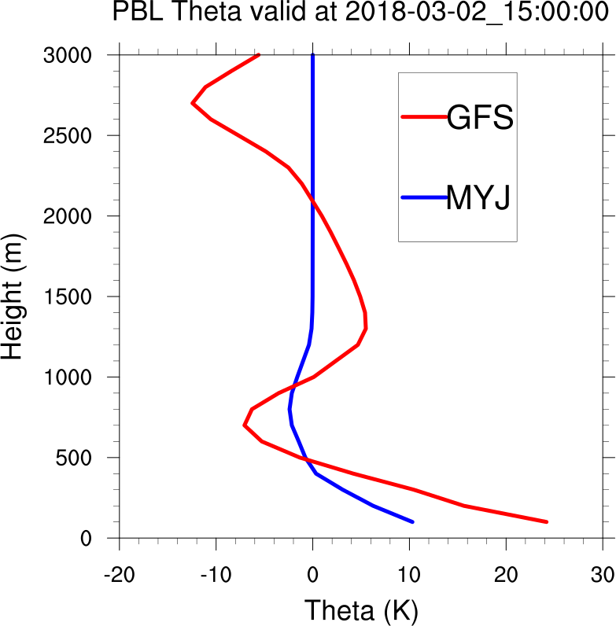
Research
1–2” for ALB
Verified 12–16”

Slide 5
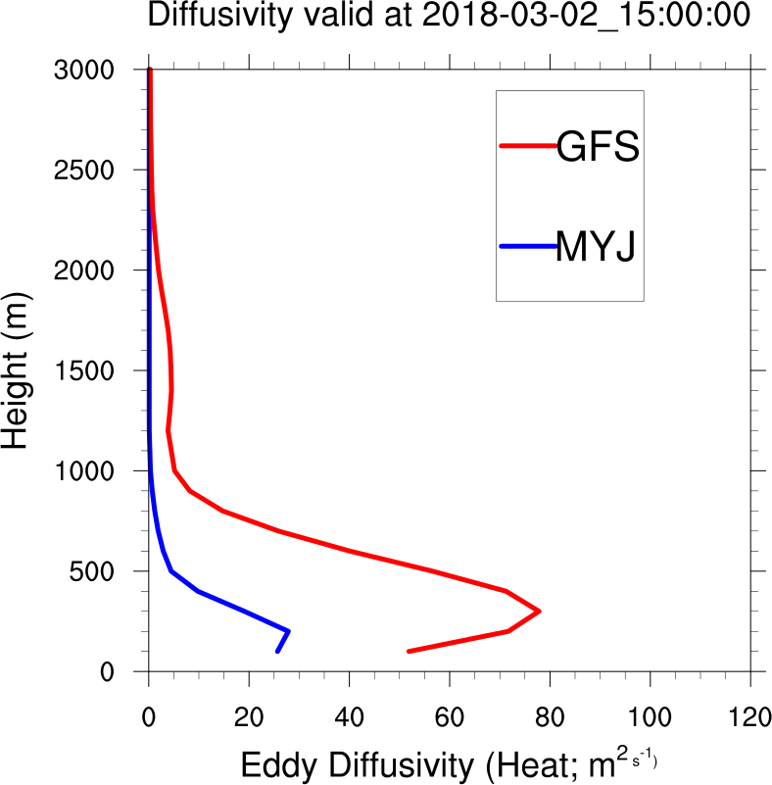
Research
1–2” for ALB
Verified 12–16”

Slide 6
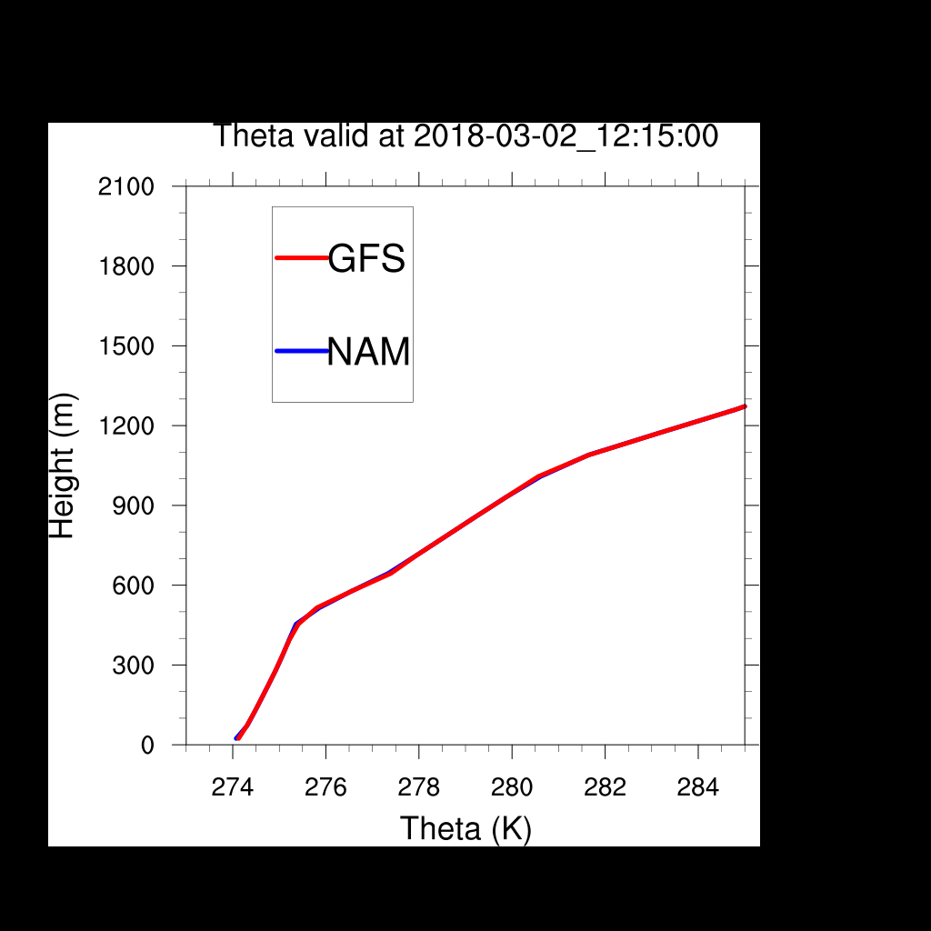
Research
Single Column Model
1–2” for ALB
Verified 12–16”

Slide 7
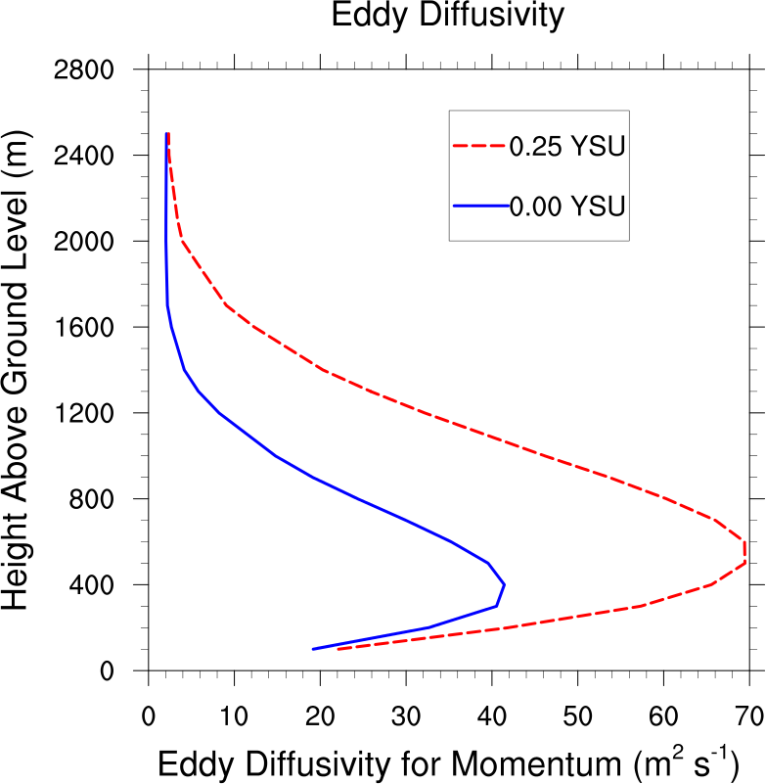
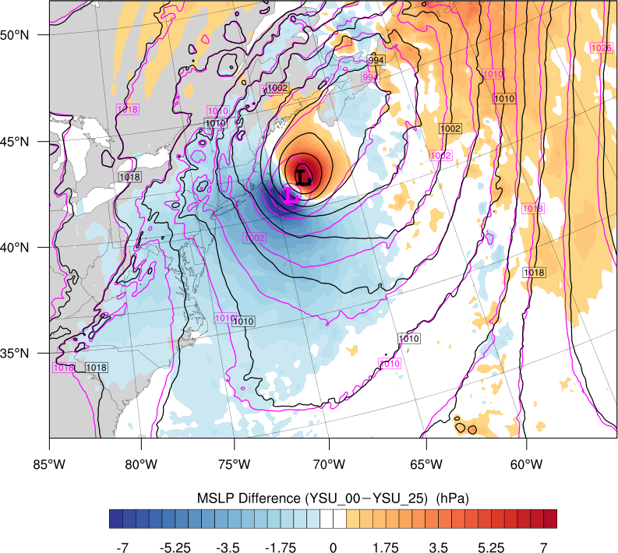
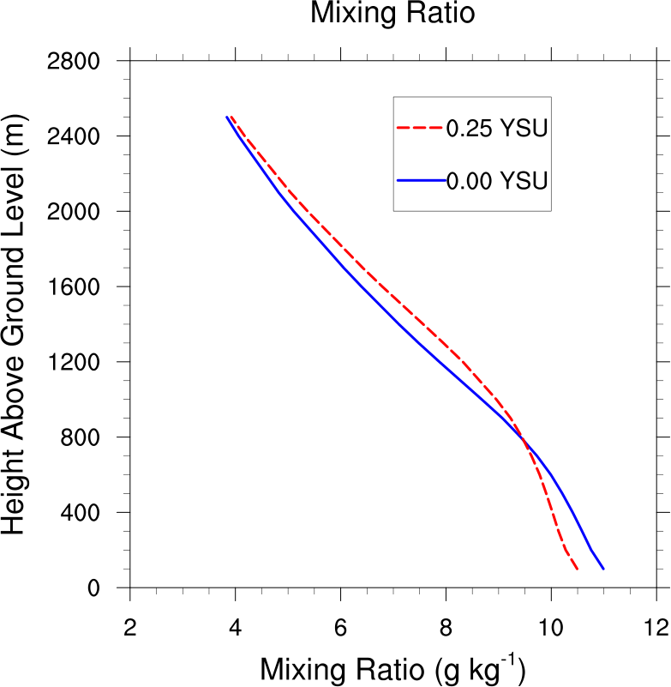
PBL Variations
Synoptic Variations
MSLP Difference (fill; less mixing–more mixing) and MSLP for MOISTURE MIXING ONLY
?
0300 UTC 28 January 2015

Slide 8
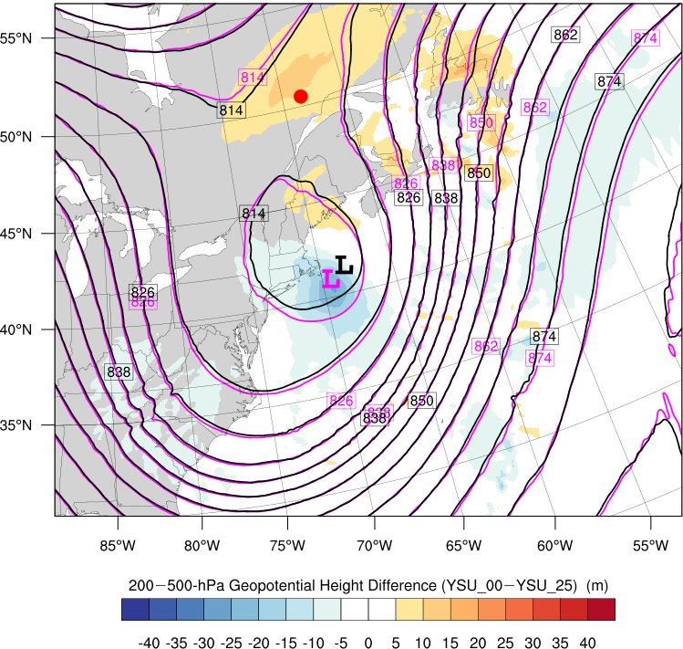
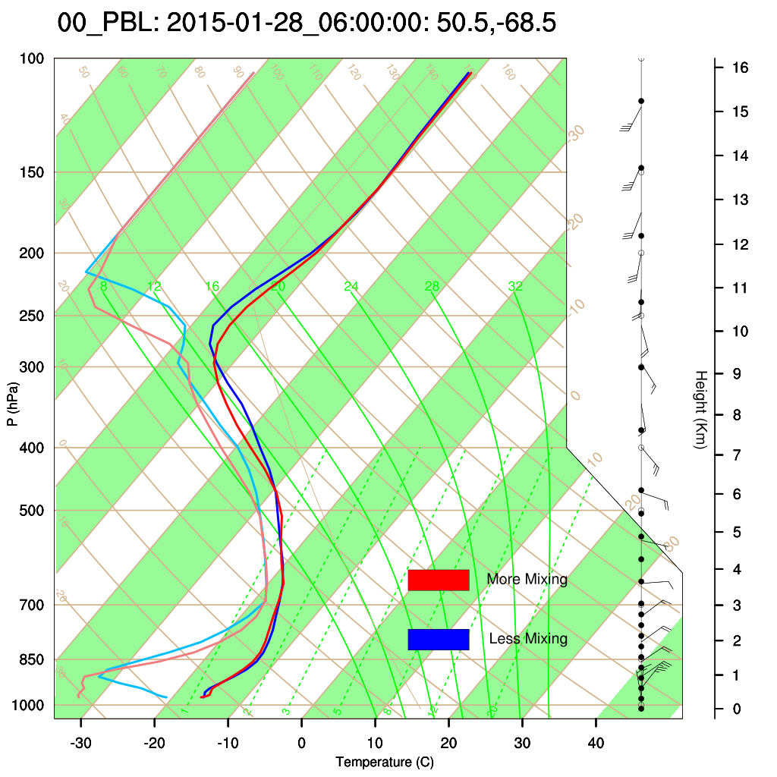
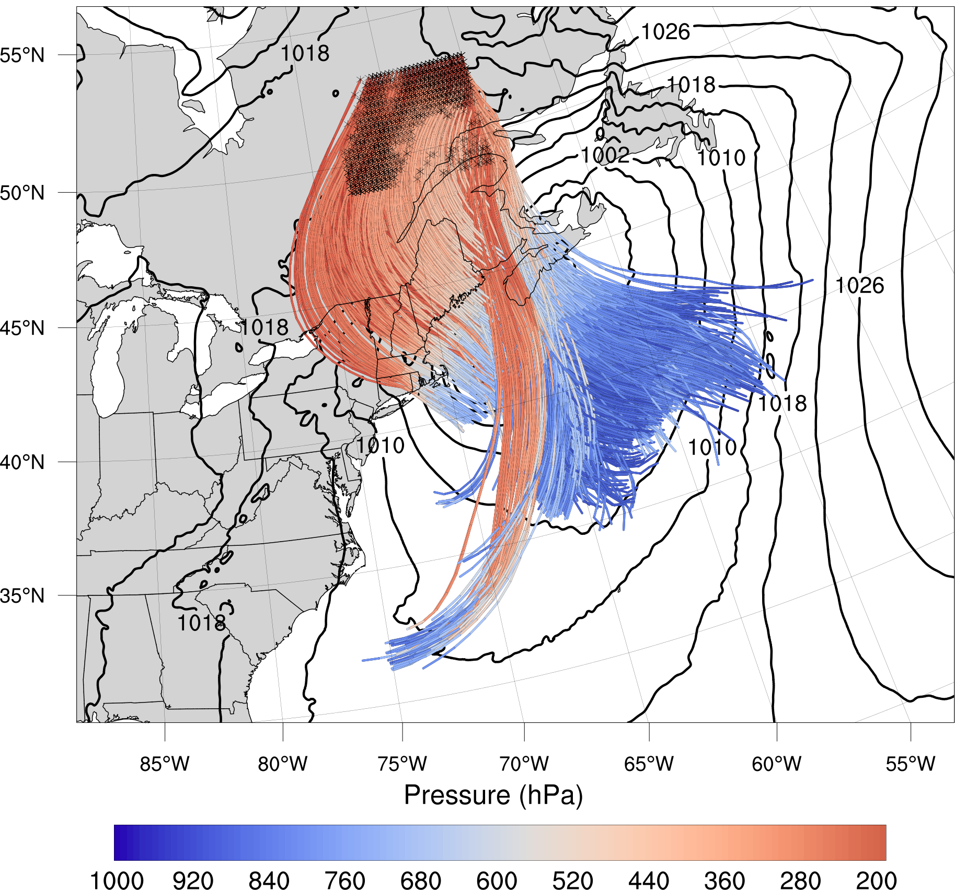
Research
Ridge sounding (less mixing – more mixing)
0600 UTC 28 January 2015 (at red dot)

Slide 9
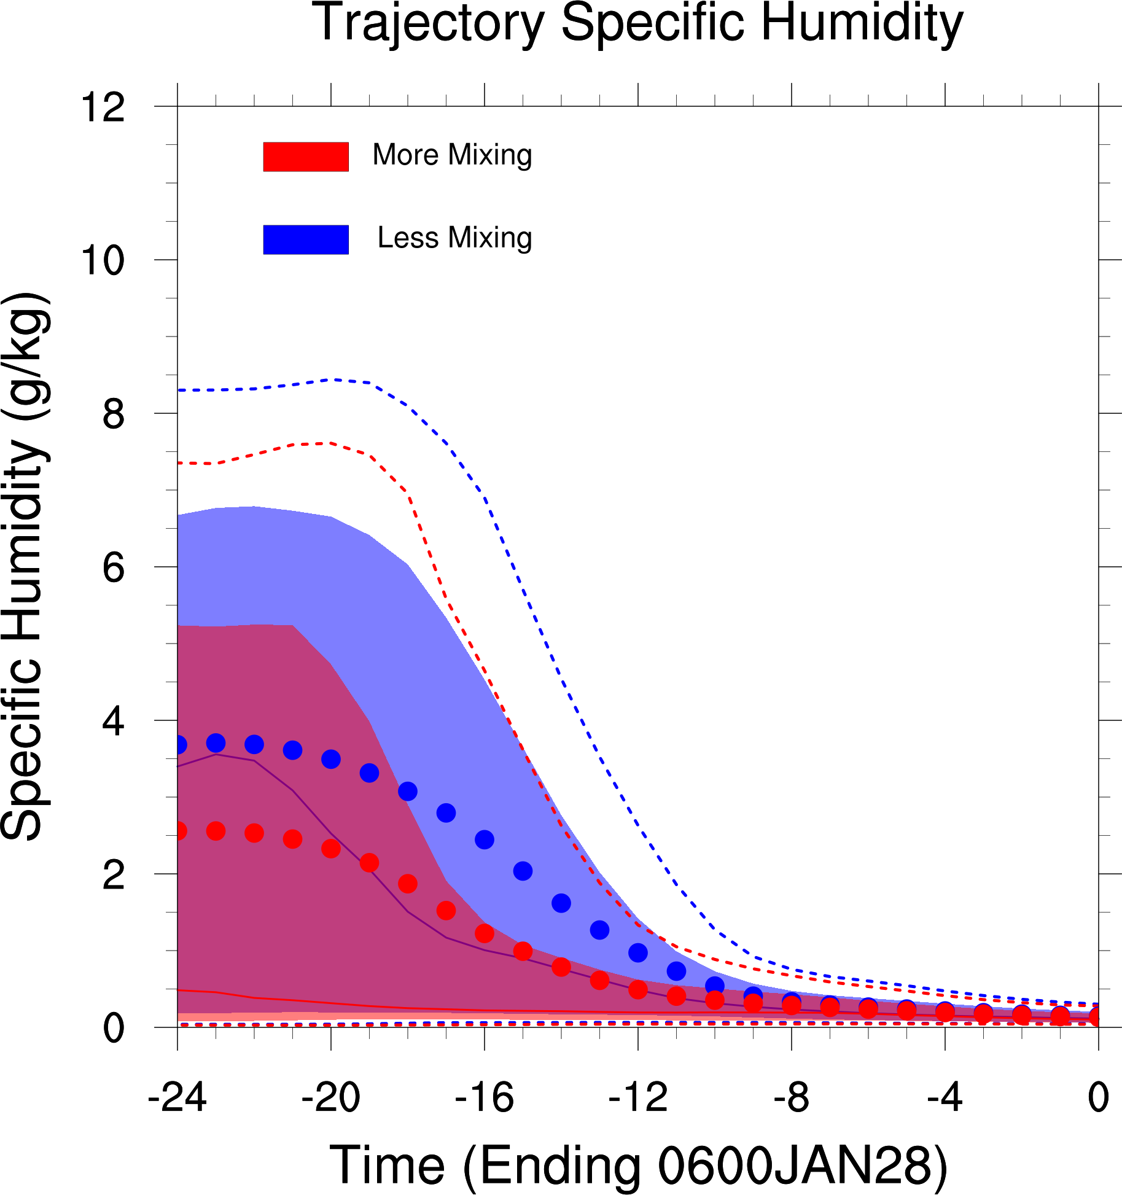
Distributions of 24-h backward trajectories ending 0600 UTC 28 January for specific humidity. The distribution median (solid lines) along with interquartile range (shading),distribution means (dots), and top and bottom tenth percentiles (dashed) are plotted. Bold dots indicate statistical significance at the 95% confidence level.

