Slide 1
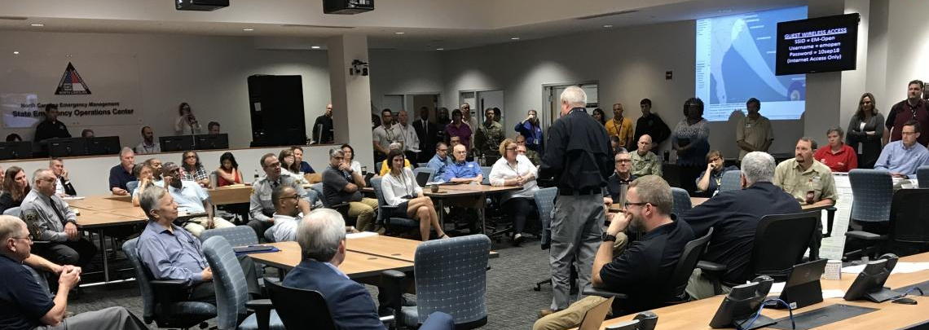
Predicting and communicating Tropical Cyclone Expansion
Emily Paltz
August 7, 2019
Notes:
Hello, my name is Emily Paltz. I am just finishing up my first year of graduate school here at the University at Albany. Today, I would like to share with you a project that I am developing which I have entitled predicting and communicating tropical cyclone expansion.

Slide 2
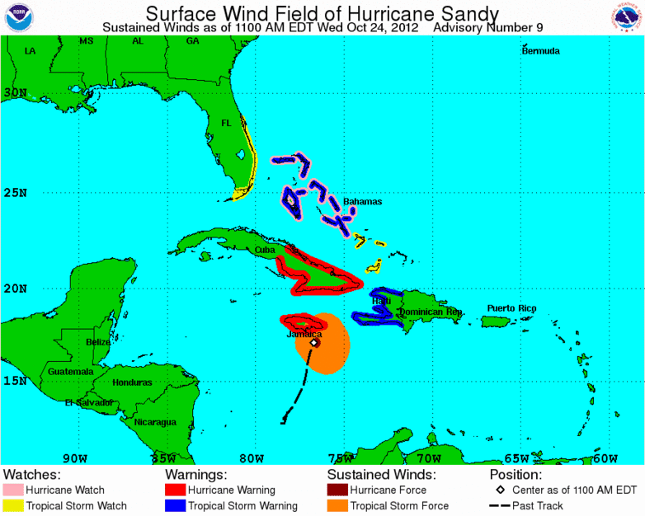
Motivation
Notes:
This project is motivated by events like that of Hurricane Sandy in 2012 where tropical cyclones have lower or decreasing intensity, but whose wind field expands dramatically as Sandy did after passing over the Bahamas. This expansion may be attributed to extra-tropical transition or tropical-cyclone trough interactions, but, to my knowledge, we do not fully understand the physical processes behind tropical cyclone expansion.

Slide 3
Questions
What are the physical processes responsible for an increase in tropical cyclone size?
Can we predict an increase in tropical cyclone size?
How far in the future can we accurately forecast TC expansion?
Are forecasters conveying information about TC size and change in size to emergency managers?
If yes, do emergency managers understand the information and its implications?
How can we improve this communication?
Notes:
So, with this research I want to try to answer that question as well as questions regarding the predictability of tropical cyclone expansion.

Slide 4
Literature
Chen et al. 2018, 2019 suggest that the orientation of the low-level mean flow vector (LMF) relative the vertical wind shear vector (VWS) can tell us whether a storm is likely to intensify or expand.
Shear
Low-level Mean Flow Vector
850 hPa mean flow
Vertical Wind Shear Vector
Difference between the 200 and 850 hPa mean flows
Notes:
Recent papers by Chen et al. in 2018 and 2019 suggest we may be able to predict whether a storm is likely to intensify or expand by looking at the orientation of the low-level mean flow vector, which they have defined as the mean winds at 850 hPa, relative to the vertical wind shear vector, which they have defined as the difference in the mean winds at 850 hPa and 200 hPa.

Slide 5
Literature
Enhanced surface fluxes
Shear
Low-level Mean Flow
= Intensification
Chen et al. 2018, 2019
Notes:
Their results propose that when the low-level mean flow vector is oriented to the left of the vertical wind shear vector fluxes of energy from the ocean surface are enhanced in the downshear region of the tropical cyclone. This aids in the production of convection downshear which then propagates upshear to create a more symmetric storm. Other literature has noted that more symmetric storms are more likely to intensify.

Slide 6
Motivation
Literature
Shear
Shear
Low-level Mean Flow
= Expansion
Chen et al. 2018, 2019
Enhanced surface fluxes
Notes:
Conversely, when the low-level mean flow vector is oriented to the right of the vertical wind shear vector fluxes of energy from the ocean surface are enhanced in the upshear region of the tropical cyclone. This aids in the production of convection upshear which then propagates into the downshear rain band region and leads to an expansion of the tropical cyclone.

Slide 7
Motivation
Literature
Shear
= Intensification
Nguyen et al. 2019
Enhanced surface fluxes
Notes:
Another recent paper by Nguyen et al. in 2019, however, appears to contradict the findings of Chen et al. They find that enhanced surface fluxes in the upshear region strengthen convection in the downshear region. This allows for intensification. It is important to note, however, that the two studies are not completely comparable. Chen et al. only study tropical cyclones in the West Pacific, and different basins with different environments can create differences in the way tropical cyclones develop. Additionally, Nguyen et al. did not focus particularly on the orientation of the low-level mean flow.

Slide 8
Future Steps
Use data from the Tropical Cyclone Dropsonde Research and Operations Product Suite (TC-DROPS) to study the relation between the vertical wind shear vector and the low-level mean flow vector using methods similar to that of Chen et al. 2018
Contact and converse with emergency managers about the information they receive and use to determine how to prepare their communities for the effects of tropical cyclones
Notes:
Therefore, I am proposing to use the Tropical Cyclone Dropsponde Research and Operations Product Suite, also know as TC-DROPS, that was used by Nguyen et al. to study the relationship between the vertical wind shear and low-level mean flow vectors using methods similar to that of Chen et al. 2018.

Slide 9
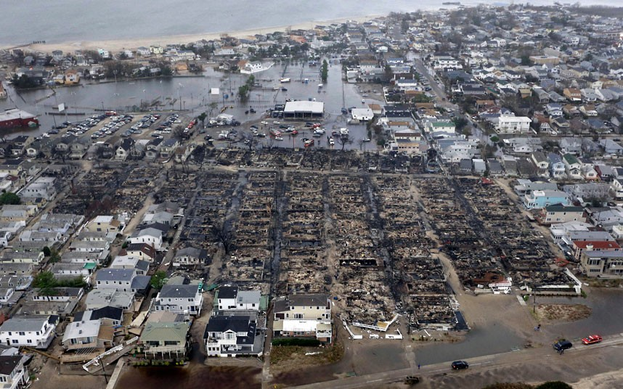
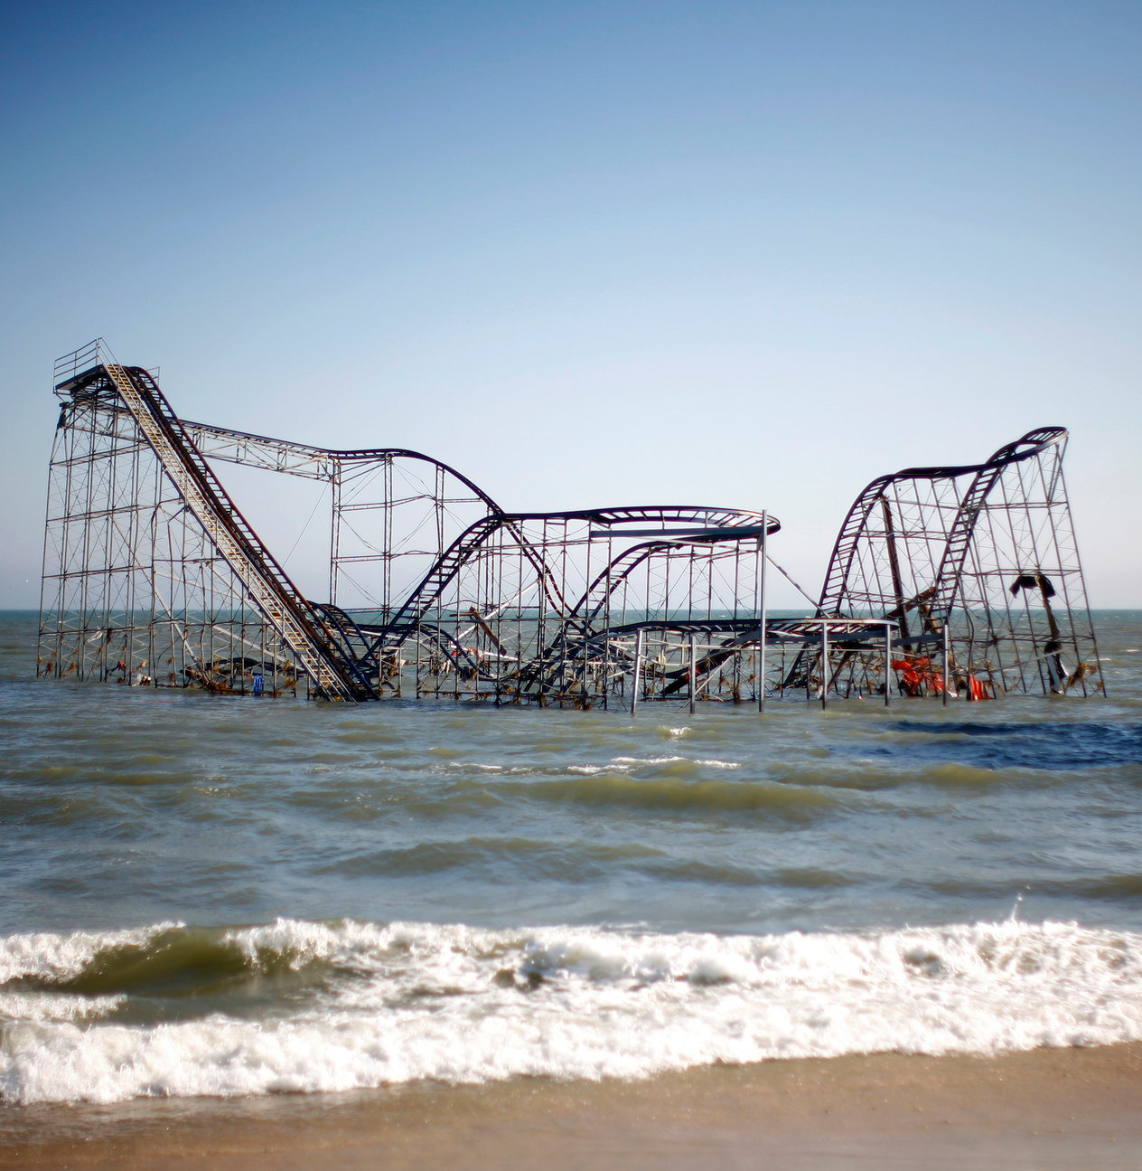
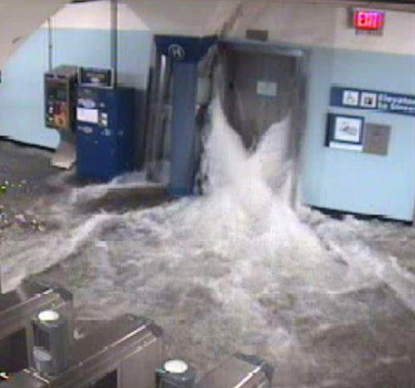
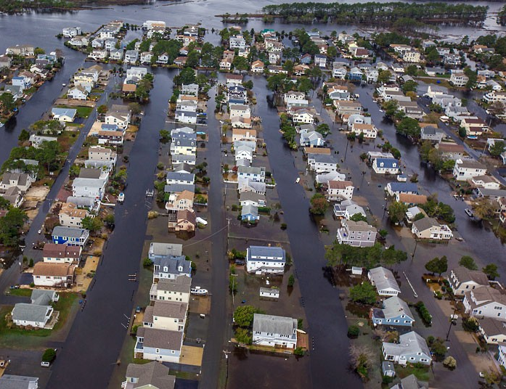
Motivation
Notes:
You may recall, however, that Hurricane Sandy and most disasters for that matter, are not known publically for their interesting meteorological characteristics. Instead, they gain such immense attention from the devastation that they cause as shown in these pictures on the right. Hurricane Sandy was not a particularly intense at landfall – a Category 1, but its enormous size meant that a lot of people were impacted. However, our primary hurricane measurement system, the Saffir-Simpson scale, focuses solely on intensity. This led my advisors and I to ask the question:
Photo credits: Mike Groll/AP; Eric Thayer/Reuters; AP Photo/Port Authority of New York and New Jersey; The Wilmington News-Journal, Robert Craig/AP

Slide 10
Questions
What are the physical processes responsible for an increase in tropical cyclone size?
Can we predict an increase in tropical cyclone size?
How far in the future can we accurately forecast TC expansion?
Are forecasters conveying information about TC size and change in size to emergency managers?
If yes, do emergency managers understand the information and its implications?
How can we improve this communication?
Notes:
Are forecasters conveying information about TC size and change in size to emergency managers who should find this information important the number of people they need to work with. If yes, do emergency managers understand the information and its implications? And more generally how can we improve communication on this topic between forecasters and emergency managers?

Slide 11
Future Steps
Use data from the Tropical Cyclone Dropsonde Research and Operations Product Suite (TC-DROPS) to study the relation between the vertical wind shear vector and the low-level mean flow vector using methodology similar to that of Chen et al. 2018
Contact and converse with emergency managers about the information they receive and use to determine how to prepare their communities for the effects of tropical cyclones
Notes:
To answer these questions, my goal is to contact and converse with emergency managers about the information they receive and use to determine how to prepare their communities for the effects of tropical cyclones

