Slide 1
A Brief History of Midlatitude Cyclones
Matthew Vaughan
Notes:
DOUBLE check

Slide 2
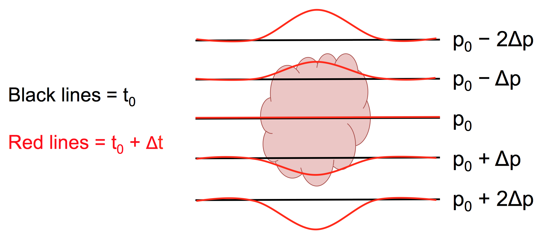
Thermal Theory
Espy (1841)
Linked cyclones with clouds and precipitation
Believed cyclones were powered by “the caloric of elasticity of (water) vapor”…CISK???
Carried out numerous experiments to estimate moist and dry adiabatic lapse rates
A. Bentley

Slide 3
Norwegian School
Bjerknes and Solberg (1922)
Noted large horizontal temperature gradients near cyclones. Polar front is the main battleground
Supported Margules (1905) who posited baroclinicity as a potential energy source
Suggested cyclone strengthened up until occlusion.
Bjerknes and Solberg (1922)

Slide 4
Norwegian School
Bjerknes and Solberg (1922)
Notes:
Use original from Bjerknes and Solberg

Slide 5
Norwegian School
Bjerknes and Solberg (1922)
Notes:
Use original from Bjerknes and Solberg

Slide 6
Norwegian School
Bjerknes and Solberg (1922)
Notes:
Cross-section south of center with the observer looking northward.
“All cyclones which are not yet occluded, have increasing kinetic energy”
“The above rule seems to be verified practically without exception”
Once occluded, cyclone forces low-levelcold air to rise, depleting kinetic energy while upper warm air rises until it reaches it’s potential temperature
Noted transitional layer formation due to warm air rising (and cooling) more rapidly closer to the front.
“Essential condition is the co-existence of cold and warm air adjecent to each other”

Slide 7
Norwegian School
Occlusion boundary
Bjerknes and Solberg (1922)
Notes:
Cross-section south of center with the observer looking northward.
“All cyclones which are not yet occluded, have increasing kinetic energy”
“The above rule seems to be verified practically without exception”
Once occluded, cyclone forces low-levelcold air to rise, depleting kinetic energy while upper warm air rises until it reaches it’s potential temperature
Noted transitional layer formation due to warm air rising (and cooling) more rapidly closer to the front.
“Essential condition is the co-existence of cold and warm air adjecent to each other”

Slide 8
Norwegian School
Bjerknes and Solberg (1922)
Notes:
Source paper

Slide 9
Norwegian School
Bjerknes and Solberg (1922)

Slide 10
Norwegian School
Bjerknes and Solberg (1922)

Slide 11
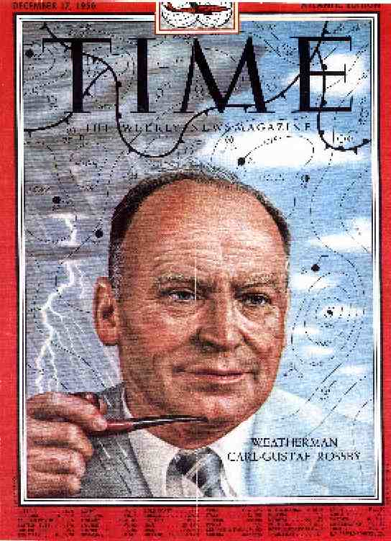
Norwegian School
Rossby and Weightman (1926)
Applied polar front model to North America
17 December 1956 Issue

Slide 12
Norwegian School
Rossby and Weightman (1926)
Applied polar front model to North America
Presented techniques for identifying fronts
Wind shift

Slide 13
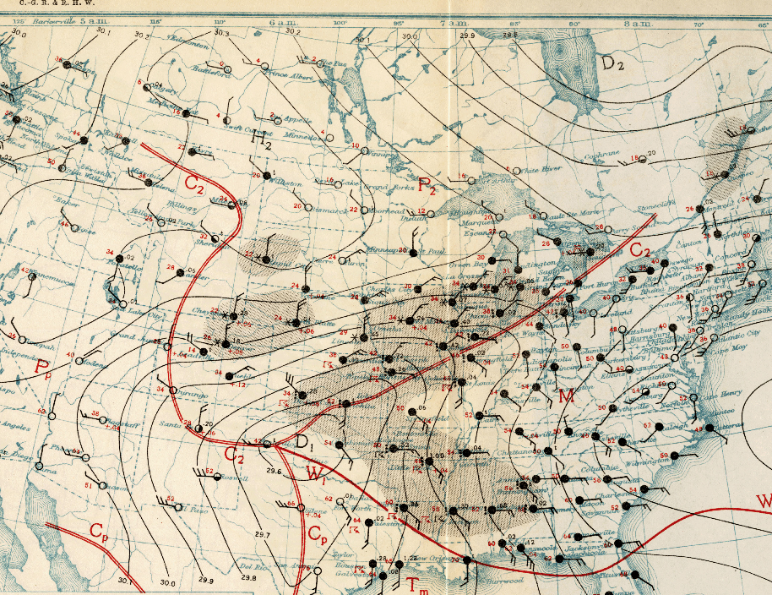
Norwegian School
Rossby and Weightman (1926)
Applied polar front model to North America
Presented techniques for identifying fronts
Wind shift (S-ly to E-ly for warm front)

Slide 14
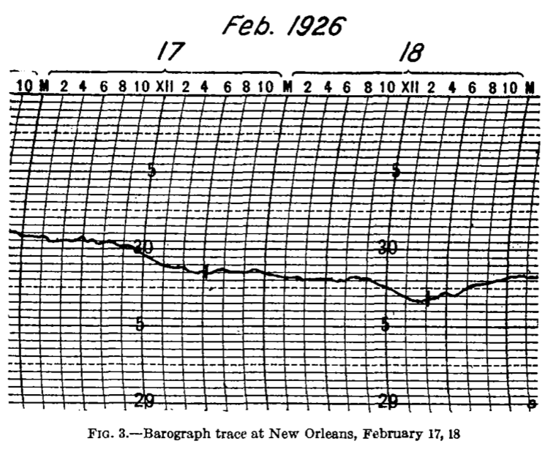
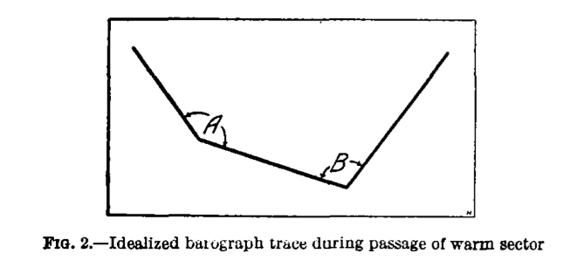
Norwegian School
Rossby and Weightman (1926)
Applied polar front model to North America
Presented techniques for identifying fronts
Wind shift
Barograph tendency
Rossby and Weightman (1926)

Slide 15
Sutcliffian Thinking
Sutcliffe (1947) and Sutcliffe and Forsdyke (1950)
Contributed a development theory for the movement and intensification of cyclones and anticyclones
Utilized surface vorticity and rudimentary upper-level charts to diagnose and forecast surface cyclone development using shear
Notes:
Thought -> Thinking

Slide 16
Sutcliffian Thinking
Sutcliffe (1947) and Sutcliffe and Forsdyke (1950)
Term A controls the surface cyclone motion
Term B controls the development of vorticity over the cyclone center
Real world example
Carlson (1988); adapted from ATM 401

Slide 17
Baroclinic Instability
Charney (1947) and Eady (1949)
Identified preferred wavelengths of wave packets for baroclinic development
Unstable waves on the order of radius of deformation ~1000 km
Wavelength of fastest growing waves ~4000 km
Notes:
Make equation in pp

Slide 18
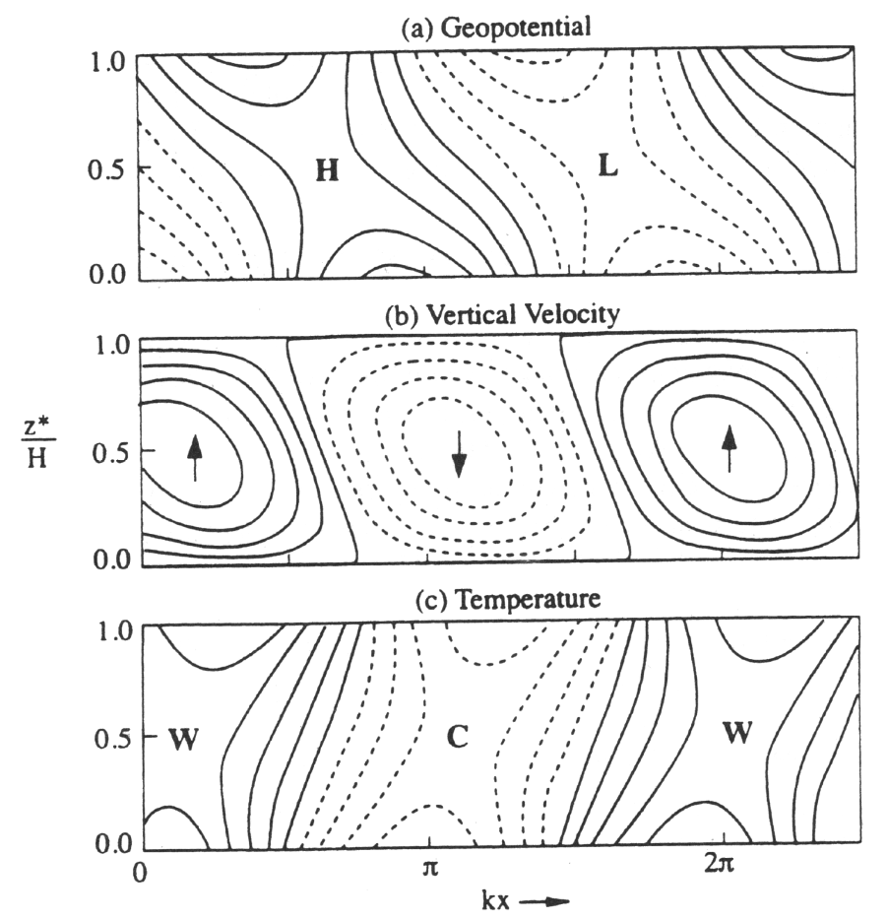
Baroclinic Instability
Charney (1947) and Eady (1949)
Reaffirmed importance of CAA upstream and WAA downstream of a trough contributing to mean potential energy transfer
Emily Shuckburgh (University of Cambridge, 2006)
Notes:
Check spelling in reference

Slide 19
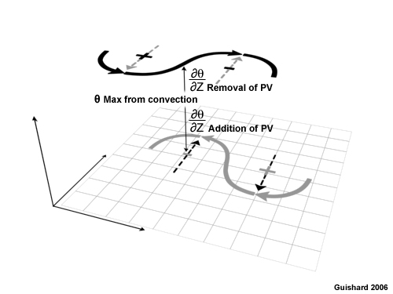
Baroclinic Instability
Diabatic heating effects
Latent heat release modulates PV field and reduces half wavelength of the wave system (Kocin and Uccellini 2004)
Guishard (2006)
Notes:
Standard reference for monograph

Slide 20
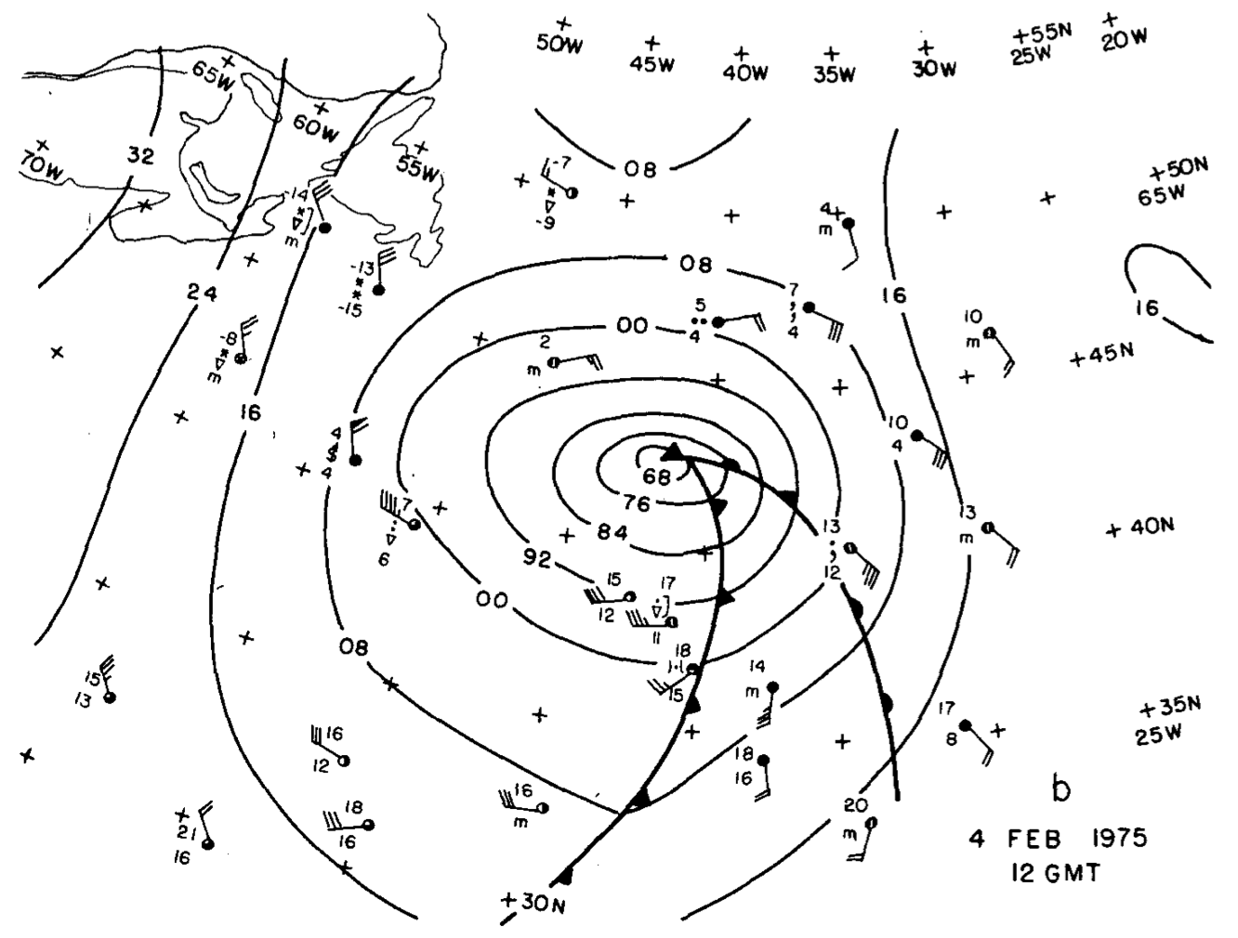
Explosive Cyclogenesis (a.k.a. Bombogenesis)
Sanders and Gyakum (1980)

Slide 21
Explosive Cyclogenesis (a.k.a.Bombogenesis)
Sanders and Gyakum (1980)
Construct climatology of explosive cyclogenesis over three cool seasons

Slide 22
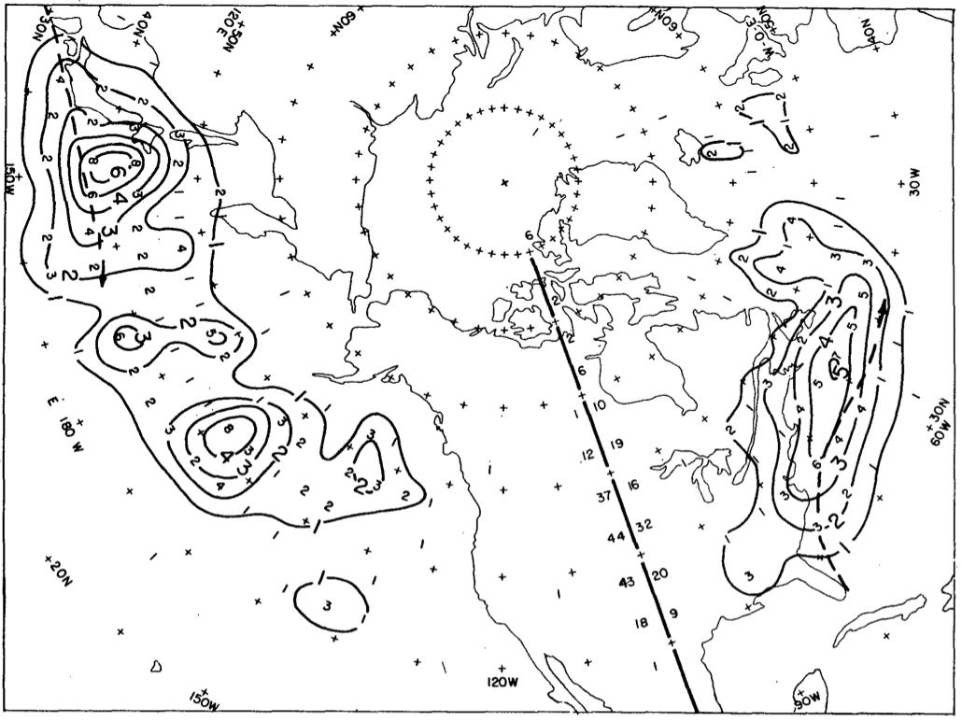
Sanders and Gyakum (1980)

Slide 23
Explosive Cyclogenesis (a.k.a. Bombogenesis)
Sanders and Gyakum (1980)
Construct climatology of explosive cyclogenesis over 3 cool seasons
Magnitude of SSTs unimportant but SST gradient is critical

Slide 24
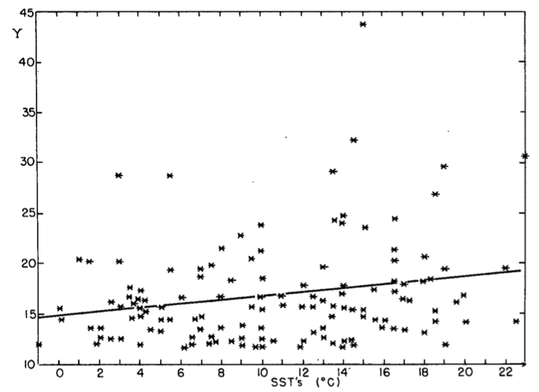
Sanders and Gyakum (1980)

Slide 25
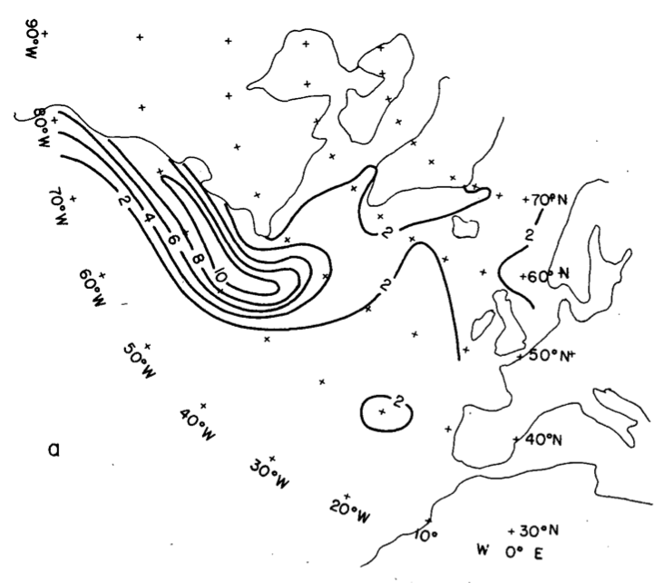
15 January 1979
Sanders and Gyakum (1980)

Slide 26
15 January 1979
Sanders and Gyakum (1980)

Slide 27
Explosive Cyclogenesis (a.k.a. Bombogenesis)
Sanders and Gyakum (1980)
Model performance was poor for explosive cyclogenesis

Slide 28
Explosive Cyclogenesis (a.k.a. Bombogenesis)
Sanders and Gyakum (1980)
Model performance was poor for explosive cyclogenesis
Sanders and Gyakum (1980)

Slide 29
Explosive Cyclogenesis (a.k.a. Bombogenesis)
Sanders and Gyakum (1980)
Model performance was poor for explosive cyclogenesis.
Postulate that representation of cumulus convection and PBL are of primary importance in model (under)performance as opposed to horizontal resolution

Slide 30
References
Espy, James P. (1841). The Philosophy of Storms
MARGULES, M. 1903. Uber die Energie der Sturme. Jahrb. Zentralanst. Meteor. Wien, p. 1- 26. Translation in C. Abbe (1910). Smithsonian Inst. Meteorol. Coll 54: 533-595.
Bjerknes J. and H. Solberg, 1922: Life cycle of cyclones and the po-lar front theory of atmospheric circulation. Geofys. Publ., 3(1), 3–18
ALFRED J. HENRY, 1922: J. BJERKNES AND H. SOLBERG ON THE LIFE CYCLE OF CYCLONES AND THE POLAR FRONT THEORY OF ATMOSPHERIC CIRCULATION1. Mon. Wea. Rev., 50, 468–473.
CARL-GUSTAF ROSSBY and RICHARD HANSON WEIGHTMAN, 1926: APPLICATION OF THE POLAR-FRONT THEORY TO A SERIES OF AMERICAN WEATHER MAPS1. Mon. Wea. Rev., 54, 485–496.
Charney, J. G., 1947: The dynamics of long waves in a baroclinic westerly current. J. Meteor., 4, 135–162.
Sutcliffe, R. C., 1947: A contribution to the problem of de- velopment. Quart. J. Roy. Meteor. Soc., 73, 370–383.
Eady, E. T., 1949: Long waves and cyclone waves. Tellus, 1(3), 33–52.
Sutcliffe, R. C. and Forsdyke (1950) The theory and use of upper air thickness patterns in forecasting, Ibid., 76, 189-217.
Frederick Sanders and John R. Gyakum, 1980: Synoptic-Dynamic Climatology of the “Bomb”. Mon. Wea. Rev., 108, 1589–1606.
Paul J. Kocin and and Louis W. Uccellini, 2004: Volume I: Overview. Meteorological Monographs, 32, 1–289.
Guishard, M. P. (2006), Atlantic subtropical storms: Climatology and characteristics, 158 pp., PhD thesis, Pa State Univ., University Park, Pa.
Notes:
Pg. 41 in Life cycles of Extratropical Cyclones
Rossby and Weightman (1926) paper for earlier discussion.

